Slide 1
2005 Convention on the Protection and Promotion of Cultural Expressions
PERIODIC REPORT
Online Interactive Form

Slide 2
GENERAL STEPS TO FOLLOW
Access the ‘Registration Form’ to get a Username and a Password to Access the Periodic Report Form.
Once you have your Username/Password, ‘Create a new Periodic Report’.
Follow the steps and answer the questions. Pay attention to the number of characters allowed for each question and be aware that you can ‘Save as a draft’ your form at any time.
Print the filled form, sign it and send it to the following address: UNESCO, Section of the Diversity of Cultural Expressions, 7, Place Fontenoy 75352 Paris 07 SP, France. The person signing has to be a government official with the authority to sign it on behalf of the government. The person completing the form may not necessarily be the person signing it.
NOTE: Only one person per country should register.

Slide 3
BASIC
INSTRUCTIONS

Slide 4
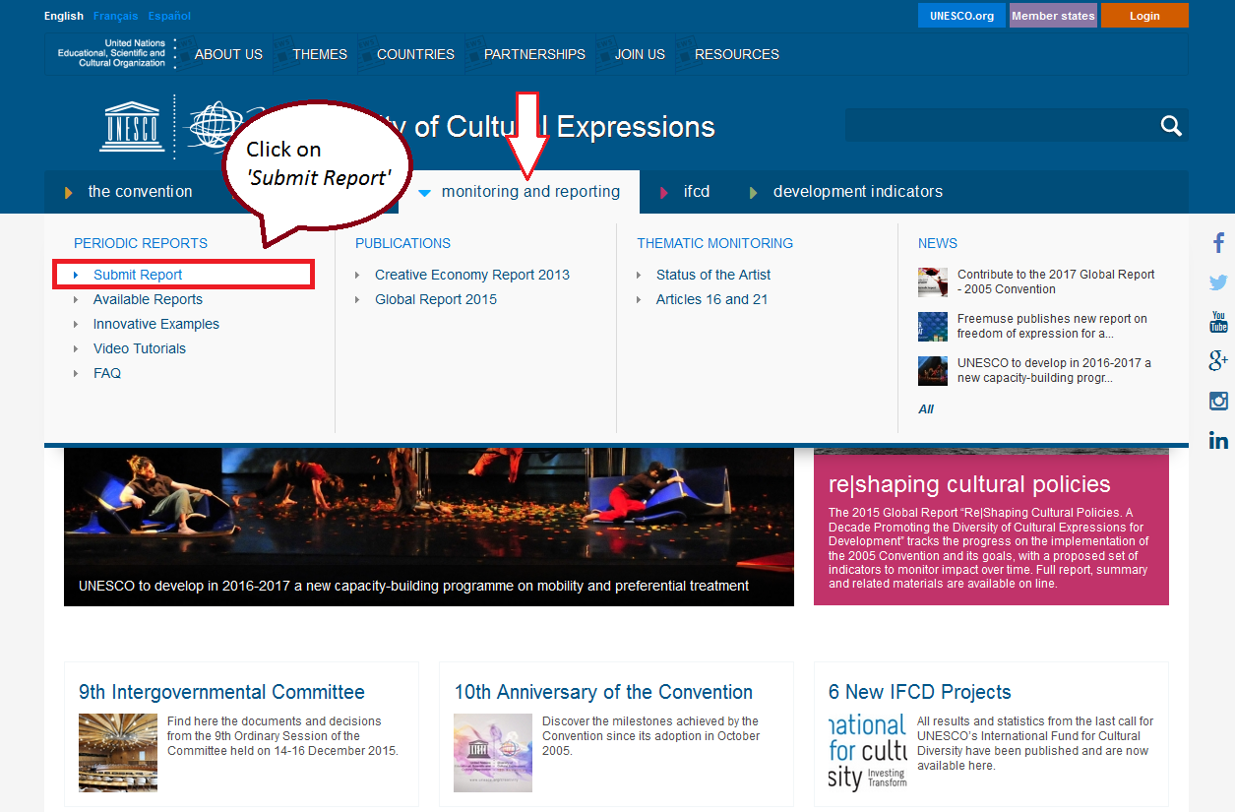
STEP 1. WHERE TO FIND THE FORM
Go to ‘Submit Report’. http://en.unesco.org/creativity/monitoring-and-reporting/periodic-reports/submit-report

Slide 5
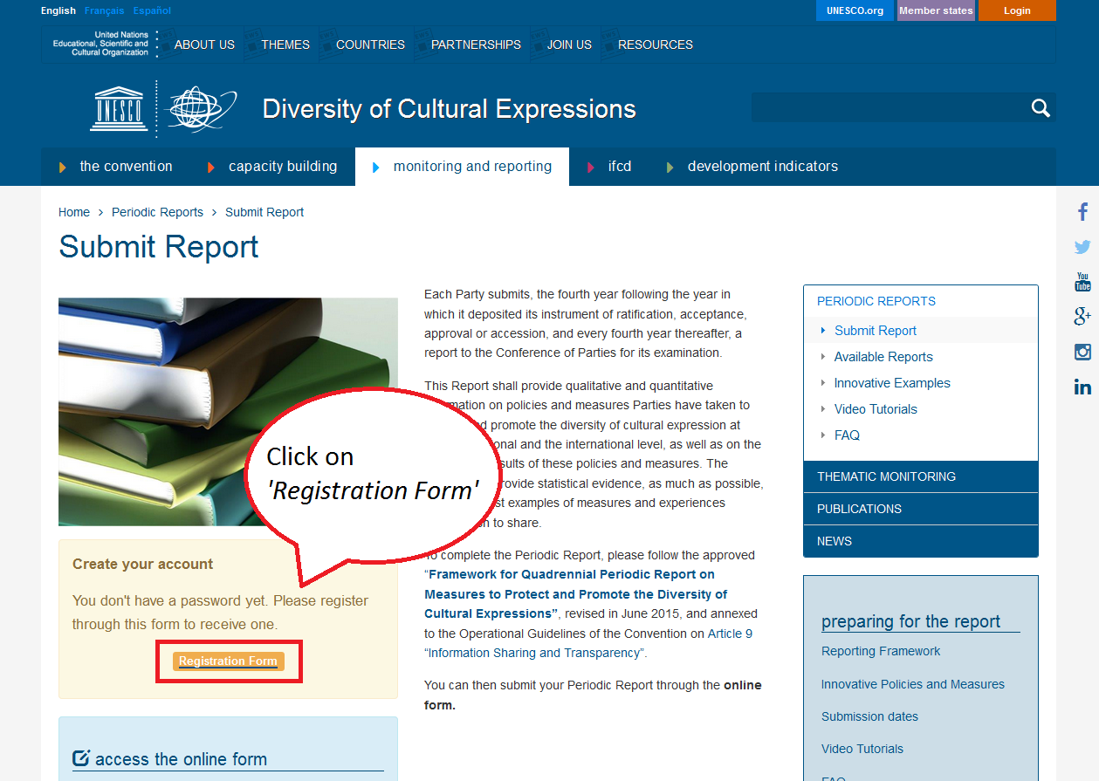
STEP 2. CREATE YOUR ACCOUNT /REGISTRATION FORM

Slide 6
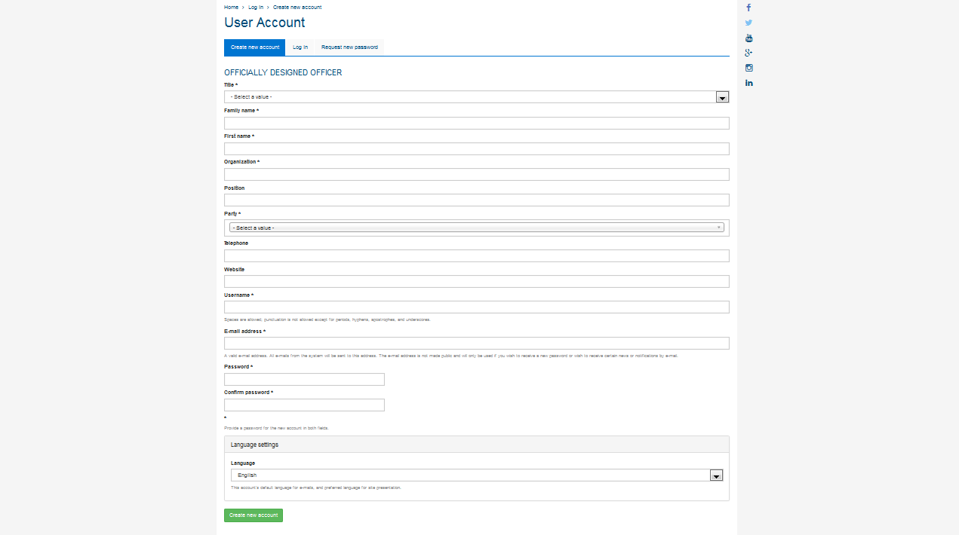
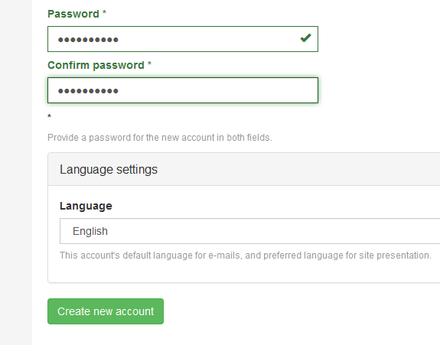
STEP 3. FILL IN THE REGISTRATION FORM
Once filled, click on ‘Create new account’

Slide 7
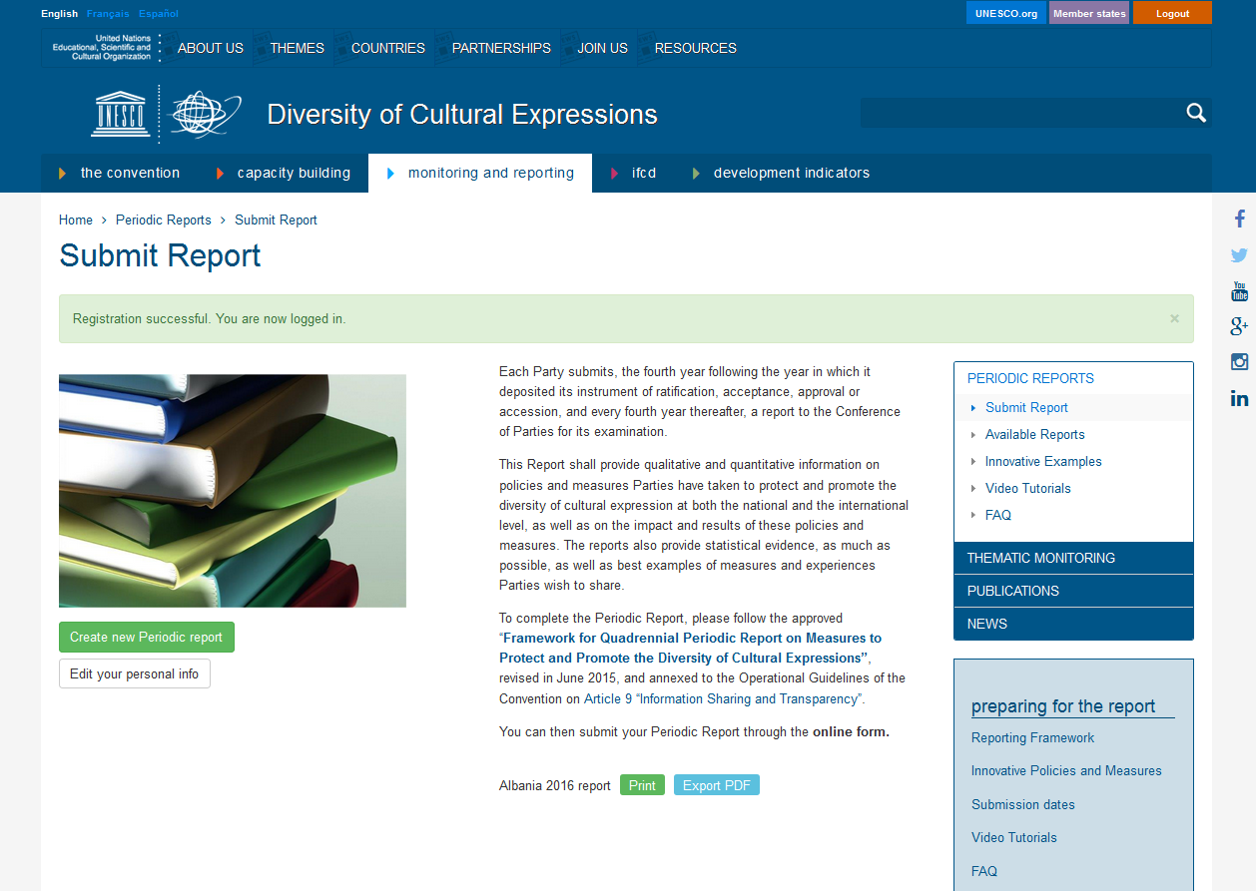
STEP 4. REGISTRATION SUCCESSFUL. NOW YOU CAN START THE REPORT!
Registration successful. You are now logged in.

Slide 8
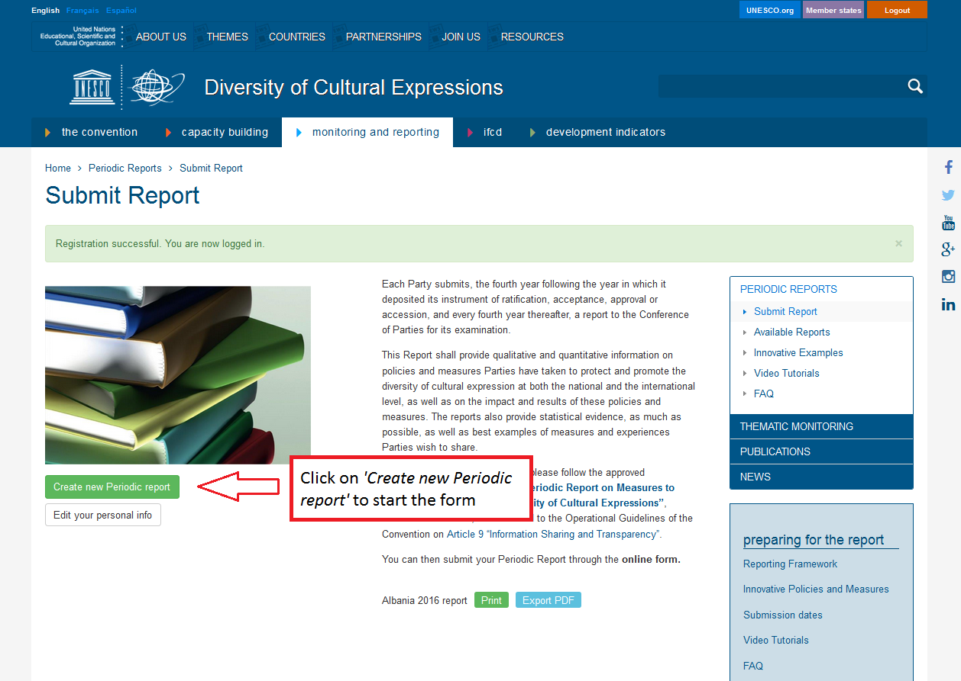
STEP 5. CLICK ON ‘CREATE NEW PERIODIC REPORT’

Slide 9
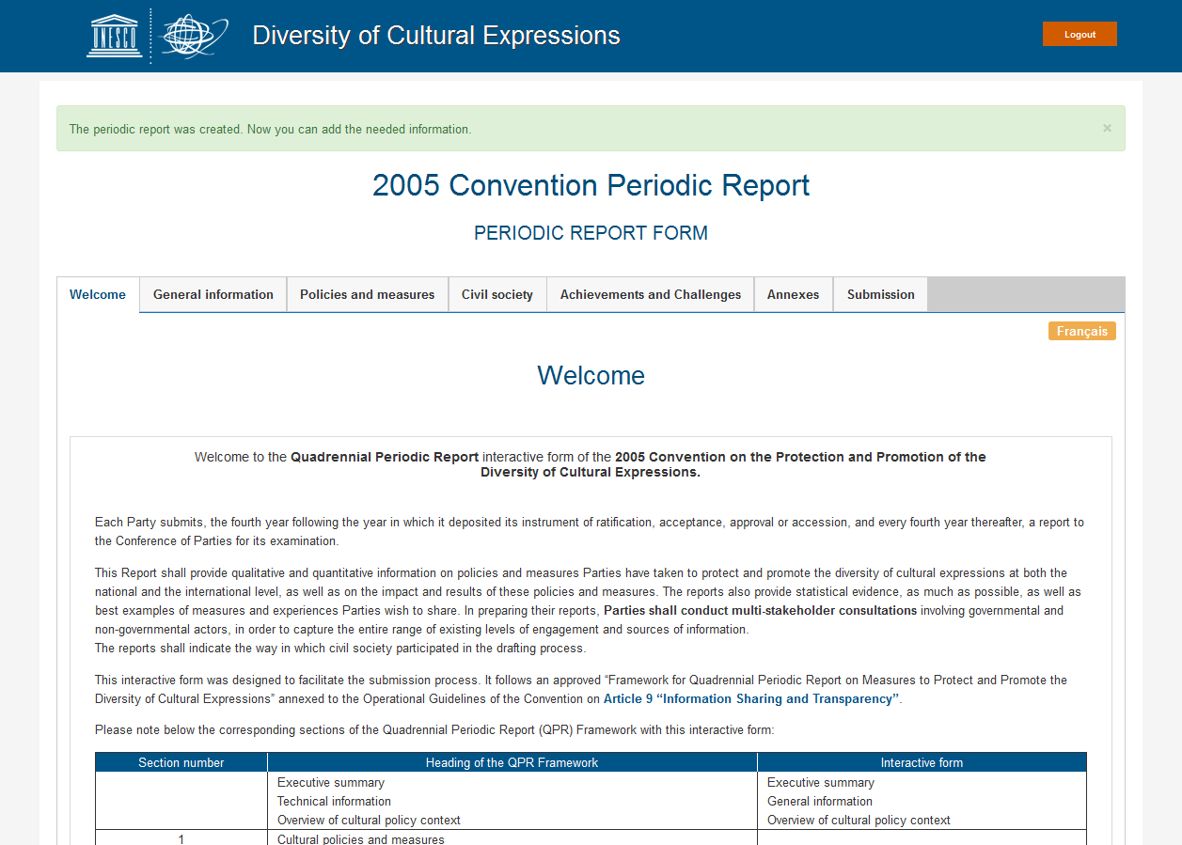
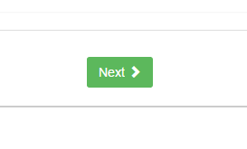
STEP 6. WELCOME. ENTERING THE FORM.
You have created a new periodic report and you will be able to edit it (before submission)
Read all the information and click on ‘Next’ to continue.

Slide 10
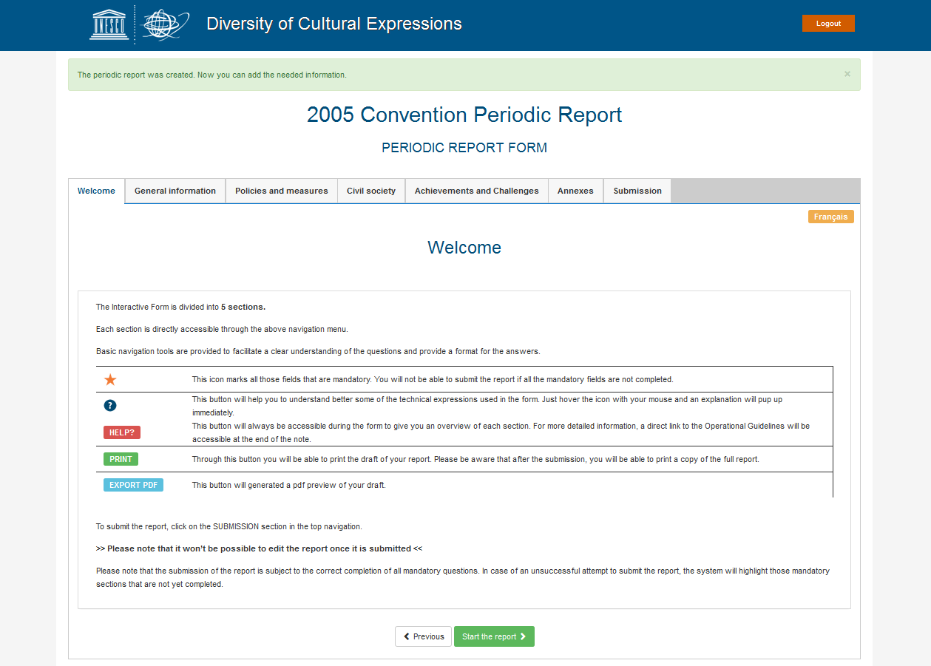
STEP 7. NAVIGATION TOOLS AND INSTRUCTIONS . CLICK ON ‘START THE REPORT’.
Click on ‘Start the report’ to start filling in the form.

Slide 11
STEP 7. NAVIGATION TOOLS AND INSTRUCTIONS . BASIC NAVIGATION TOOLS.

Slide 12
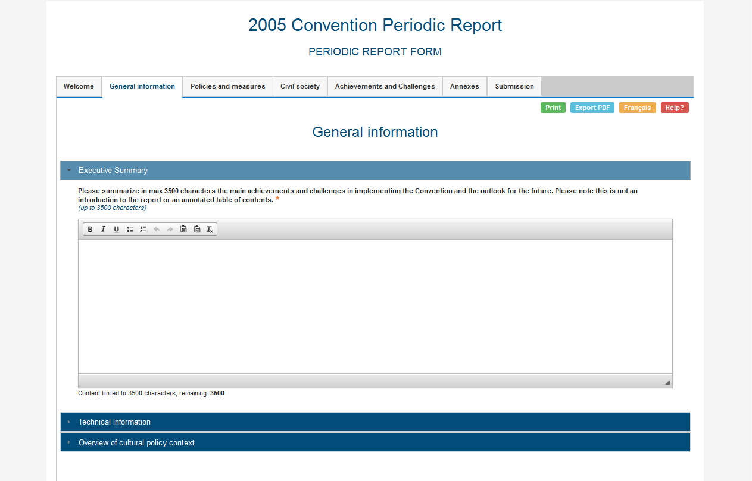
STEP 8. GENERAL INFORMATION – A. EXECUTIVE SUMMARY.
Write here, up to 3500 characters.

Slide 13
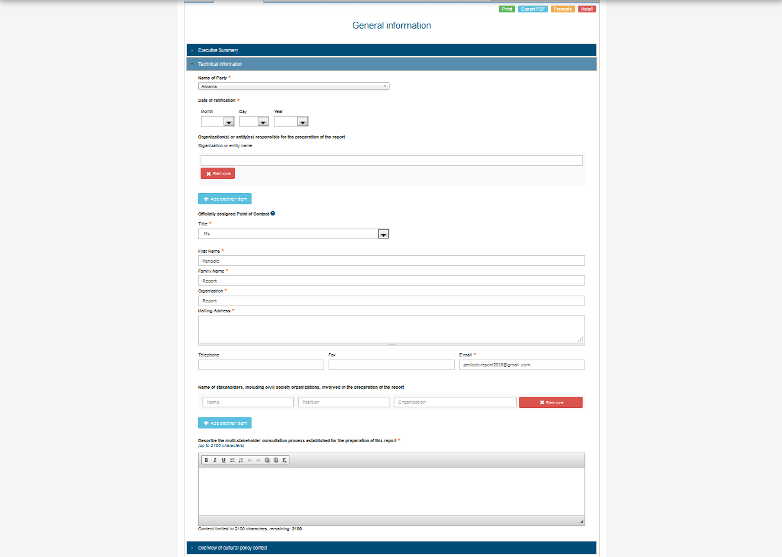
STEP 9. GENERAL INFORMATION – B. TECHNICAL INFORMATION.
Fill in all the sections. The ‘red start’ means that that section is compulsory to submit the report.
Click on ‘Technical information’ to open the section.
Up to 2100 characters.

Slide 14
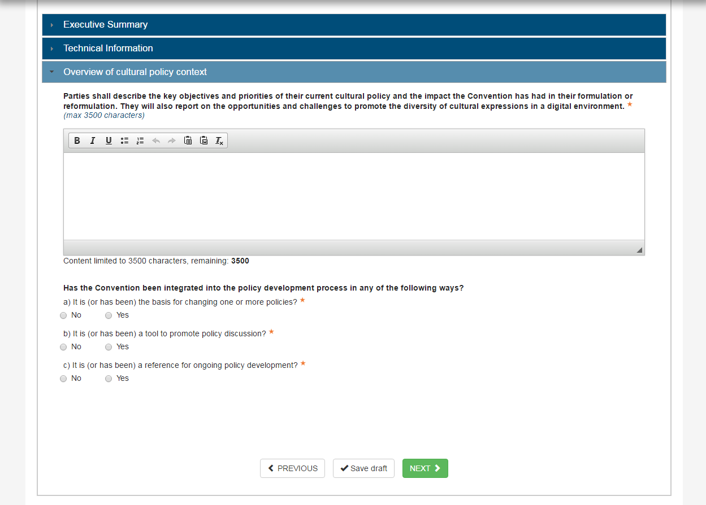
STEP 10. GENERAL INFORMATION – C. OVERVIEW OF CULTURAL POLICY CONTEXT.
All the sections have to be filled in order to submit the report.
Click on ‘Overview of cultural policy context’ to open the section.
Write here, up to 3500 characters.
If you want to stop and continue later, please, click on ‘Save draft’ to save your changes.

Slide 15
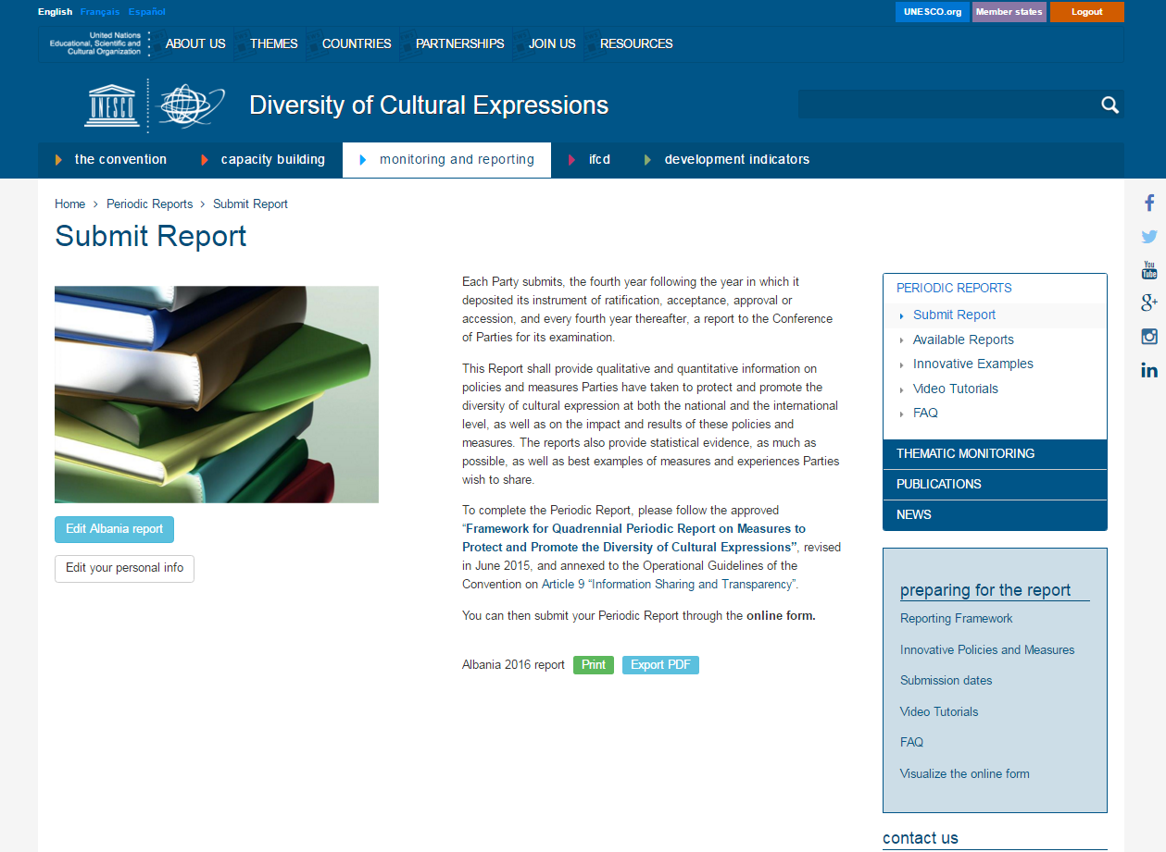
IF YOU ‘SAVE AS DRAFT’ AND WANT TO GO BACK TO YOUR DRAFT REPORT , CLICK ON ‘EDIT PERIODIC REPORT’.
You can continue to fill in your report where you left it the last time by clicking on ‘Edit’

Slide 16
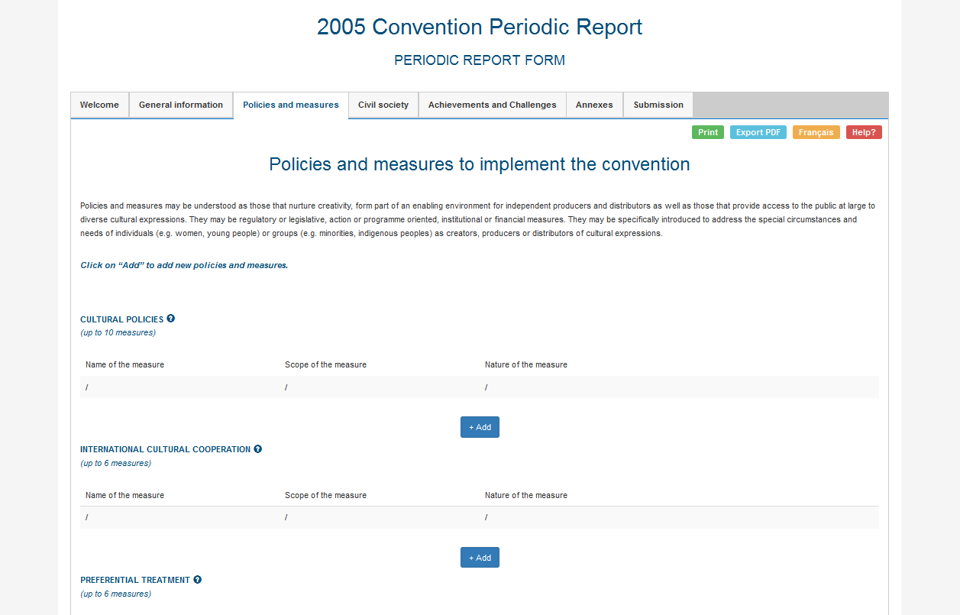
STEP 11. POLICIES AND MEASURES.

Slide 17
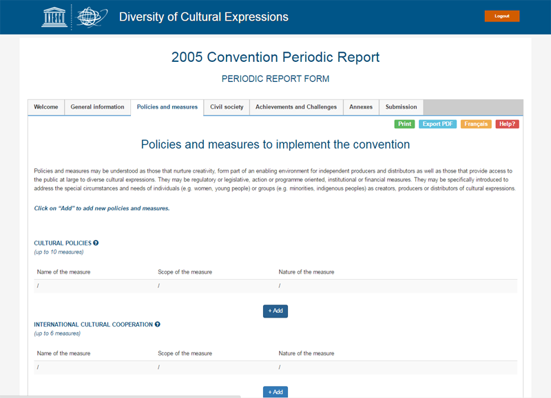
STEP 11. POLICIES AND MEASURES. ADD MEASURES.
To add a new measure click on ‘+ Add’ and a new window will pop up.
Pay attention to the number of measures that you can add for each section, as the number varies.

Slide 18
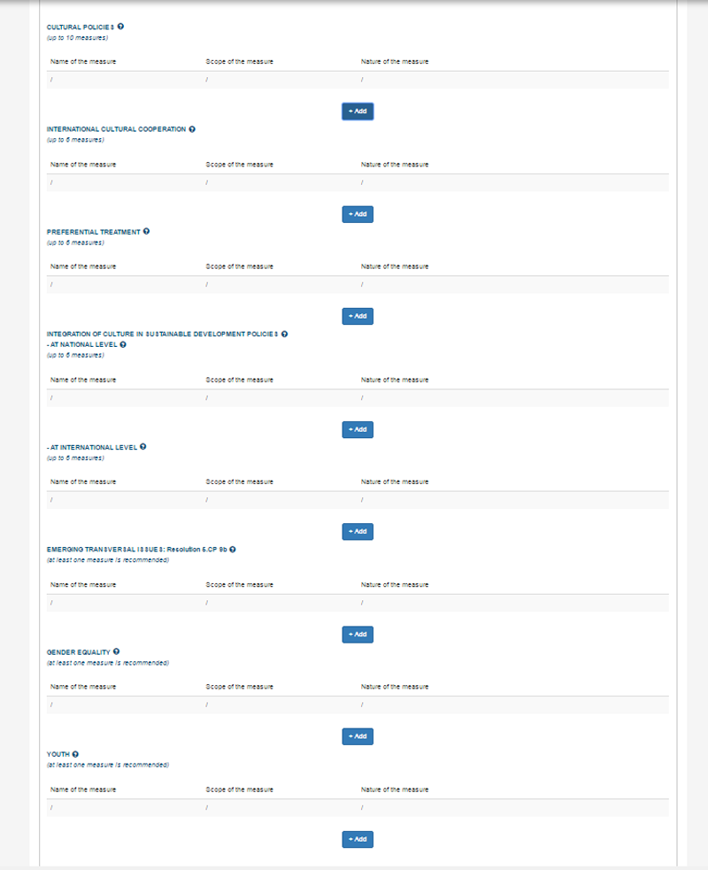
STEP 11. POLICIES AND MEASURES. NUMBER OF MEASURES/SECTION.
Cultural Policies: up to 10 measures.
International Cultural Cooperation: up to 6 measures.
Preferential Treatment: up to 6 measures.
Integration of Culture in Sustainable Development Policies. – At national level (up to 6 measures); - At intenational level (up to 6 measures)
Emerging Transversal Issues: at least one measure is recommended.
Gender Equality: at least one measure is recommended.
Youth: at least one measure is recommended.

Slide 19
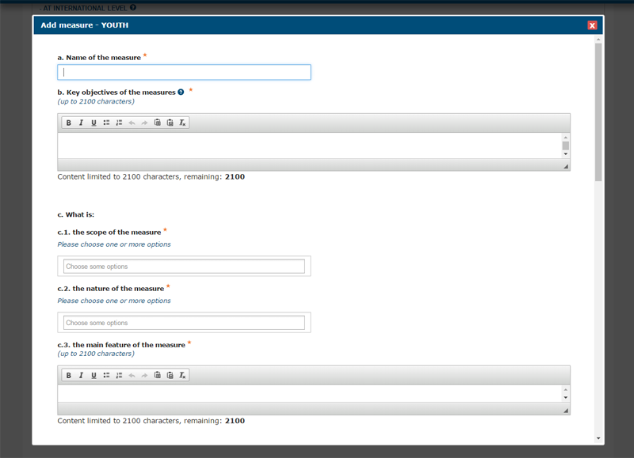
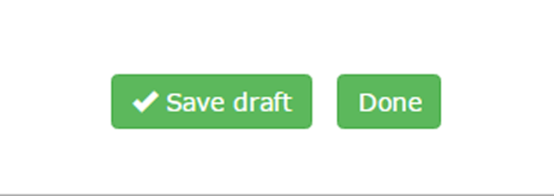
STEP 11. POLICIES AND MEASURES. SAVE EACH MEASURE.
Click on ‘+ Add’ and fill in the blanks.
Up to 2100 characters.
‘Save draft’ vs ‘Done’
If you have NOT completed all the compulsory fields, please ‘Save draft’ so that you can complete your full measure later.
If you have completed the measure, please submit it by clicking on ‘Done’. The system will check that all the required fields are duly completed. ATTENTION: All the measures saved “as drafts”should be completed. Otherwise, they will be automatically removed when you submit the report at the end of the process.
Up to 2100 characters.

Slide 20
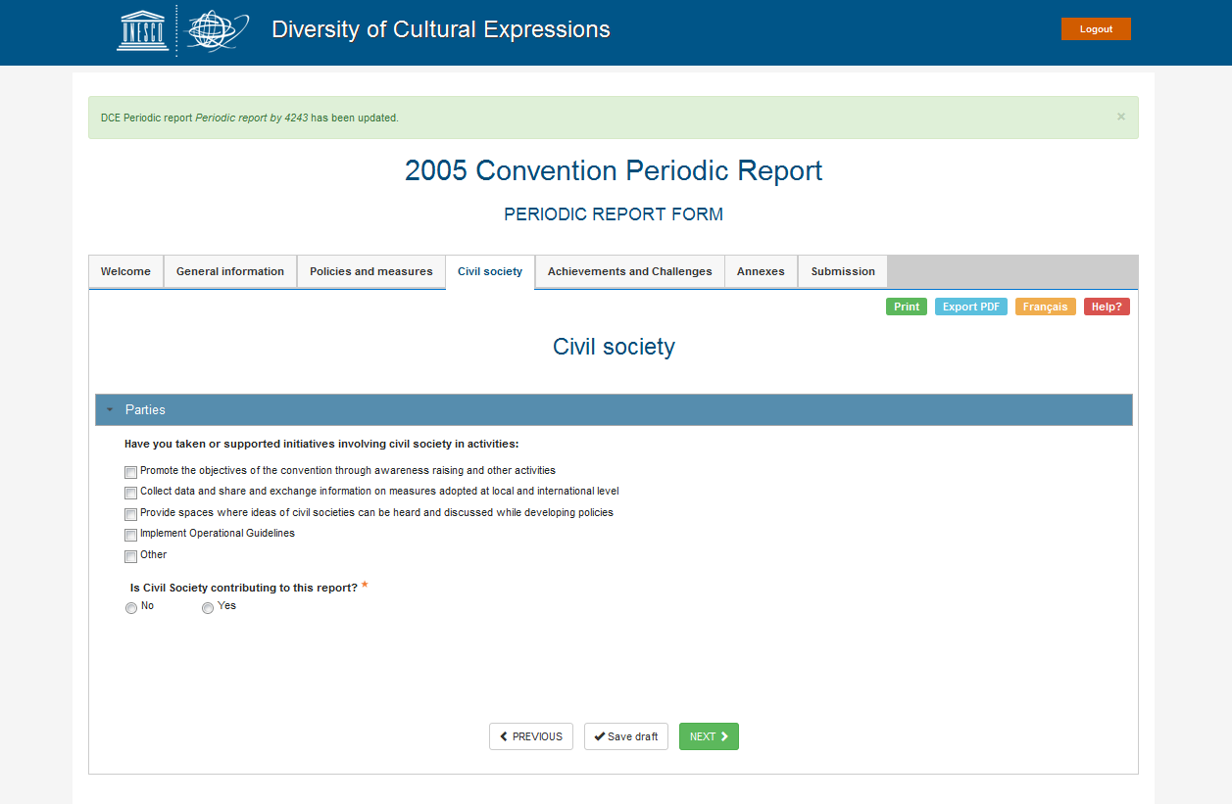
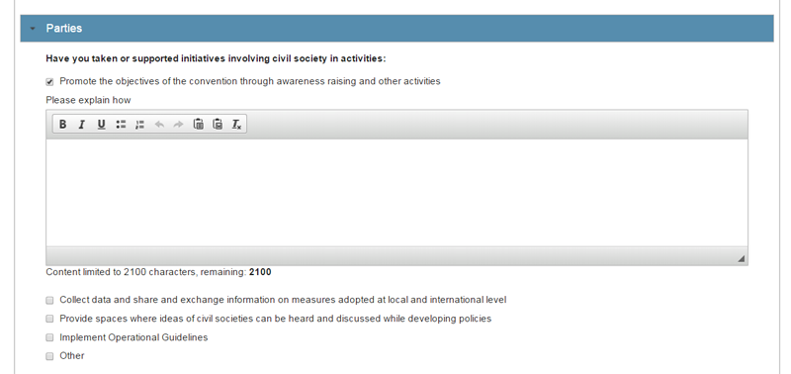
STEP 12. CIVIL SOCIETY.
Once you tick on one of these options (you can choose more than one), you will have to explain how (up to 2100 characters)
Up to 2100 characters.

Slide 21
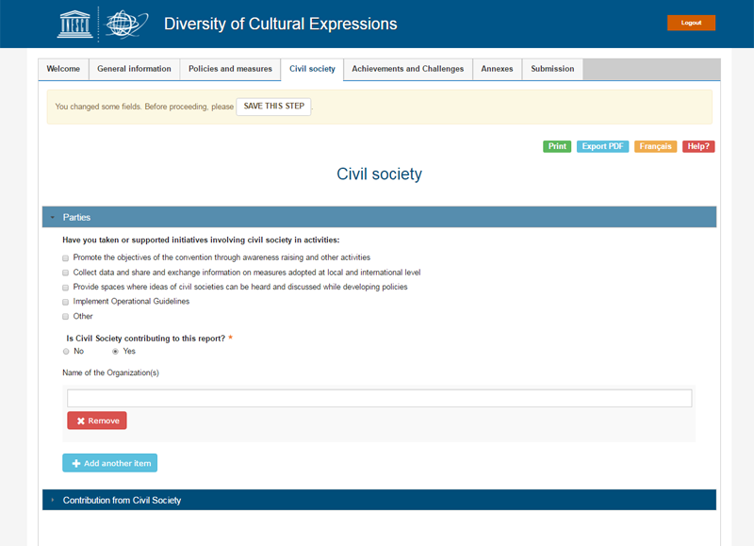
STEP 12. CIVIL SOCIETY. PARTIES.
Is Civil Society Contributing to this report? YES/NO
‘Contribution from Civil Society’ only visible IF YES.
If ‘YES’, please, fill in ‘Contribution from Civil Society’.

Slide 22
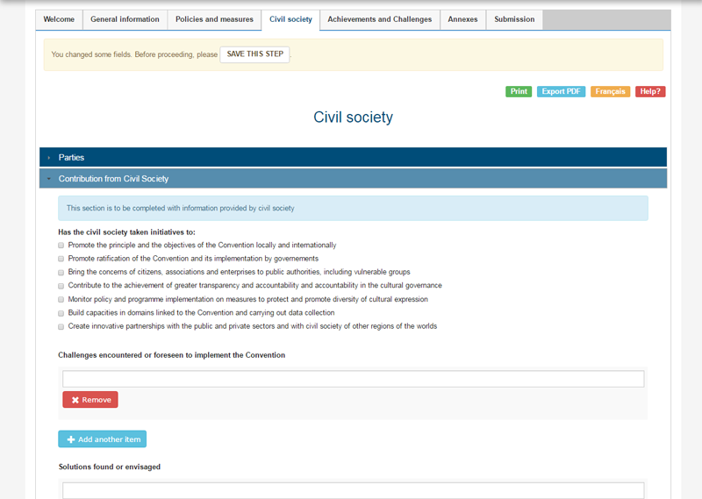
STEP 12. CIVIL SOCIETY. CONTRIBUTION FROM CIVIL SOCIETY.
Please attach supporting documents provided by the civil society, if relevant. Submission of as many relevant supplementary documents by civil society as possible can be very useful information to share.

Slide 23
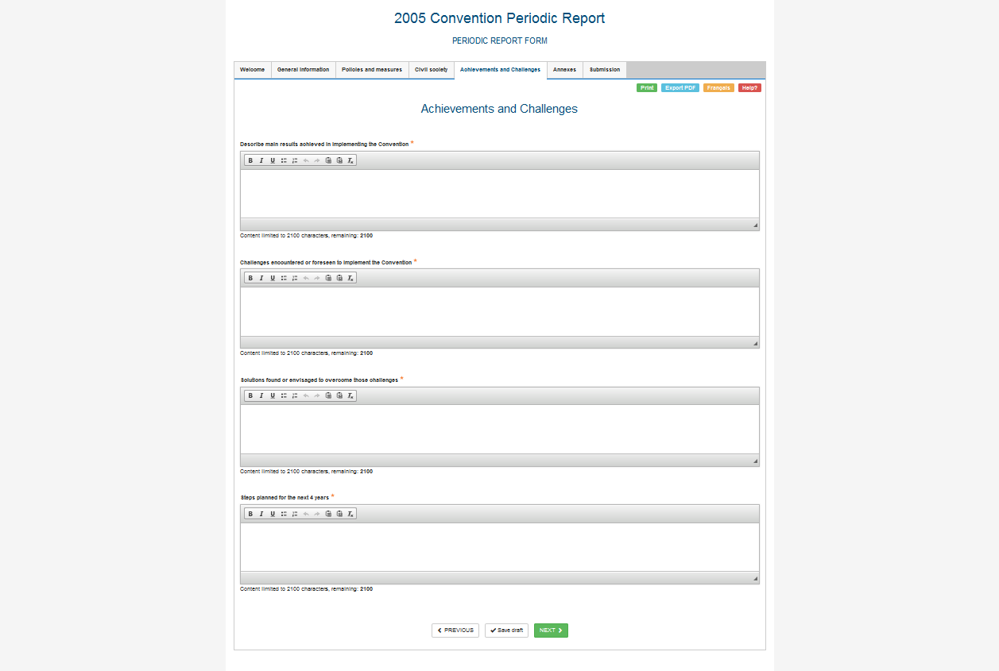
STEP 13. ACHIEVEMENTS AND CHALLENGES.
All the sections have to be filled in to submit the report, up to 2100 characters.
Up to 2100 characters.
Up to 2100 characters.
Up to 2100 characters.
Up to 2100 characters.

Slide 24
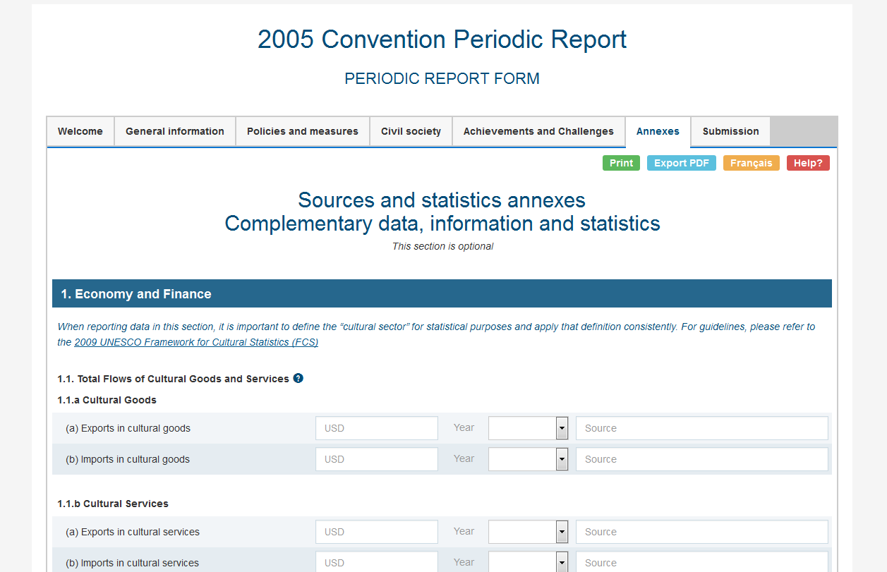
STEP 14. ANNEXES (This section is optional).
This section is optional, but highly recommended.

Slide 25
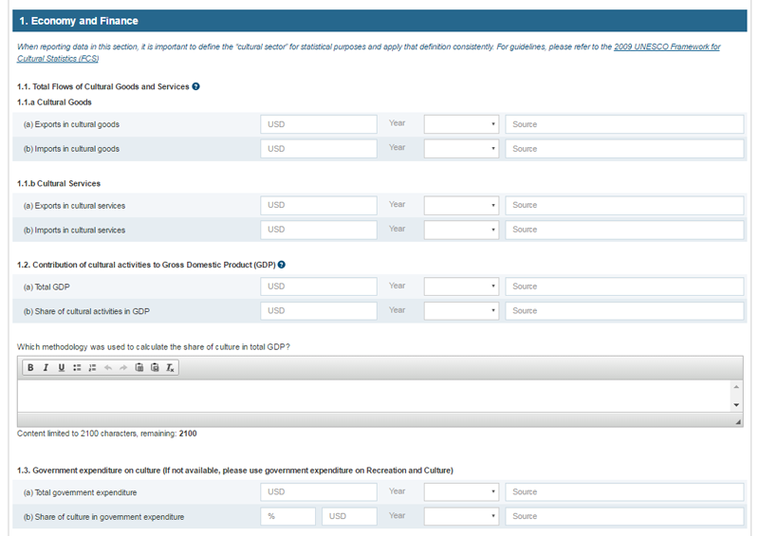
STEP 14. ANNEXES. 1. ECONOMY AND FINANCE.
Up to 2100 characters.

Slide 26
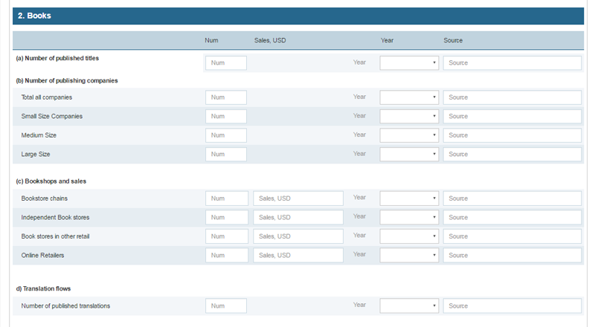
Small size (1-20 titles per year)
Medium size (21-49 titles per year)
Large size (50 titles and above per year)
STEP 14. ANNEXES. 2. BOOKS.
Number

Slide 27
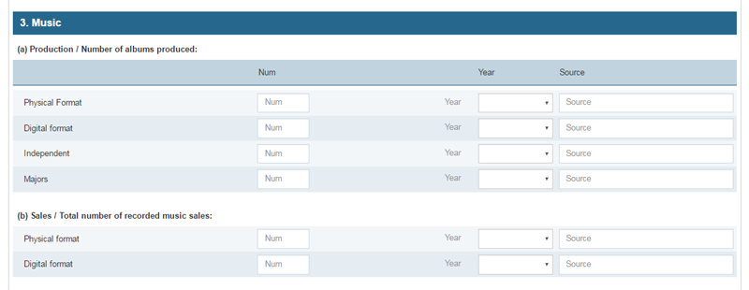
Majors: refers to the big transnational companies (ex: Universal, Sony, Warner)
Independent: refers to companies, often small/medium size, that are not owned or operated by record labels or parent companies
STEP 14. ANNEXES. 3. MUSIC.
Number

Slide 28
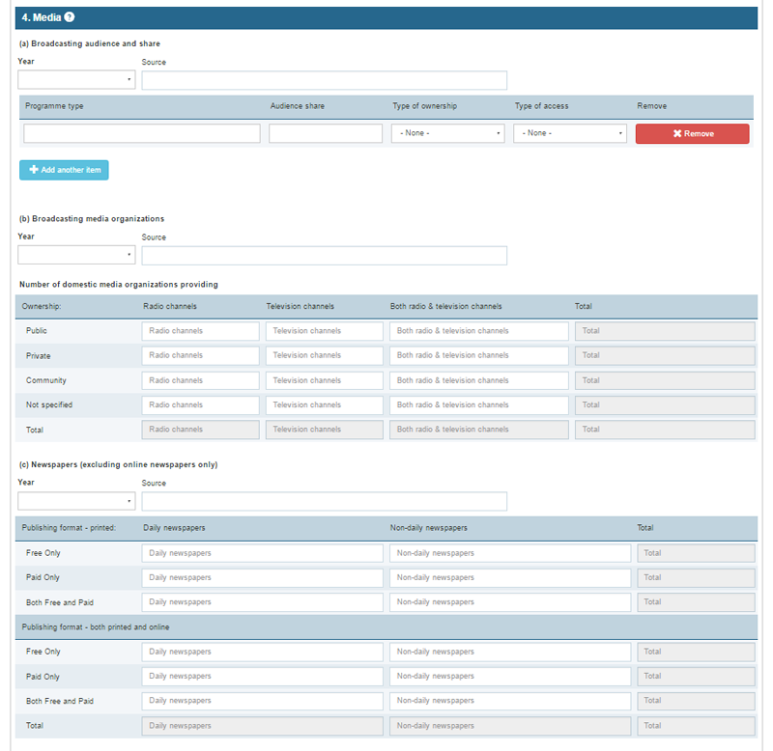
STEP 14. ANNEXES. 4. MEDIA.
Audience share = %
You can add more than one. Ex.: Channel 1, channel 2…
Number
Excluding online newspapers only
Number
Number

Slide 29
STEP 14. ANNEXES. 5. CONNECTIVITY, INFRASTRUCTURE, ACCESS.
Number

Slide 30
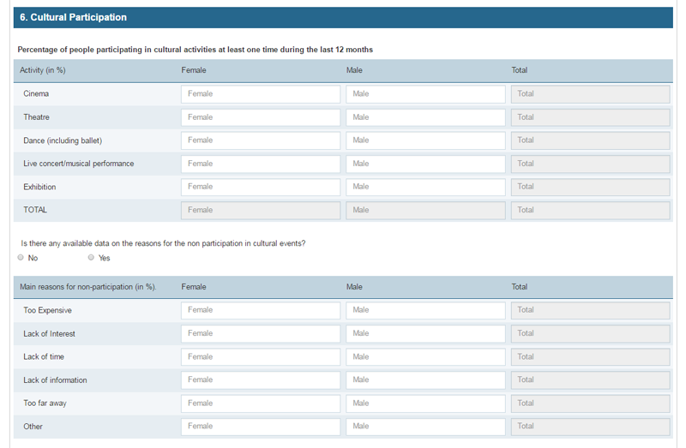
STEP 14. ANNEXES. 6. CULTURAL PARTICIPATION.

Slide 31
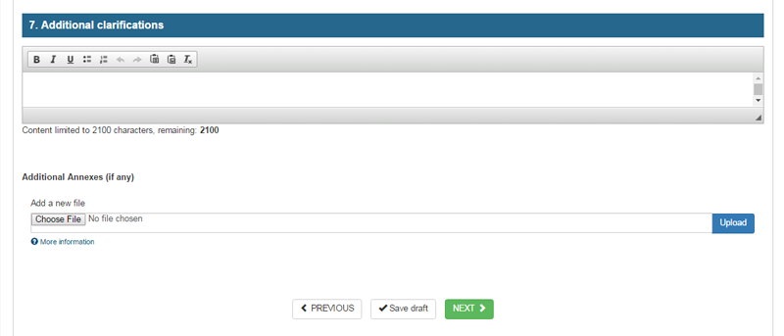
STEP 14. ANNEXES. 7. ADDITIONAL CLARIFICATIONS.
Up to 2100 characters.
Please provide any additional explanations and clarifications as necessary.
Multiple attachments are allowed. Once you upload the first one, you will be offered the option to add a description of the uploaded document and the option ‘Add a new file’.

Slide 32
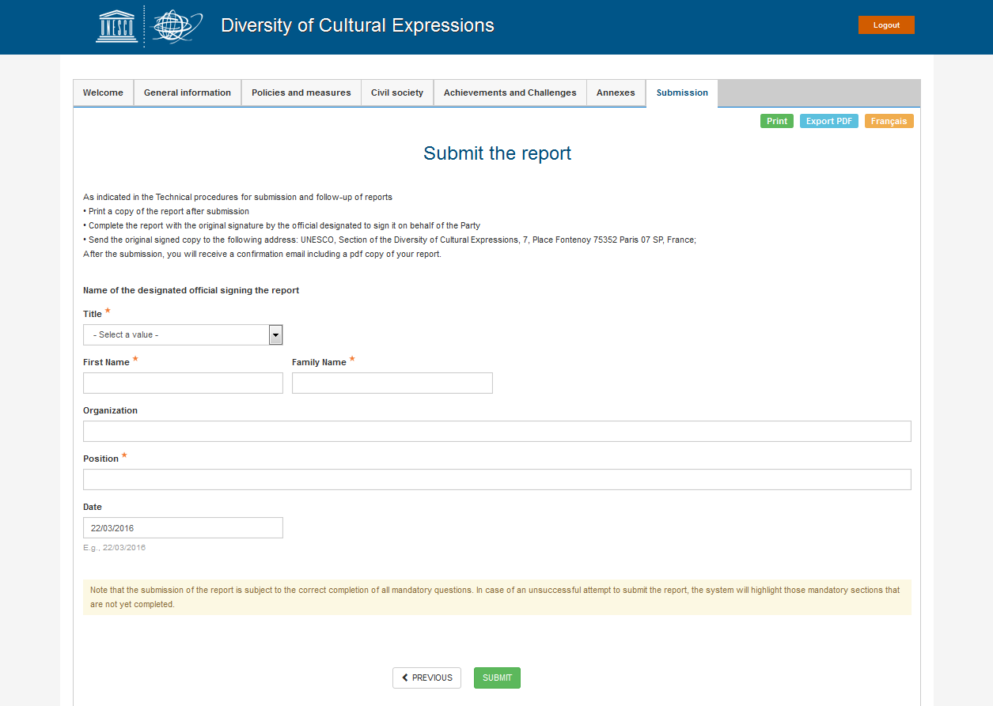
STEP 15. SUBMISSION. SUBMIT THE REPORT
Once you click on ‘Submit’, you will not be able to make further modifications, but you will be able to print the report or save the pdf.

Slide 33
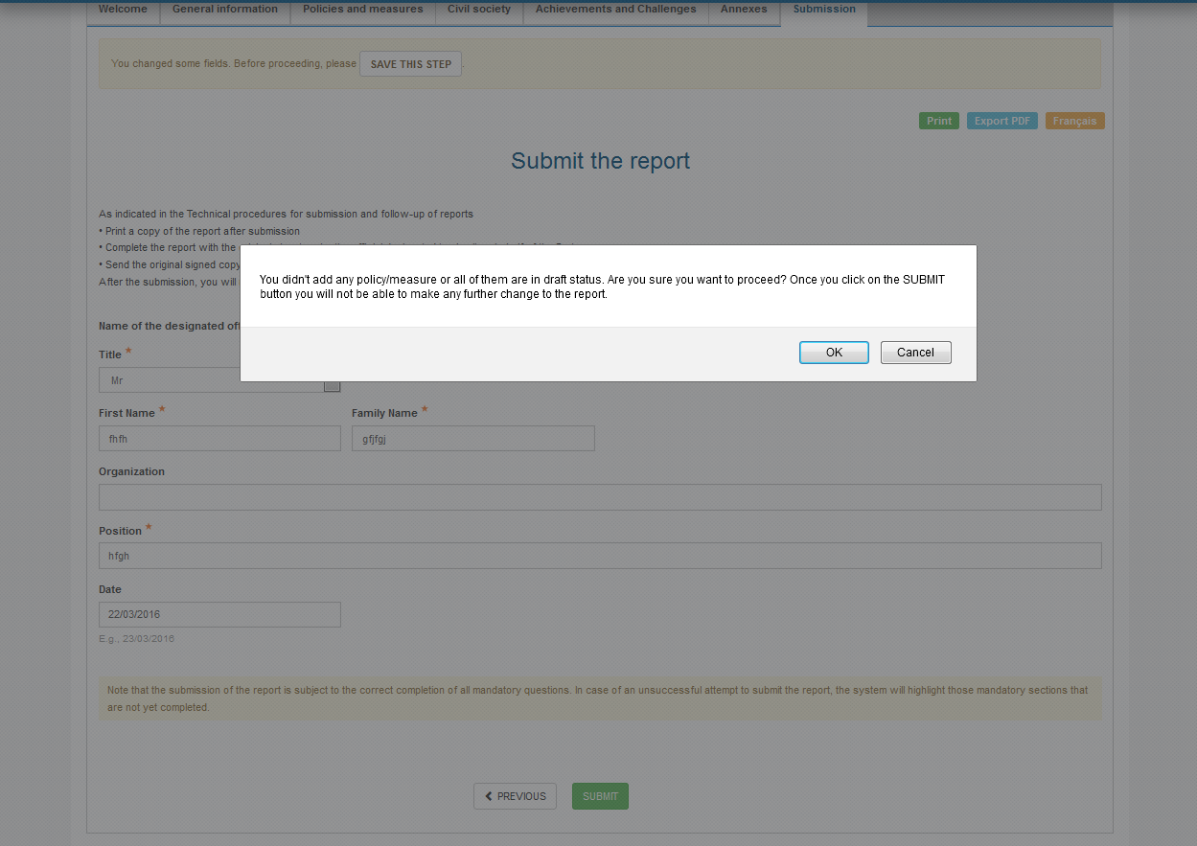
STEP 16. BEWARE: Once you click on the ‘SUBMIT’ button you will not be able to make any further change to the report.
This message will pop up.

Slide 34
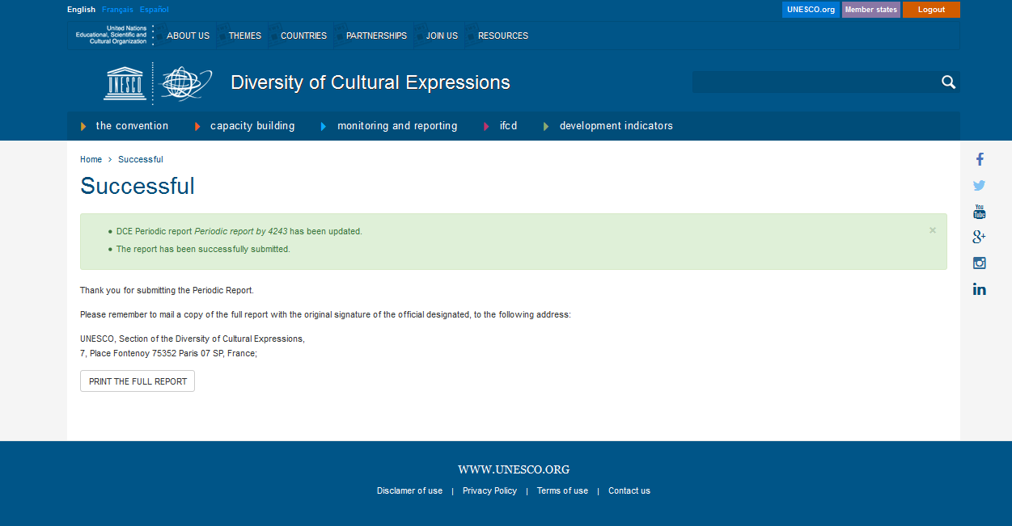
STEP 17. ONCE SUBMITTED, PRINT, SIGN AND SEND.
Click on ‘PRINT THE FULL REPORT’ to print a copy.

Slide 35
STEP 18. SIGN AND SEND
Print the completed form, have it signed by a government official who is authorized to sign it on behalf of your government and send it to the following address: UNESCO, Section of the Diversity of Cultural Expressions, 7, Place Fontenoy 75352 Paris 07 SP, France.
Next statutory submission deadline is 30 April 2016, but can be extended to 30 June 2016 for Parties requiring additional time for consultations.

Slide 36
THANK YOU
For any enquiries, please contact the UNESCO Secretariat at reports2005@unesco.org

