Slide 1
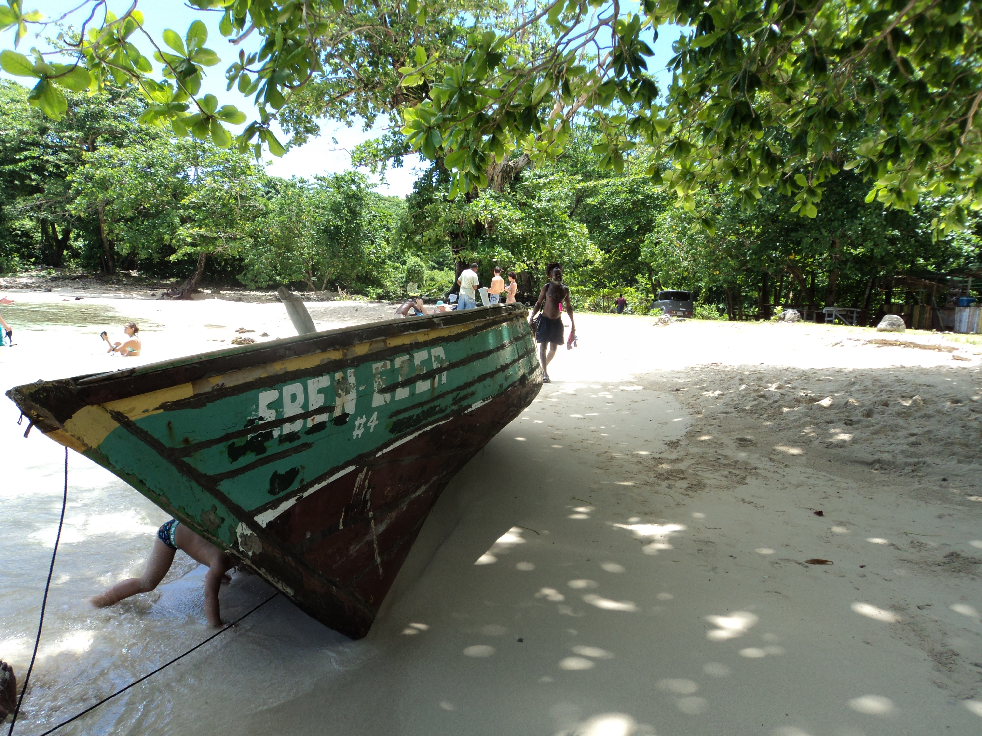
“New challenges for the mobility of haitian women to the dominican republic following the earthquake in haiti” Bridget Wooding, Observatory caribbean migrants, cies unibe, FLACSO - RD
UNESCO
PARIS, 5 May 2011

Slide 2
Introduction
Feminization of migrations
New Haitian migration to the DR
Vulnerability to human trafficking and the illicit smuggling of people
SGBV in the sending country
Difficulties of access to justice (Haiti and the DR)
Dificulties on knowledge of rights (Haiti and the DR)

Slide 3
forced migration and Haiti
Dictatorship of the Duvaliers
Response from the USA
Deportations from the USA and the DR
Human trafficking and illicit smuggling of persons. Dominico haitian border

Slide 4
New challenges after the earthquaKE
Change in dominico haitian relations
Difficulties persist on Haitian immigration in DR
Earthquake shakes up traditional beliefs
DR now as “good Samaritan”
There is no stampede of Haitians
There is a positive evaluation of the advances made on combating SGBV
Example of new situation: truck drivers on border

Slide 5
The response of key actors: international community
Synergies across the island
Example: cluster/sub-cluster GBV/Protección
Dificulties of coordination because of number of actors
New opportunities, for example border

Slide 6
The response of key actors: civil society
Proximity to affected population
Research into old phenomena with a new look
For example, situation of Haitian children migrants
Situation of Haitian women migrants
New opportunities for policy advocacy

Slide 7
the respon se of the two governments and the two states
More contact at the level of the Ministries, for example the Womens Ministry on both sides of the border
Summits (and role of the DR)
Reactivation of the Bilateral Mixed Commission BMC

Slide 8
Perspectives to reinforce follow up by insular civil society
Need to continue to make more visible as a robust actor
Challenge of balancing efforts on both sides of the island
Threats with old phenomena aggravated by earthquake, especially as regards women, boy and girl migrants
New opportunities as regards the Dominican authorities
Need to renew policy dialogue in this relation.

Slide 9
Thank you Bridget Wooding bridget.wooding@gmail.com

