Slide 1
Programme implementation at the national level
Insights gained from UNESCO assessments
Bangkok - THAILAND
7 March 2017

Slide 2
Objectives
Recall expected results and approach of the capacity-building programme;
Present some findings from some recent UNESCO assessments of the capacity-building programme;
To spur thinking on the achievements and challenges of implementing the programme at the national level.
© All Rights Reserved: UNESCO/ ICH

Slide 3
Expected results
▶ Improved infrastructure for safeguarding and strengthened human resources.
▶ Improved policies and strategies for safeguarding in relevant policy areas (culture, education, environment, peace, food security, etc.).
▶ Availability of community-based inventorying and safeguarding methodology.
▶ Effective participation in the Convention’s international cooperation mechanisms.
© All Rights Reserved: UNESCO/ ICH
Notes:
Let us remind ourselves what we are trying to do with the programme

Slide 4
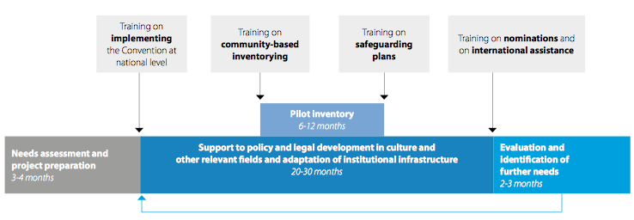
Delivery
Notes:
Training on international assistance can be combined with other training at any stage.
Capacity-building projects generate new needs and often require a second round of programme activities

Slide 5
Advisory dialogue
Other ministries
Resear-chers
UNESCO HQ + FO
Line ministry
Civil society
Bearers
Facilitators/ advising experts

Slide 6
Combined modalities
Needs assessment
Dedicated training + networking
Individualized advisory services
Dialogue with
national counterparts
Notes:
The projects currently foresee three modalities to provide support to policy and legal development:
1. Preliminary consultations with national counterparts on their demands for policy assistance during the needs assessment phase;
2. General discussions on policy requirements as part of the training workshop on implementing the Convention at national level, which covers the Convention’s objectives, key concepts, State obligations and cooperation mechanisms;
3. Specific provisions for policy advice in the form of consultancy services and/or stakeholder consultations at national level (introduced only more recently in projects developed as of 2012).

Slide 7
Policy Support (1)
WHAT | WHERE
Needs assessment (includes policy support) | Albania, Cabo Verde, Comoros, Djibouti, Ecuador, Egypt, Guinea-Bissau, Haiti, Madagascar, Moldova, Palestine, Senegal, South Sudan, Sudan
Incorporation of ICH in cultural policy | Belize, Ecuador, Samoa, South Sudan, Sri Lanka
Incorporation of ICH in cultural heritage laws | Angola(in progress), Dominican Republic, Cabo Verde(in progress)
Specific law for safeguarding ICH | Eritrea(adopted), Palestine(drafted), Tajikistan

Slide 8
Policy Support (2)
WHAT | WHERE
Action plans for ICH safeguarding | Cuba, Jamaica, Botswana, Lesotho, Malawi, Namibia, Swaziland, Zambia and Zimbabwe
Establishment of national bodies to safeguard ICH | Comoros, Dominican Republic, Mauritania, Morocco, Myanmar, Sao Tome and Príncipe, Tunisia
Review of existing national institutions for safeguarding ICH | Eritrea, Kyrgyzstan, Tajikistan and Uzbekistan

Slide 9
Monitoring and evaluation of CAP to date
Reports to governing bodies
Regular internal UNESCO reporting
Reports to donors
Facilitators reports
Regional review meetings
Towards an Overall Results Framework
Follow-up and evaluation mechanism for CAP
© All Rights Reserved: UNESCO/ ICH

Slide 10
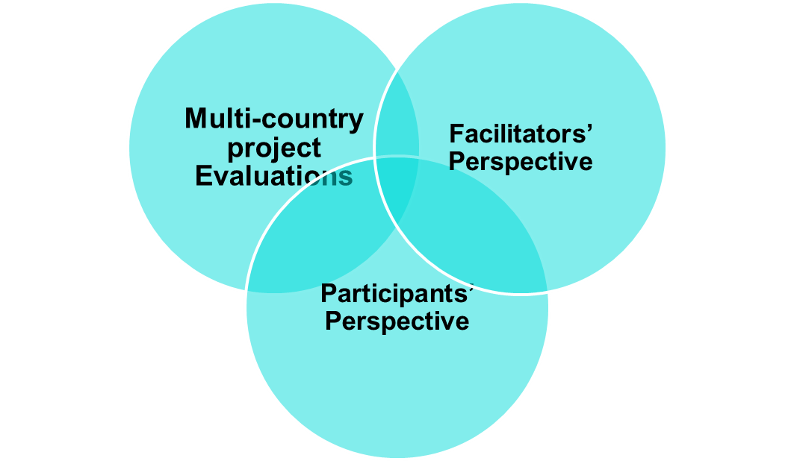
Some recent UNESCO Assessments
PALOP (2016) (5)
Central Asia (2016) (4)
Asia Pacific (9) (to start)
Cross-regional analysis of facilitators’ reports (2016)
Pilot tracer study (ongoing) (2)
© All Rights Reserved: UNESCO/ ICH
Notes:
We are looking at:
programme efficiency: Has the programme achieved what has set out to do? and
programme relevance: What has been its added value in the country context and in the regional/ international context
Background info on country projects:
PALOP (2016) – capacity-building programme in Portuguese-speaking countries in Africa implemented from 2011 to 2016 (Angola, Cabo Verde, Guinea-Bissau, Mozambique, Sao Tome and Principe) implemented
Central Asia (2016) – programme supported by government of Norway in Central Asia (Kazakhstan, Kyrgyzstan, Tajikistan, Uzbekistan, implemented from 2012-2014. Provide in-depth look of effectiveness and relevance of capacity-building activities in certain country contexts. Provide useful information on institutional and policy developments at country level.
Cross regional analysis of 73 facilitators’ workshop reports. Facilitators reports in particular helped to verify if the programme approach and methodology was working and where it could be improved.
These assessments provide information on the short-term effects of the programme and do not assess the wider impact of capacity-building activities at the national level. Key insights will be used today to stimulate our discussion by examining what stakeholders see as the major strengths and weaknesses of the programme.

Slide 11
PALOP project (1)
Angola, Cabo Verde, Guinea-Bissau, Mozambique, Sao Tome and Principe
Brought PALOP countries into the Convention process – closing a language gap
Two ratifications in 2016: Cabo Verde and Guinea-Bissau (plus Angola almost)
Dedicated departments, councils, committees (Cabo Verde, Mozambique, Sao Tome and Principe)
Critical mass of human resources (180 trained plus 3 new facilitators )
© All Rights Reserved: UNESCO/ ICH
Notes:
The project also enhanced the establishment of improved institutional infrastructure in some countries, such as the creation of the Department of Intangible Cultural Heritage in Cabo Verde, in April 2015, within the IPC - Institute of Cultural Heritage, that operates under the aegis of the Ministry of Culture and the Creative Industries. In Mozambique, ARPAC has developed an internal action plan to create a National Council for Safeguarding ICH within the existing Council for Heritage. This National Council of Cultural Heritage will use the UNESCO 2003 Convention to define the council’s responsibilities and implement its intervention plans. Finally, Sao Tome and Principe has a Committee of Intangible Heritage, integrated within the Ministry of Education, Culture and Science, the entity responsible for ICH, developing its action in cooperation with the General Directorate of Culture, which has a delegation in the Island of Principe.

Slide 12
PALOP project (2)
Inventory frameworks developed in all countries and tested in seven communities of four countries
Capacity strengthened to request International assistance and elaboration of requests ongoing
Four countries identified elements for possible inscription on the Lists
Regional cooperation network with strong expertise in two countries as an asset
© UNESCO
© All Rights Reserved: UNESCO/ ICH
Notes:
5. Involvement in the Convention’s mechanisms for international cooperation
Regarding the involvement in the Convention’s mechanisms for international cooperation, all five countries worked on an international assistance request during the training of the regional workshop. Guinea-Bissau had started preparing a request already during the national workshop. Moreover, Cabo Verde, Mozambique and Sao Tome and Principe identified several elements that might be proposed for inscription in one of the Convention's Lists.

Slide 13
PALOP project (3)
Partcipants valued:
acquisition of knowledge usable in their daily work and understanding the need for safeguarding
the good quality of the training activities
the possibility for sharing and cooperation during trainings
the establishment of a cooperation network (national/regional/international)
availability of key documents and materials in Portuguese
Notes:
* Do we have time for this slide?

Slide 14
PALOP project (4) – Challenges
Political and economic instability
Focus on tangible, rather than intangible cultural heritage in one country
Finding resources to support a second phase:
Safeguarding plans
Policy development and links with sustainable development strategies
Strengthening the regional network
Notes:
In Guinea-Bissau, the various conflicts that occurred in the country led to the loss of heritage inventories during the years 2001 and 2002, and political instability is considered one of the main factors that may weaken the ICH safeguarding capacities. Considering the challenges that the country faces at all levels, it is understandable that culture is not a government priority at the moment. This situation, however, has been taken into account in the project, and inventorying activities were substituted by capacity-building in financial assistance requests, so that later on Guinea-Bissau may have some resources to start safeguarding its intangible cultural heritage.
In Angola, besides the governmental changes that occurred during the project development, it seems clear that the country has recently chosen to invest in implementation of the 1972 UNESCO Convention, and it is hoped that the project has left some seeds that may flourish at least after the country's mandate in the World Heritage Committee has ended.

Slide 15
Central Asia (1)
Kazakhstan, Kyrgyzstan, Tajikistan and Uzbekistan
Communities and NGOs gradually taken on board in implementing the Convention
Community-based inventory frameworks developed and in use
Increased participation in governing bodies and listing mechanism
© All Rights Reserved: UNESCO/ ICH
Notes:
A major achievement was the increased community participation in activities in Central Asia. This was particularly Significant given the initial resistance to community stewardship in the field of ICH.

Slide 16
Central Asia (2) -- Challenges
Change from an ethnological and folklore approach to safeguarding living heritage takes time
Finding resources to support a second phase:
Safeguarding plans
Policy development and links with sustainable development strategies
Strengthening the regional network
Not enough Russian-speaking facilitators

Slide 17
Facilitators: Analysis of workshop reports
Confirmed relevance of the programme
Workshop approach is not enough
Participant selection is key for success
Language – need to invest in translation and interpretation
Local logistics – always room for improvement
Sufficient time for preparation
Tips for improving materials (theme, approach)
Need for follow up at country level
Notes:
Feedback from the facilitators report indicate that in general the approach and methodology used in the training workshops is well appreciated. However facilitators have highlighted several issues with regard to the logistics and organisation of training workshops:
selection of participants
Linguistic difficulties (translation of materials and interpretation during workshops)
Benefits and challenges of co facilitation
In addition, several facilitators raised the challenges relating to workshop follow up and suggested organising follow up missions to interview trainees about how they have used what they learnt from the trainings

Slide 18
Pilot tracer study
- Initiated 2016
- Purpose:
1) To assess the feasibility and adequacy of this approach
2) To collect feedback from individuals about their experience of the programme and whether this has led to a change in the way they engage with activities to safeguard ICH.

Slide 19
Benefits
New knowledge on ICH concepts and safeguarding
“These two trainings really empowered me... Before those trainings, I had no idea about ICH, but after I have really been encouraged and am even doing a PHD now related to the topic.” – Researcher
New skills on community-based inventorying
“I already had the theoretical knowledge, but since the training I got to know the practical side of things like inventorying.” – Local government
Networking with diverse stakeholders
“I entered into a great network. My relations expanded and through these new experiences, and this new knowledge and expertise I am going to provide to my villages.” - Civil society

Slide 20
Challenges
“There are still large things left to be done. Only the trainings have been conducted.” – Researcher
Lack of institutional capacity
“I think it is the resources. We have the time but we lack the human capacity.” – Government official
“The budget that is allocated to the ministry that is responsible is not enough. Our planning commission should be convinced first.” – Government official
Lack of follow up
“After the workshop, the ministry should be doing some kind of follow up. If UNESCO could take commitment from the institution.” - Local authority
Notes:
There are participants who take the trainings, but they have not been able to practice what they learnt, so maybe if they are provided with some pilot projects – Government official

Slide 21
Needs/Gaps
Decentralization
“We need decentralization. You need to hold meetings in the communities, with the proper people, in the local languages – that would be more effective.” – Community member
Engaging younger generations
“For example, giving a workshop, targeting teachers. If these people understand it, then they will be able to infuse it into education.” – Government official
“That is one thing I wanted to do -- culture clubs to help those elder people to go and talk and communicate the cultural norms of our culture across generations.” – Local government official

