Slide 1
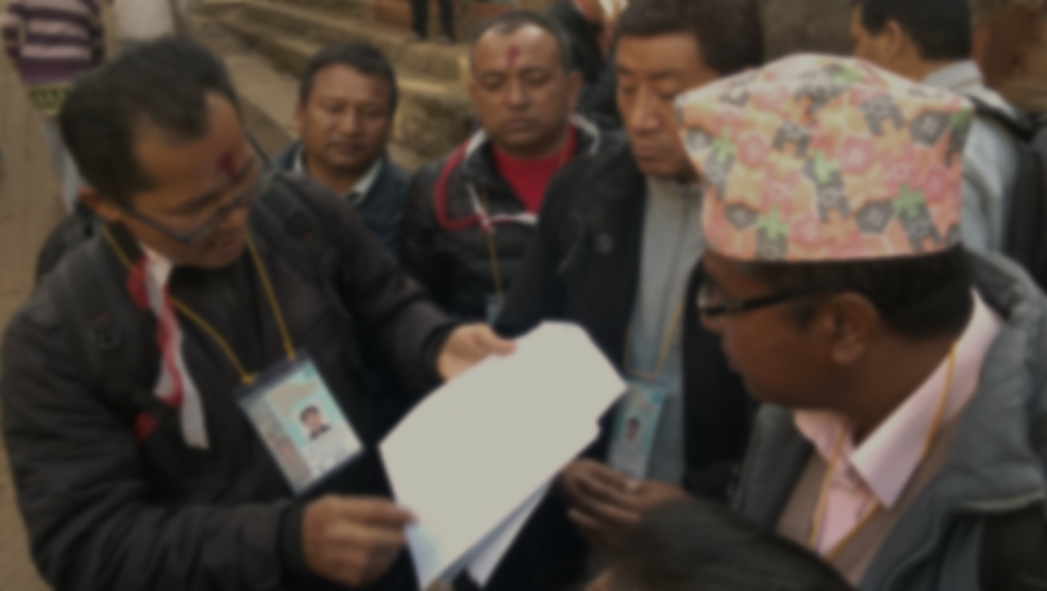
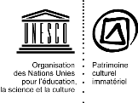
Materiaux de renforcement des capacites
Evolutions récentes et à venir

Slide 2
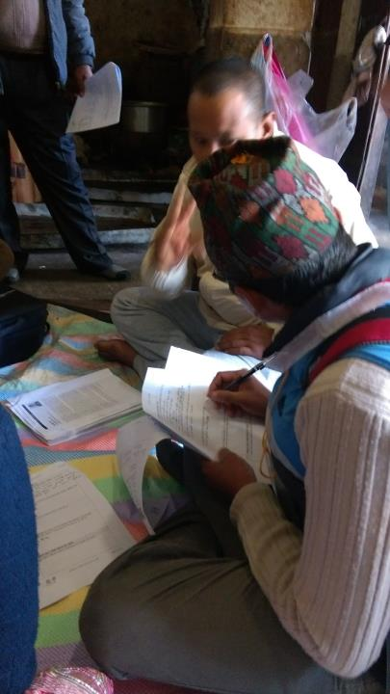
Situation actuelle:
54 unités destinées aux parties prenantes
6 thèmes principaux
Plus de thèmes en préparation
Mises à jour régulières
Plus de 260 demandes d’accès aux matériaux

Slide 3
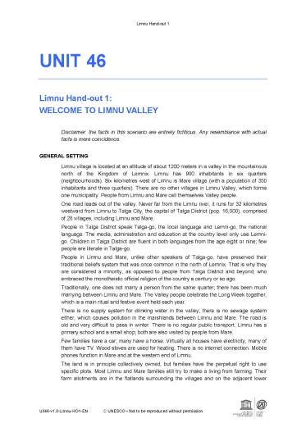
Repertoire des materiaux
Login avec nom d’utilisateur et mot de passe
Accès pour le public
Mis à jour régulièrement
répertoire des matériaux

Slide 4
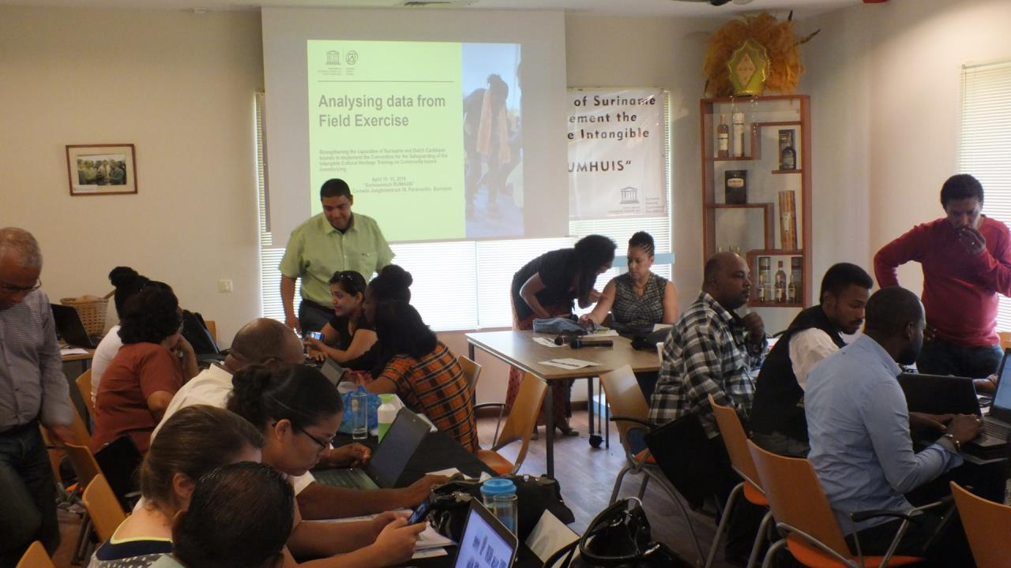
Nouveaux materiaux

Slide 5
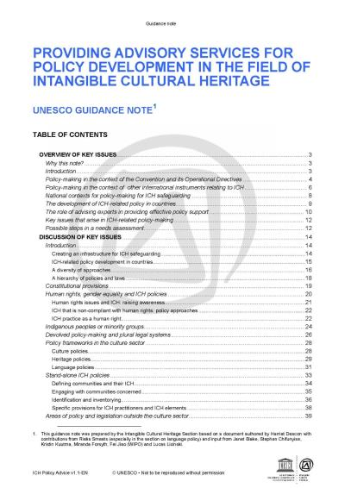
Note d’orientation soutien au développement de politiques
Guide à l’attention des experts
pour fournir des services de conseil aux partenaires nationaux
Anglais, français, espagnol, portugais
À venir: nouveaux modèles

Slide 6
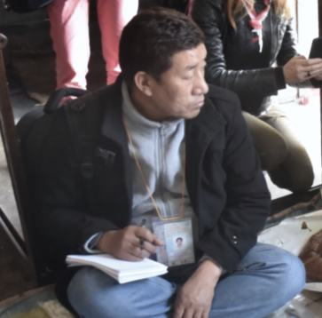
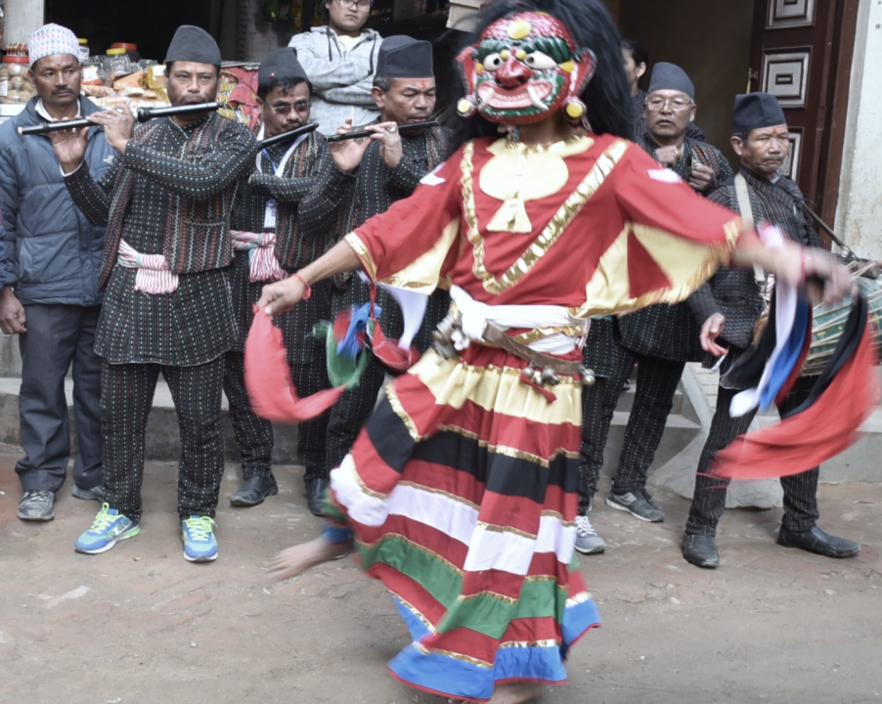
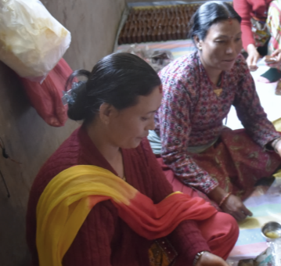
elaboration de politiques
Recent materials: Policy
Unité 10 (partie de l’IMP) et unité 55
13 études de cas
Les matériaux pour les ateliers de 3 à 5 jours peuvent combiner plusieurs thèmes
Anglais, français et espagnol

Slide 7
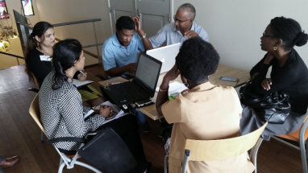
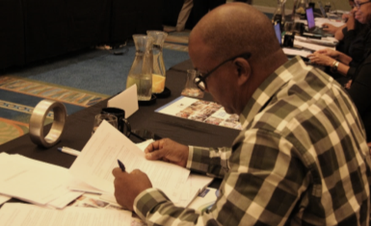
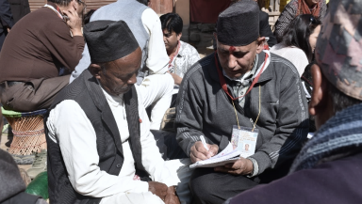
Mise a jour: candidatures
Réflexion sur les effets recherchés + 2 études de cas
Candidatures fictives améliorée + consentements des communautés et extraits de l’inventaire
Candidatures fictives multinationales
Anglais et français

Slide 8
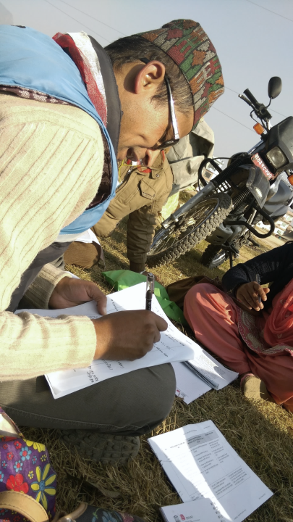
Elaboration de plans de sauvegarde
Atelier de 5 jours
Unité 45: Introduction
Unité 46: Scénarios and jeux
Unité 47: Session de clôture
Anglais, français et espagnol

Slide 9
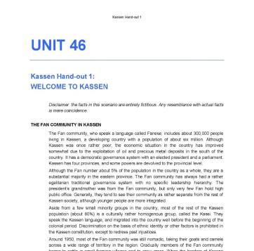
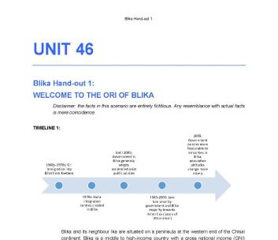
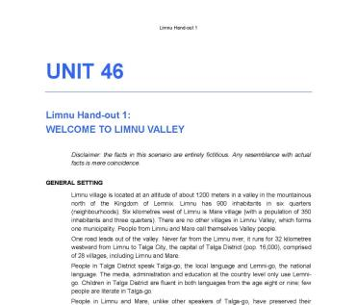
3 scenarios, 2 facons de “jouer”
3 scénarios: Kassen, Limnu, Blika
Versions avec et sans jeu
Les facilitateurs choisissent le scénario le plus approprié

Slide 10
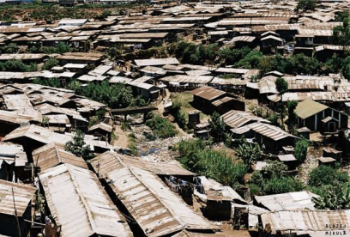
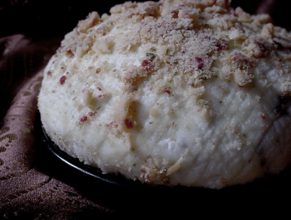
Kassen
Minorité: les “Fans”
Zones périurbaines et rurales
Pays à revenu moyen
Plan de sauvegarde pour le fromage fanoko
1 à 1.5 jour
Notes:
Sustainable development
Intellectual property issues

Slide 11
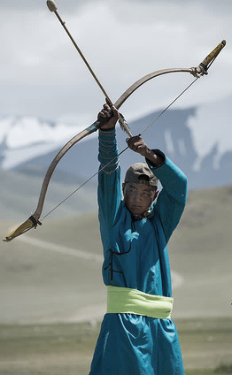
Blika
Communauté immigrée: les “Oris”
Pays à revenue moyen ou élevé
Grandes villes
Réunion pour proposer des éléments de PCI pour l’inventaire + élaboration d’un plan de sauvegarde
2 jours
Notes:
Blika ICH Council, preliminary inventory
Ori SafeCom meeting to propose ICH for inventory + plan for endangered ICH

Slide 12
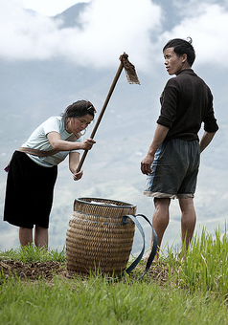
Limnu
2 villages dans une vallée écartée
Pays à faible revenu ou milieu rural dans un pays à revenu moyen
Définition des éléments + préparation d’un plan de sauvegarde
1,5 à 2 jours
Notes:
‘The long week’, ‘Festival of the Clouds’
Role of Council of Elders, associations of people sharing the same occupation
Environmental, societal and infrastructural problems
Outmigration, unemployment

Slide 13
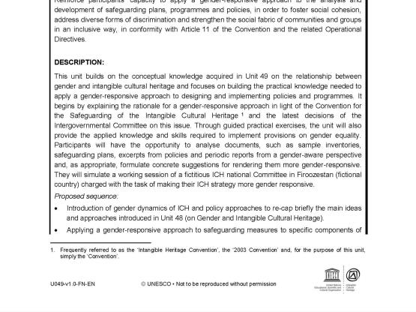
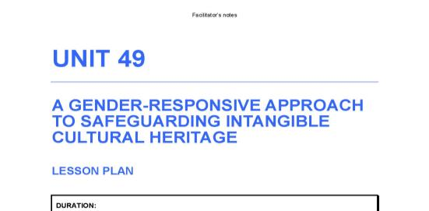
Genre
2 unités et 6 études de cas
Unité 48: Genre et PCI
Unité 49: Une approche sensible au genre pour la sauvegarde du PCI
Anglais, français, espagnol, arabe
Atelier de 2 jours
ou
combiné à d’autres formations
Notes:
The objective of Unit 48 is to develop awareness of the gender dynamics involved in the creation, practice, enactment, transmission and safeguarding of intangible cultural heritage and, at the same time, build the knowledge and skills required to analyse and explain why intangible cultural heritage is decisive for the creation and transmission of gender roles and identities. Moreover, enable participants to understand the dynamic nature of these processes, and the opportunities to move towards greater gender equality and overcome gender-based discrimination through the practice of intangible cultural heritage.
6 case studies:
An indigenous Andean textile art
Two examples of ICH and conflict prevention/resolution
Ritual and performance art of a non-mainstream gender group
Mindusian traditional dance performance
A shamanistic ritual and its associated ceremony
Gender roles in the case of the 1st Order practice
The objective of Unit 49 is to reinforce participants' capacity to apply a gender-responsive approach to the analysis and development of safeguarding plans, programmes and policies, in order to foster social cohesion, address diverse forms of discrimination and strengthen the social fabric of communities and groups in an inclusive way, in conformity with Article 11 of the Convention and the related Operational Directives.
9 hand-outs

Slide 14
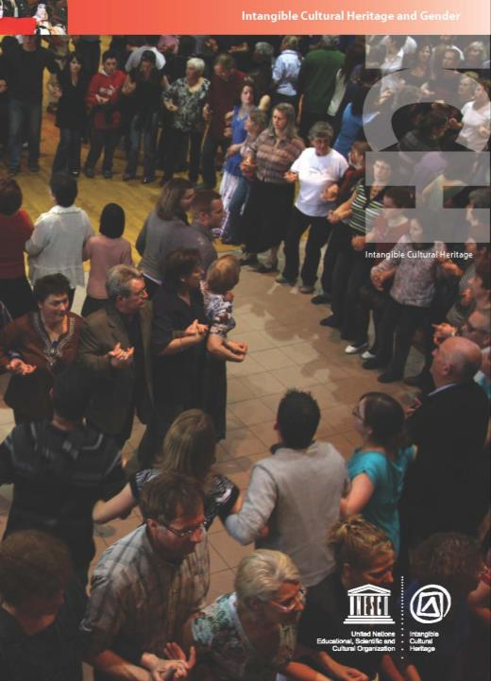
Le concept du genre et le PCI
Devéloppement des identités de genre
Evolution des rôles de genre et des relations entre les genres
Diversité des concepts de genre
Egalité des genres
Genre et sauvegarde
Analyse selon le genre
Notes:
Creating gender identities Values, norms and rules related to gender are diverse among societies, communities and groups. All intangible cultural heritage expressions carry and transmit knowledge and norms related to the roles and relationships between and within gender groups in a given community. In such a way, intangible cultural heritage is a privileged context for shaping gender roles and identities and transmitting them. Intangible cultural heritage and the construction of one’s gender identity are therefore inseparable. A simple and common example: Traditional foodways are in many communities a domain where women hold a prominent role. Central to this practice is the social relationship between mothers and daughters: the daughters observe, learn and join their mothers in carrying out the task. Taking on this specific role gradually and through repetition becomes part of their identity as women.
Evolving gender roles and relations
Gender roles, however, are not static. Like intangible cultural heritage, they are constantly changing and adapting to new circumstances. Communities ‘negotiate’ their gender roles and norms over time, and many gender-specific traditions that were the exclusive domain of one gender group in the past have since been opened by the community to include other gender groups. Intangible cultural heritage plays an important role in the creation and dissemination of gender-related values and norms, and their transformation. The motivation for changing a practice can be pragmatic, such as to find a solution to a specific threat. It can also be principles-based, to promote equal opportunities.
Another factor for gender-related changes concerns effective participation in the negotiation process and the issue of who has influence. Decision-making about transmission and safeguarding of intangible cultural heritage does not happen in a vacuum but is embedded in a larger system of gender- and power relations. These norms and relationships govern behaviours, relationships and negotiation processes. They are frequently questioned from within a community to allow greater participation and balance in power relations.
Diversity of gender concepts
As intangible cultural heritage varies from community to community, gender conceptions can be equally diverse. There is not one globally universal understanding of gender. Moreover, gender roles and values have to be analysed from the community perspective. Some native North American tribal groups, for example, recognize up to seven different genders, including transgender and double-spirited people. Several European and Asian societies today recognize three or more gender groups. Often age and gender are closely connected, for instance, the gender-related norms and expectations regarding children’s behaviour are different from those that apply to adolescents and adults. As gender roles and values evolve in a society, these changes may lead to adaptations in practices and expressions of intangible cultural heritage.
Gender equality
As the gender relations of communities are constantly evolving, they create opportunities to move towards gender equality and to overcome gender-based discrimination through the practice of intangible cultural heritage. Equality and non-discrimination are core human rights principles. When considering gender equality and intangible cultural heritage, a human rights perspective concentrates not on the differences between gender roles, but whether they deny the dignity and well-being of those involved. The Convention on the Elimination of Discrimination Against Women (CEDAW ) does not view traditional cultural attitudes and practices themselves – or even differentiated roles assigned to men and women – as the challenge, but rather the specific negative consequences that may result from them, such as applying stereotypical roles to women that disempower them or otherwise harm their interests. When speaking of gender-based discrimination in intangible cultural heritage, extreme caution is required to avoid an overly simplistic view that discounts practices simply on the basis that one gender group practises them. It is a reality in many – if not most – societies worldwide that a significant number of social and cultural practices are segregated (on the basis of age, gender and other criteria) and this alone should not be taken as a sign that discrimination is taking place. Only through a gender-based analysis can communities recognize whether their intangible cultural heritage – a social practice, ritual, knowhow, oral tradition, etc. – is actually discriminatory. Moreover, it is not necessary that gender segregation be involved for discriminatory aspects to be identified.
Gender in safeguarding
Understanding the intimate relationship between gender relations and intangible cultural heritage can open new avenues for effective safeguarding. The emphasis on the central role of the community in safeguarding is a crucial opportunity in this regard. As communities and groups are not homogeneous, it is important to identify the diversity of actors and their roles in relation to specific intangible cultural heritage, paying due attention to gender considerations. Otherwise, new possibilities for effective safeguarding risk remaining invisible and untapped. Gender and intangible cultural heritage interact in complex and, to a degree, mutual ways through enactment, practice, transmission, etc. Therefore, safeguarding approaches have the potential to impact gender relations, and to both strengthen and weaken the status and recognition of communities and their individual members or sub-groups. The Convention foresees a number of safeguarding measures at national and international levels. At national level they include identifying and inventorying intangible cultural heritage, establishing institutional, policy and legal frameworks, and developing safeguarding plans, research, and awareness-raising and education initiatives. At the international level, States Parties may request International Assistance for safeguarding and submit nominations for inscription on the Convention’s Lists or proposals for the Register of Best Safeguarding Practices.
Mainstreaming gender
While the text of the Convention for the Safeguarding of the Intangible Cultural Heritage is not explicit about gender, the governing bodies have given increased attention to gender issues, and have requested that States ‘pay special attention to the role of gender’ when reporting on the status of inscribed elements inscribed on the Lists of the Convention (ITH/14/9.COM/Decisions). Upon their request, all forms and instructions regarding the international cooperation mechanisms and periodic reporting of States Parties on implementing the Convention now contain references to gender, and the Convention’s Operational Directives have been amended accordingly. The recently adopted chapter of the Operational Directives on intangible cultural heritage and sustainable development contains a specific paragraph on gender equality with reference to the 2030 Agenda for Sustainable Development that includes a goal on gender equality and women’s empowerment (Goal 5). As a next step, UNESCO mainstreamed gender throughout the core capacity-building curriculum on implementing the Convention at national level that it developed in the context of its global capacity-building programme. The intention of the gender mainstreaming is to sensitize governments and other stakeholders to gender issues in safeguarding ICH and provide guidance on how to take into account gender equality in the design and implementation of safeguarding measures, while respecting values recognized by communities, groups and individuals and sensitivity to cultural norms. The importance of paying special attention to gender equality is also explicitly mentioned in the recently adopted Ethical Principles for Safeguarding Intangible Cultural Heritage that have been elaborated in the spirit of the 2003 Convention for the Safeguarding of the Intangible Cultural Heritage and existing international normative instruments protecting human rights and the rights of indigenous peoples.

Slide 15
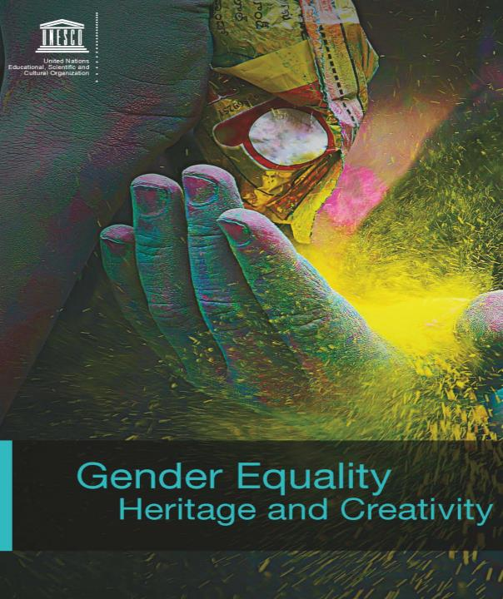
Notes:
As gender relations of communities are constantly evolving, they create opportunities to move towards gender equality and to overcome gender based discrimination through the practice of ICH.
Equality and non-discrimination are core human rights principles. When considering gender equality and ICH, a human rights perspective concentrates not on the differences between gender roles, but whether they deny the dignity and well being of those involved.
Understanding the relationship between gender and ICH is significant for effective safeguarding in two ways: it can open new avenues to safeguarding and can strengthen steps towards gender equality. Mainstreaming gender in safeguarding is therefore not only an opportunity, but important from an ethical perspective.

Slide 16
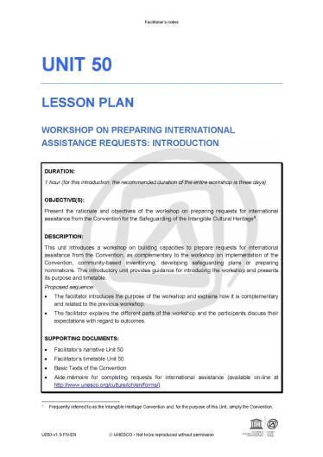
Assistance Internationale
Atelier de 2-3 jours (peut se combiner à d’autres ateliers)
Même méthodologie que pour l’atelier sur l’élaboration de candidatures
Unité 50: Introduction
Unité 12: Coopération et assistance internationales
Unité 51: Evaluation d’exemples de demandes
Unité 52: Session de clôture

Slide 17
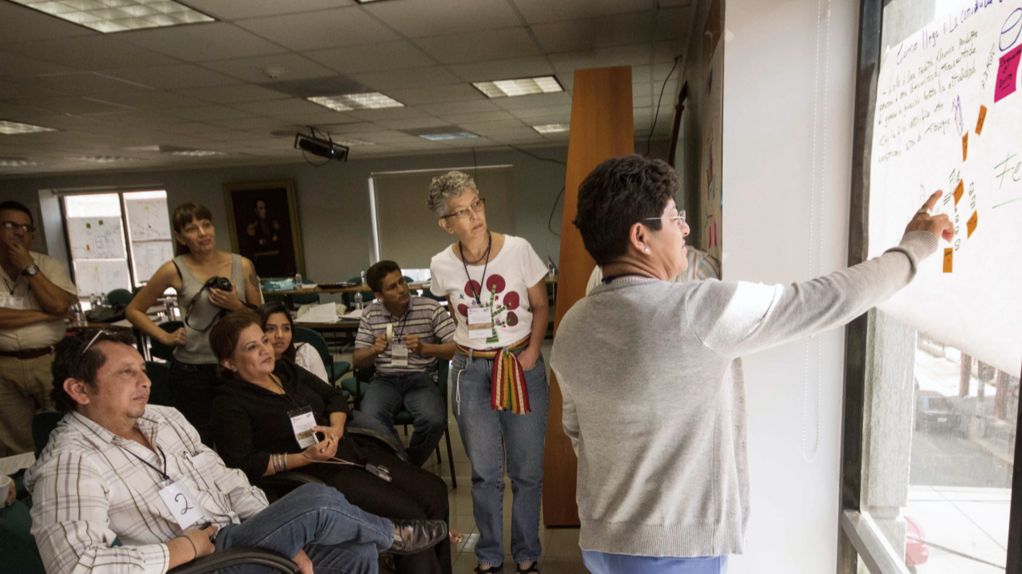
Demandes fictives
1: Projet pilote d’inventaire
2: Un programme de renforcement des capacités
3: Projet de sauvegarde pour un élément du PCI
Notes:
Mock request 1: Pilot inventorying project
Imaginary country; South-East Asia
First province to start inventorying
Mock request 2: 24-month capacity-building program
Imaginary country; Latin America
Planned series of workshops
Mock request 3: Safeguarding an expression of ICH
Imaginary country; Southern Africa
Satsowa: reciprocal communal labour amoung the Sowara people

Slide 18
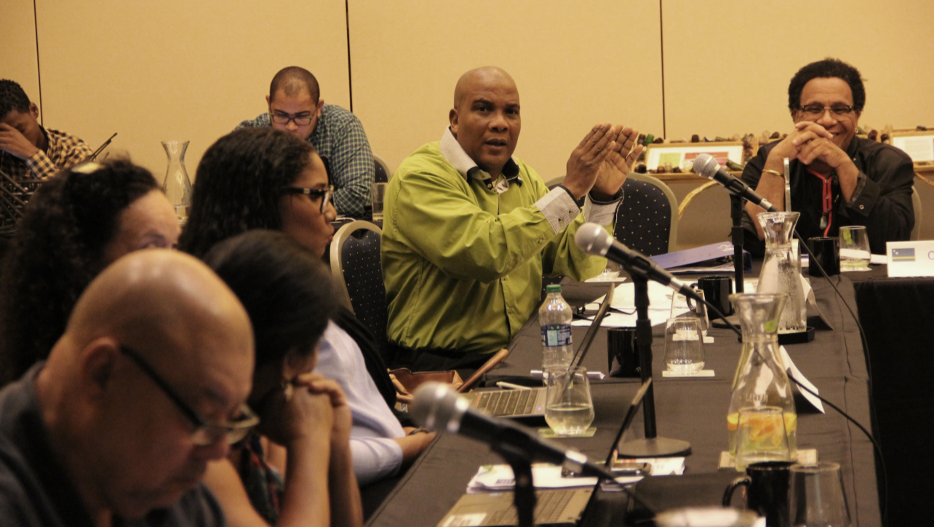
Bientot !

Slide 19
Materiaux a venir
Une unité et des études de cas sur l’éthique
Nouvelles études de cas sur le genre et les politiques
Tutoriels vidéo sur les politiques et le genre
Matériaux mis à jour sur l’élaboration d’inventaire
Nouveaux matériaux sur le développement durable

Slide 20
Enquête sur l’utilisation des matériaux à venir
Formulaire de demande d’accès aux matériaux
Plus de 260 demandes d’accès aux matériaux
Information de base recueillie à l’inscription
Fin 2017: enquête sur l’utilisation des matériaux
Qui demande l’accès?
Notes:
Please note that the numbers used for this slide and the following slides are rough. They were based on the number available at that time. At the time of the survey, most likely more people will have requested access.
The purpose of these slides is to share some rough information, not exact figures. More specific information will be shared after the completion of the survey (To be undertaken in the second half of 2017)

Slide 21
Occupation professionnelle
Notes:
Student: PhD and MA/MSc students
Academic: Professors, researchers and lecturers
Professional working in culture: Museums, Anthropologists, etc.
Professional working in education: Teachers, Literacy specialists, etc.
Other: Journalists, Lawyers, Doctors, Accountants etc.
Etudiants: doctorants et étudiants de MA/MSc
Universitaires: professeurs, chercheurs et autres
Professionnel du monde de la culture: musées, anthropologues, etc.
Professionnel du monde de l’éducation: professeurs, spécialistes de l’alphabétisation
Autre: journalistes, avocats, docteurs, comptables, etc.

Slide 22
D’ou viennent-ils?
Ou utiliseront-ils les materiaux?
Notes:
Many times within groups there are differences between the country where someone is from, and the country where they are working. For example, an Australian requesting access to the materials is working in Nepal (both in the same group). Those differences aren’t visible in this chart.

Slide 23
Pourquoi ont-ils demande acces?
Notes:
These are rough categories based on reasons that people gave. For example ‘interest in ICH’ includes people who gave answers such as ‘my NGO works on ICH issues’ or ‘I am a traditional wooden boat maker’ that don’t really specify anything reason beyond interest.
Projects – they are developing or already working on a project on related to ICH
Reference materials – they simply wrote ‘reference’ or ‘resource’ or said they wanted to consult the materials regarding a specific question, for example
Use in education – they are someone who works primarily in education but the materials are useful for them, for example a literacy specialist looking to incorporate ICH in their work
Reference material (government) – they mentioned they were using the materials as reference for their work on policy or other government activities, for example
Preparing nominations – they are preparing a nomination and wanted some reference materials
Other – UNESCO consultant, UNESCO (not ITH), Category II centres, etc.

Slide 24
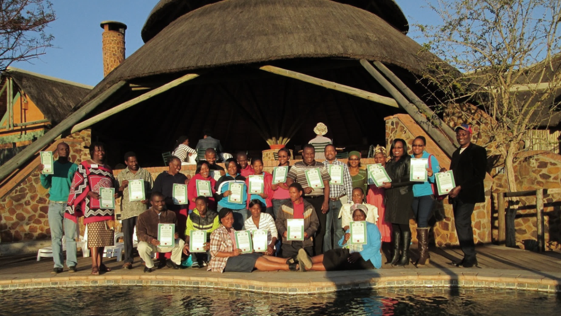
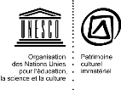
Merci!

