Slide 1
Collaboration with UNESCO in the Global Capacity Building Programme
CRIHAP
July 6th 2015

Slide 2
I. Briefing on Global Capacity Building Strategy under the framework of the 2003 Convention

Slide 3
Concept and definition:
" a comprehensive, long-term engagement with Member States to create institutional and professional environments for safeguarding intangible cultural heritage “,
or "to support States in creating institutional and professional environments favourable to the sustainable safeguarding of intangible cultural heritage and in promoting broad public knowledge and support for the Convention’s concepts and objectives".

Slide 4
This global strategy entails a long-term and multi-faceted approach that addresses:
1) revision of policies and legislation
2) redesign of institutional infrastructures
3) development of inventory methods and systems
4) full involvement of diverse stakeholders
5) technical skills required to safeguard intangible cultural heritage.

Slide 5
previous 4 axes:
i) developing training content and materials
ii) strengthening the network of expert facilitators
iii) delivering capacity-building services to beneficiary countries
iv) monitoring and evaluation.

Slide 6
(i) Capacity-building services effectively delivered to beneficiary countries.
(ii) Follow-up and evaluation mechanism established for capacity-building activities to gather data about their effectiveness.
(iii) Facilitators’ network and relevant education institutions strengthened.
(iv) Content and format of the capacity-building programme reviewed and adapted to ensure that it responds to the major implementation challenges at the national level.
(v) Appropriate capacity-building formats and approaches developed and tested to support countries in the development of legislation and policy.
(vi) Capacity-building programme planning, implementation and monitoring strengthened through improved information systems.

Slide 7
i) Capacity-building services effectively delivered to beneficiary countries
completed activities
on-going activities
activities planned
Beneficiary countries of capacity-building activities since 2009

Slide 8
Question/Wish List (1)
1. Is it possible to include qualified capacity building training workshops jointly organized by CRIHAP and UNESCO field offices into UNESCO capacity building activities?

Slide 9
Four regular courses were identified as most urgent to bring Member States to a common level of knowledge and experience and in order to provide them with the necessary tools to take full advantage of the 2003 Convention:
(a) ratification
(b) implementing the Convention at the national level
(almost 1/3)
(c) community-based inventorying (2/5)
(d) elaborating nominations to the Lists of the Convention

Slide 10
Question/Wish List (2)
2. Appeal for a closer, smoother and more efficient interactive relationship and mechanism among UNESCO HQs, field offices, C2Cs and counterparts of member states.

Slide 11
(ii) Follow-up and evaluation mechanism established and implemented for capacity-building activities to gather data about their effectiveness

Slide 12
(iii) Facilitators’ network and relevant education institutions strengthened
www.unesco.org/culture/ich/en/capacitation
Review Meeting of UNESCO's Global Strategy for Strengthening National Capacities for Safeguarding ICH (Beijing, 2012)
2 Training-of-Trainers Workshops (Beijing, 2011; Shenzhen, 2015).

Slide 13
Question/Wish List (3)
3. Could C2Cs be involved more in the training-of-trainers workshops and the expansion of the facilitators' network?

Slide 14
(iv) Content and format of the capacity-building programme reviewed and adapted
a. ratification
b. implementing the Convention at the national level
c. community-based inventorying
d .elaborating nominations to the Lists of the Convention
e. elaborating safeguarding plans
f. intangible cultural heritage and sustainable development
g. intangible cultural heritage and gender
h. revision of policies and legislations

Slide 15
Question/Wish List (4)
4. Curriculum materials be translated into more different languages. Limited access to the training materials failed to satisfy the tremendous needs from basic-level communities, and materials in only English, French, Spanish, Arabic, Russian, Portuguese and Uzbek are seemly not enough.

Slide 16
(v) Appropriate capacity-building formats and approaches developed and tested to support countries in the development of legislation and policy

Slide 17
Question/Wish List (5)
5. To discuss capacity building strategy of safeguarding ICH with a broader cultural background, and to link UNESCO 1972, 2003 and 2005 Conventions with an overall ecological environment.

Slide 18
(vi) Capacity-building programme planning, implementation and monitoring strengthened through improved information systems

Slide 19
(vii) Mobilizing resources for the implementation of the capacity-building strategy
http://en.unesco.org/partnerships/partnering/building-capacities-protect-promote-and-transmit-heritage
http://www.unesco.org/culture/ich/en/Category2/

Slide 20
Question/Wish List (6)
6. Wish to have more interactive exchange and cooperative opportunities among C2Cs.

Slide 21
II. Activities of CRIHAP

Slide 22
1. at least 12 countries including China from 2012 through 2014;
2. covering at least 4 countries in the Asia-Pacific region from2015;
3. 10-20 people for each workshop, 160-320 accumulatively by the end of 2015.
---CRIHAP Medium-Term Development Plan (2011-2015)
10 training workshops in the South Pacific region, Southeast Asia, Northeast Asia, etc., covering 21 countries, involving nearly 300 persons as direct beneficiary.
---June, 2015

Slide 23
1. CRIHAP plans and allocates training resources according to the current status and actual demand with full respect to the suggestions of UNESCO HQs, 7 UNESCO cluster offices and 7 national offices.

Slide 24
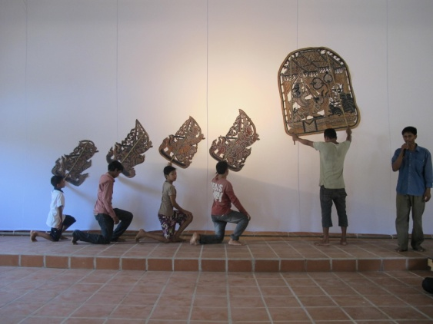
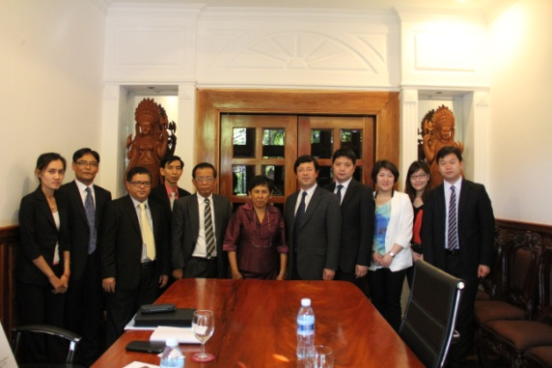
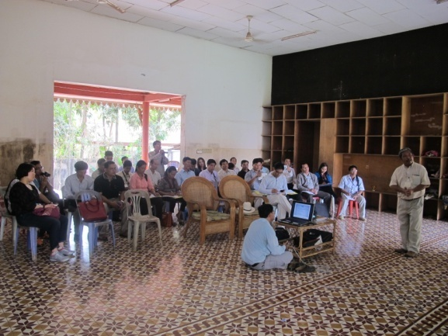
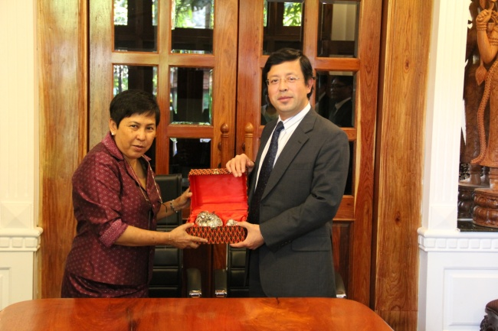
Workshop on Community-based Documentation and Inventorying for Intangible Cultural Heritage
Siem Reap, Cambodia, 2014

Slide 25
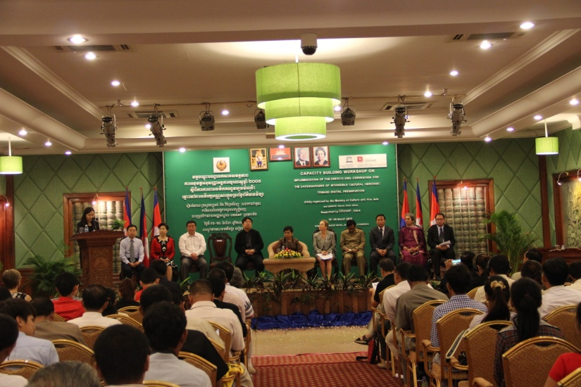
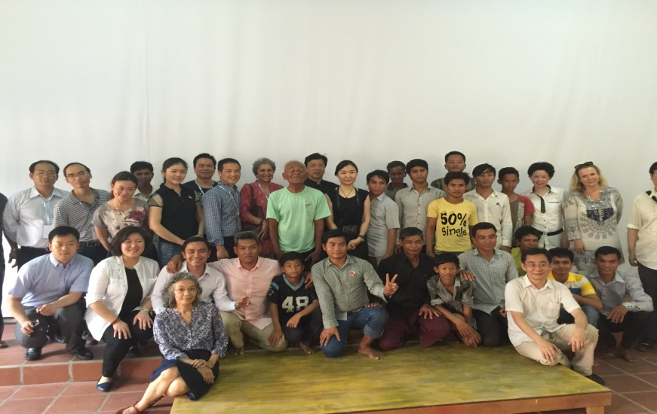
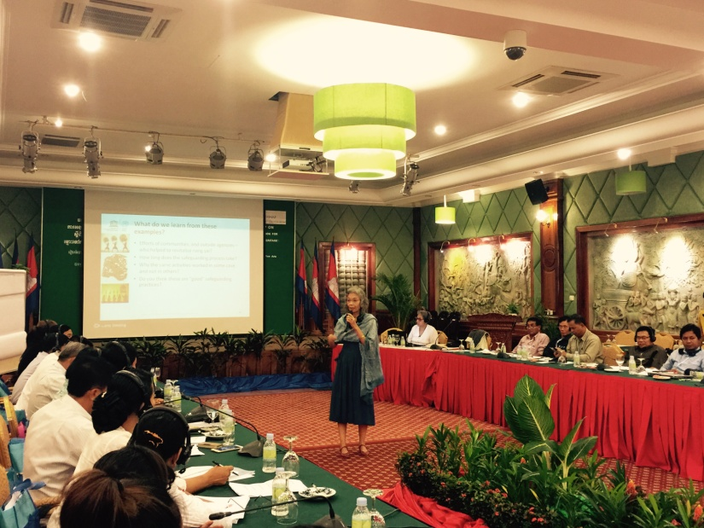
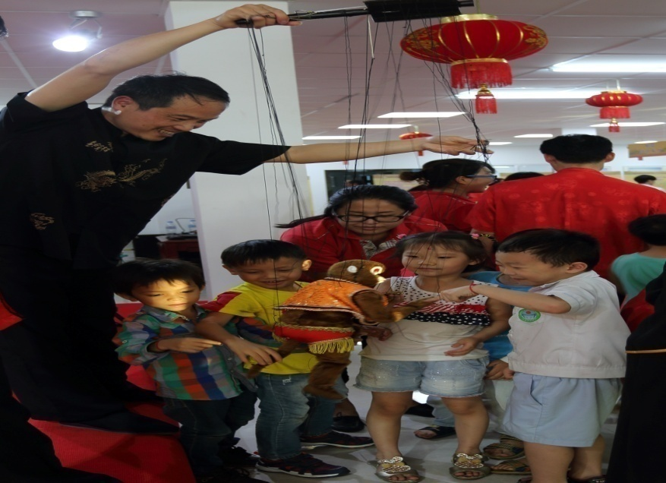
Workshop on Implementation of the Convention for the Safeguarding of the ICH: Digital Preservation
Siem Reap, Cambodia, 2015

Slide 26
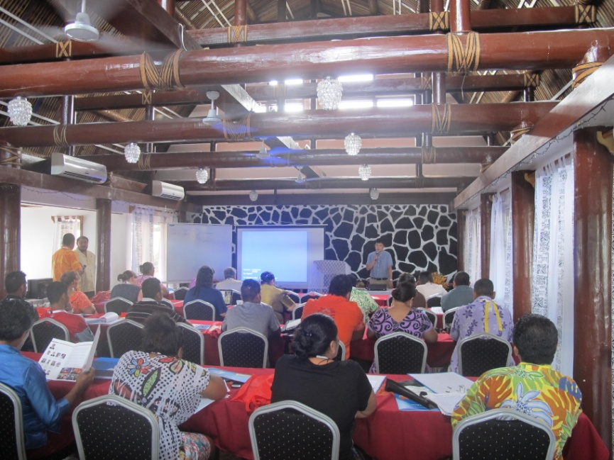
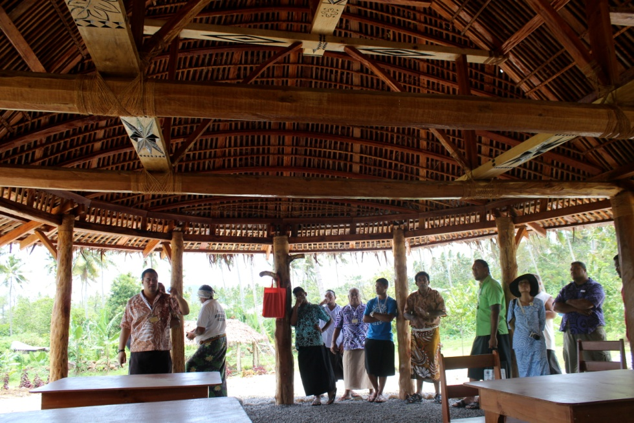
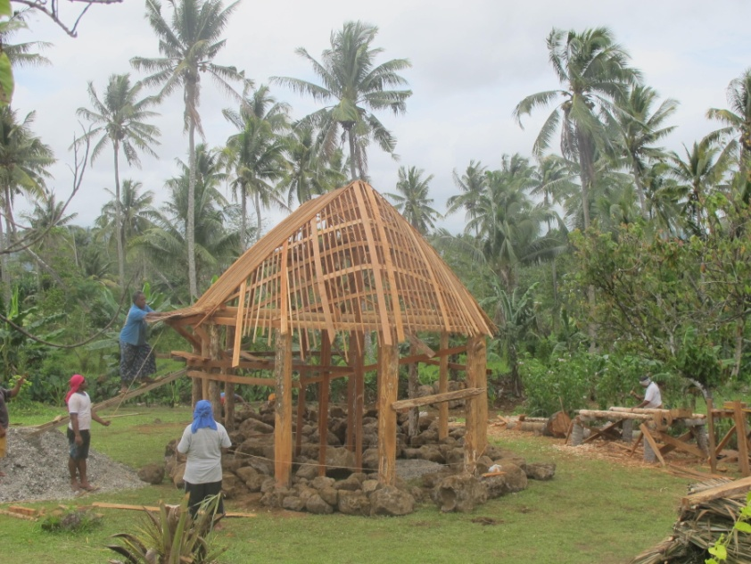
Workshop on Revitalization of Indigenous Architecture and Sustainable Development of Building Skills in South Pacific
Apia, Samoa, 2014

Slide 27
Question/ Wish List (7)
7. Cooperation between CRIHAP and these offices as well as relevant category 2 centres needs to be strengthened, so as to jointly complete the collection of information on training needs for ICH safeguarding, design and implementation of training plans, and to improve pertinence and efficiency of the capacity building training activities.

Slide 28
2. Formulate a 3-year
(2015-2017) training guidance

Slide 29
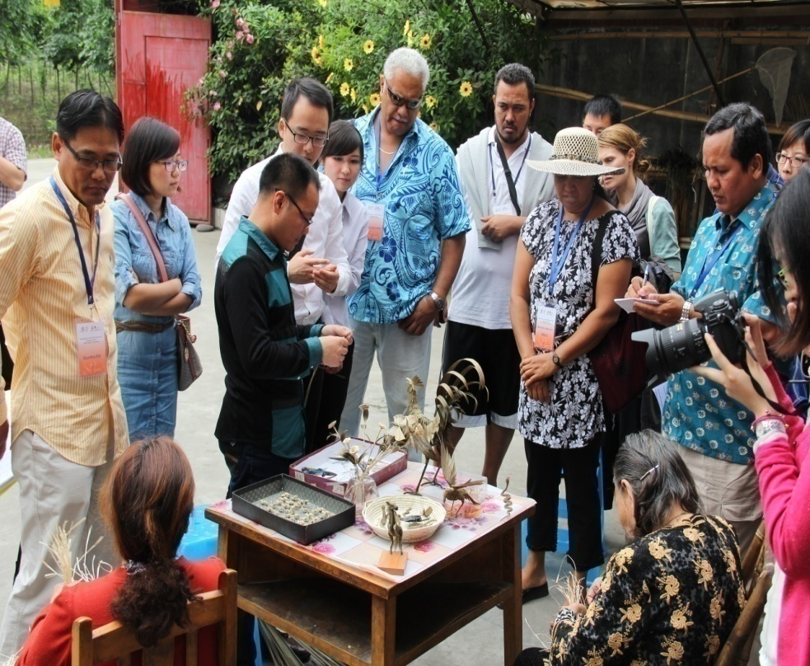
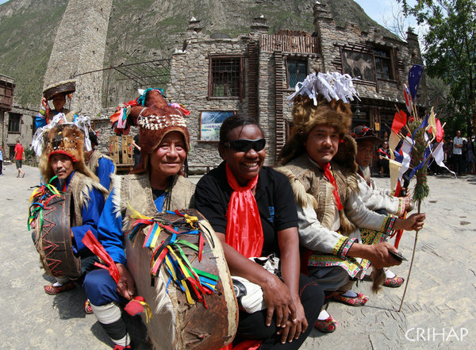
Workshop on Community-based Documentation and Inventorying for Intangible Cultural Heritage
Chengdu, China, 2014

Slide 30
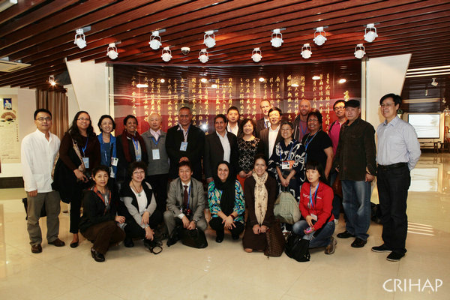
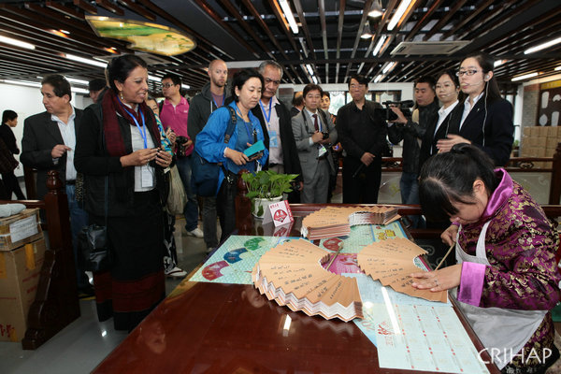
Workshop on the Safeguarding and Sustainable Development of Traditional Craftsmanship in the Asia-Pacific Region
Hangzhou, China, 2013

Slide 31
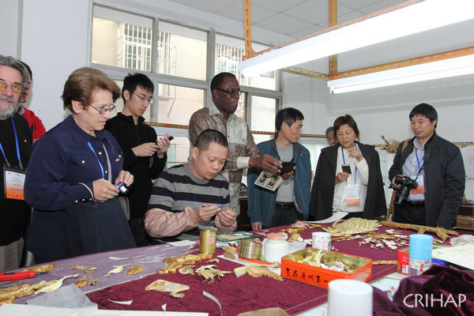
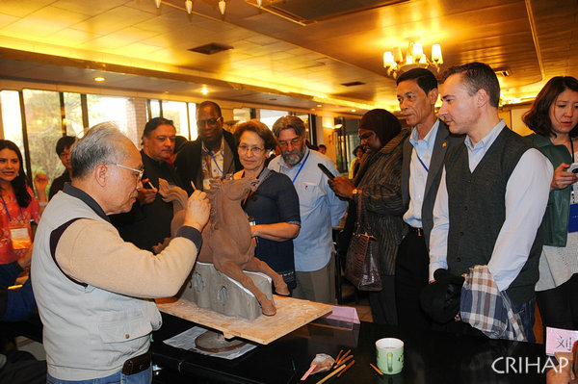
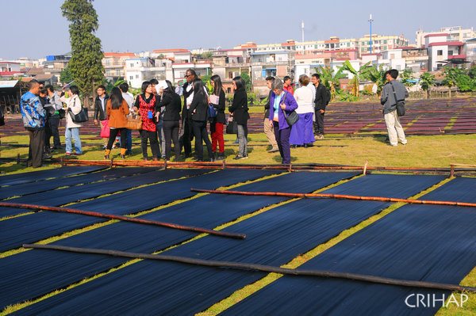
Workshop on Safeguarding and Promotion of Traditional Festivals
Chaozhou and Foshan, China, 2013

Slide 32
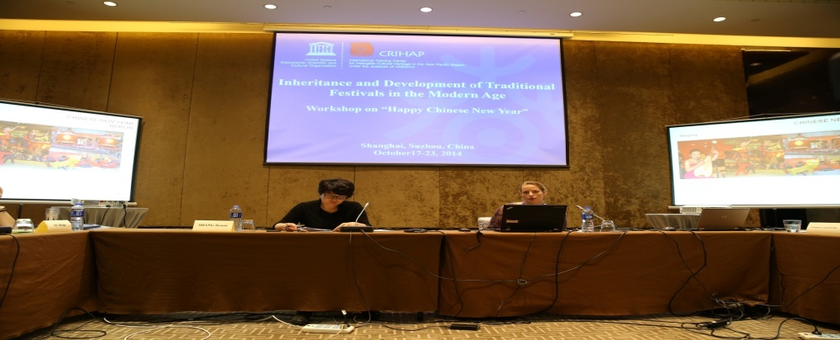
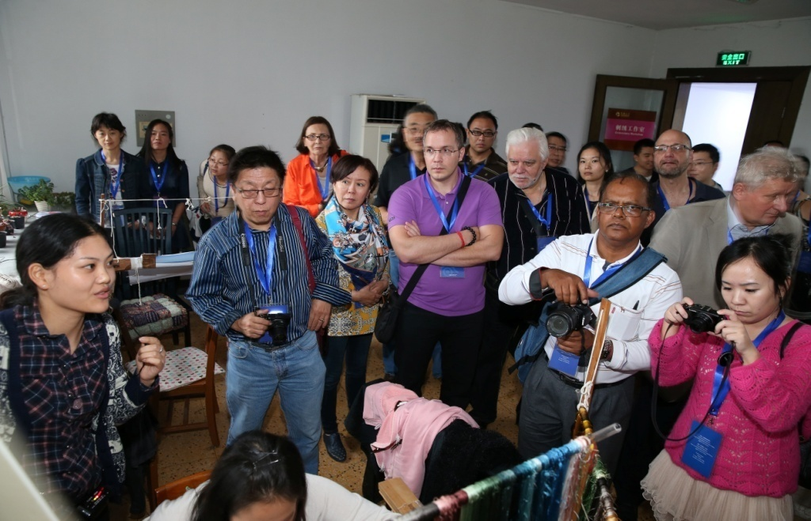
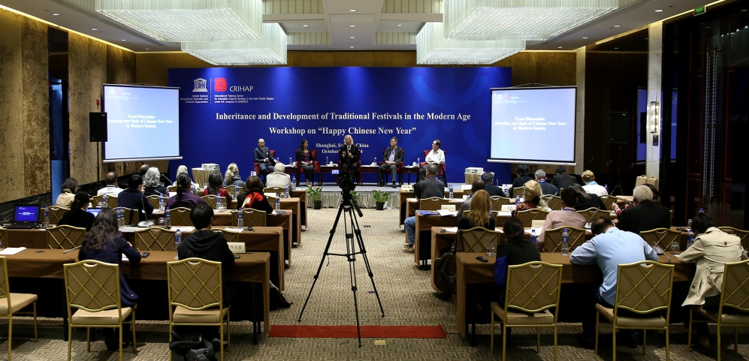
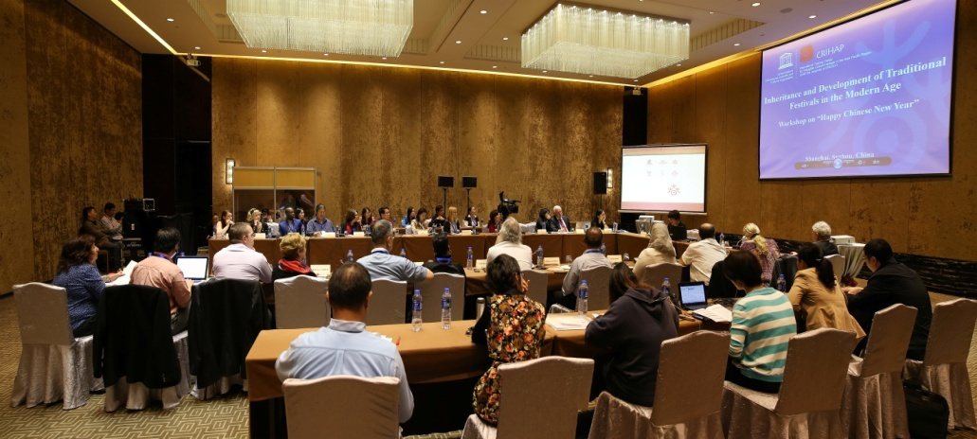
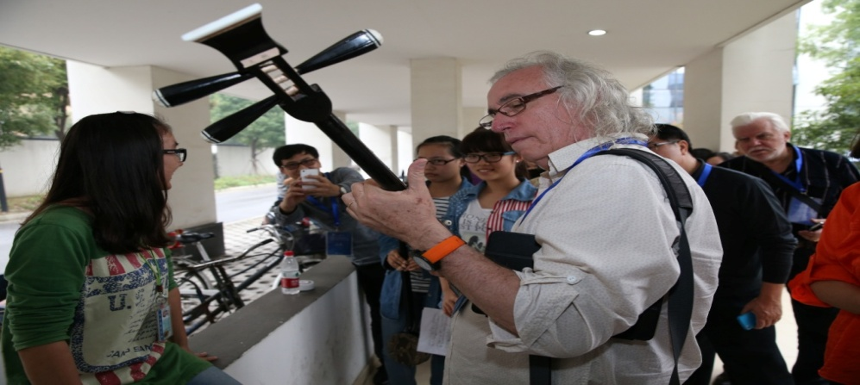
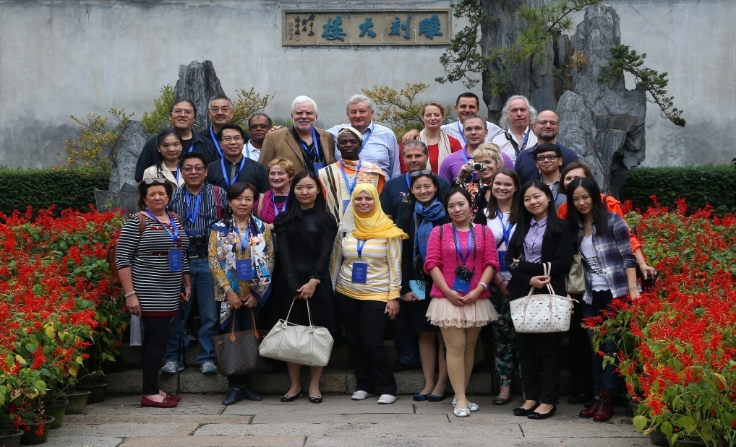
Workshop on Inheritance and Development of Traditional Festivals in the Modern Age
Shanghai and Suzhou, China, 2014

Slide 33
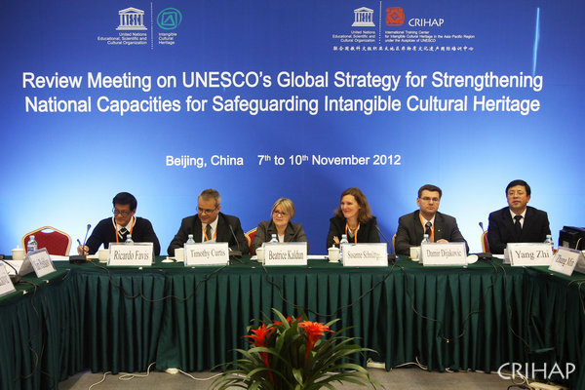
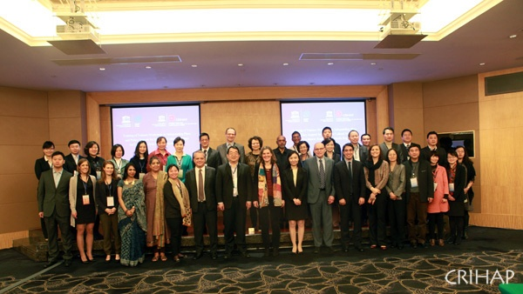
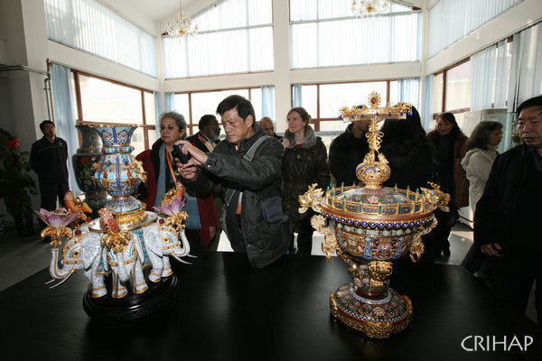
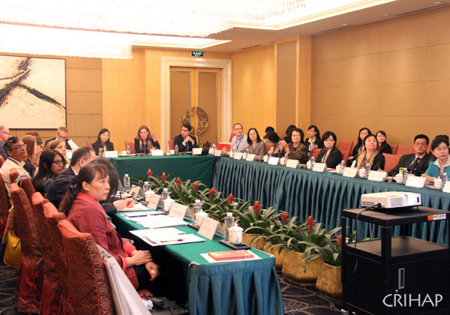
Review Meeting on UNESCO’s Global Strategy for Strengthening National Capacities for Safeguarding Intangible Cultural Heritage
Beijing, China, 2012
The Training of Trainers Workshop
Shenzhen, China, 2015

Slide 34
Question/Wish List (8)
8. How can we balance the demand from member states for thematic ICH training with core curriculum of UNESCO capacity building?

Slide 35
3. Set up a measuring indicator
for the training plan from 2015 -2017

Slide 36
4. Expand CRIHAP’s network of partners
when carrying out training activities
in the Asia-Pacific Region

Slide 37
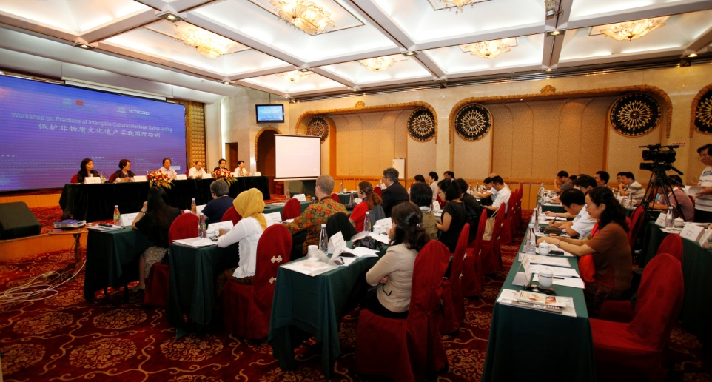
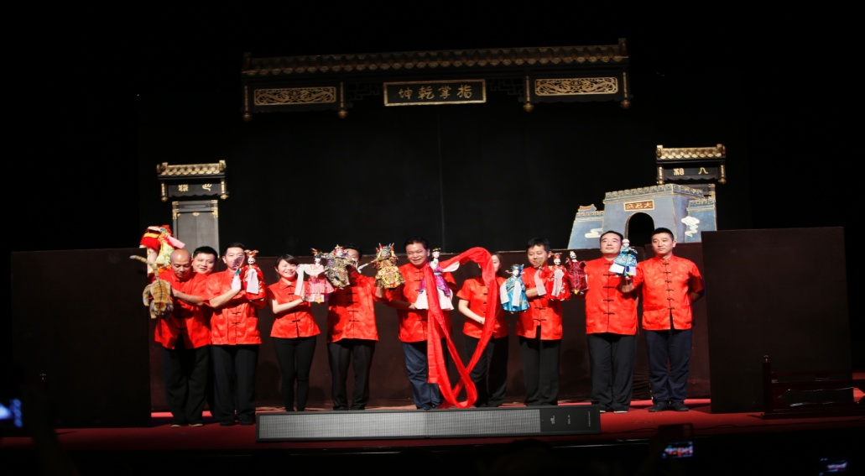
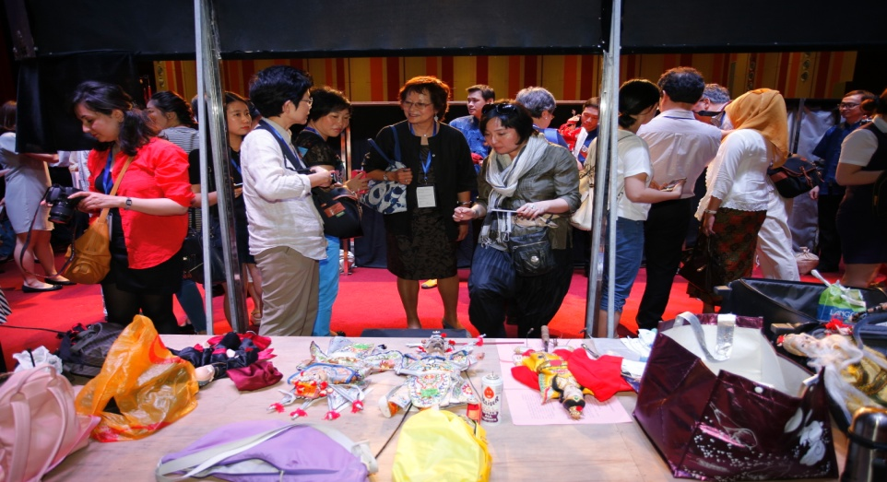
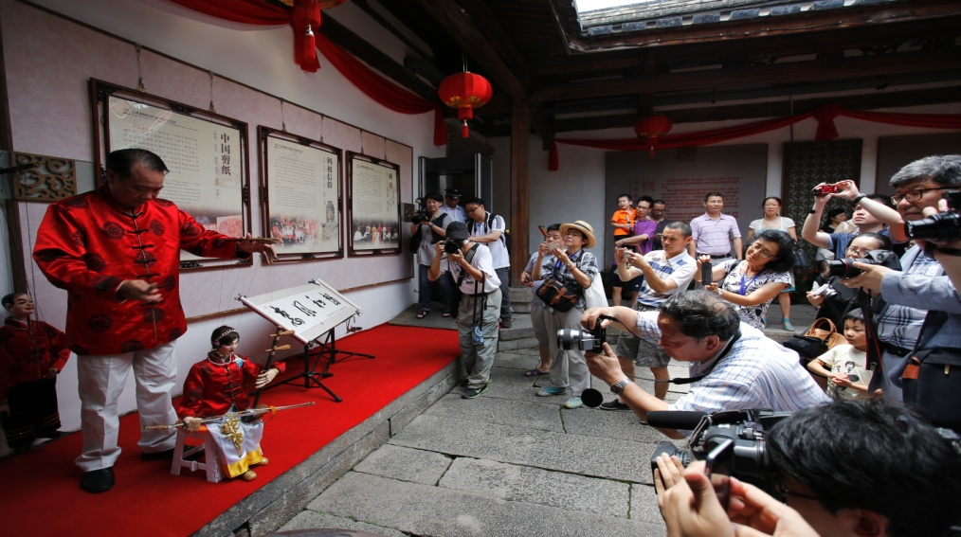
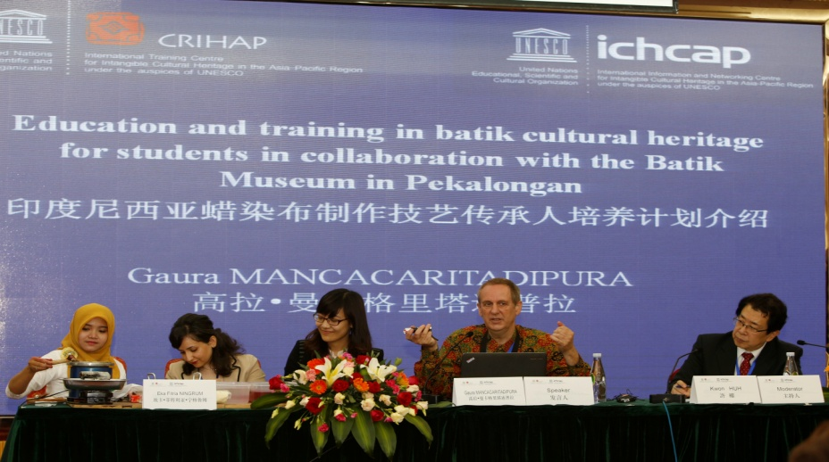
Workshop on Practices of Intangible Cultural Heritage Safeguarding
Quanzhou, China, 2015

Slide 38
1) Education and training in Indonesian batik intangible cultural heritage in Pekalongan, Indonesia
2) Fandango’s Living Museum
http://www.unesco.org/culture/ich/en/Register

Slide 39
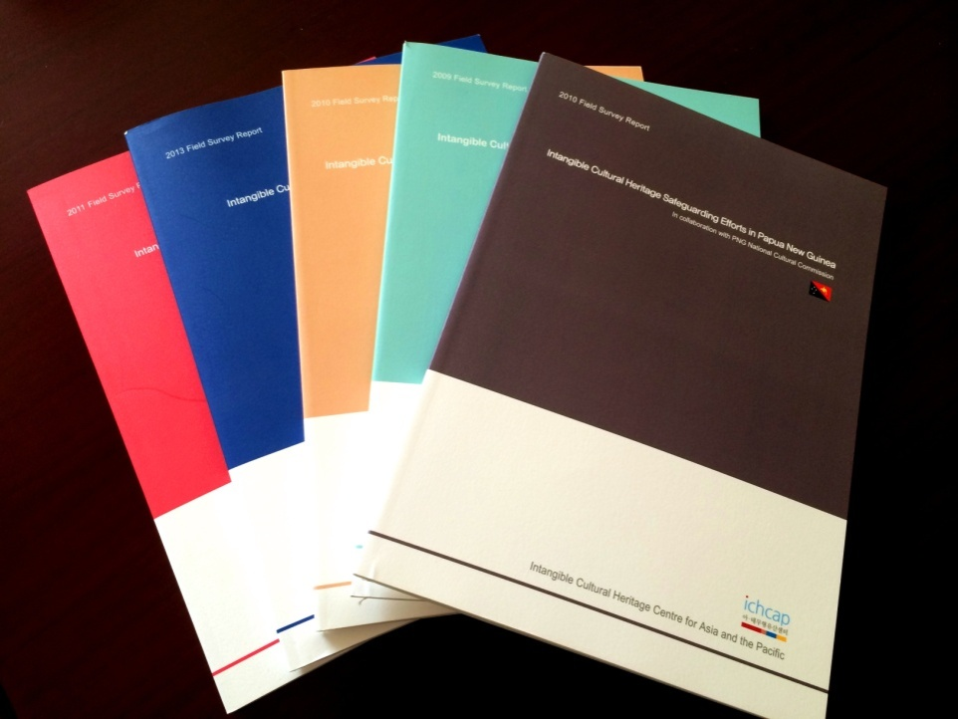
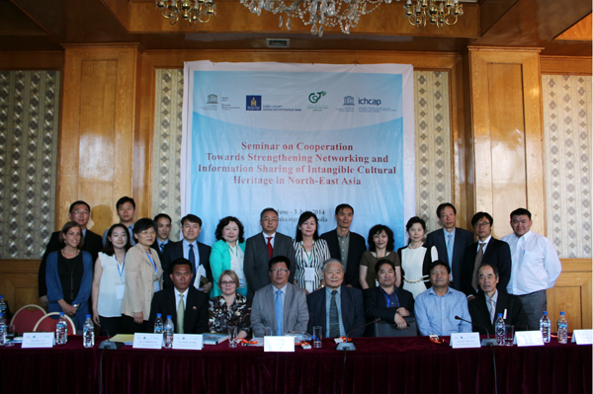

Slide 40
III. Question/Wish List

Slide 41
Question/Wish List : Category A: Activities
1. Recognition of capacity building workshops jointly organized by C2Cs and Field Offices.
5. To link UNESCO 1972, 2003 and 2005 Conventions with an overall ecological environment.

Slide 42
Category B: Materials, facilitators and translation
3. Recommendation of future facilitators from respective region.
4. Capacity building curriculum materials, Registers and Lists be translated into more different languages.
8. Balance the demand from member states for thematic ICH training with core curriculum of UNESCO capacity building.

Slide 43
Question/Wish List : Category C: Relationship
2. A closer, smoother and more efficient interactive relationship and mechanism among UNESCO HQs, Field Offices, C2Cs and counterparts of Member States.
6. More interactive exchange and cooperative opportunities among C2Cs.
7. Cooperation between Field Offices and C2Cs in information collection of training needs, design and implementation of training plans, pertinence and efficiency of the training activities.

Slide 44
THANK YOU !

