Slide 1
CRIHAP 2017 & Beyond
Shiraz, Islamic Republic of Iran
September 10,2017

Slide 2
In 2017 Work Plan
Status
Evaluation and renewal
Ongoing
Evaluation of Cambodia workshops
Ongoing
√
Workshop in Suzhou
Workshop in New Zealand
√
√
600万
明星代言
Workshop in Kyrgyzstan
Workshop in Republic of Korea
√
Workshop in Nepal
√
Workshop in Mongolia
Ongoing
Workshop in Pakistan
Yet to come

Slide 3
1,New DG
Mr. LIANG Bin

Slide 4
Appointment procedures
1 Ministry’s recommendation
2 GB Chair consultancy with UNESCO DG
3 UNESCO DG’s confirmation

Slide 5
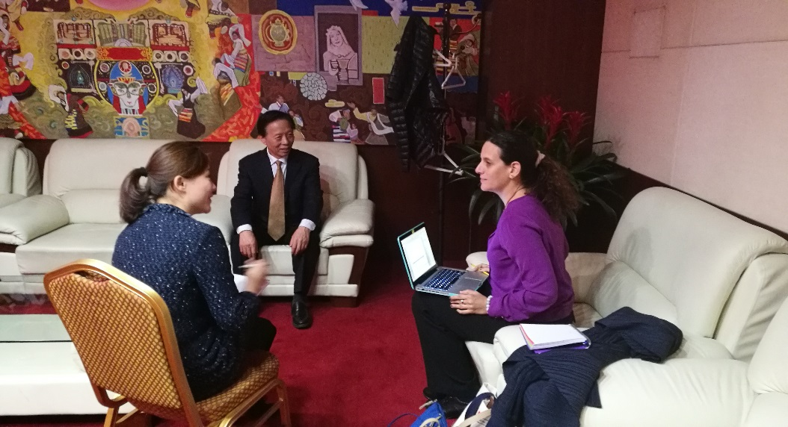
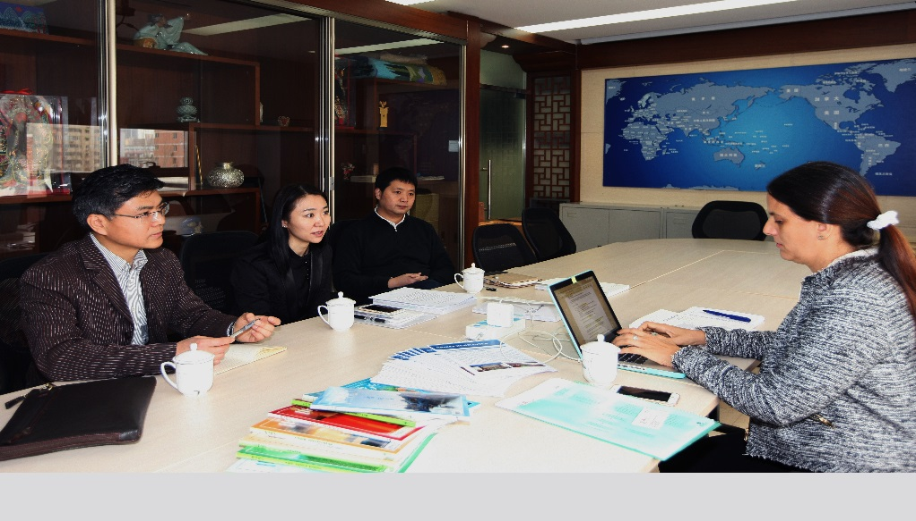
2,Evaluation and Renewal
2017-2018
Field work: February 2018 GB and AC meetings
Stake Holders: UNESCO, Government, CRIHAP

Slide 6
The Centre’s job:
Documents: compiling a booklet of all information needed
Fund: paid in 2017
Interview managements: liaising parties concerned
Logistics: office and transportation

Slide 7
Evaluator’s Recommendation
“It is strongly suggested that UNESCO renew its agreement with the Chinese government”
After that:
Renewal process is looked after by the government and UNESCO
Both sides have agreed on the text of the draft
The 202nd Session Executive Board

Slide 8
3, Evaluation of Combodia Workshops
3 workshops from 2014-2016
Partners: UNESCO Phon Phen Office, Ministry of Fine Arts
Chief Expert: Rahul Goswami
Progress: a meeting held
Expected outcome: a final report by the end of 2017

Slide 9
4,Trainings: Workshop for Russian speaking Facilitators
A UNESCO event, Bishkek, Kyrgyzstan
First one in Central Asia
Trainees:19 Facilitators: Ms. Naila Ceribasic

Slide 10
Workshop for Korea
First one in Korea
First one in cooperation with a C2C
Trainees:30 Facilitators: Mr.Marc Jacobs & Ms.Sangmee Bak

Slide 11
Workshop for Pacific States
Trainees:17
Facilitators: Mr.Sipiriano Dominiko & Ms.Noriko Aikawa- Faure
States non party

Slide 12
Workshop for Nepal
Workshop on Capacity Building of the 2003 Convention: Cultural Policymaking for ICH with Special attention to Disasters
Workshop on Capacity Building of the 2003 Convention: Cultural Policymaking for ICH with Special attention to Disasters
September 4-8, 2017

Slide 13
Workshop for Mongolian Media Practitioners
Workshop on Role of Media for Implementation of the 2003 Convention for the Safeguarding of the ICH in
Workshop on Role of Media for Implementation of the 2003 Convention for the Safeguarding of the ICH in Mongolia
September 11-16, 2017
First one for media practitioners
Follow-up of the seminar 2016

Slide 14
Workshop for Pakistan
Yet to come (November, 2017)
2nd one in the three year plan

Slide 15
Work Plan 2018
Under formulation
Considerations:
One workshop in each sub-region
Experts training for China
More pertinent: for specified group of personnel, media, officials, teachers
Prior survey
TOT in Asia Pacific?

Slide 16
Challenges
Local logistics: governments act differently
Needs good partner for local organizing work
knowledge on Country situation of ICH safeguarding

Slide 17
Efforts can be made
Capacity Building of the Centre
Staff training + recruiting new staff
UNESCO strategy and working methods
ICH and Convention related knowledge

Slide 18
Utilization of facilitators network:
training staff
Focal point in his/her own country (in this region)
Cooperation and mediation with partners:
UNESCO field offices
C2Cs: ICHCAP (country report, network), IRCI (research outcomes) , Teheran Centre, etc.

Slide 19
THANK YOU!

