Slide 1
CAPACITY-Building CURRICULUM
CONTENTS, PEDAGOGY, FACILITATION

Slide 2
the role of facilitator

Slide 3
Sharing experiences from facilitating workshops
SABIRA SOLTONGELDIEVA
ILYA fetysov
Recent materials: Policy

Slide 4
facilitator’s skills and competencies
Know about ICH and the Convention
Good active listener
Good communicator
Able to create an inclusive environment
Analytical
Factual and non-judgmental
Diplomatic
Notes:
Facilitate means “to make easy.” As a facilitator, your job is to help participants achieve results
Able to relate questions and issues back to the Convention
Mirroring, paraphrasing and tracking are three tools you can leverage to help you with active listening.

Slide 5
facilitator’s skills and competencies
Knowing the audience
Having sense of humor
Having sense of timing
Creative
Flexible
Neutral (without a personal agenda)
Diplomat
…other?
Notes:
Facilitate means “to make easy.” As a facilitator, your job is to help participants achieve results
Mirroring, paraphrasing and tracking are three tools you can leverage to help you with active listening.

Slide 6
Curriculum - Contents

Slide 7
Initial workshop packages
Ratification (RAT)
Implementation (IMP)
Inventorying (INV)
Nominations (NOM)

Slide 8
SINCE then…
Developing safeguarding plans (SAFE)
Policy development (POL)
International Assistance (IA)
Gender
Sustainable development (SD)

Slide 9
New packaging - unit system
More user-friendly
More flexible
Easier to adapt
Easier to update

Slide 10
A workshop TODAY…
Unit 39: Workshop on preparing nominations: introduction
Unit 40: Introducing the nomination forms
Unit 41: Assessing initial sample nominations
Unit 42: Evaluating final sample nominations
Unit 43: Describing an element
Unit 44: Workshop on preparing nominations: concluding session
Notes:
‘

Slide 11
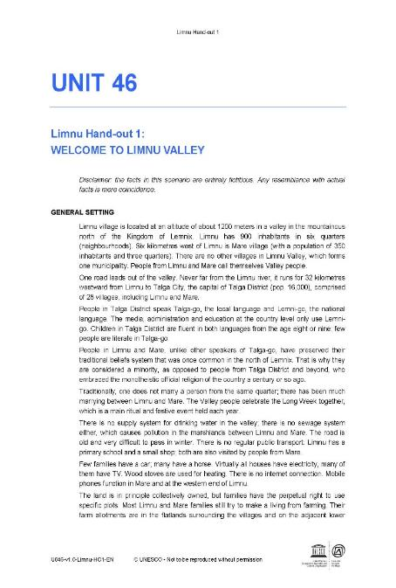
… in a unit
Facilitator’s notes
Participant’s text
Hand-out
PowerPoint Presentation
Case Studies

Slide 12
WHERE WE ARE AT TODAY?
55 Units
8 Key thematic areas
55 Case studies
5+ Languages

Slide 13
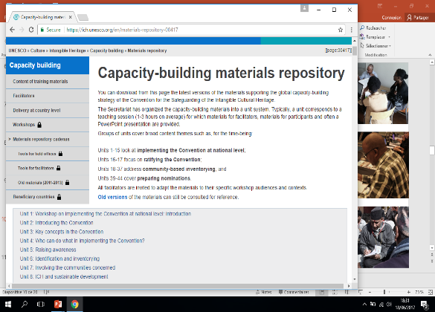
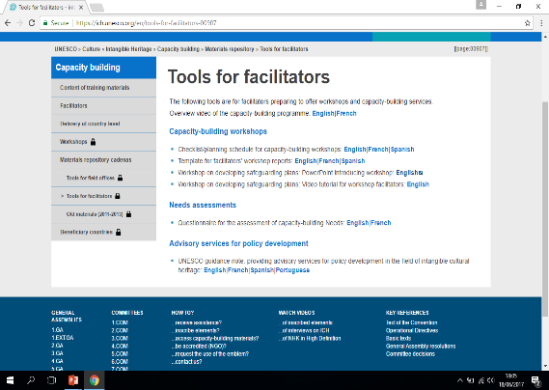
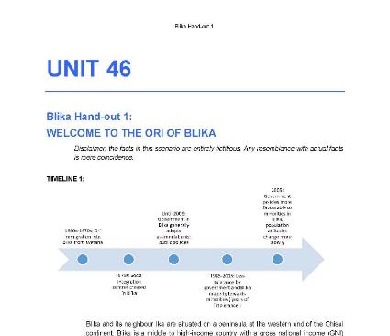
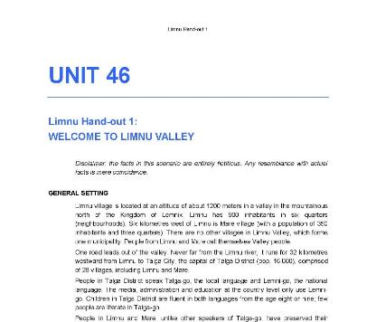
Tools for facilitators

Slide 14
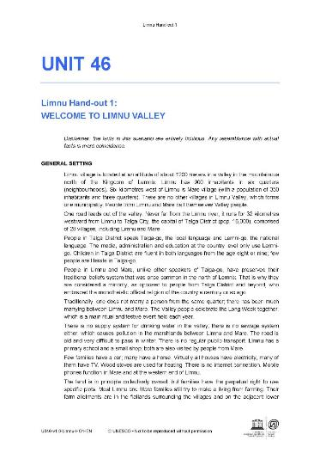
Materials repository
Login with username and password
Access for general public
Updated regularly (English master)
Visit the Materials repository

Slide 15
Additional materials
ICH and sustainable development brochure + digital exhibition + unit
ICH and gender brochure + units
Policy development guidance note + unit
Aide-mémoire for completing nomination files
Guidelines for elaborating requests for international assistance

Slide 16
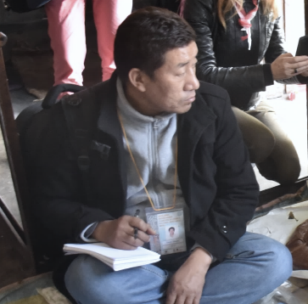
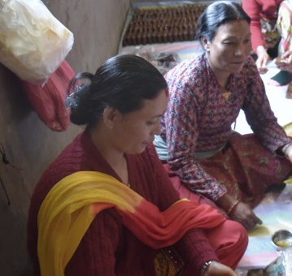
Other tools for facilitators
Unit 10 (part of IMP) and Unit 55
13 case studies
Materials for 3 to 5 day workshop
Can combine with other themes
English, French and Spanish
Recent materials: Policy

Slide 17
Curriculum - pedagogy

Slide 18
pedagogy
Tailor made for each group
Mixing theory and practice
Hands-on experience (field work)
Interactive methods
Notes:
Case studies, videos, role games,, group work

Slide 19
Thank you!

