Slide 1
Workshop on preparing nominations (NOM)

Slide 2
NOM materials structure
Unit | Duration
Unit 39. Introduction | 1 hour
Unit 2. Introducing Convention | 1,5 hour
Unit 3. Key concepts | 1,5 hour
Unit 6. Ident. and inventorying | 1,5 hour
Unit 12. IA | 1 hour
Unit 11. Nominations: overview | 3 hours
Unit 40. Introducing forms | 1 hour
Unit 41. Initial nominations | 6,5 hours
Unit 42. Final nominations | 4 hours
Unit 43. Describing the element | 1,5 hour
Unit 7. Involving communities | 1 hour
Unit 9. Safeguarding | 3 hours
Unit 44. Concluding unit | 1,5 hour
Unit 15. Evaluation | 45 min

Slide 3
Outline of the workshop
Introducing the NOM workshop, the Convention and the requirements of the nomination process;
Evaluating sample nominations and making recommendations for inscribing elements;
Developing key parts of a nomination file; and
Conclusing session and workshop evaluation.

Slide 4
Part 1. Introducing the NOM workshop, the Convention and requirements
This part has four purposes:
To introduce the participants to each other and situate the workshop in its context;
To provide an overview of the Convention and its main concepts;
To explain the subject of inventorying ICH, emphasizing the link with the nomination processes, and discuss international assistance; and
To explain how the nomination process works and how nomination files are examined against criteria for inscription.
2 case studies on positive and negative effects

Slide 5
Part 2. Evaluating sample nominations and making recommendations
The second part of the workshop has two sections:
a general assessment of initial sample nomination files in break-out groups, followed by a report and discussion in plenary; and
a substantive evaluation of the related final sample nomination files and making recommendations on its possible inscription, followed by a report and discussion.

Slide 6
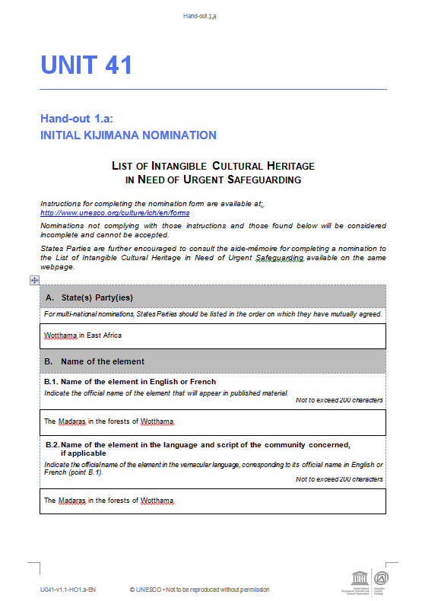
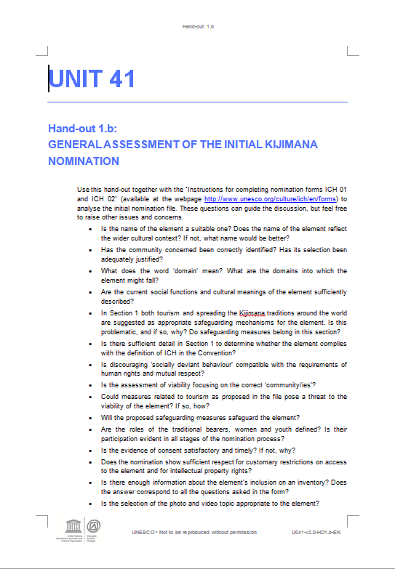
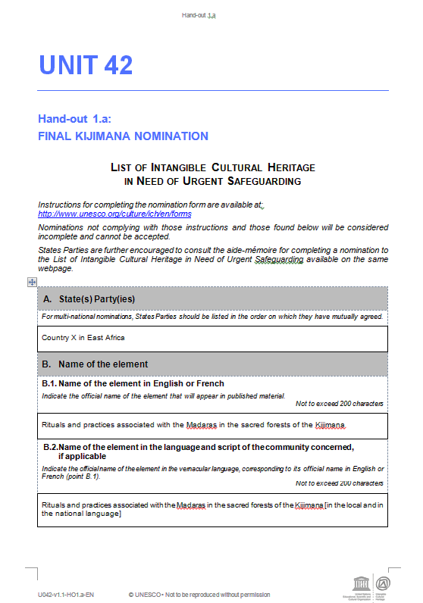
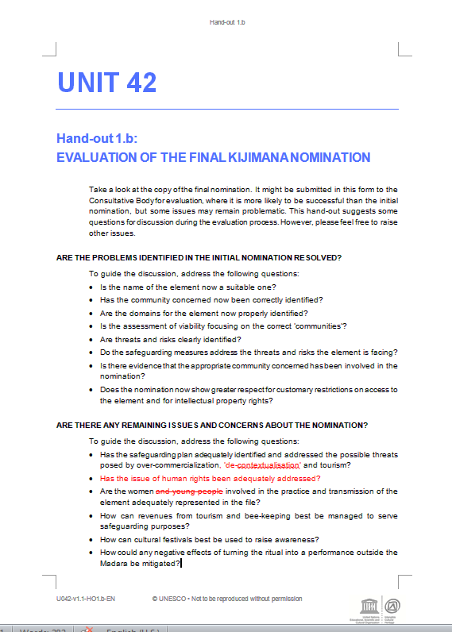
Mock nominations
X 7
Initial mocks are the first versions of nominations submitted by states
Final mocks are the ones submitted by states after revision.

Slide 7
Logic of mock nominations
Participants are divided in groups.
Each of them is given a mock and a general assessment HO (2 documents)
Each group appoints a chair and a rapporteur. The chair organizes the discussion, the rapporteur takes notes and reports back to plenary after.

Slide 8
Logic of mock nominations
Participants are required to:
Check systematically the number of words in each section (technical side)
identify missing and incorrectly placed information,
detect and discuss some basic discrepancies between the criteria of the form and the information provided
indicate how the problems can be fixed and how the file can be improved

Slide 9
Mock nominations
Kijimana traditions and practices (Africa) – USL
Skills for wooden bridge construction (Asia) – USL
Fonabal music and singing (Latin America) – USL
Mashriq storytelling (Arab States) – USL
Council of Irrigators (Western Europe) – RL
Procession of Hana (Eastern Europe) – RL
Haddo Harvest Festival (Western Europe, multinational) – RL
Mock community consents and inventory extracts

Slide 10
Mock 2: Skills for wooden bridge construction (USL, East Asia)
Element found also beyond the borders of the submitting state (‘but the best version of it is in our country only”)
Problematic of legal protection of bridge-building wood species (to ensure environmental sustainability)
Historical aspects of the practice introduced in safeguarding measures
Researchers role put upfront instead of communities
Communities considered not eligible for giving consents. Problematic of a mayor eligible or not to represent a community.
Commitment of the state to inventory the element in the future,
2 community consent letters and no inventorying extract

Slide 11
Part 3. Developing key parts of a nomination file
The third part of the workshop builds participants’ capacities in the practical skills needed to develop a satisfactory nomination form.
Participants will use a special USL sample nomination (the Sword Dance) to develop a summary description of the element, a community participation strategy, and to suggest safeguarding measures.

Slide 12
Part 4. Concluding session and workshop evaluation
This part allows participants to evaluate the workshop.
A multiple-choice questionnaire to be used as the basis for discussion on nominations

