Slide 1
Intangible cultural heritage and sustainable development Unit 8 PowerPoint presentation
UNESCO Intangible Cultural Heritage Section

Slide 2
Sustainable development
‘A development which meets the needs of the present without compromising the ability of future generations to meet their own needs’ (Brundtland Commission 1987)

Slide 3
2030 Agenda for Sustainable Development
Transforming our world
3 principles | 3 + 1 dimensions
human rights (cultural rights) | social
sustainability | environmental
equality | economic
 | + peace
17 integrated and indivisible objectives
Recognizing cultural diversity and the contribution of cultures

Slide 4
Culture in the objectives of the 2030 Agenda
1. End poverty in all its forms everywhere
2. End hunger, achieve food security, improve nutrition and promote sustainable agriculture
3. Ensure healthy lives and promote well-being for all at all ages
4. Ensure inclusive and equitable quality education and promote lifelong learning opportunities for all
5. Achieve gender equality and empower all women and girls
6. Ensure availability and sustainable management of water and sanitation for all
7. Ensure access to affordable, reliable, sustainable and modern energy for all
8. Promote sustained, inclusive and sustainable economic growth, full and productive employment and decent work for all
9. Build resilient infrastructure, promote inclusive and sustainable industrialization and foster innovation
10. Reduce inequality within and among countries
11. Make cities and human settlements inclusive, safe, resilient and sustainable
12. Ensure sustainable consumption and production patterns
13. Take urgent action to combat climate change and its impacts
14. Conserve and sustainably use the oceans, seas and marine resources for sustainable development
15. Protect, restore and promote sustainable use of terrestrial ecosystems, etc.
16. Promote peaceful and inclusive societies for sustainable development, provide access to justice for all and build effective, accountable and inclusive institutions at all levels
17. Strengthen the means of implementation and revitalize the Global Partnership for Sustainable Development

Slide 5
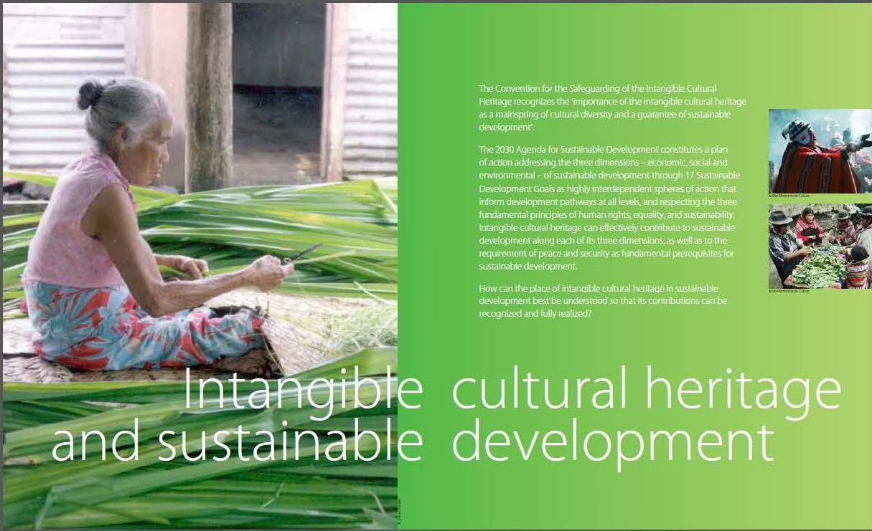
Guarantee of sustainable development

Slide 6
Inclusive social development: ICH and quality education
Andean cosmovision of the Kallaway
© Jérôme Tubiana UNESCO

Slide 7
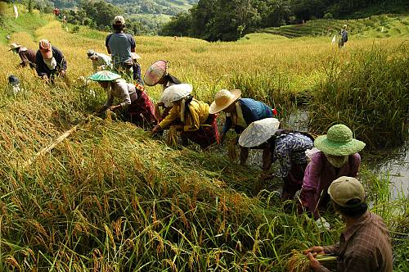
Environmental sustainability:
ICH and resilience to natural disasters
Hudhud chants of the Ifugao
© 2008 by J. Uñalivia/NCCA-IHC

Slide 8
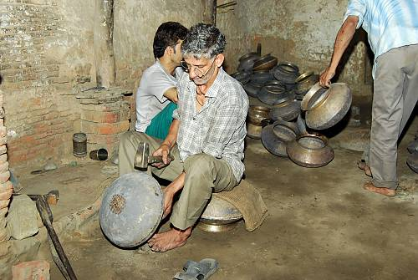
Inclusive economic development.
ICH and income generation
Traditional brass and copper craft of utensil making among the Thatheras of Jandiala Guru, Penjab, Inde
© Sangeet Natak Akademi
Notes:
Sustainable use of natural and cultural heritage is key to sustainable development. Supporting traditional systems of environmental protection and resource management can contribute to a better sustainability of fragile ecosystems and preservation of biodiversity, while preventing competition and conflict over access to natural and cultural resources. Disaster risk management strategies that fully respect and build on traditional knowledge and community participation, providing support and resources for their implementation.
In a context of rapid environmental change, such time-tested and climate change adaptive strategies take on urgent new importance.

Slide 9
Peace and security: ICH and conflict resolution
Irrigators’ tribunals of the Spanish Mediterranean coast: the Council of Wise Men of the plain of Murcia and the Water Tribunal of the plain of Valencia
©2005 by Generalitat Valenciana

Slide 10
Exercise: Identify an element and describe how it contributes to:
quality education (social development)
resilience to natural disasters (environmental sustainability)
income generation (economic development)
conflict resolution (peace and security)

Slide 11
Safeguarding is essential
if communities across the world are to make the changes ‘needed to shift the world on to a sustainable path’
if we want to find innovative, culturally sensitive solutions to the challenges posed by development
if we want to ensure the well-being of all

Slide 12
Income-generating opportunities created by safeguarding activities
Tourism
Use of traditional knowledge to manage environmental resources in a sustainable way for the purpose of profit
Use of traditional knowledge for new purposes
Introduction of relevant products and practices from traditional medicine into the health system
Sale of handicrafts
ICH performances with admission fees
Festivals
Competitions
Corporate sponsorship

Slide 13
Risks
ICH freezing (discontinuation)
Loss of purpose and meaning
Decontextualization
Misrepresentation
Misappropriation
Unequal income distribution
Overexploitation of natural resources
Unrealistic expectations
Lack of dialog, leading to over-involvement of institutional mechanisms
Commercialization

Slide 14
Mitigating risks with the help of...
The participation and consent of the communities
Capacity building
Consultation mechanisms
Risk evaluation and strategic solutions
Legal frameworks for protecting the rights of communities

