Slide 1
Objectives of the meeting and recent developments in the life of the 2003 Convention and the Organization
Sixth annual coordination meeting of
category 2 centres active in the field of
intangible cultural heritage
Paris – UNESCO HQ
7 June 2018

Slide 2
Objectives of the 6th annual meeting

Slide 3
Objectives (1)
General discussion on:
new perspectives under the 2003 Convention in the framework of the 39 C/5
new funding priorities
39 C/5 and its performance indicators

Slide 4
Objectives (2)
General debate on:
Synergies and cooperation amongst the Centres and with UNESCO Secretariat
Current challenges faced by the Centres in implementing the Convention
Renewal of category 2 centre status - updates

Slide 5
Recent developments in the life of the 2003 Convention

Slide 6
Towards universal ratification
178 States Parties (June 2018)
4 new ratifications since last C2Cs meeting:
Kiribati
Singapore
Solomon Islands *
Suriname

Slide 7
Towards universal ratification
Only 17 States non party
EG | States non party
I | Canada, Israel, San Marino, UK and USA [5]
II | Russian Federation
III | Guyana
IV | Australia, Maldives, New Zealand and Niue [4]
Va | Angola, Liberia, Sierra Leone, Somalia and South Africa [5]
Vb | Libya

Slide 8
12.COM Jeju Island 2017
Periodic reports
Inscriptions and governance
Transfer and removal
Intangible cultural heritage in emergencies

Slide 9
7.GA Paris 2018
Election of 12 new members of the Committee
Revisions of the Operational Directives on periodic reporting
Overall results framework
Accreditation of NGOs

Slide 10
Committee Members
Group IV
China 2018-2022
Japan 2018-2022
Kazakhstan 2018-2022
Philippines 2016-2020
Sri Lanka 2018-2022
Group V(a)
Cameroon 2018-2022
Djibouti 2018-2022
Mauritius 2016-2020
Senegal 2016-2020
Togo 2018-2022
Zambia 2016-2020
Group V(b)
Kuwait 2018-2022
Lebanon 2016-2020
Palestine 2016-2020
Group I
Austria 2016-2020
Cyprus 2016-2020
Netherlands 2018-2022
Group II
Armenia 2016-2020
Azerbaijan 2018-2022
Poland 2018-2022
Group III
Colombia 2016-2020
Cuba 2016-2020
Guatemala 2016-2020
Jamaica 2018-2022

Slide 11
Important meetings
13.COM (26 November to 1 December 2018, Port Louis, Republic of Mauritius)
TOTs for facilitators in Central Asia (June 2018) and Asia-Pacific (July 2018) with CRIHAP + Europe with Sofia Centre (September 2018)

Slide 12
Funding priorities

Slide 13
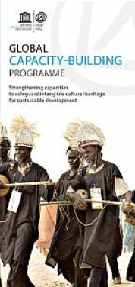
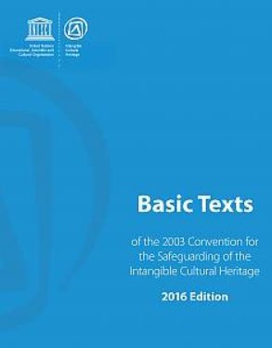
2 Funding priorities
Priority 1
Strengthening capacities to safeguard intangible cultural heritage and contribute to sustainable development
Priority 2
Safeguarding intangible cultural heritage in formal and non-formal education
Article 2 safeguarding measure

Slide 14
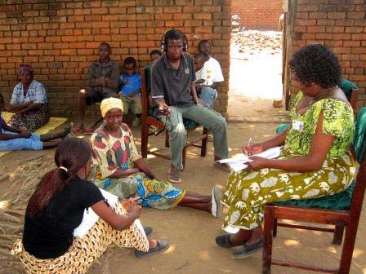
Priority 1 CAP to be continued with strategic reorientation
New focus on building national networks of trainers
Stronger partnerships with relevant institutions at national level
Implementing “new” topics (gender, sustainable development, …)
Developing CAP for emerging priorities (periodic reporting, INV in cities, emergencies, …)

Slide 15
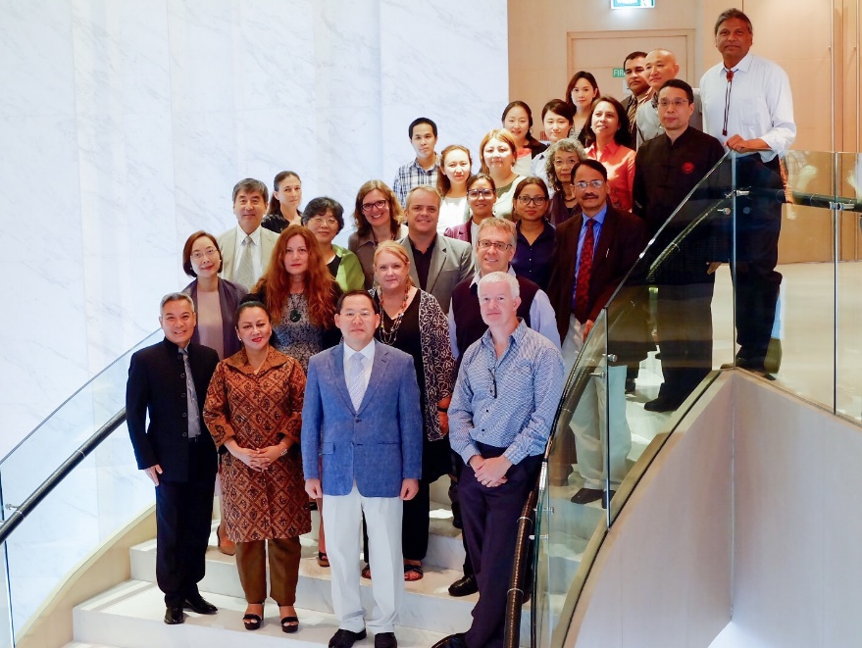
Networking with tertiary education institutions
Tertiary education important for training future decision-makers, planners and administrators
ICH is dispersed in multiple disciplines
Diversity of approaches exist
Focus on networking/network building
Networking activities in
Asia and the Pacific (survey 2017, meeting 2018)
Latin America and the Caribbean (meeting 2017)
Africa (survey 2018)

Slide 16
Priority 2 - NEW
Intangible cultural heritage and education
Education in the Convention, but …
Transmission though formal and non-formal education as a safeguarding measure (Article 2.3).
Ensure recognition of, respect for, and enhancement of the intangible cultural heritage in society through education (Article 14).
Benefits for education
Increase relevance of education
Improve learning outcomes
Target 4.7 ‘promotion of a culture of peace and non-violence, global citizenship and appreciation of cultural diversity and of culture’s contribution to sustainable development’

Slide 17
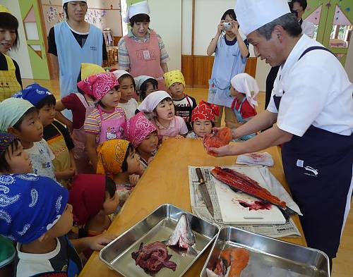
ICH transmission—What is the situation today?
Key requirement for viability
Intergenerational, creative process
No longer always embedded in daily life (informal learning)
Often disrupted for many reasons
Today schools and non-formal education programmes can be places of transmission

Slide 18
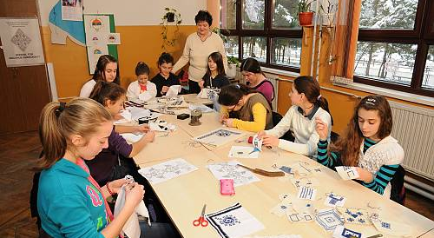
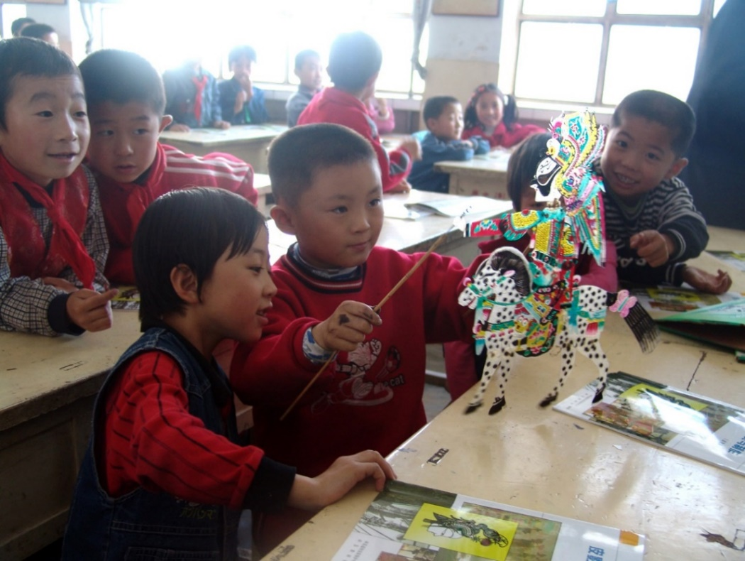
Broad programme framework
Objective: Safeguarding intangible cultural heritage through transmission in formal and non-formal education
Outcome 1: Countries engage in action to safeguard intangible cultural heritage through formal and non-formal education and thereby improve educational quality and relevance.
Notes:
© 2013 by Museum of Republic of Srpska Photograph: Dejan Kosić Zmijanje embroidery https://ich.unesco.org/en/RL/zmijanje-embroidery-00990

Slide 19
Implementation strategy
Intersectoral collaboration is key!
Nine field offices have activities planned under the regular programme.
UNESCO Regional Bureaus for Education and Field Offices take the lead
Cooperation with national counterparts and UNESCO Education Institutes, and with on-going technical support from Headquarters.
At the global level, UNESCO Headquarters will establish a clearinghouse for integrating ICH in education.

Slide 20
Recent developments for UNESCO – 39 C/5

Slide 21
39 C/5 (2018-2021)
Adopted at the 39th session of the General Conference (30 October to 14 November 2017)
It covers the second and final quadrennium of the UNESCO’s Medium-Term Strategy for 2014-2021 (document 37 C/4)
First biennium 2018-2019 (39 C/5) and second biennium 2020-2021 (40 C/5)

Slide 22
New approaches
C/5 Budget based on an Integrated Budget Framework: greater transparency of resources.
Structured Financing Dialogues: bringing together the Secretariat with its Member States and the donor community at large, to jointly ensure the funding necessary for the implementation of the programme and achievement of the Ers for a better resource mobilization.
Results Based Budgeting (RBB) tool: to map the needs at the field and global levels.
Results Based Management (RBM): thorough application of its principles to define clearer, outcome-oriented results and targets

Slide 23
Major Programme IV – CLT
Same programmatic structure of the Approved 38 C/5, with two MLAs, one on heritage and one on creativity, and one C/5 expected result for each of the six conventions.
Two additional cross-cutting ERs to support the development of a transversal implementation of the CLT conventions:
on emergencies
on the 2030 Agenda, to enhance the role of culture and support the culture-engaged achievement of the SDGs by Member States

Slide 24
MLA 2: Creativity
‘Fostering creativity and the diversity of cultural expressions, as well as the safeguarding of intangible cultural heritage for sustainable development’

Slide 25
Expected result 6:
‘Intangible cultural heritage identified and safeguarded by Member States and communities, in particular through the effective implementation of the 2003 Convention’

Slide 26
Performance indicators (1)
PI 1: Sound governance exercised through the adoption and implementation of strategic resolutions/decisions of the governing bodies of the 2003 Convention
PI 2: Number of supported Member States utilizing strengthened human and institutional resources for the safeguarding of intangible cultural heritage

Slide 27
Performance indicators (2)
PI 3: Number of supported Member States which have integrated intangible cultural heritage into their plans, policies and programmes, in particular as a contribution towards the achievement of SDGs in a gender-responsive manner
PI 4: Number of States Parties who have effectively implemented international assistance, including from the Intangible Cultural Heritage Fund, complementing their national safeguarding efforts

Slide 28
Performance indicators (3)
PI 5: Number of initiatives undertaken by supported Member States which have enhanced knowledge and understanding of intangible cultural heritage safeguarding and of the 2003 Convention

Slide 29
Expected result 8:
‘Culture integrated into policies and measures at the national and local levels by Member States for the effective implementation of the 2030 Agenda for Sustainable Development’

Slide 30
37 GC/Resolution 93
Integrated Comprehensive Strategy:
Renew emphasis on contributions of category 2 centres to:
strategic programme objectives and global priorities (C/4)
sectoral or intersectoral programme priorities and themes (C/5)

Slide 31
37 GC/Resolution 93
Clarification of renewal procedures and timetable with a pre-renewal evaluation
Full costs to be borne by category 2 centres and/or host countries

Slide 32
General discussion on several topics

Slide 33
General debate on:
Role of C2Cs in the implementation of the Convention
Exploring Secretariat potential fields of cooperation with the Centres and ways to improve
Current challenges faced by Centres in the daily implementation of the Convention
Renewal of Agreements between host countries and UNESCO

Slide 34
Other business

Slide 35
C2C annual meetings
1st in Sozopol, Bulgaria, July 2013
2nd in Paris, UNESCO HQ, June 2014
3rd in Guiyang, China, July 2015
4th in Paris, UNESCO HQ, June 2016
5th in Shiraz, Iran, September 2017
6th in Paris, UNESCO HQ, June 2018
7th …

