Slide 1
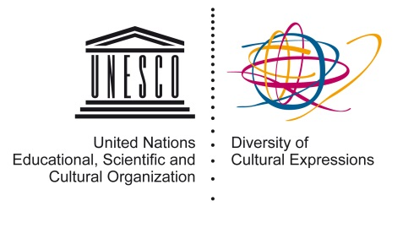


Enhancing fundamental freedoms through the promotion of the diversity of cultural expressions
Capacity-building on periodic reporting and the Global Monitoring Reports (GMR) for the 2005 Convention on the Protection and Promotion of the Diversity of Cultural Expressions
With funding from the
Swedish International Development Cooperation Agency
Project funded by the Swedish International Development Agency (Sida)
Implementation by the Diversity of Cultural Expressions Section of the Culture Sector, in cooperation with UNESCO Field Offices
2014-2017
Notes:
The project is funded by the Swedish International Development Cooperation Agency.
It is comprised of two components: One is the capacity-building at the country level, and the other the production of two global monitoring reports.

Slide 2

2005 Convention on the Protection and Promotion of the Diversity of Cultural Expressions
What is it?
International standard setting instrument
Guiding principles
Respect for human rights and fundamental freedoms
Policy framework for the governance of culture
Participatory, transparent, informed and evidence-based policy making
Policies/measures to support every stage of the cultural value chain
Sovereignty
Equal dignity of and respect for all cultures
International solidarity and cooperation
Complementarity of economic and cultural aspects
Sustainable development
Equitable access
Openness and balance
Creation
Production
Distribution/
dissemination
Enjoyment
Notes:
The 2005 Convention on the Protection and Promotion of the Diversity of Cultural Expressions (“the Convention”) is an international standard setting instrument providing a framework for the governance of culture. The most recent UNESCO Convention in the field of culture, it encourages governments to introduce policies for culture within a global context and commitment to protect and promote the diversity of cultural expressions. In accordance with the Convention, these policies are to be based on fundamental principles of freedom of expression, gender equality, openness and balance to other cultures and expressions of the world and on the complementary economic and cultural aspects of sustainable development.
With 135 Parties as of January 2015, the Convention has experienced an extremely rapid rate of ratification since its adoption in 2005 and entry into force in 2007

Slide 3
State of ratification
141 Parties as of January 2016
Notes:
The 2005 Convention on the Protection and Promotion of the Diversity of Cultural Expressions (“the Convention”) is an international standard setting instrument providing a framework for the governance of culture. The most recent UNESCO Convention in the field of culture, it encourages governments to introduce policies for culture within a global context and commitment to protect and promote the diversity of cultural expressions. In accordance with the Convention, these policies are to be based on fundamental principles of freedom of expression, gender equality, openness and balance to other cultures and expressions of the world and on the complementary economic and cultural aspects of sustainable development.
With 135 Parties as of January 2015, the Convention has experienced an extremely rapid rate of ratification since its adoption in 2005 and entry into force in 2007. Yet, there exists, in certain regions of the world, a lack of awareness and understanding about the Convention and its relevance, hindering its widespread ratification.
Respect for human rights and fundamental freedoms
Sovereignty
Equal dignity of and respect for all cultures
International solidarity and cooperation
Complementarity of economic and cultural aspects of development
Sustainable development
Equitable access
Openness and balance

Slide 4
Sida-UNESCO cooperation
New Programme Cooperation Agreement
UNESCO and Sida (Sweden) signed in Nov. 2014 a Programme Cooperation Agreement (PCA) for 2014-2017
2005 Convention
A project to implement the 2005 Convention nationally and globally
Commitment by Sweden
New funding by Sida signals a strong commitment from Sweden towards the objectives of the 2005 Convention
Notes:
The signing of this agreement marks an important moment in UNESCO-Sida cultural cooperation, and signals a strong commitment from Sweden towards the objectives of the 2005 Convention. Sweden, which ratified the 2005 Convention as early as 2006, played a leading role during the elaboration of the World Report “Our Creative Diversity” (1996), culminating in the 1998 Stockholm Intergovernmental Conference on Cultural Policies for Development (1998), both inspiring the Universal Declaration on Cultural Diversity (2001) and eventually the 2005 Convention.
UNESCO and Sida (Sweden) signed in Dec. 20144 a Programme Cooperation Agreement (PCA) for 2014-2017 worth 54 million USD

Slide 5
Project’s overall goal
Supporting periodic reporting/ policy monitoring efforts
Enhance the establishment of systems of good governance (transparent, participatory, informed)
Support the active participation of both governmental and civil society actors
Notes:
Through supporting periodic reporting/policy monitoring efforts both nationally and globally, we aim to:
Enhance the establishment of systems of good governance (transparent, participatory, informed) that are based on fundamental freedoms stipulated in the Convention (freedom of expression, gender equality, openness and balance to other cultures and expressions of the world, complementary economic and cultural aspects of sustainable development) and that foster the diversity of cultural expressions
Support the active participation of both governmental and civil society actors in assessing and monitoring policies and measures that are underpinned and driven by guiding principles of the Convention (Article 2), and that can have a structural impact on the democratization processes.

Slide 6
Component 1
Country-level capacity development interventions

Slide 7
Context
Periodic reports is one of the statutory obligations of all Parties, but, Parties…
Lack capacity to elaborate the report
Lack understanding of the scope of the Convention
Lack statistical data and indicators for the culture sector
Capacity-building identified as a priority
Policy-making being a cyclical process, monitoring and reporting constitutes an indispensable step within this policy cycle, helping countries to grasp the state of affairs of their creative sector and understand/define priority actions for the future
Notes:
Where do we stand?
71 reports received between 2012-2014
out of 116 expected
2012: 94 reports expected, but 45 received
2013: 11 reports expected, but 4 received (+ 16 overdue from 2012)
2014: 11 reports expected, but 3 received (+ 3 overdue from 2012)
What’s next?
Future periodic reporting
2015: 4 reports expected + 45 overdue reports from previous years
2016: 94 reports expected
2017: 11 reports expected
Why start with capacity-building on monitoring and reporting? Some Committee members wondered whether it is better to start with capacity-building on policy-making because some Parties may have nothing to report.
Policy-making as a cyclical process -> in order to create a policy, consultation and assessment of the state of affairs is indispensable.

Slide 8
UNESCO Office in Dakar
UNESCO Office in Havana
UNESCO Office in Addis Ababa
UNESCO Office in Harare
UNESCO Office in Rabat
UNESCO Office in Phnom Penh
UNESCO Office in Jakarta
UNESCO Office in Hanoi
UNESCO Office in Quito
Senegal
Burkina Faso
Ethiopia
Zimbabwe
Morocco
Tunisia
Cambodia
Indonesia
Viet Nam
Cuba
Colombia
UNESCO Office in Nairobi
Rwanda
Latin America and the Caribbean
Asia
Arab states
Africa
Country-level capacity-building interventions in 12 developing countries that are Parties to the Convention

Slide 9
Selection criteria
Target country | Submission of periodic report expected | Other capacity-building activities implemented | Presence UNESCO Field Office | Synergies with CI proposed target countries
Burkina Faso | Second report in 2017 | Technical assistance, CDIS, IFCD | Dakar Cluster Office
Cambodia | Second report in 2017 | CDIS, technical assistance, IFCD | Phnom Penh Office
Cuba | Second report in 2017 | IFCD | Havana Cluster Office
Colombia | First report in 2017 | CDIS | Quito Office
Ethiopia | First report overdue |  | Addis Ababa Office | x
Indonesia | First report in 2016 | IFCD | Jakarta Office
Morocco | First report in 2017 |  | Rabat Office | x
Rwanda | First report in 2016 |  | Nairobi Office | x
Senegal | First report overdue | IFCD | Dakar Office
Tunisia | Second report due in 2016 | IFCD | Rabat Office | x
Vietnam | Second report in 2017 | Technical assistance, CDIS | Hanoi Office | x
Zimbabwe | First report overdue | IFCD | Harare Office | x
Notes:
These countries were selected based on several criteria such as:
Ongoing activities, be it technical assistance, IFCD, indicators
Synergies to be created with the CI

Slide 10
Quadrennial Periodic Report (QPR) Deadlines
30 April 2016
Indonesia (1st QPR)
Rwanda (1st QPR)
30 April 2017
Colombia (1st QPR)
Morocco (1st QPR)
Tunisia (2nd QPR)
Ethiopia (1st QPR overdue since 2012)
Cuba (2nd QPR)
Burkina Faso (2nd QPR)
Cambodia (2nd QPR)
Viet Nam (2nd QPR)
Zimbabwe (1st QPR overdue since 2012)
Senegal (1st QPR overdue since 2012)
Notes:
These countries were selected based on several criteria such as:
Ongoing activities, be it technical assistance, IFCD, indicators
Synergies to be created with the CI

Slide 11
Country-level capacity-building process
1. Consultation
(1-day event) &
needs assessment
(1-2 months)
2. National training workshop
(3-days)
3. Elaboration of a periodic report
(6-8 months)
4. Public presentation & debate on the periodic reports
(1-day event)
Notes:
The capacity-building activities follows 4 sequences.
The experts chosen will be key in delivering these capacity-building interventions.
How do we choose experts?
DCE in consultation with the concerned FO will pre-select 5-6 experts for each beneficiary countries, taking into account the particularities of the countries concerned (e.g., past/ongoing UNESCO activities such as EU TA, languages spoken, special needs for cultural statistics, etc.)
The beneficiary countries in consultation with the concerned FO decide on 1 to 2 international experts from the Expert Facility.
The selected experts will be offered a consultant contract to accompany the beneficiary countries through the four sequences of the capacity-building action. This concrete means, three times travelling to the countries (first time for the consultation and assisting the country to do the needs assessment; the second time for the 3-day workshop; and the third time for the public presentation of the periodic reports).

Slide 12
1. One-day Consultation and needs assessment
1-day multi-stakeholder consultation
= Raising awareness about the Convention among them is essential
1 - 2 months for
Multi-stakeholder team to include governmental and civil society
Needs assessment by the national team
Notes:
1-day multi-stakeholder consultation to inform stakeholders (e.g., government officials from different ministries, civil society representatives including women and youth, independent journalists) about:
the main purpose of the project
the fundamental principles and objectives of the Convention
participatory policy monitoring and reporting
Here,
To make synergies with the communication and information, media professionals such as (independent journalists covering culture issues) should be invited to this consultation.
1 - 2 months to:
Conduct a needs assessment by the national team
Establish a multi-stakeholder team: Governmental and civil society
One of the tangible outcomes of the Sida-funded project = this national team would be the core people in the country to continue spearheading the 2005 Convention implementation

Slide 13
2. Three-days training workshop
3-day national training workshop
by experts from the Expert Facility &
UNESCO Field office
Participants representing various stakeholders
Notes:
Objectives and guiding principles of the Convention
Structure and objectives of the Quadrennial Periodic Report
Data collection exercises (statistics, qualitative/quantitative)
Participatory drafting of a periodic report
Elaboration of a workplan for elaboration of a periodic report
Participants include representatives of various ministries such as:
Ministries of culture, education, social affairs, employment, economic development, foreign affairs, youth and trade, etc.
Participants must also include at least 3 civil society organization representatives.

Slide 14
3. Elaboration of periodic reports
(6-8 months)
Participatory drafting of a periodic report
Collection of relevant data and information
Mentoring provided by the experts
Inclusion of contributions by civil society
Finalization of a draft periodic report

Slide 15
4. One-day public presentation of the periodic report
Integration of comments provided at the forum
Submission of the finalized periodic reports to UNESCO
Multi-stakeholder forums for feedback and validation
Notes:
One-day public presentation of the periodic report at a multi-stakeholder
forum for feedback/validation
The experts will be present together with the national team.

Slide 16
Deliverables of Component 1
1 day consultations organized
Periodic reports elaborated by the national team with inputs from various governmental institutions and civil society organizations
National team developed for periodic reporting
Needs assessment conducted
3-day national workshop conducted
Public presentation organized to review/finalize the periodic reports
Periodic reports submitted to UNESCO

Slide 17
Keeping in mind:
Creating synergies with CI Sector
Media diversity
Consultation, training and public presentation of periodic reports to involve media professionals/experts
Media Indicators
Capacity-building activities to contribute to indicator development including media diversity

Slide 18
Component 2
Production of two Biennial Global Monitoring Reports (GMR) in
(1st edition in December 2015 and 2nd in December 2017)

Slide 19
What is GMR and what for?
A tool for benchmarking, monitoring and follow-up of the implementation of the Convention
Identification of emerging challenges
Sharing of solutions/good practices
Promotion of transparency/good governance of culture based on guiding principles of the Convention (respect of human rights, fundamental freedoms)
Analysis of current global trends
Assessment of the impact of policies and measures

Slide 20
How to produce GMR?
2005 Convention Secretariat is responsible for the overall coordination
Editorial board is established composed of authors chosen to write articles
Knowledge management system (KMS) is to be developed to facilitate data collection/collation and analysis and information sharing
Analytical framework and indicators for the monitoring of the Convention implementation are to be developed
Authors are to analyze not only periodic reports submitted by Parties but also other sources (academic research, contribution from civil society)

Slide 21
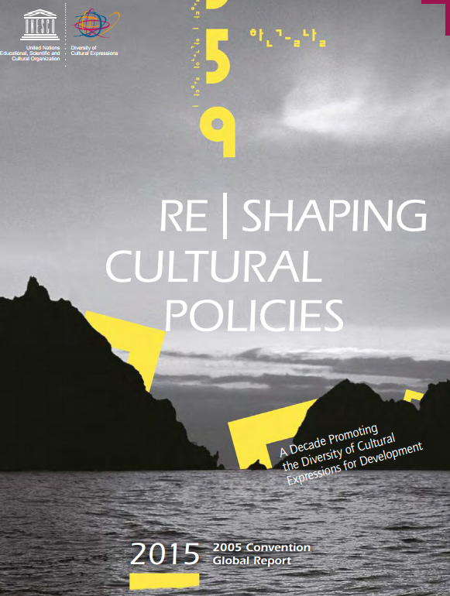
A first 2005 Convention Global Report published in December 2015
Re|shaping cultural policies: A decade promoting the diversity of cultural expressions for development

Slide 22
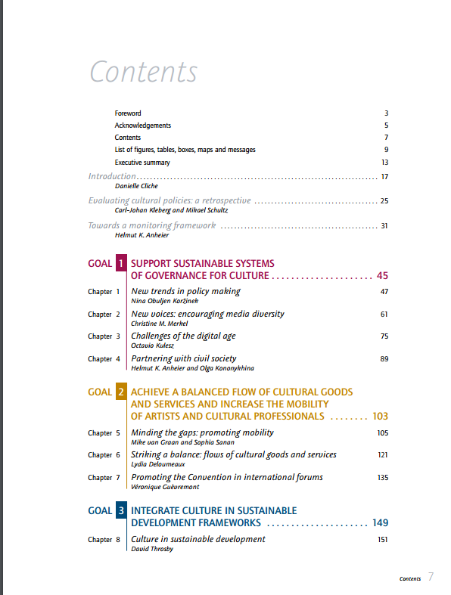
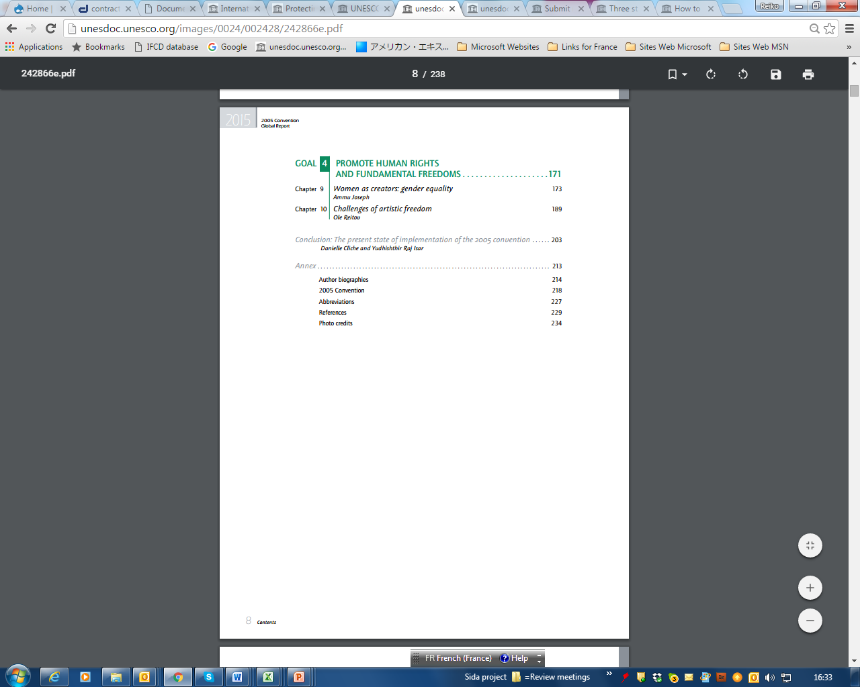
Table of contents
Notes:
(2 articles)

Slide 23
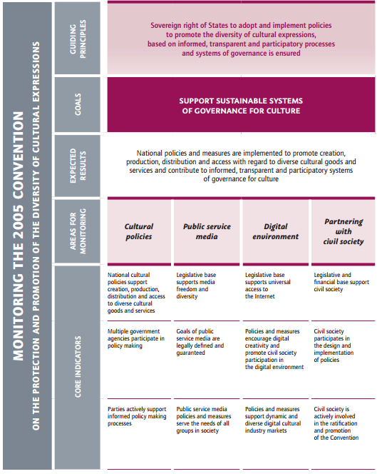
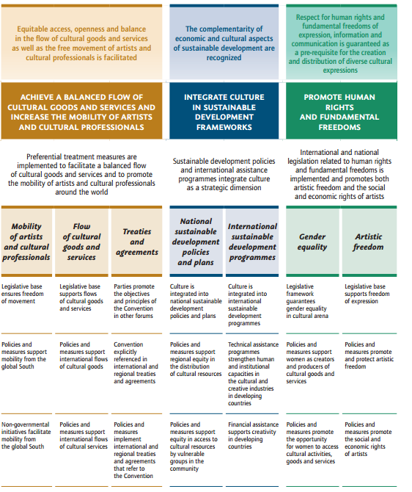
Monitoring Framework
Notes:
(2 articles)

Slide 24
Expected results of the project
1.
Governmental and civil society actors participate in transparent and informed policy making processes
2.
Countries apply evidence-based and informed policy making
3.
Synergies in analysis and advocacy are created with the Communication Sector
Notes:
Expected Result 1: Governmental and civil society actors participate in transparent and informed policy making processes that promote fundamental principles of freedom of expression as a prerequisite for ensuring the diversity of cultural expressions
Expected Result 2: Countries apply evidence-based and informed policy making based on fundamental principles of freedom of expression, gender equality, sustainability, openness and balance
Expected Result 3: Synergies in analysis and advocacy are created in areas of media diversity, freedom of expression and diversity of cultural expressions

Slide 25
For more information: http://en.unesco.org/creativity/
Thank you.

