Slide 1
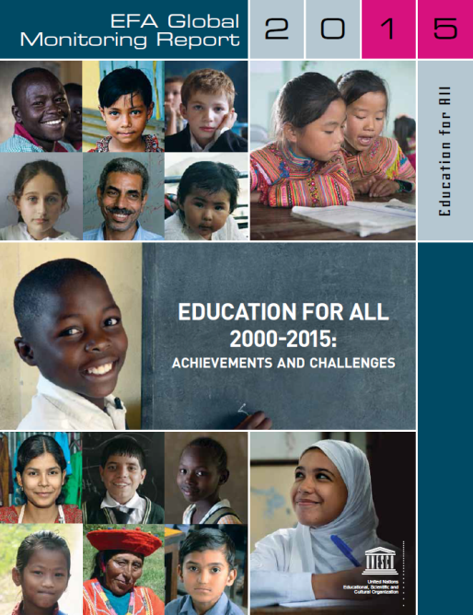
EDUCATION FOR ALL 2000-2015: Achievements and Challenges
Name:
Event:
Location, date 2015
Notes:
[Introduce yourself.]
[Ask people to turn off their phones]
In April 2000, global leaders met in Dakar Senegal and agreed on the six Education for All (EFA) goals; they promised to achieve them by 2015. 2015 is now!
So how do different countries measure up?
Have the goals been met, and where has progress proven difficult?
Have governments and international partners lived up to their commitments?
Which policies have worked best, and what lessons have we learned to guide future reform?
Today’s report provides independent and authoritative answers to these questions.

Slide 2
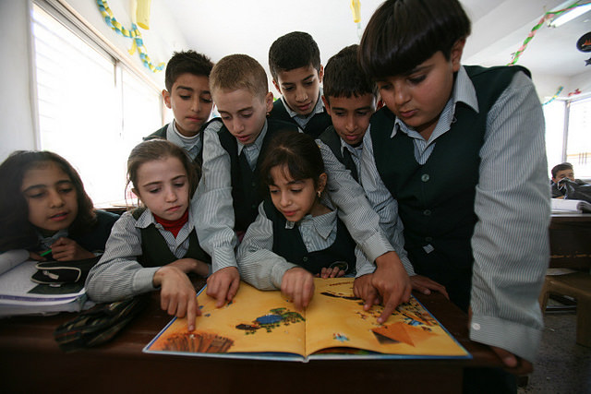
Key messages: There is much to celebrate
There has been much education progress since 2000:
There are 84 million fewer out-of-school children and adolescents
…52 million of these are girls
34 million more children have gone to school due to intensive efforts of EFA movement
Two-thirds more children are enrolled in pre-primary education
Notes:
There has been tremendous progress since 2000 that we must not forget.
[click] 84 million fewer children and adolescents are out of school now than in 1999. Of these the vast majority (62%) were girls, indicating that parity is improving along the way.
34 million more children are in school now than would have been had trends from the 1990s persisted. This increased enrolment can be attributed to the efforts of governments and NGOs generated by the EFA movement
And enrolment in pre-primary education increased by two-thirds.
This progress is a huge source of optimism as we establish a new vision for the next 15 years.

Slide 3
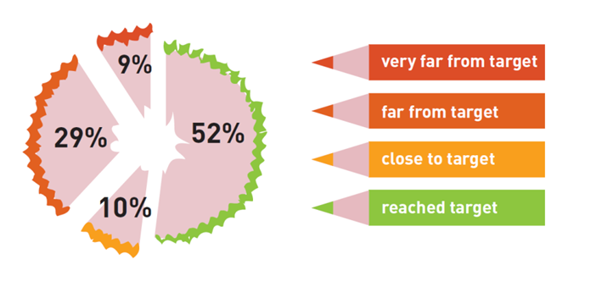
Key messages: …but we did not reach Education for All
Just a third of countries have achieved all of the measurable EFA goals
Only just over half of countries achieved Universal Primary Enrolment
121 million children and adolescents were still out of school in 2012
A third of countries did not reach gender parity in primary education; a half of countries did not in secondary
Notes:
Yet, despite these efforts, just a third of countries reached all of the EFA goals with measurable targets: ensuring universal primary education, reducing adult literacy by 50%, and achieving gender parity in both primary and secondary education.
The aim of ensuring that every child is enrolled in, and completes, primary school by 2015 has not been achieved. Only just over half of countries achieved universal primary enrolment.
[click] Moreover progress has stalled in recent years. There were 204 million children and adolescents out of school in 1999, which declined rapidly until 2008, when 127 million were out of school. Since then the decline has slowed and in 2012, 121 million children remained out of school.
[click] In addition, a third of countries did not achieve gender parity in primary education, and a half of countries did not in secondary education, even though this goal was meant to be achieved in 2005

Slide 4
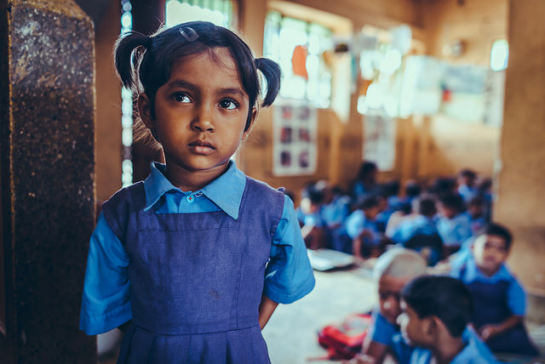
Key messages: Major inequalities in education remain
The poorest children are 4x more likely to be out of school, and 5x more likely not to complete primary education than the richest
The proportion of out of school children in conflict-affected zones has grown since 2000
There remain pronounced learning gaps between the most and least advantaged students
Nearly two-thirds of the 781 million adults with minimal literacy skills are women
Notes:
One of the main messages to come through the GMR 2015 is that major inequalities still remain and act as a powerful obstacle to education progress.
[click] The most disadvantaged children continue to be the last to benefit. The poorest are four times more likely to be out of school and five times more likely not to complete primary education than the richest.
The proportion of children out of school in conflict affected countries and zones is high at 36% and has grown since 2000
[click] There remain significant learning gaps between the most and least advantaged students and they often increase as children progress in school.
And women continue to make up the majority of adults who are denied the right to literacy.
These inequalities are a major reason why Education for All has not been achieved.

Slide 5
EFA Goal 1: There are still millions of preventable child deaths
Progress in early childhood care and education was rapid, yet too few vulnerable and marginalized children have gained access.
Child mortality rates dropped by nearly 50% but
Global malnutrition fell from 40% in 1990 to 24% in 2013,
but 1 in 4 children are still short for their age.
Notes:
Beyond these key messages, let us take a look at each goal in turn:
Goal 1 addresses the conditions necessary for building a strong learning foundation for life. This includes both early childhood care, and education.
Since 2000, there has been substantial progress to improve the care and development of young children, yet the marginalised – who would benefit the most - have been left behind.
[click] As for childhood care, while there has been an almost 50% drop in child mortality, that is still not enough to achieve the MDG target set in 2000 of a two-thirds reduction relative to 1990.
Likewise, most countries have made progress in reducing the percentage of malnourished children since the 1990s, yet today one in 4 children are still too short for their age, an indicator of malnutrition.

Slide 6
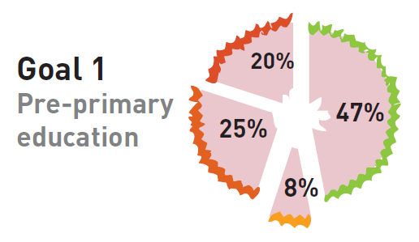
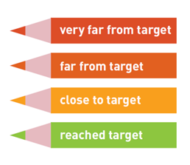
EFA Goal 1: Progress has been made, but inequitable
Only half of countries made clear progress in pre-primary education
Notes:
The second part of Goal 1 looks at numbers enrolled in pre-school.
There was no official target for pre-primary education.
If we select an indicative enrolment target of 80% , the verdict is that just less than half of countries achieved it – the green slice of this pie. A further 8% are close (the orange slice).
There is still a long way to go, as pre-primary education is compulsory in only 40 countries.
[click] A positive takeaway from this goal is that global enrolments in pre-primary education increased by two-thirds since 1999 (from 112 million to 184 million).
Some countries made remarkable progress. The percentage of children enrolled in pre-primary education in Nepal, for instance, increased almost eightfold. In Algeria the corresponding increase was from just 2% to 79%.
Progress was the slowest in sub-Saharan Africa. Only six countries in the region achieved pre-primary enrolment rates above 80%, and the regional average only reached 20% in 2012.

Slide 7
EFA Goal 1: Policy successes since 2000
Laws passed
Mexico mandated participation for children aged 4 to 5 years and gross enrolment rose to 101%
Fees abolished
South Africa provides a year of free pre-primary schooling; and the enrolment rate rose from 21% in 1999 to 77% in 2012.
Visibility increased
Indonesia established ECCE centres in 65% of villages in the country
Incentives made conditional
In China, incentives conditional on attendance increased the likelihood children would attend by 20%.
Parents targeted
In Thailand, extensive provision and awareness campaigns boosted ECCE attendance to 93%
Multi-sectoral collaboration
Colombia coordinates between its Ministry for Social Protection and Ministry of Education
Quality improved
Jamaica has designed a curriculum that is appropriately targeted to the progressive needs of 5 & 6 year olds
Notes:
How have some countries achieved significant change in early childhood, and others not?
The GMR 2015 has found that some of the policies achieving the greatest successes in increasing pre-primary enrolment AND improving early childhood care include the following:
Laws to mandate participation: Mexico made it mandatory for those aged 4 to 5 years and the gross enrolment ratio rose to 101%.
Abolishment of fees: South Africa has phased in a year of free pre-primary schooling from 2001. The gross enrolment ratio has risen from 21% in 1999 to 77% in 2012
Increasing programme visibility: Indonesia established ECCE centres in 65% of villages in the country.
Financial incentives: In China, such incentives conditional on attendance increased the likelihood children would attend by 20%.
Appealing to parents: In Thailand, extensive provision and awareness campaigns boosted ECCE attendance to 93%
Multi-sectoral collaboration: Colombia coordinates its childhood services between its Ministry for Social Protection and the Ministry of Education.
Guaranteeing quality provision: Jamaica has designed a curriculum that is appropriately targeted to the needs of 5 and 6 year olds

Slide 8
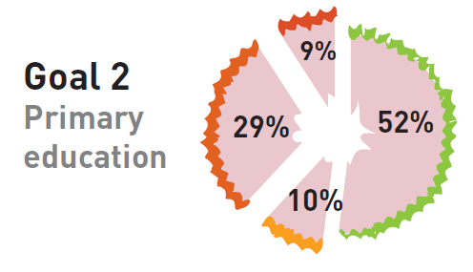
EFA Goal 2: Just half of countries reached the goal
This was the most prominent of the EFA goals
Yet, despite progress, just over half of countries have reached universal primary enrolment
100
South/West Asia
Primary adjusted net enrolment ratio (%)
Centr./East. Europe
East Asia/Pacific
N. America/W. Europe
World
Latin America/Caribbean
Central Asia
90
Arab States
-
Sub-Saharan Africa
80
70
60
50
1994
1990
1992
1996
1998
2000
2002
2004
2006
2008
2010
2012
2014
2015
Source: UIS database; Bruneforth (2015).
Notes:
Universal Primary Education is the most prominent of the EFA goals. It has been well funded, politically supported and extensively monitored.
Yet, despite considerable progress, just over half of countries have reached universal primary enrolment (in which all relevant primary age children are enrolled in primary school). A further 10% are close.
[click] Looking at regional breakdowns, the graph shows there was particularly dramatic progress in South and West Asia since 1999, helped hugely by India which reduced its out of school population by over 90%.
[click] In the Arab States, even though significant progress can be seen in countries such as in Morocco and Tunisia, the region is still home to 4.5 million out-of-school children.
[click] And in sub-Saharan Africa, although the number of children enrolled in primary schools increased by 75%, there were still 30 million out of school in 2012.

Slide 9
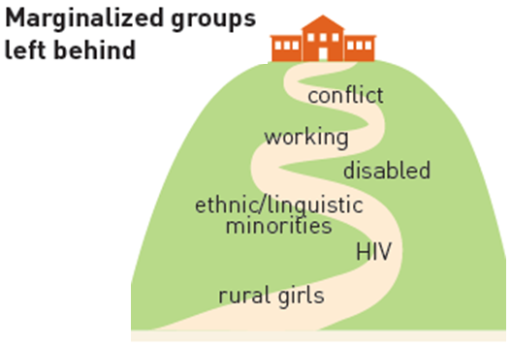
EFA Goal 2: Inequalities in primary school attainment remain
57 million children are out of primary school in 2015.
100 million children will not complete primary school in 2015.
The gaps in attainment between the poorer and the richer households have increased in some countries.
The proportion of out-of-school children in conflict-affected countries increased from 30% to 36% from 1999 to 2012.
Notes:
[click] Overall, 57 million are expected to be out of school in 2015
About 100 million, or one in six, children in low and middle income countries are projected to not complete primary school in 2015.
[click] The Report also shows gaps growing between children from poorer and richer households in some countries in primary school attainment.
Significantly the numbers of out of school children in conflict affected zones constitute a growing proportion today as compared to 1999: from 30% to 36%
In short, improvements are needed to reach all marginalized groups: children from the poorest households, ethnic and linguistic minorities, working children, those in nomadic or sparsely populated areas, orphans and children affected by HIV and AIDS, slum dwellers, children with disabilities and children living in complex emergencies.

Slide 10
EFA Goal 2: Policy successes since 2000
Guaranteeing a free education
Ethiopia, Ghana, Kenya, Malawi, U.R. Tanzania Burundi and Uganda abolished school fees and increased enrolment as a result.
School construction
Mozambique tripled the number of schools and increased enrolment by 35 percentage points.
Conditional cash transfer programmes
Nicaragua, Mexico and Brazil implemented such programmes and helped close gaps between rich and poor.
School feeding programmes
In 32 countries in sub-Saharan Africa, providing on-site meals increased girls’ and boys’ enrolment by 28% and 22% respectively.
Notes:
Policy successes that help the most marginalised gain access primary education include:
Guaranteeing a truly free education, by abolishing tuition fees and covering costs related to school uniforms, transport, and textbooks. Ethiopia, Ghana, Kenya, Malawi, U.R. Tanzania, Burundi and Uganda abolished fees and increased enrolment as a result.
School and classroom construction: Mozambique tripled the number of its primary schools and increased enrolment by 35 percentage points
Conditional cash transfer programmes: Nicaragua, Mexico and Brazil implemented such programmes and helped closed enrolment gaps between rich and poor children.
School feeding programmes: In 32 countries in sub-Saharan Africa, providing on-site meals increased girls’ and boys’ enrolment by 28% and 22% respectively.

Slide 11
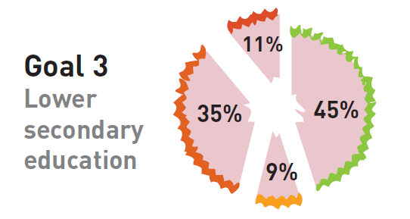
EFA Goal 3: 63 million adolescents are still out of school
Under half of countries achieved universal lower secondary education by 2012, a proxy of skill acquisition
There are 42 million more adolescents in lower secondary education since 2000
If trends continue, universal lower secondary completion will only be achieved towards the end of this century
Notes:
The third EFA goal focused not only on formal education in schools but also on experiences outside school, such as on-the-job training and other learning opportunities over the life course. This wide focus came at the cost of clarity: the goal lacks a clear and measurable target and refers to outcomes – life skills and learning – that can be understood in many ways.
For the purposes of assessing some aspect of progress, the GMR looks at enrolment in lower secondary education, which should provide young people with key foundation skills.
[click] As the graphic shows, under half of countries have achieved universal lower secondary education so far.
This pattern masks significant progress, however. There are 42 million more adolescents in lower secondary education than in 2000.
But this progress is not fast enough. 63 million adolescents currently remain out of school.
If trends continue, only half of adolescents in low income countries are expected to complete lower secondary education by 2030. Universal lower secondary education will only be achieved in all countries towards the end of this century.

Slide 12
EFA Goal 3: Drop out is a major issue in poor countries
Only 1 in 3 adolescents finish lower secondary school in low income countries...
…compared to 5 of 6 adolescents in upper middle income countries
100
Lower secondary attainment rate (%)
90
81
85
80
Upper middle income
69
70
59
65
Low and middle income
60
52
64
Lower middle income
50
52
40
46
25
31
Low income
30
22
20
10
0
1992
1994
1996
1998
2000
2004
2006
2008
2002
Source: EFA Global Monitoring Report team calculations (2015) based on Demographic and Health Surveys, Multiple Indicator Cluster Surveys and other national household surveys.
Notes:
[click] There are big differences between richer and poorer countries in how many students complete lower secondary education.
Only one in three adolescents finish lower secondary school in low income countries as compared to over four fifths of adolescents in upper middle income countries.
[click]
These figures show that students dropping out or leaving school early remains a salient policy challenge
Inequalities in completion are also found between adolescents in urban and rural areas within countries.
In a few countries the rural–urban gap in lower secondary school attainment was substantially reduced, such as Nepal, where the gap fell by 20 percentage points.
In other countries, such as the Lao People’s Democratic Republic, inequalities remained or even increased.

Slide 13
EFA Goal 3: Policy successes since 2000
Abolish school fees
Of the 107 low and middle income countries with data, 94 have legislated free lower secondary education
Assure lower secondary education is compulsory in law
Two out of three countries where lower secondary education was not compulsory in 2000 changed their legislation by 2012
Suspend exams at the end of primary school
Pakistan discontinued these exams in order to increase transition to lower secondary
Ratify the ILO Minimum Age Convention
167 countries have ratified the convention
Support home language of migrant children
Immigrants whose home language is different from the language of instruction at school maintain a clear disadvantage in mathematics
Provide second chance programmes
In Bangladesh, BRAC targets out of school children & prepares them for secondary education
Notes:
The policies that stand out as having helped increase enrolment in lower secondary education, but also ensured young people acquire skills include…
Abolishing school fees. Of the 107 low and middle income countries with data, 94 have legislated free lower secondary education.
Changes in the legal frameworks to assure basic education. Two out of three countries where lower secondary education was not compulsory in 2000 had changed their legislation by 2012.
Ratifying the ILO Minimum Age Convention to enforce labour protection for working children, as has been done by 167 countries so far.
Suspending exams at the end of primary school as in the case of Pakistan
Supporting home language proficiencies of migrant students: OECD results show that immigrant students whose home language differs from the language of instruction at school maintain a clear disadvantage in mathematics, unless policy steps are taken
Providing alternative second chance programmes: BRAC targets out of school children in Bangladesh and prepares them for secondary education, providing financial support to poor primary school graduates.

Slide 14
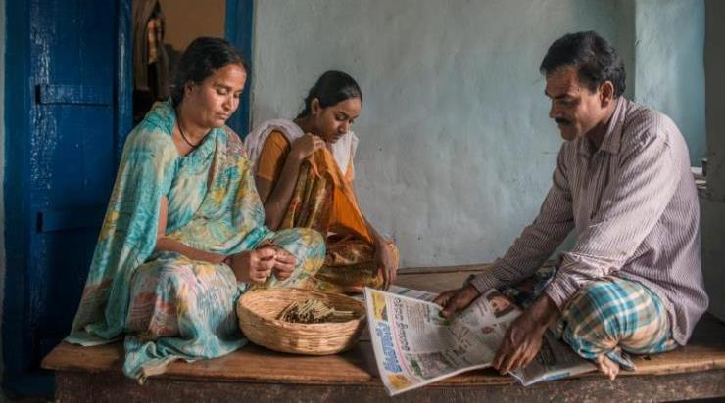
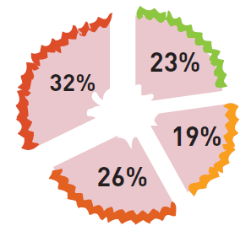
EFA Goal 4: Very few countries met the EFA literacy target
Progress towards EFA’s fourth goal has been slower than improvements in other goals…
The global adult illiteracy rate will have fallen by only 23% by 2015, far short of the 50% target.
Only a quarter of countries reduced their adult illiteracy rates by 50%, and 19% are close.
Notes:
Goal 4 focuses on literacy proficiencies among adults.
Our report shows that the global adult illiteracy rate will have fallen by only 23% by 2015, far short of the 50% target set in 2000.
In total, of those countries with a literacy rate below 95% in 2000, only a quarter (that is 17 out of 72 countries) will have achieved the goal of halving their illiteracy rates by 2015.

Slide 15
EFA Goal 4: No movement reducing gender gaps in literacy
781 million adults with minimal literacy skills, of which two-thirds are still women.
Half of all Sub-Saharan African women lack minimum literacy skills
100
90
World
Adult literacy rate (%)
80
Arab States
70
South/West Asia
60
Sub-Saharan Africa
Sub
Saharan Africa, female
50
40
30
1990
2000
2010
2015
(projection)
Source: UIS database.
Notes:
There has been little significant change in the relative literacy status of adult women since 2000.
Nearly two-thirds of the global total of 781 million adults denied the right to literacy are women – a proportion that has changed very little with time.
[click]
In sub-Saharan Africa today, half of all adult women lack basic literacy and numeracy skills.

Slide 16
EFA Goal 4: Policy successes since 2000
Direct assessments
Kenya carried out a survey in 18 languages. It showed far lower literacy levels than from self-declarations.
Mother tongue programmes
Mexico developed learning materials in 45 languages to help marginalised groups.
Measure literacy skills on a continuum
The LAMP initiative measures literacy on a continuum in five countries, including Jordan and Mongolia.
Well planned and resourced mass literacy campaigns
Nepal invested $35 million in a campaign and achieved huge increase in literacy by 2011.
Keep literacy programmes relevant
In Cameroon farmers learned how literacy skills could help market participation
Notes:
There are fewer policy successes of note for Goal 4, because there are fewer cases in which adult literacy rates have substantially improved over the decade, apart from more educated groups of young people reaching adulthood. However, those that have shown a closer policy focus include:
International or national surveys that directly assess literacy skills, as contrasted to those based on self-declarations, increase our understanding of literacy levels: Kenya’s 2006 direct assessment of literacy was administered in 18 languages and helped identify crucial policy challenges.
Mother tongue literacy programmes: Mexico developed learning materials in 45 languages to help marginalised groups acquire literacy skills.
Measuring literacy skills on a continuum, as opposed to assessments that characterize adults as either literate or illiterate, is important. The LAMP initiative conducted by UIS measures literacy on a continuum in five countries, including Jordan and Mongolia.
Well planned and resourced literacy campaigns: Nepal invested $35 million in a national campaign and achieved a significant increase in literacy rates by 2011.
Relevant literacy programmes linked to community needs: In Cameroon farmers were shown how better literacy skills would help them benefit more from market participation.

Slide 17
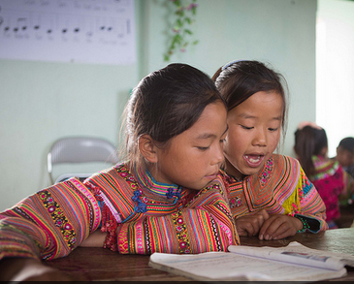
EFA Goal 5: A goal that should have been achieved in 2005
There has been strong movement worldwide towards greater gender parity, but country progress has been uneven
Defining and measuring gender equality remains contested
A third of countries did not reach gender parity in primary education; a half did not in secondary
Notes:
There have been substantial reductions in gender disparities since 1999, but they have not been eliminated.
Progress towards gender equality entails more than reducing gender disparities. It involves interventions such as providing gender-sensitive curricular content and learning materials, training teachers to support gender equality in their teaching methods, and ensuring school leaders are knowledgeable about, and take actions to address, school-related gender based violence (SRGBV). There are different views on how to define and measure gender equality which undermines effective monitoring.
[click]
Achieving gender parity, meanwhile, was one of the measurable Education for All goals, with clear targets set in 2000 and an early deadline was set for 2005, not 2015.
One third of countries will not have achieved gender parity in primary education by 2015.
In secondary education just over a half of countries are projected to reach the target by 2015.

Slide 18
EFA Goal 5: Disadvantages persist and overlap
The poorest girls continue to be most likely never to have attended school
100
Poor female
Never been to school (%)
Poor male
80
Average
60
40
20
0
1998
2012
2000
2010
1999
2012
2005
2010
2006
2012
2000
2011
1998
2011
Niger
Chad
Guinea
Senegal
Pakistan
Ethiopia
Côte d'Ivoire
Notes:
Girls remain less likely than boys to ever enter school, this is even more the case among girls from poor families.
[click]
In Guinea and Niger in 2010, over 70% of the poorest girls had never attended primary school, compared to less than 20% of the richest boys.
Aside from access, in some poorer countries where girls have historically faced barriers, they continue to face disadvantages in learning the basics as well.
By contrast in many wealthier middle and high-income countries, in Europe and LAC, girls out-perform boys in some subjects, and boys are at higher risk of failing to complete a cycle of secondary education.

Slide 19
EFA Goal 5: Policy successes since 2000
Enabling Environment
Burkina Faso and Ethiopia integrated gender perspectives into education plans, with targeted interventions to close gender gaps
Policy Reform
Community mobilisation
Tajikistan used TV and radio campaigns to promote girls’ education
Build Demand
Policies reducing pregnancy and child marriage
Uganda and Zambia encouraged young men and women to engage in responsible sexual behaviour and pregnancy rates fell
Infrastructure, water and sanitation
India built more latrines in 2000s, which resulted in increased girls’ enrolment.
Improved Facilities
Female teachers
Afghanistan tripled the number of female teachers
Address Gender Equality
Safe schools
Brazil worked with men and boys to promote non-violence and reflect on gender norms
Gender-sensitive training
The Forum for African Women Educationalists carried out gender-sensitive training for over 6600 teachers since 2005
Notes:
Policy successes for achieving gender equity, but also addressing gender equality more broadly include
Creating an ENABLING ENVIRONMENT through Policy reform
Burkina Faso and Ethiopia integrated a gender perspective into national education plans, including promoting girls’ right to education and including targeted interventions to close gender gaps
BUILDING DEMAND through Community mobilisation and advocacy campaigns, as was seen in Tajikistan.
Demand can be increased by directly addressing social challenges such as child marriage and adolescent pregnancy: Uganda and Zambia did this by working to encourage young men and women to engage in responsible sexual behaviour. Pregnancy rates in targeted areas fell
IMPROVING FACILITIES including water and sanitation also helps. India built more school latrines in early 2000s and increased enrolment of girls
And it is important to ADDRESS GENDER EQUALITY IN THE CLASSROOM

Slide 20
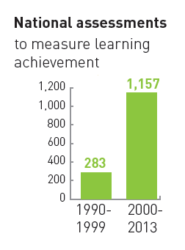
EFA Goal 6: A shift in discourse towards learning
While many countries have made impressive gains in access to education since Dakar, ensuring good quality education has been much more of a challenge
YET: Since 2000, double the number of countries (142) are now monitoring learning outcomes in order to improve education quality.
Some countries - Ghana, Kenya, and Mexico - have increased access and learning at the same time
Notes:
While many countries have made impressive gains in access to education since Dakar, ensuring good quality education has proven to be a more elusive goal. 250 million children today are without basic literacy skills, over half of whom have spent four years in school.
Effective strategies to assess and monitor learning require rigorous assessments that provide countrywide information about student gaps and progress.
[click] A positive development since 2000, showing that concern over poor learning outcomes has really taking hold, is that the number of countries now monitoring learning has doubled: from 70 to 142. In fact worldwide more than 1100 national learning assessments have been carried out since 2000.
[click] Another positive development we have seen over the decade, contrary to many people’s beliefs, is that improvements in learning can go hand in hand with increased access.
In Mexico, for example, far more 15 year olds enrolled in education between 2003 and 2012, and their mathematics scores, as recorded by PISA, also increased, notably among the disadvantaged.

Slide 21
EFA Goal 6: Trained teachers often still remain in short supply
EVEN THOUGH:
In primary education, pupil/teacher ratios have declined in over 80% of countries In lower secondary education, 87 out of 105 countries have a pupil/teacher ratio below 30:1.
Nicaragua
Guinea
Kyrgyzstan
Anguilla
Guyana
Lesotho
…In one-third of the 91 countries with data for 2012, less than 75% of primary school teachers were trained according to national standards.
Nigeria
Grenada
St. Kitts/Nevis
Chad
Dominica
Antigua and Barbuda
C.A.R
Bangladesh
Ethiopia
Liberia
Serbia
Barbados
Comoros
Sierra Leone
Belize
Solomon Is.
Ghana
Mali
Eq. Guinea
Senegal
Angola
Benin
South Sudan
Guinea-Bissau
0
10
20
30
40
50
60
70
80
Trained teachers (%)
Notes:
There is also positive evidence of reductions in pupil/teacher ratios: in primary education pupil / teacher ratios have declined in over 80% of countries; in lower secondary education over 80% of countries have a pupil/teacher ratio below 30:1.
And yet, there remains a global teacher shortage: we need 4 million more teachers in order to achieve universal primary education by 2030.
[click] Improving the quantity of teachers, while important, will not be enough. Teachers need to be well trained and motivated. Many countries have expanded teacher numbers rapidly by hiring individuals without proper training and required qualifications.
In one-third of the 91 countries with data in 2012, less than three-quarters of primary school teachers were trained according to national standards.
Some, like Guinea-Bissau, have even fewer than 50% trained.

Slide 22
EFA Goal 6: Policy successes since 2000
Learning assessments
Early grade reading assessments have prompted governments and donors to rethink policies.
Fill the trained teacher gap
Nepal decreased the pupils per trained teacher ratio from 260:1 in 1999 to 28:1 in 2013
Improve teacher status
Indonesia requires teachers to have a four year degree and be certified.
Multi-lingual policy
38 countries in sub-Saharan Africa now use local languages in primary education
Instructional time
In Chile, a longer school day resulted in higher achievement in language and mathematics in high-school
Appropriate learning materials
In Swaziland, the percentage of children with sole use of textbooks rose from 74% to 99%
Learner-centred pedagogy
In Tanzania primary teachers adapted teaching practices to diverse classroom needs
Better education governance
Empowering teachers and communities in Kenya led to improved students’ language and mathematics scores
Notes:
Policies that have improved the provision of good quality education include:
Utilizing learning assessments to help monitor and provide countrywide information about learning outcomes: Early grade reading assessments have prompted governments and donors to rethink early grade policies in language instruction.
Filling the trained teacher gap: Nepal made particularly dramatic progress on this front, reducing its trained teacher gap from 260:1 to 28:1 over the decade
Improving teachers’ status: Indonesia requires teachers to have a four year degree and be certified.
Shifting towards a multi-lingual language policy: 38 countries in sub-Saharan Africa now use local languages in primary education
Increasing instructional time: Time devoted to learning does enhance students’ exposure to knowledge. International agencies and reports have recommended that primary schools operate between 850 and 1,000 hours per year, or about 200 days, assuming a five-day school week In Chile, a longer school day resulted in higher achievement in language and mathematics in high-school

Slide 23
Domestic Finance: Many countries have increased spending
Many low income countries have increased their spending on education…
Public expenditure on education as a share of GNP (%)
14
Increase of one percentage point or more
Decrease of one percentage point or more
12
10
8
6
1999
2012
4
2
0
Cuba
Iceland
Swaziland
Ghana
Rep of Moldova
Ireland
Cyprus
Kyrgyzstan
Bolivia
Belize
Kenya
Costa Rica
Argentina
Jamaica
Ukraine
United Kingdom
Brazil
Netherlands
Burundi
Barbados
Senegal
Benin
Mexico
Mali
Rep of Korea
Nicaragua
Nepal
Uruguay
Ecuador
Gambia
Tajikistan
Mauritania
Uganda
El Salvador
Cameroon
Laos PDR
Cambodia
Sudan
Israel
St. Vincent
Vanuatu
Bhutan
St. Lucia
Seychelles
India
Guyana
Sierra Leone
Azerbaijan
Brunei Darussalam
Fiji
Panama
Source: Annex, Statistical Tables 9 (print) and 11 (GMR website); UIS database.
Over half of low income countries spent the minimum recommended amount of 4% of their GNP on education
Notes:
A key expected result of the Dakar process was that credible plans would help effectively mobilize financial resources for EFA- both domestic and international.
[click] The GMR shows that many governments, especially among low income countries, have increased spending
[click] In fact 38 countries increased their spending by 1 percentage point or more of national income – these are shown on the left side of this table, with those that decreased their spending are noted on the right.
[click] Globally, the amount devoted to education as a share of GNP was equivalent to 5% in 2012, yet many countries allocated below even 4%.

Slide 24
International Aid: Donors did not keep their promise
Aid to education fell by US$1.3 billion between 2010 and 2012
14
13.9
13.9
13.0
12.6
12.0
11.8
12
10.9
Constant 2012US$ billions
9.8
5.4
5.5
10
5.1
5.2
8.6
8.9
5.1
4.8
8
4.9
6.5
4.5
2.5
2.4
Total aid to post-secondary education
4.2
4.0
2.2
2.3
Total aid to secondary education
6
1.9
1.9
Total aid to basic education
2.6
1.2
1.6
4
1.1
1.3
Only 2% of aid to basic education went to pre-primary education
1.0
6.0
6.0
5.7
2
4.1
4.4
5.0
5.1
5.1
2.9
3.2
3.5
0
2002
2003
2004
2005
2006
2007
2008
2009
2010
2011
2012
Source: OECD-DAC, 2014
Notes:
The pledge made at Dakar that “no country should be thwarted in achieving the EFA goals due to lack of resources” has been one of the biggest failures of the EFA period. Donors failed to live up to their commitments.
[click] Aid to education initially increased and then began stagnating in 2010. In 2012, total aid to basic education for low income countries was US$2.9 billion.
Aid to basic education in sub-Saharan Africa, home to over half of the world’s out-of-school children, grew steadily from 2002 then fell from 2009 onwards.
[click] Of the share that went to basic education, a very small share – only 2% - went to pre-primary education because of the emphasis on universal primary education prioritised by the Millennium Development Goals.

Slide 25
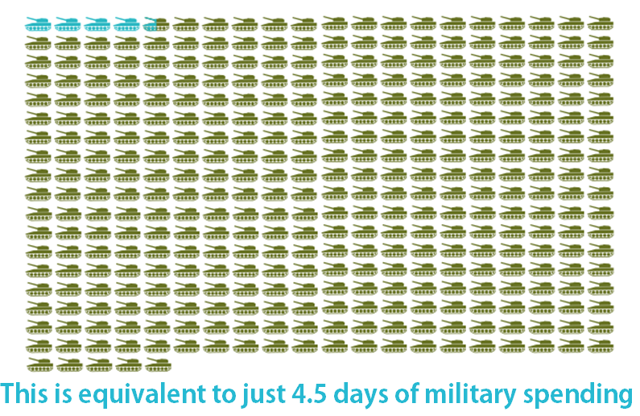
There is a significant finance gap for education
For every child in low and lower middle income countries to benefit from an expanded basic education of good quality by 2030, there is an annual external funding gap of US$ 22 billion
Notes:
The GMR 2015 has calculated the costs of providing all children with an expanded basic education cycle--one year of pre-primary, as well as universal primary and lower secondary education--by the new proposed deadline of 2030.
Even after significant increases in government spending over the next fifteen years, the finance gap amounts to US$22 billion per year. If national education budgets do not increase, this will double.
[click]
If we are to fill this gap, aid for pre-primary, primary and lower secondary education will need to increase by at least four times in the coming years.
This isn’t unthinkable. It is equivalent to just 4.5 days of global military spending
It is crucial that we address this finance gap. If external funding doesn’t increase, basic education for all will not be achieved until the 2060s

Slide 26
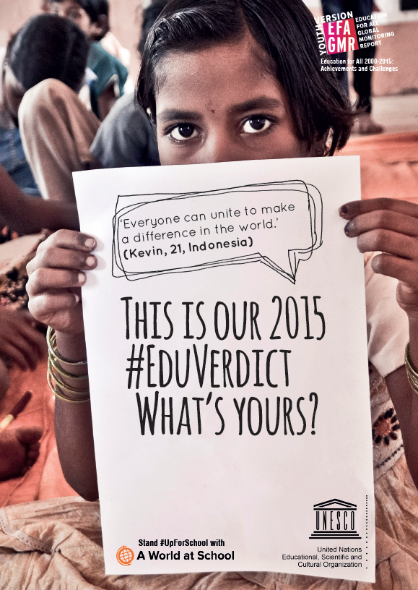
Our #EduVerdict. What’s yours?
We did not reach Education for All.
But we made accelerated progress, notably in getting millions of children and youth into school, and reducing gender disparities.
Those left behind are the most marginalised and vulnerable.
And many millions are still not learning the basics, whether in school or not.
Adult education and learning has been all but forgotten.
While country spending is rising, donors have failed to live up to their commitments.
Notes:
So this is our EduVerdict
We invite you to share yours with us on twitter using this hashtag.
We did not reach Education for All.
2) But we made accelerated progress, notably in getting millions of children and youth into school, and reducing gender disparities.
3) Those left behind are the most marginalised and vulnerable.
4) And many millions are still not learning the basics, whether in school or not.
5) Adult education and learning has been all but forgotten.
6) While country spending is rising, donor commitments have stalled.

Slide 27
Explaining progress towards EFA: The international context
Demographics
Civil society activity
Domestic resource mobilization
Gender discrimination
Armed conflict
Extreme poverty
Education initiatives and coordination
Notes:
From an international perspective several trends and factors have influenced country progress in education.
[click] For example, over the past decade, sub-Saharan Africa has been on a different demographic path than the rest of the world. From 1990 to 2010, the number of children aged 5 to 14 in sub-Saharan Africa increased by 65% while it declined in other regions.
[click] Domestic resource mobilisation also played a part. Developing countries have returned to sustained growth and have outperformed advanced economies over the past 15 years. The economies of the Arab States, Latin America and sub-Saharan Africa had shrunk in the 1990s, but all three returned to economic growth of about 2.5% after 2000. It is mainly this increase that helps explain the growth in education expenditure in developing countries in terms of GDP, as education did not receive a much higher share of the budget over this period
[click] In many countries, prosperity has grown, but this has not always benefitted the poor, leaving many still struggling with the same barriers to education as before.
[click] Education in complex emergencies is an evolving and serious problem.

Slide 28
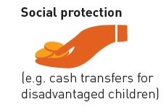
Recommendations
Universal pre-primary education: At least one year of compulsory pre-primary education should be provided as part of an extended basic education cycle.
Universal primary and lower secondary completion: Both levels should be compulsory. School fees should be abolished, and costs for textbooks, uniforms and transport should be covered so that education is truly free.
Notes:
Today, the Dakar vision to ensure quality basic education for all is unfinished. The 2015 GMR advances the following recommendations to address these critical challenges:
[click] Pre-primary education
First and foremost, at least one year of compulsory pre-primary education should be provided as part of an extended basic education cycle.
Non-formal and community-based early learning programmes should be supported where formal programmes are less feasible.
To ensure a better quality education, staff should be trained to stimulate young children cognitively and offer socio-emotional support.
Countries should strive to attract more and better caregivers and teachers by lifting their status and pay to the level of primary school teachers.
[click] Universal primary and lower secondary completion
Attendance at both levels should be compulsory
School fees should be abolished, and costs for textbooks, uniforms and transport should be covered so that education is truly free.
Situations
Governments should develop realistic cash transfer programmes, with simplified conditionality and targeting schemes, to help poor households meet costs
Governments should implement intersectoral programmes in areas such as health and nutrition, as well as investments in roads, water and electricity infrastructure.
Governments should prepare contingency plans to meet the education needs of children in conflict and emergency situations

Slide 29
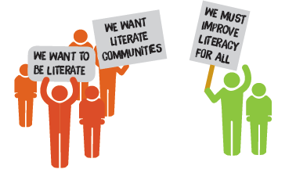
Recommendations
Youth skills: All countries should ratify and implement international conventions that establish a minimum age for employment. Young people should be encouraged to study full-time, rather than part-time, in secondary education.
-
Adult literacy: Literacy and learning policies should be linked with existing development strategies and community priorities.
Notes:
[Click]
Youth Skills
All countries should ratify and implement Convention 138 of the International Labour Organization, which sets a minimum age for admission to employment.
Students should be encouraged to attend secondary education programmes full time.
Policy-makers should identify and prioritize the types and levels of skills to be acquired by the end of each stage of formal schooling.
[click]
Adult Literacy
Countries and international partners should take steps to ensure that the right to literacy is not forgotten
Literacy policies and strategies should be linked to existing development priorities in areas such as health, community development, agricultural innovation and active citizenship.
The use of mobile phones and other ICT platforms for literacy retention and skill acquisition should be supported.
[click]

Slide 30
Recommendations
Gender parity and equality: Countries should adopt policies that reduce child marriage and early pregnancy. There should be more emphasis on gender equality, including through teacher education and safe school environments.
Lifelong learning: All stages of formal and non-formal education should specify the skills to be attained. Governments must significantly expand adult learning and education opportunities.
Notes:
[click]
Gender parity and equality:
Incidences of child marriage and early pregnancy need to be addressed directly in policy.
Gender disparities at all levels of education should be eliminated
To address gender equality, schools need to be safe and gender-friendly.
Governments need to ensure that teacher training covers gender strategies. These programmes must be carefully designed according to local contexts.
Curricula should be gender sensitive and address issues such as sexual and reproductive health
[click]
Lifelong learning:
Countries should significantly expand learning and education opportunities for youth and adults.
All stages of formal and non formal education should specify the skills and other leaning outcomes to be attained
Governments should develop the means to measure and monitor programme participation and outcomes.

Slide 31
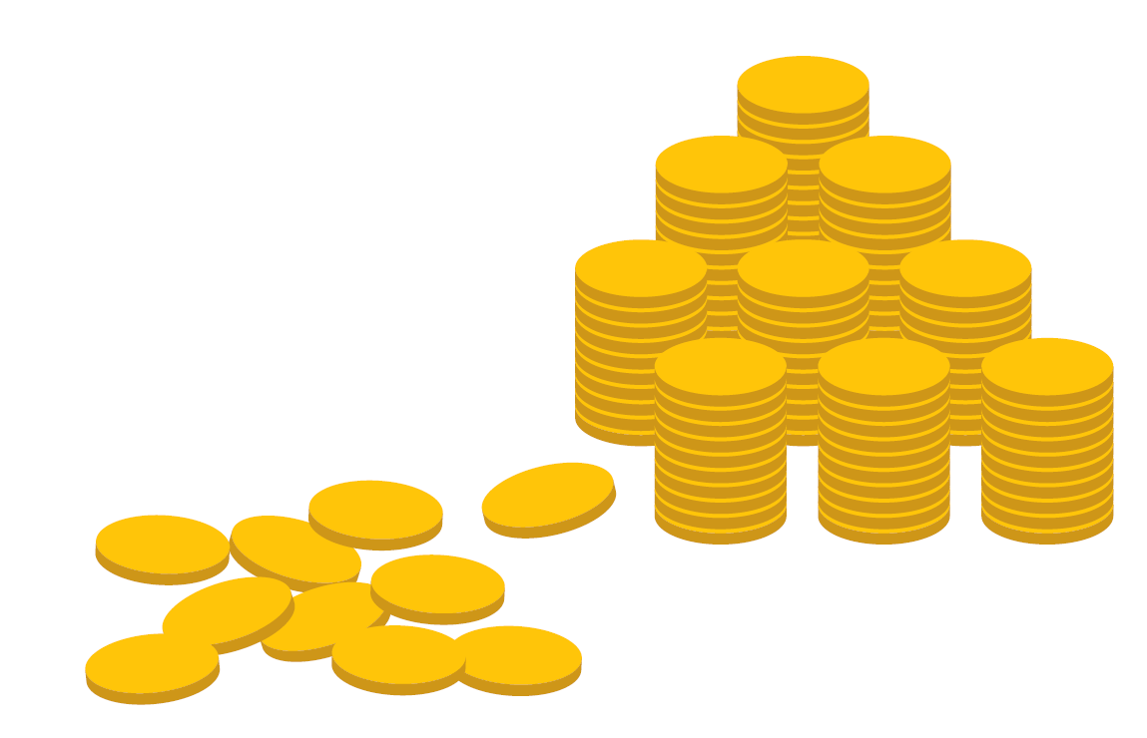
Post-2015 development - A global resolution
Financing for education has to be significantly stepped up:
Governments must ensure that 15-20% of national budgets are spent on education.
Donors need to bridge the US$22 billion annual finance gap.
No finance target exists for education within the sustainable development goals.
Notes:
Governments should mobilize more domestic resources to ensure a sustainable source of funding for the post-2015 education framework.
Governments will need to allocate 15-20% of national budgets to education.
Donors urgently need to help bridge the US$22 billion finance gap
There is no finance target within the new sustainable development goals which holds no one to account.

Slide 32
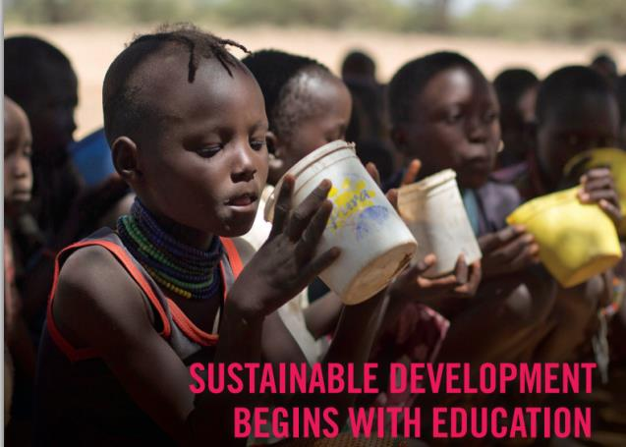
Post-2015 development - A global resolution
Improve education monitoring
Close critical data gaps in learning outcomes
Use disaggregated data from surveys to monitor equity and make the marginalized visible
Improve transparency of all sources of education finance
Education holds the key to achieving most of the post-2015 goals from gender equality and healthy families to sustainable consumption and peaceful societies
Sectors should therefore collaborate closely at the national and global level to improve synergies
Notes:
The past 15 years have shown that measuring progress is a powerful tool for making progress. This remains true for the post-2015 period too.
We must improve the knowledge base of national educational systems to close critical data gaps, especially in learning outcomes over time and across countries.
We need better breakdowns of data in order to be able to monitor whether education progress post-2015 is equitable or not.
Countries need to monitor all sources of education finance to better understand who benefits from public interventions and where improvements can be made.
[click]
Education holds the key to achieving most of the goals of the post-2015 development agenda: from gender equality and healthy families to sustainable consumption and peaceful societies: It is a catalyst for development that cannot be ignored by all working on the sustainable development agenda from now until 2030
In order to benefit from the power of education, sectors should collaborate closely within and between countries to enable synergies to take shape and take root

Slide 33
www.efareport.unesco.org
Blog: efareport.wordpress.com
#EduVerdict / @efareport
Notes:
If you want to join in the conversation about these findings, and find out more, please join us online on our website, or on twitter with the hashtag #Eduverdict.
Thank you for listening.

