Slide 1
‘Approaches to programme planning and budgeting’
Experience of Regional Centre for the Safeguarding of Intangible Cultural Heritage in South-Eastern Europe under the auspices of UNESCO, Sofia, Bulgaria
Third annual meeting of category 2 centres active in the field of Intangible Cultural Heritage
6 July 2015, Guiyang, China

Slide 2
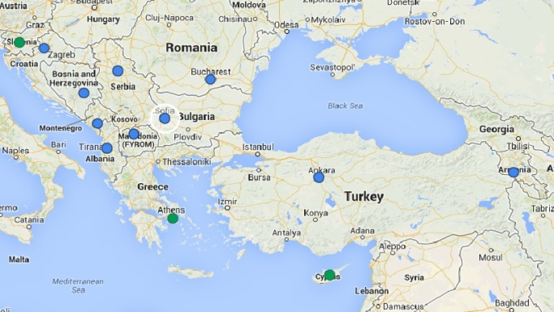
Key Objectives
Agreement between UNESCO and the Government of the Republic of Bulgaria (2010)

Slide 3
To promote the UNESCO 2003 Convention and contribute towards its implementation in the South-Eastern Europe;
To strengthen the participation of individual communities, groups and persons in the safeguarding of ICH in the countries of South-Eastern Europe;
To expand the opportunities for UNESCO member States in South-Eastern Europe for safeguarding of ICH;
To coordinate, exchange and disseminate information regarding the safeguarding of ICH in the sub-region;
To promote regional and international cooperation for the safeguarding of ICH

Slide 4
Specific functions
Agreement between UNESCO and the Government of the Republic of Bulgaria (2010)

Slide 5
Instigate and coordinate research into practices of safeguarding ICH elements present in the South-Eastern European countries;
Organize training courses;
Enhance international and regional cooperation through networking.

Slide 6
Long term programme
Approved by the General Assembly in 2012

Slide 7
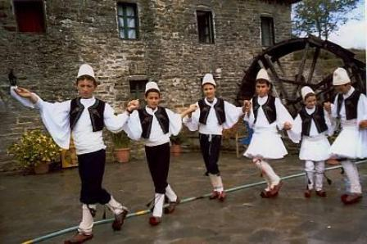
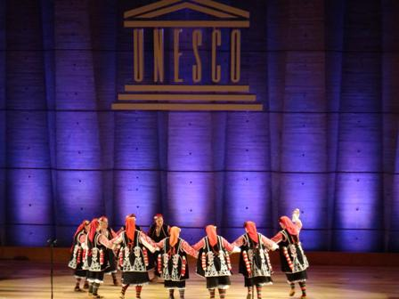
Main fields of activities
Identification and documentation of ICH elements;
Safeguarding of ICH;
Transmission and dissemination of ICH elements;
International Cooperation;
Creation of expert networks;
Actions promoting the work of the Centre;

Slide 8
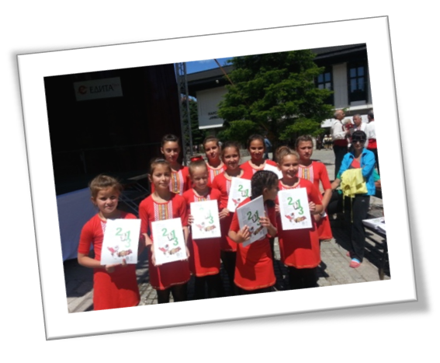
Approaches to programme planning and budgeting

Slide 9
UNESCO’s objectives
37 C/4 2014-2021 Strategic objectives
SO 7 Protecting, promoting and transmitting heritage;
SO 8 Fostering creativity and the diversity of cultural expressions.
37 C/5 Major Programme IV
Building peace and sustainable development through heritage and creativity
Expected Result 6: ‘National capacities strengthened and utilised to safeguard intangible cultural heritage, including indigenous and endangered languages, through the effective implementation of the 2003 Convention.’

Slide 10
Indicators
Number of supported Member States utilizing strengthened human and institutional resources for intangible cultural heritage and integrating ICH into national policies;
Number of Member States with institutional resources strengthened (ministries, institutes, NGOs, universities, ICH committees);
Percentage of UNESCO-trained female cultural professionals who then contribute to national-level decision-making processes in the field of culture;
Number of persons trained in the field of intangible cultural heritage;
Number of supported Member States that have human resources strengthened;
Number of best practices promoted;

Slide 11
Guiding principles
Include all the countries from SEE;
Include representatives of diverse groups of stakeholders;
Promote gender equality and involve marginalized and vulnerable communities and individuals;
Include young people in its activities;
Collect and share up to date information on ICH related policies in SEE;
Assess the results of the planned activities through regular monitoring and evaluation;

Slide 12
Medium-term goals 2014-2018
Increasing the capacity of the South-Eastern European countries for the safeguarding of ICH and for implementing the 2003 Convention at the national level;
Networking and promoting cooperation in the field of ICH;
Promoting ICH in South-Eastern Europe;
Dissemination and exchange of information in the field of the ICH;

Slide 13
Work plan 2015
Approved by the General Assembly
10 March 2015
Sofia, Bulgaria

Slide 14
Objective 1: ‘ Increasing the capacity of the SEE countries for the safeguarding of ICH and for implementing the 2003 Convention’
Activities 1.2. and 1.2. Workshops
In the framework of UNESCO’s capacity-building strategy for the safeguarding of intangible cultural heritage;
Themes: Basic concepts and principles of the 2003 Convention and the safeguarding of the intangible cultural heritage, as presented in the 2003 Convention and its Operational Guidelines;
Trainers: Part of UNESCO’s network of facilitators delivering capacity-building services around the world;
Venue: in Tirana, Albania (14-18 September, 2015); in Skopje, the Former Yugoslav Republic of Macedonia (13-17 October, 2015);

Slide 15
Expected results:
The understanding of the 2003 Convention and its implementation among national experts from SEE increased;
Capacities of local authorities, NGO’s, cultural centres, institutes, ICH bearers strengthened.
Heightened interest in ICH in the context of the implementation of the 2003 Convention in SEE;

Slide 16
Indicators
Number of supported Member States utilizing strengthened human and institutional resources for intangible cultural heritage and integrating ICH into national policies;
Number of Member States with institutional resources strengthened (ministries, institutes, NGOs, universities);
Number of persons trained in the field of intangible cultural heritage;

Slide 17
Objective 2: ‘Networking and promoting cooperation in the field of the ICH’
Activity 2.2. Workshop on ‘Intellectual property, Intangible Cultural Heritage and Traditional medicine’
Seminar organized in close cooperation with UNESCO and WIPO;
April 23-24, 2015 in Sofia, Bulgaria;
Lecturers from WIPO and UNESCO;
Themes: Concepts of the essence of intellectual property, traditional knowledge, traditional cultural expressions, UNESCO’s work on ICH safeguarding and its relation to IP; IP and traditional knowledge, IP and documentation of ICH;

Slide 18
Expected results
In-depth knowledge of the specificities of intellectual property and copyright with relevance to the intangible cultural heritage;
Heightened attention to the issues of intellectual property and copyright;
Shared good practices concerning intellectual property and copyright with relevance to the intangible cultural heritage;

Slide 19
Indicators
UNESCO's cooperation with WIPO on questions of intellectual property strengthened;
Number of organizations within and outside the United Nations system, civil society, and the private sector contributing to programme delivery;
Number of Member States with institutional resources strengthened (ministries, institutes, NGOs, universities);

Slide 20
Objective 3: Promotion of ICH in South-Eastern Europe
Activity 3.1. Interactive cultural calendar for ICH in SEE
Part of the new webpage of the Regional Centre Sofia;
Objective: Collection, dissemination and exchange of information about initiatives and activities aimed at the safeguarding and publicity of ICH in South-Eastern Europe;
Accessible to anyone registered to post information on it in English;

Slide 21
Expected results
Creation and maintenance of a current database of ICH in SEE;
Collection, dissemination and exchange of information about initiatives and activities aimed at the safeguarding and publicity of ICH;

Slide 22
Indicators
Strengthen informal sharing of interesting and innovative examples on working on the Convention (including safeguarding, policy and legislation, sustainable development);
Number of best practices for ICH promoted;

Slide 23
Many Centers have started integrating the Results Based Management methodology in their programming.
QUESTIONS:
What are the challenges of adopting this methodology?
How have the centers surmounted those challenges?
If budgets are annual, how can Centers effectively plan beyond a 12 months timeframe?

Slide 24
THANK YOU FOR YOUR ATTENTION!
webpage: www.unesco-centerbg.org facebook: Unesco Centre Sofia

