Slide 1
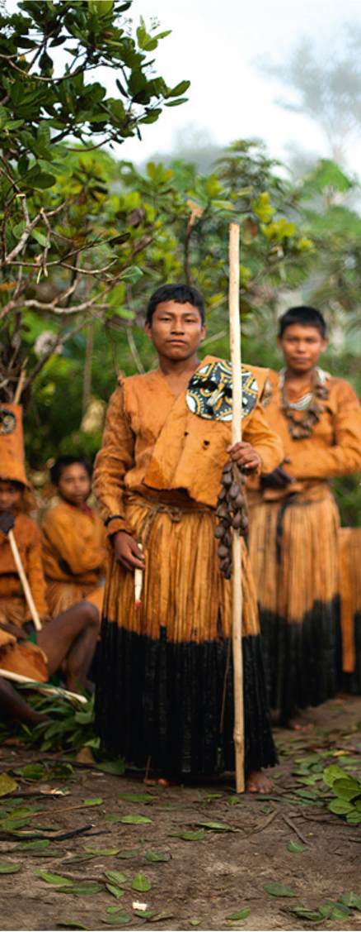
Supporting policy development in the field of ICH in Africa
Conclusions
Constantine — ALGERIA
28 September to 2 October 2015

Slide 2
Objectives
Improve the content and format of the capacity-building programme to provide policy advice effectively.
Equip expert-facilitators with the knowledge and tools required to support policy development.

Slide 3
Topics discussed
Role and mandate of the advising expert
Concept of ICH policy making in the context of the 2003 Convention
Possible synergies and tensions with other policy frameworks and instruments
Policy making within the culture sector and outside the culture sector

Slide 4
Topics discussed
Community participation
Involvement of NGOs
Processes of policy development
Lessons learnt from providing cultural policy advice

Slide 5
Outputs
Suggestions/clarifications
Approach to policy support
Role and mandate of expert facilitator
Key issues in the Guidance Note
Required tools (training workshop national counterparts)

Slide 6
Approach
Embedded in longer-term capacity building programme
Concerns culture and other policy areas
Creates synergies with other Conventions and relevant policy frameworks and standards
Combines expertise –ideally two experts (policy making, ICH, other)

Slide 7
Approach (2)
Combines different intervention modalities (advice/collaborative reflection, stakeholder consultation, training)
Demand driven and needs-assessment based
Not a quick fix, but long-term investment
Participatory and inclusive

Slide 8
Mandate of experts
Represent UNESCO and promote the principles of the Convention
Assist country counterparts to make locally-appropriate, informed choices
Not to suggest model solutions or write policy documents for States
Not be judgmental about issues that fall under the sovereign authority of the State and that fall outside the scope of the Convention

Slide 9
Role of experts
Provide analysis and give examples from other countries
Ask questions to prompt consideration of different options and possible implications
Act as a sounding board for their ideas
Facilitate consensus building
Assist to formulate recommendations
Notes:
provide analysis, information and other support for an endogenous and consultative process of policy development
facilitate consensus building in engaging with country stakeholders, and acting as a sounding board for ideas during their discussions

Slide 10
Tips and ideas
Understand the place of ICH within the strategic vision of the country
Manage expectations from governments wanting a quick-fix
Build trust with all stakeholders and seek to understand their interests
Tread sensitively on difficult issues

Slide 11
Tips and ideas
Listen and ‘read between the lines’ about the reasons for certain views
Be aware of the limitations of perspective that relate to what you are able to observe in the State
Need to engage both, technical and decision-making levels

Slide 12
Tips and ideas
Build on existing expertise, organisations and consultative mechanisms
Report: a tool to be used (do not hide the gaps)

Slide 13
Add in guidance note
Examples of ICH safeguarding issues that are or could be addressed through policy and programmes (recognition of bearers; freedom of movement; ICH of displaced people, etc.)
Areas of related policy, notably in the section on sustainable development (food security, …)

Slide 14
Add in guidance note
Give examples of successful integration of ICH in development policies
Provide information of approaches and examples of community participation in the process of policy formulation and in implementation
Highlight the benefits of State agents and NGOs of engaging in policy work

Slide 15
Add in guidance note
More about how to promote intersectoral communication
More references to specific examples of policy approaches from different countries that already put in place ICH policy
More on budget issues. How much to spend on the implementation of the Convention?

Slide 16
Tools
Guidance note
Training of trainers
FO and HQ backstopping
Materials to train national counterparts

Slide 17
THANK YOU
Notes:
The private sector seems to be more important for the 2005 Convention than for the 2003 Convention, as it is closely in relation with the development of cultural industries;
The two Conventions have different approaches to commercialization: while cultural industries policies need to emphasize on commercialization as a key lever to sustain cultural industries, policies related to ICH should, on the contrary, consider the possible dangers implied by commercialization (e.g. negative impact on cultural practices);
In terms of policy advice, ICH has a more transversal dimension (culture, education, agriculture, health, etc.) than the creative industries sector (culture, art, employment, finance, etc.);
The scope of the 2005 Convention has been debated – Should craft be considered in the scope of the 2005 Convention? For some participants, no, because it is not a cultural industry (there is no production at the industrial level). For other participants, the 2005 Convention clearly refers to ‘cultural expressions’, ‘cultural goods and services’, and both concepts include kraft. In Brazil (and it is also the current trend at UNESCO today), the scope of the 2005 Convention has enlarged to the ‘creative economy’, including de facto gastronomy, design and kraft for instance.
The main following suggestions for action were made:

