Slide 1
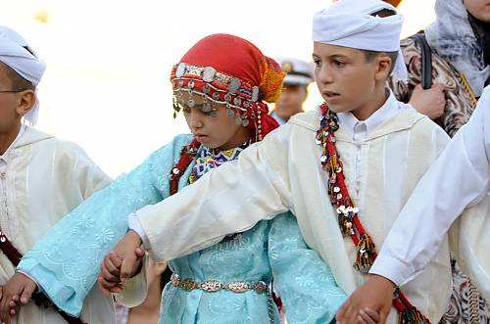
Policy development in the framework of the 2003 Convention for the Safeguarding of the Intangible Cultural Heritage
Harriet Deacon

Slide 2
1
Request by State Party
Needs assessment
2
Consultations
Policy workshop(s)
3
Policy development process
Implementation / revision

Slide 3
Overview
ICH policy making under the Convention
Experiences so far
Policy challenges and opportunities
Policy development processes
Drawing on: Guidance Note and underlying reports; Smeets, R. ‘Policy making for ICH safeguarding‘, Presentation at UNESCO ICH meeting, Shenzhen Jan 2014

Slide 4
Policymaking under the Convention

Slide 5
Policymaking encouraged
Article 13
To ensure the safeguarding, development and promotion of the ICH present in its territory, each State Party shall endeavour to:
(a) adopt a general policy …
(d) adopt appropriate legal, technical, administrative and financial measures …

Slide 6
An infrastructure for safeguarding - I
ICH-related policy, regulations and legislation (Article 13; ODs 103–105);
Bodies to assist in safeguarding with communities (Article 13(b-c); OD 109);
Consultative bodies or coordination mechanisms with community representation …(OD 80);
Documentation centres for management and access to information about the ICH (Article 13(d); OD 109);

Slide 7
An infrastructure for safeguarding - II
Building capacity for safeguarding (13(d)(i), 14, OD 82, 86, 107(k) and 109);
Encouraging cooperation and networking between communities, and between communities and other stakeholders (ODs 79–80, 86 and 88);
Financial measures (Article 13(d) and OD 78); and
Sharing expertise and information internationally (Articles 1(d) and 19, ODs 86–88).

Slide 8
In the spirit of the Convention
Policy to support the safeguarding of ICH should ideally …
Promote recognition of diversity of ICH (Article 1, Preamble),
Promote community participation in ICH safeguarding activities (Article 15, 11(b));
Respect the principles of human rights, sustainable development and mutual respect (Article 2.1); and
Promote international cooperation and assistance (Articles 19-20).

Slide 9
Where is the emphasis?
State encourages communities in their safeguarding activities, and assists in creating a supporting infrastructure
NGOs, research institutions and centres of expertise play a supportive role
Emphasis on community involvement in identification and safeguarding of their ICH

Slide 10
Experiences so far

Slide 11
National policy-making grows
IOS evaluation: 75% of reporting States (29 out of 41 in 2011-13) developed some kind of new ICH safeguarding policy
UNESCO hosts a database of national cultural heritage laws, which can be consulted for a broader range of ICH policies; 250 entries, according to the database classification system, are ICH-related laws. http://www.unesco.org/culture/natlaws/index.php
The World Intellectual Property Organization (WIPO) maintains a database of legislation that can be filtered for entries pertaining to Traditional Cultural Expressions (1,018 entries) and Traditional Knowledge (1,965 entries).
http://www.wipo.int/wipolex/en/results.jsp?countries=&cat_id=16
http://www.wipo.int/wipolex/en/results.jsp?countries=&cat_id=18

Slide 12
Diversity in approaches
Specific ICH policies
ICH policies integrated into overall culture policies
Devolved policy arrangements for ICH
New institutions or directorates responsible for ICH
Broader mandates of existing institutions responsible for ICH
Policies for specific ICH elements
Living Human Treasures policies
Provisions for specific communities and their ICH
Notes:
Legislation specifically for ICH safeguarding (e.g. Japan, China, Georgia, Niger), or integrating it into overall culture legislation (e.g. France, Morocco, Serbia, Viet Nam);
Legislation promulgated and enforced at the sub-national level (such as in provinces or counties in a federal structure) (e.g. Austria, Brazil, Belgium, Italy, Mongolia, Switzerland, Spain, UAE);
Establishing new institutions or directorates responsible for ICH (e.g. the Dominican Republic, Gabon), others have expanded the mandates of existing institutions (e.g. Burkina Faso);
Legal instruments aimed at protecting particular ICH elements inscribed on their national ICH inventory/register and/or the Representative List
Living Human Treasures (e.g. Cambodia, Morocco, Senegal);
Provisions for specific communities and their ICH

Slide 13
Why this diversity?
Regional and international influences;
Approaches before ratification;
Interpretations of the Convention;
Reasons for ratifying the Convention; and
Socio-political, historical and economic contexts

Slide 14
Policy challenges and opportunities

Slide 15
Challenges and opportunities
General context
Within the culture sector
Operational challenges

Slide 16
1. General challenges and opportunities
New area for policy development; different reasons for making ICH policy
No detailed guidance on policymaking in the Convention and its ODs - policymaking encouraged but not a binding obligation
Complexity of integration into existing policy agendas
Different policy roles for ‘culture’ as concept
Low political priority given to culture

Slide 17
Different policy goals
Safeguarding ICH to benefit communities
Development, tourism and innovation;
Diversity and intercultural dialogue;
Public participation and democracy;
Social cohesion, nation-building and identity;
International relations and cooperation;
Recognition and protection of minorities or indigenous groups
ALSO: claiming ownership over ICH nationally or internationally, developing ‘national culture’, etc.

Slide 18
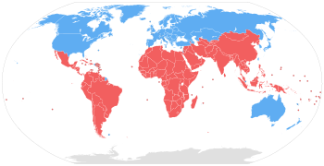
The global context: shifting priorities
Enforcing common IPR standards through trade agreements and treaties
Open data, open access, open culture
Cultural exceptions to trade rules
Cultural industries promotion
Safeguarding ICH
Limiting impacts of IPR protection through provisions for delayed compliance and compulsory licensing, etc.
Protection of TK etc., ensure benefits to communities / developing states

Slide 19
Different policy frameworks affect ICH safeguarding
ICH
IP Rights
Tourism
Human rights
Sustainable development
Education
Heritage sites and objects

Slide 20
Synergy and tensions
Cultural industries
IP protection
ICH safeguarding

Slide 21
Different stakeholders
How are different interests served by policies in different policy areas?
What is the effect on safeguarding?
What is the effect on communities?
State
General public
Communities, groups individual practitioners
NGOs and researchers etc

Slide 22
The work that ‘culture’ does
Culture as ‘civilization of the nation’ (a model for everyone)
Culture as identity (freedom of association, expression)
Culture as a reason for giving specific rights or allowing exceptions to rights provisions for certain groups and not others
Culture as creativity (promoting individual artistry)

Slide 23
Kenya: three different visions of culture in the Constitution National culture
Recognition of ‘culture as the foundation of the nation and as the cumulative civilization of the Kenyan people and nation’ (article 11),
Deacon, H.J. ‘A comparative review of cultural rights provisions in the Kenyan constitution’, 2014. Desk Report for the ESRC-funded research project Cultural Rights and Kenya's New Constitution (2014-17), The Open University, Milton Keynes, UK, http://katibaculturalrights.com/.
Notes:
… the final document of the new constitution must, as far as possible, exhibit qualities of relative objectivity and palpable sense of detachment from possible narrow interests that may threaten to creep into it through the backdoor (Nyasani 2003: 98).

Slide 24
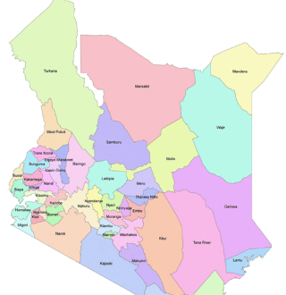
‘Cultures’ of groups
‘cultural diversity’ of the nation (Preamble, articles 197, 238).
‘culture’ affects electoral and county boundaries (articles 89.5 and 188.2),
freedom ‘to participate in the cultural life, of the person's choice’ (article 44),
AND
reducing ‘harmful cultural practices’ by groups (article 44.3, 53.1(d) and 55(d)).
https://opendata.go.ke/facet/counties
Deacon, H.J. ‘A comparative review of cultural rights provisions in the Kenyan constitution’, 2014. Desk Report for the ESRC-funded research project Cultural Rights and Kenya's New Constitution (2014-17), The Open University, Milton Keynes, UK, http://katibaculturalrights.com/.

Slide 25
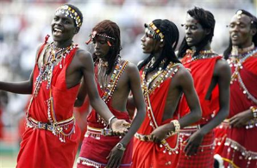
Culture as creativity
Ensuring freedom of expression, including freedom of artistic creativity (article 33).
Protecting the IP rights of communities regarding their traditional knowledge (article 11.3)
GENEVA (Reuters) – The Maasai people of Kenya have enlisted the United Nations to help turn their songs, dances and stories into copyrighted assets, a model that could create new income for indigenous groups worldwide.
http://www.wired.com/2009/07/maasai-music-itunes/
Deacon, H.J. ‘A comparative review of cultural rights provisions in the Kenyan constitution’, 2014. Desk Report for the ESRC-funded research project Cultural Rights and Kenya's New Constitution (2014-17), The Open University, Milton Keynes, UK, http://katibaculturalrights.com/.

Slide 26
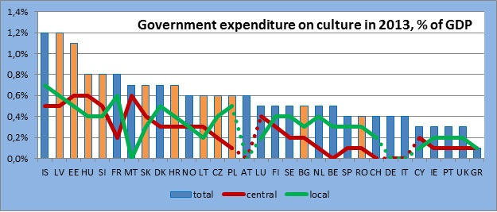
Relative priorities for culture
Percentage spent on culture in European countries
http://www.cineuropa.org/dd.aspx?t=dossier&l=en&did=296736&tid=1512

Slide 27
2. Challenges and opportunities within the culture sector
Relationships between policies within the culture sector; some vested interests
Safeguarding measures can be tailored to specific situations, but ICH policy needs to accommodate diversity and change
Variety of ICH forms and domains: how to classify?
Diversity of communities and groups concerned: how to encourage participation?

Slide 28
Relationships and interactions
Culture policy
Heritage policy
ICH policy

Slide 29
How to classify ICH?
ICH
Kind of participation
Region or community
Domain

Slide 30
Whose participation? How to encourage it?
Practitioners and groups associated with identified ICH
Identified communities or those associated with identified ICH
General public

Slide 31
Involving communities: how policies can help
Broad definition of communities
Enabling consultation and cooperation between communities and other stakeholders
Ensuring representatives have appropriate mandates
Proof of free, prior and informed consent from communities
Access and benefit sharing agreements with communities
Community involvement in institutional arrangements
Benefit to communities
Respect for traditional access limitations
Codes of ethics, etc.

Slide 32
3. Operational challenges
Weak public and community consultation mechanisms
Weak communication and collaboration within government agencies / administrative centres
Weak institutional capacities

Slide 33
Policy development processes

Slide 34
Challenges for safeguarding ICH
Existing structures and policies
Policy aims and objectives
ICH-related policies
What is the problem?
What is already in place?
What do we want to achieve?

Slide 35
Common questions
the nature of the ICH in the territory of the State and its viability in communities
problems identified by stakeholders (especially communities concerned and community-related NGOs) that could be addressed through policymaking;
the existing policy environment and institutional context
the likely aims, scope and nature of ICH-related policy in the State,
ways of developing and then achieving agreed policy outcomes,

Slide 36
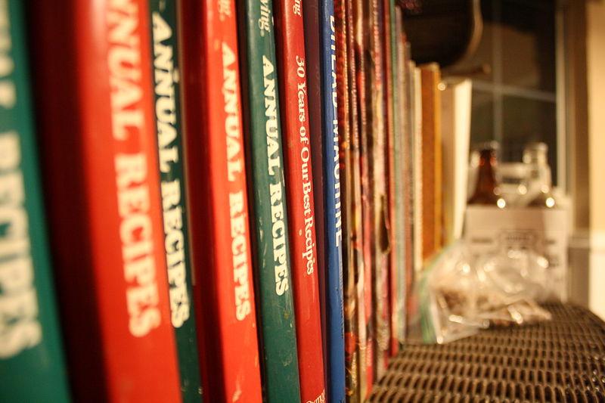
No simple recipe

Slide 37
Key ingredients
Participation of communities
Broad public support
Political will

Slide 38
Involving communities: process
Broad definition of communities
Participation by a diversity of communities and groups
Diversity of ways to involve the public
Ensuring representatives of communities have appropriate mandates to do so and are given the opportunity to consult with their constituencies

Slide 39
Other factors for policy success
Evidence-based
Feasible
Effective

Slide 40
Reiterative policy development
Pilot projects testing policy approaches in different contexts
Explore impacts
Adjust policy
Refine approaches
Develop policies
Monitor and evaluate
Adjust policies

Slide 41
When all you have is a hammer, every problem looks like a nail
It may be important to look for new and innovative approaches.

Slide 42
Thank you

