Slide 1
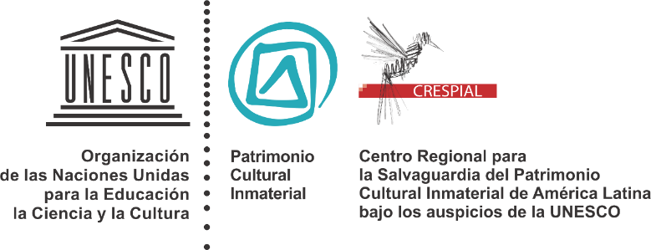
Approaches to governance and getting the most from your governing body(ies)

Slide 2
I. What is governance?
Governance are the mechanisms, processes and rules that allow an organisation to exert economic, political and administrative authority.
The organisation can be private, state or non profit.
Governance tries to understand the institutional conduct or behaviour, as it is influenced by the agents and the rules.

Slide 3
II. Challenges of Governance
Beside the in built tension of institutional design, governance faces constant challenges:
Technological progress, i.e. ICTs
Growing political role of civil society
Current redefinition of state roles
Growing demand for new ethical and associative strategies with public, private and multinational actors
Diverse scenarios posed by the processes of globalisation

Slide 4
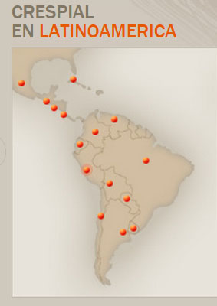
III. Governance in CRESPIAL and implementing the 2003 UNESCO Convention for ICH Safeguarding in Latin America
To achieve consensus and legitimacy CRESPIAL received the following design of government:
The Administration Council (CAD)
b) The Executive Committee (COE)
c) The Executive Secretariat of CRESPIAL

Slide 5
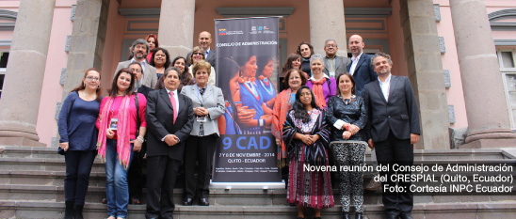
The Administration Council (CAD) is the top governing body. It comprises one representative of each of CRESPIAL’s 15 member states and a representative of UNESCO’s Director General.
To be a member state a request letter is sent to CRESPIAL’s Director General, (s)he then informs the CAD and UNESCO and membership is effective. The CAD elects a president and and a secretary every two years.

Slide 6
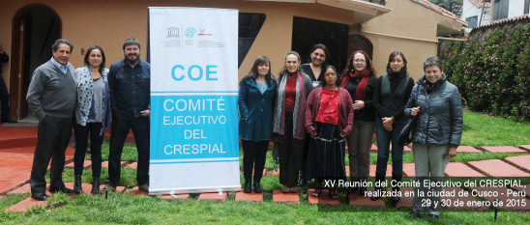
The Executive Committee(COE) produces the work agenda (every 2 years) and examines progress report (every year) to be revised and decided by the CAD. Every four years it establishes a strategic plan based on a prospective planning exercise.
The COE has four members elected by the CAD for four years. Peru is a permanent member.

Slide 7
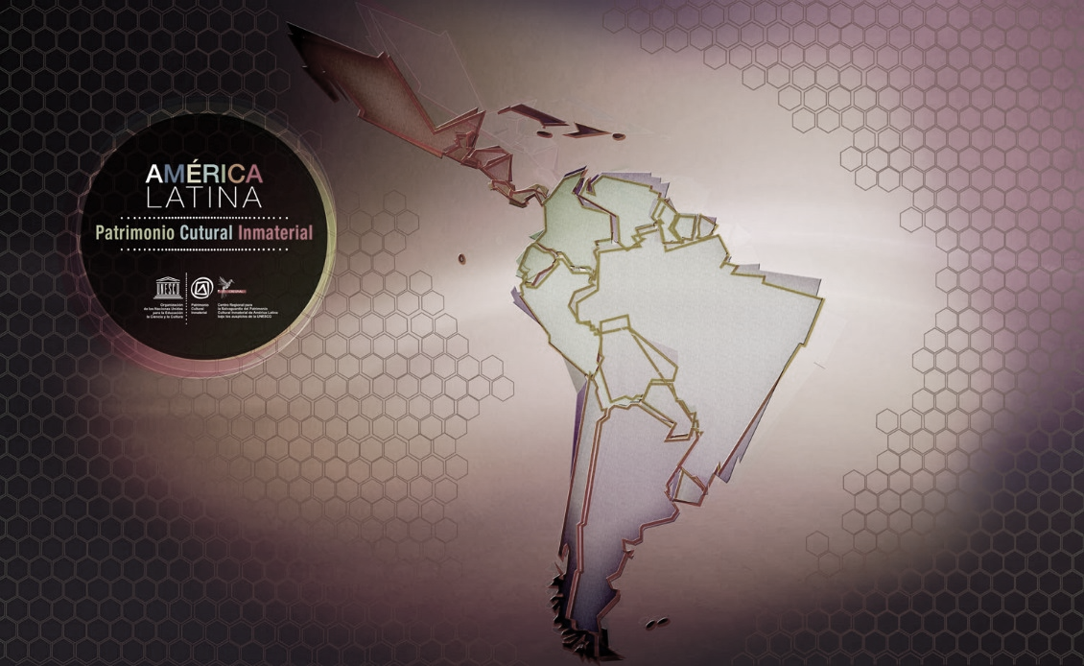
The Executive Secretariat is led by a Director General, who is elected by the member states in a selection process. (S)he designates the centre’s personnel.
The Executive Secretariat implements the Operative Plan of the institution and proposes the work plans in coordination with the COE.

Slide 8
Governance subsistems in CRESPIAL:
Participatory and prospective planning:
Every four years CRESPIAL embarks on a prospective planning workshop under the COE instructions. The workshop produces scenarios of long term futures that allow for the planning of actions oriented to the safeguarding of the regional ICH.
2) Collaborative strategies (technical and financial) and the possibility of building strategic alliances or partnerships:
CRESPIAL implements multinational projects that establish agendas of mutual interest to member states. We also promote and maintain South-South cooperation strategies based on learning from good practices and the shared financing of activities.

Slide 9
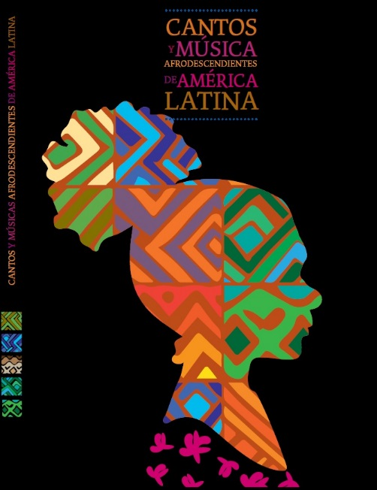
To this date the following multinational projects have been implemented:
ICH safeguarding of aymara communities of Bolivia, Chile and Peru.
Safeguarding of songs, dances and music of afrodescendants in CRESPIAL countries

Slide 10
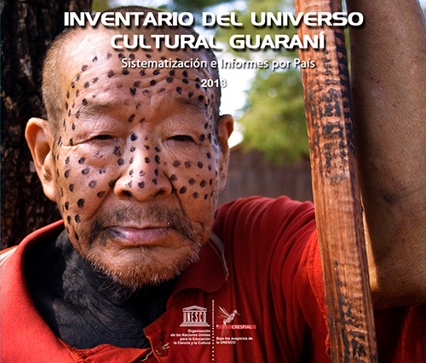
ICH safeguarding of the Communities of the Guarani Nation.
ICH safeguarding of the Maya in Mexico, Guatemala, El Salvador and Costa Rica.
Observatory of Plan and Policiesfor ICH safeguarding in CRESPIAL countries

Slide 11
The multinational projects have been an effective source of capacity building, both institutional and in ICH safeguarding. And the development of such capacity has been uneven.
Thus, challenges and difficulties remain, i.e. :
We have not advanced activities in terms of ICH in need of urgent safeguarding.
We have not developed enough reflexivity, nor effective answers, to the sustainable development in and of the projects.
We have not achieved substantial intersectoral activities.

Slide 12
3) ICT based information and communicaction
We have implemented a virtual multimedia platform and a news network on ICH safeguarding for the promotion and awareness of ICH in our 15 Latin American member states.
Achievements are based on a free access to information, while challenges relate to the respect of individual or collective intellectual property and the conceptual and practical limits with cultural industries and cultural landscapes. We also lack a clear strategy for relating to mass media.

Slide 13
4) Capacity Building
We have strengthened the management capacities of member states and in partner institutions for ICH safeguarding in each of the 15 countries members of CRESPIAL.
CRESPIAL has centred its planning of CB activities approaching needs assessment through the identification of competencies y vocational profiles for ICH safeguarding.
This is an ongoing process in relationship with the states, academia, civil society, ngos and, last but not least, the bearers of ICH.

Slide 14
Brief reflection on case specifics
Once a decision has been reached by our CAD, the micromanagement of the projects is closely related to the varying degrees of national structuration of their institutional system for ICH safeguarding. Briefly put, 3 types can be found in the CRESPIAL member states:
Those states with a substantial institutional structure for ICH safeguarding
Those states that have embarked on structuration processes but with limitations on continuity and consolidation of their institutional structures for ICH safeguarding
Those states with no ICH safeguarding system or very embrionary ones.

Slide 15
IV. Questions
What is your centre functioning structure?
How are the institutional agendas produced?
What is the participation of member states?
Can you distinguish different micromanagement actions?
How is collaboration built into the functioning of the centre and member states?

