Slide 1
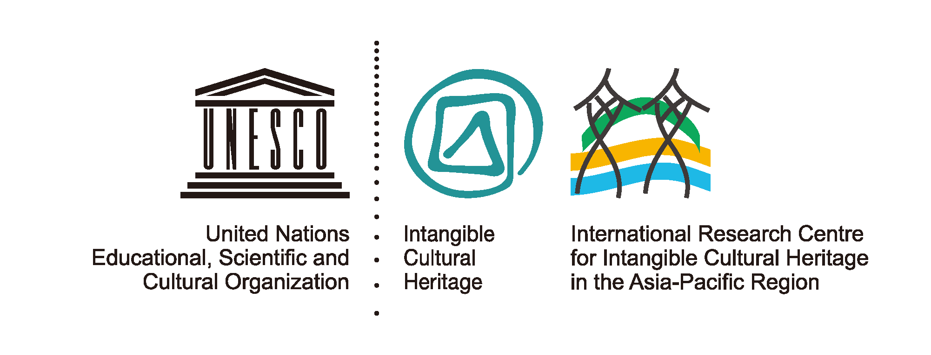
IRCI’s Activities for FY2017
Wataru iwamoto
Director-general, international research centre for intangible cultural heritage in the asia-pacific region under the auspices of unesco (UNESCO), japan

Slide 2
Contents
Overview of IRCI
Mission
Reports & Plans of IRCI’s Activities
Activity Focus 1: Promoting Research for ICH Safeguarding
Activity Focus 2: Research on ICH Safeguarding and
Disaster Risk Management
Cooperation with Sakai City, Osaka, Japan
Outcomes of IRCI’s Activities

Slide 3
Ⅰ. Overview of IRCI
Background of Establishment
：UNESCO’s Convention for the Safeguarding of Intangible Cultural Heritage (ICH)
→ Enhancement of the Safeguarding of ICH through instigating,
Facilitating and coordinating research in the Asia-Pacific region
・2003: UNESCO’s Convention for the Safeguarding of ICH
・2009: Approval of ‘Establishment in Japan of the International
Research Centre for ICH in the Asia-Pacific region as a
Category 2 Centre under the auspices of UNESCO’
・2010: Signature of the Agreement between the Government of
Japan and UNESCO
・2011: Establishment of IRCI in Sakai city, Osaka, Japan

Slide 4
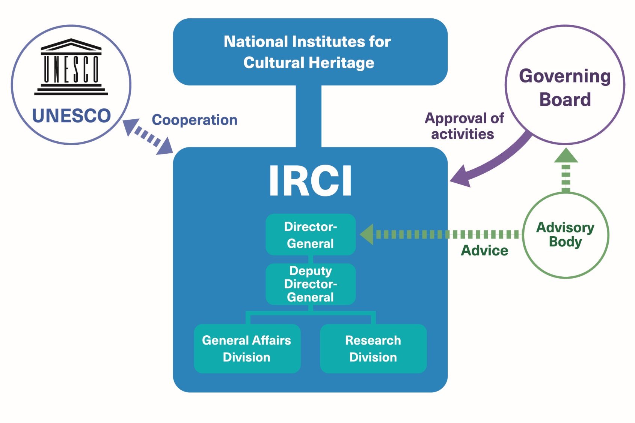
National Institutes for
Cultural Heritage
・comprised of 7 individual institutions
which have the same mission to
conserve and utilize the cultural
properties
Operation
Governing Board
・deliberates and approves
all IRCI activities
・made up of 10 experts
and representatives of
specialized institutions
inside and outside Japan
including a UNESCO
representative
UNESCO C2 Centre
・The institution that serves to contribute to
the achievement of UNESCO’s strategic
objectives
・There are eight UNESCO C2 Centres
around the world in the field of the
safeguarding of ICH
・In addition to IRCI, there are two more
C2 Centres in China and the Republic of
Korea in the Asia-Pacific Region
※ Japan - Research
China - Training Activities
Korea - Information and Networking

Slide 5
Ⅱ. Mission
①To instigate and coordinate research into practices and methodologies of safeguarding endangered intangible cultural heritage elements present in the Asia-Pacific region, while cooperating with universities, research institutions, community representatives and other governmental and non-governmental organizations in Japan and elsewhere in the region
②To assist, in terms of research, countries in the Asia-Pacific region in implementing such measures as referred to in Articles 11, 12, 13 and 14 of the 2003 Convention, while paying special attention to developing countries
③To organize workshops and seminars focusing on the role of research as a useful component for safeguarding the intangible cultural heritage and related practices and methodologies, involving experts, community representatives and administrators from the Asia-Pacific region
④To encourage and assist young researchers in the Asia-Pacific region engaging in research activities related to safeguarding the intangible cultural heritage
⑤To cooperate with other category 2 centres and institutions active in the domain of safeguarding the intangible cultural heritage, in the Asia-Pacific region
⑥To initiate cooperation among all other interested institutions active in the domain of safeguarding the intangible cultural heritage, while furthering technical assistance vis-à-vis developing countries, in the Asia-Pacific region

Slide 6
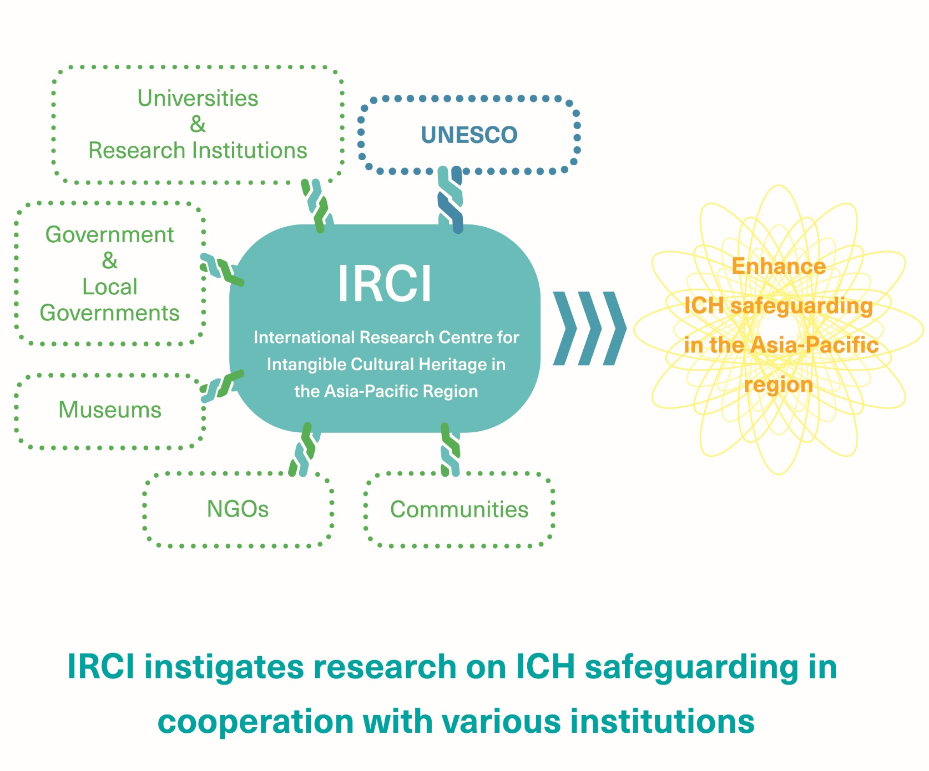
Cooperation with the related Institutions and Communities

Slide 7
Ⅲ. Reports & Plans of IRCI’s Activities
【Activity Focus 1】 Promoting Research for ICH Safeguarding
<Mapping Project 1> International Conference
<Mapping Project 2> Literature Survey
<Mapping Project 3> Research Data Collection
IRCI Researchers Forum
【Activity Focus 2】 Research on ICH Safeguarding and
Disaster Risk Management
Preliminary Research on ICH Safeguarding and Disaster-Risk Management
Study of Emergency Protection of ICH in Conflict-Affected Countries
Cooperation with Sakai City, Osaka, Japan

Slide 8
Mapping Project
Background
・Research activities and availability/accessibility of literatures for ICH
safeguarding are limited
・Information on related research activities are not shared among experts
・Insufficient development of the human and organizational resources for ICH
safeguarding
Purpose
・Expand and strengthen the network of researchers related to ICH
safeguarding in the Asia Pacific region
・Enhance and promote research for ICH safeguarding

Slide 9
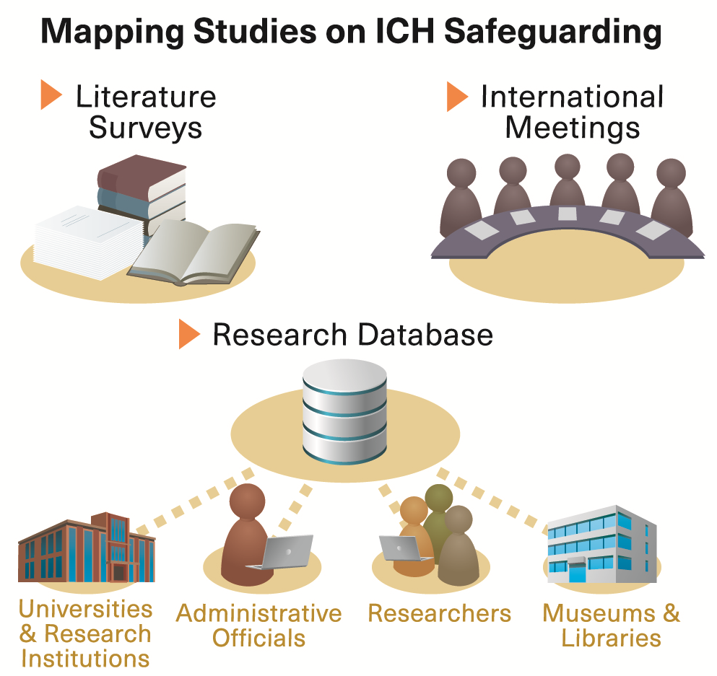
Mapping Project
The project has been implemented and managed as an integration of the following 3 sub-projects:
<Mapping Project 1>
International Conference on the Convention for the Safeguarding of ICH
<Mapping Project 2>
Literature Survey on ICH Safeguarding Research in the Asia-Pacific Countries
<Mapping Project 3>
Research Data Collection on ICH Safeguarding in the Asia-Pacific Region and Optimisation of its Use

Slide 10
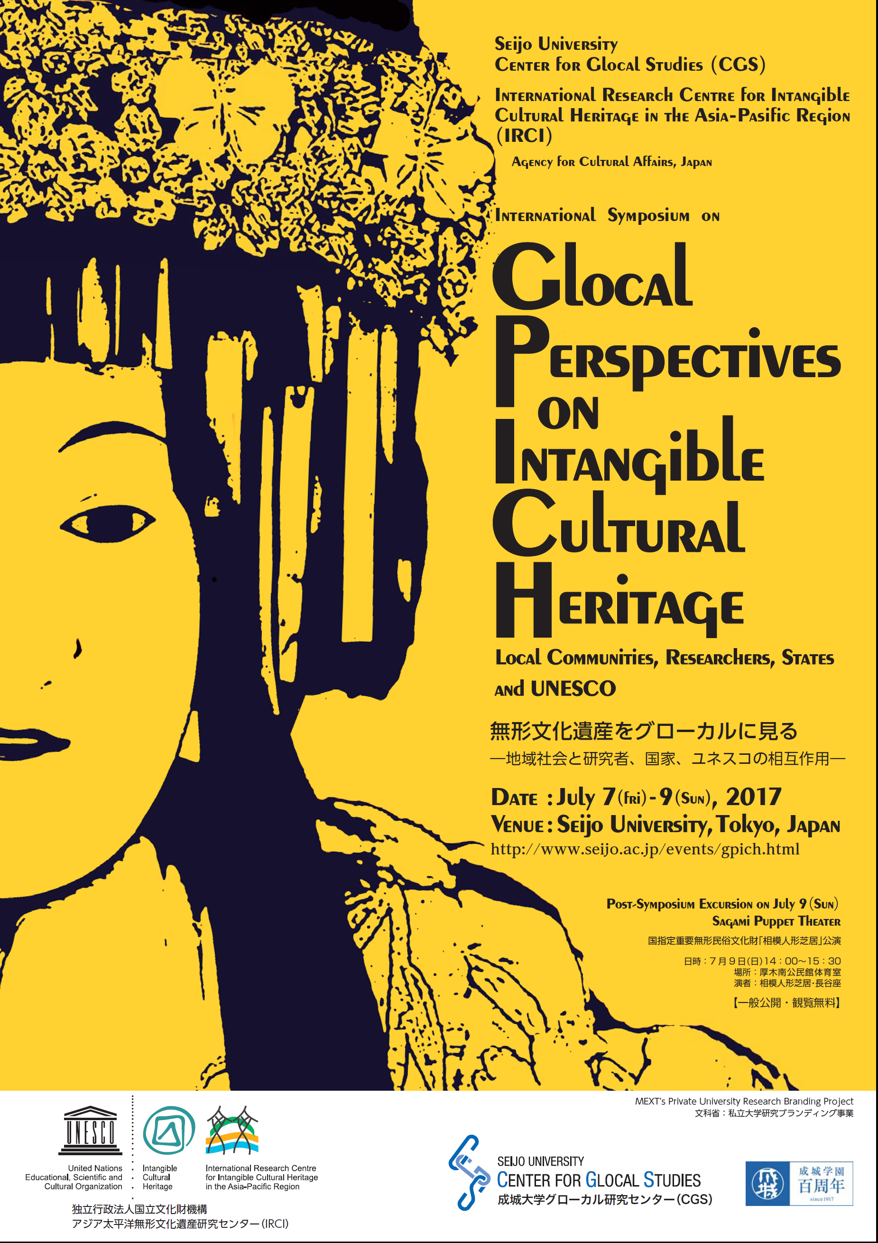
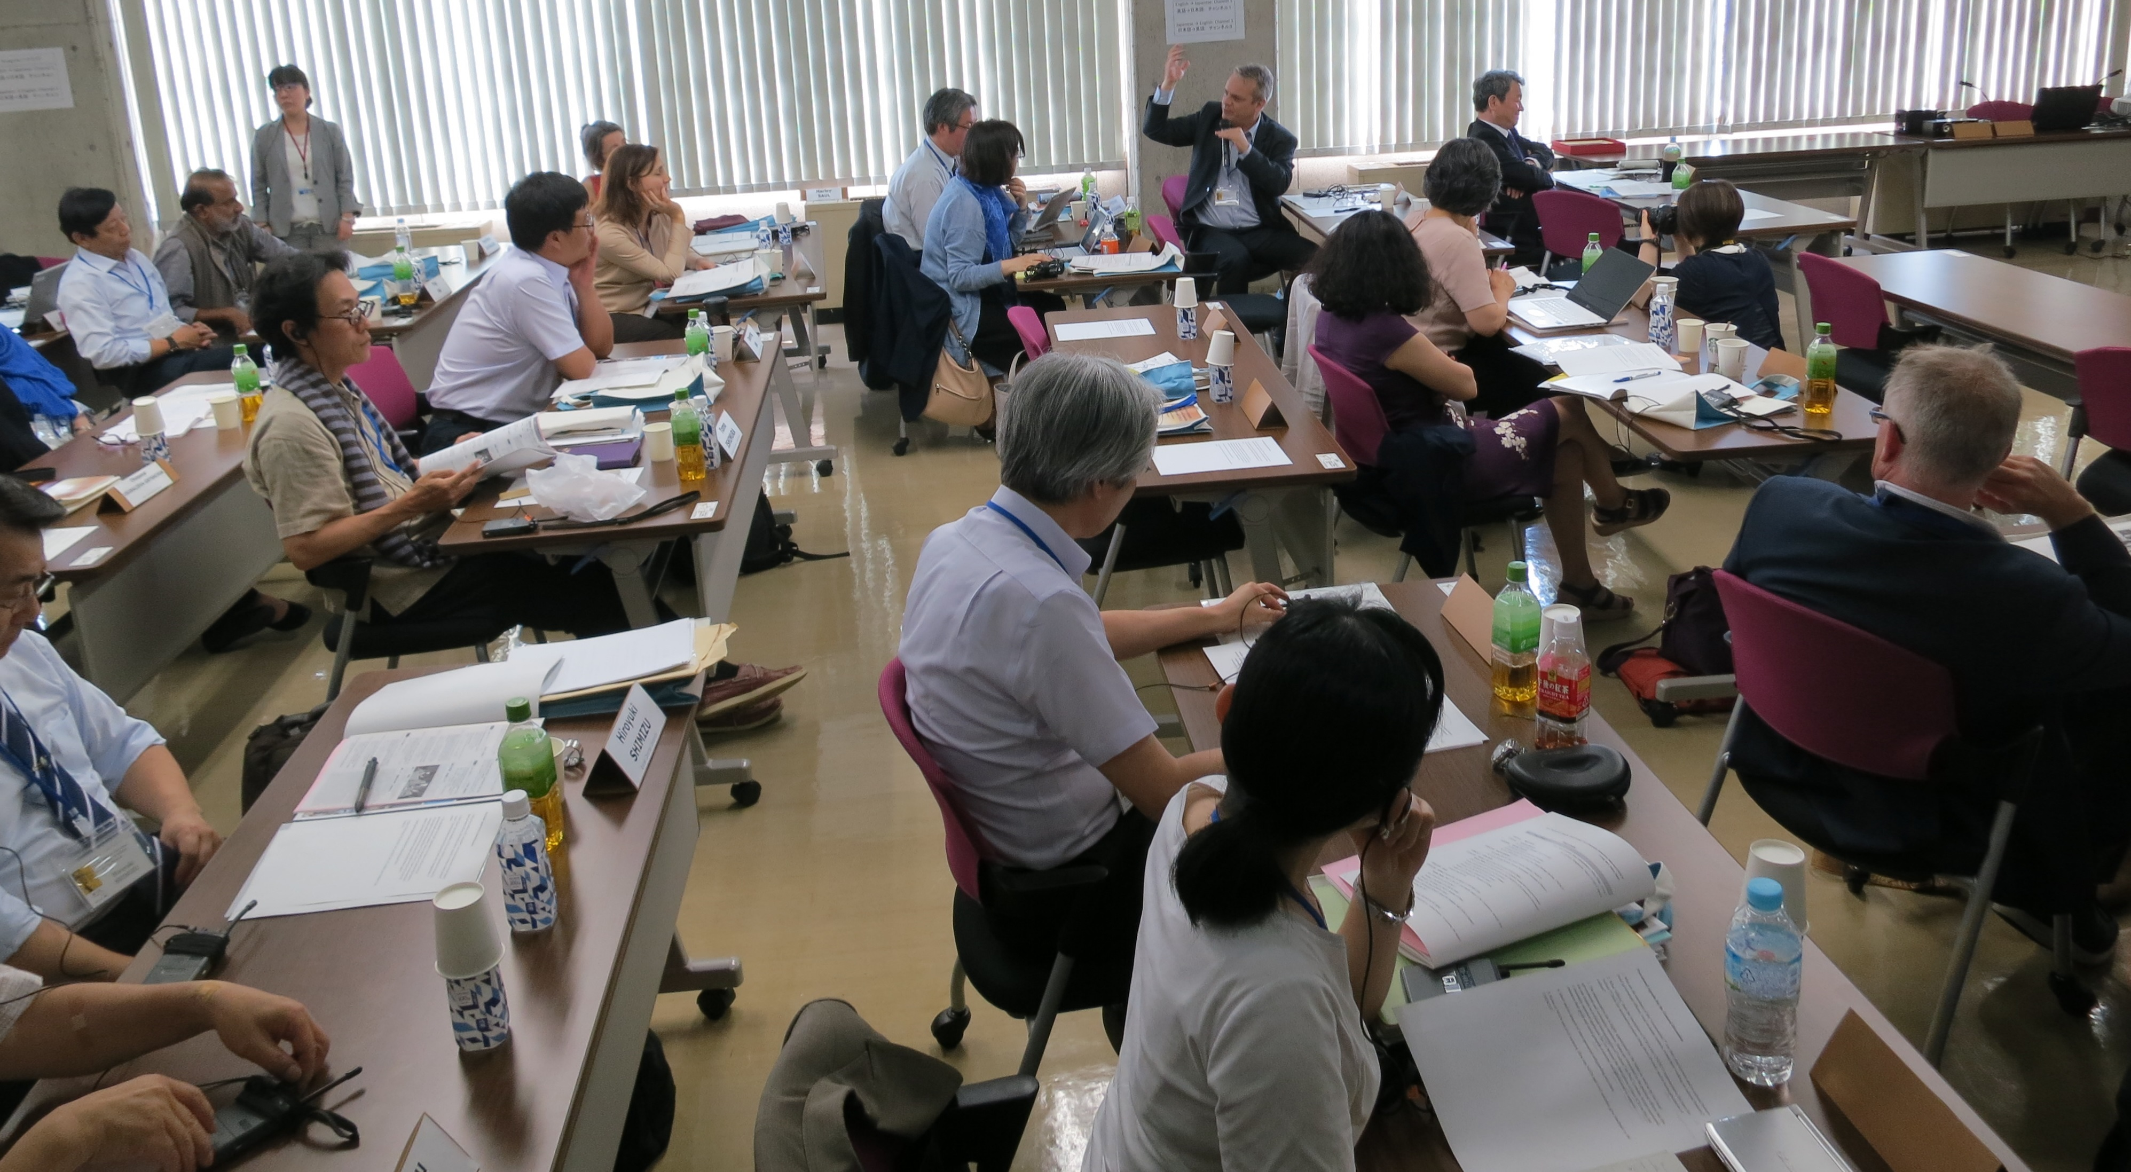
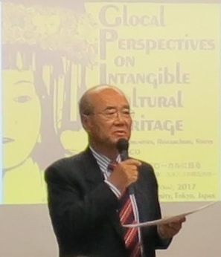
International Conference on the Convention for the Safeguarding of ICH
Glocal Perspectives on Intangible Cultural Heritage : Local Community, Researchers, States and UNESCO
- Co-organized by IRCI and Center for Glocal Studies, Seijo University, Japan
- Focus : the interface between local communities, researchers and the UNESCO Convention
- Participation of 22 experts and community members from 6 countries
- Conference proceedings will be published, and edited for future publication
(Keynote speech
by Mr. MATSUURA,
Former Director General, UNESCO)
(General Discussion)
(Poster of the symposium)

Slide 11
Literature Surveys
【24 Countries Surveyed in 2015&2016】
Australia,
Bangladesh
Cambodia
People’s Republic of China
Fiji
India
Islamic Republic of Iran
Japan
Kazakhstan
Kyrgyzstan
Lao People’s Democratic Republic
Malaysia
Mongolia
Myanmar
Nepal
New Zealand
Palau
Republic of Korea
Sri Lanka
Tajikistan
Thailand
Uzbekistan
Vanuatu
Viet Nam
Survey in 2015
①Australia, ②Bangladesh, ③Cambodia, ④People’s Republic of China, ⑤Fiji, ⑥India, ⑦Japan ⑧Kazakhstan, ⑨Kyrgyzstan, ⑩Lao People’s Democratic Republic, ⑪Malaysia, ⑫Myanmar, ⑬Republic of Korea, ⑭Tajikistan, ⑮Thailand, ⑯Uzbekistan, ⑰Viet Nam
Survey in 2016
①Cambodia, ②Islamic Republic of Iran, ③Japan, ④Malaysia, ⑤Mongolia, ⑥Myanmar, ⑦Nepal, ⑧New Zealand, ⑨Palau, ⑩Sri Lanka, ⑪Vanuatu
Survey in 2017
①Republic of the Philippines, ②Brunei Darussalam and so on…

Slide 12
Research Data Collection and Optimisation of its Use
Collecting the information of
“Literature, Institutions and Experts”
related to the safeguarding of ICH in the Asia-Pacific
【Literature Surveys since 2014】
1790 Literature, 111 Experts, 111 Institutes
in the Asia-Pacific region
2014: Literature (255), Experts (111), Institutions (110)
2015: Literature (702), Institution (1)
2016: Literature (833)
2017: Under Survey……

Slide 13
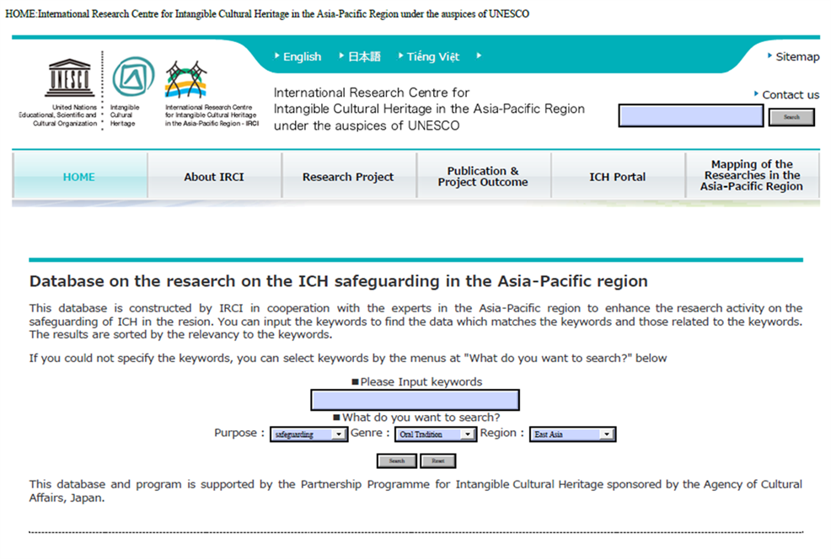
Database
Released an online research database in September 2014 (http://www.irci.jp/ichdb/)
information on relevant literature, experts, institutions and administrative officials involved with the safeguarding of ICH in the Asia-Pacific region are searchable
Currently consists approximately 2,000 entries as of April 2017
New entries will be further added to reflect the output of ongoing literature survey in FY2017
http://www.irci.jp/ichdb/

Slide 14
IRCI Researchers Forum
International Symposium “Negotiating Intangible Cultural Heritage”
Dates：29 November (Wed) ~ 1 December (Fri) 2017
Organizer：IRCI
National Museum of Ethnology
Agency for Cultural Affairs
【Objectives】
To analyse the ways in which the multiple levels of negotiation between various actors/stakeholders affects the safeguarding of ICH
To discuss the potential for reviving lost or threatened culture in the process of various negotiations regarding ICH
To lay the foundation for ICH research in the Asia-Pacific region through the professional, inter-disciplinary discussions on theories and issues in ICH safeguarding

Slide 15
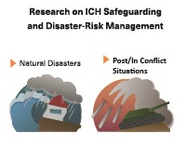
Research on ICH Safeguarding and
Disaster Risk Management
Conducts research on the current status and the cases of the safeguarding of ICH that are endangered by Natural Disasters and on the role of ICH for disaster preparedness and in the post-disaster recovery process:
Preliminary Research on ICH Safeguarding
and the Disaster-Risk Management
Study of Emergency Protection of ICH in
Conflict-Affected Countries

Slide 16
Preliminary Research on ICH Safeguarding and the Disaster-Risk Management
【Aims for FY2017】
To Access
the actual impact of natural hazards and disasters on ICH
the positive roles of ICH in disaster-risk reduction (DRR) and management (DRM)
by Conducting field surveys in selected countries such as the Philippines, Vietnam, Myanmar,
Fiji and Vanuatu
Ex.) 【Vanuatu Survey】
(Field) Gaua, Banks Islands, in northern Vanuatu affected by the 2009-2010 volcanic eruption
(Date)19-24 July 2017
Assessment of the current situation of ICH in association with natural hazards and disasters at the community level
Cooperative research between IRCI and the Vanuatu Cultural Centre

Slide 17
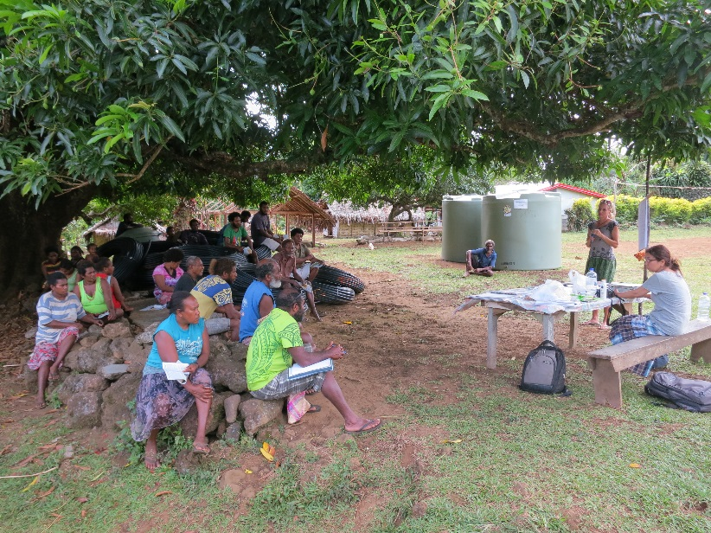
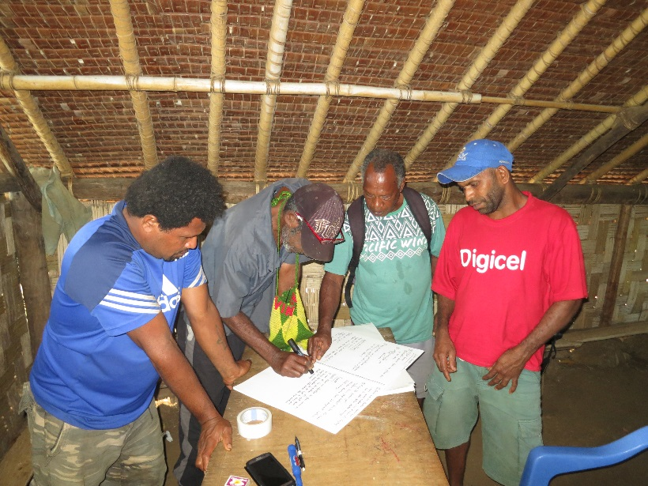
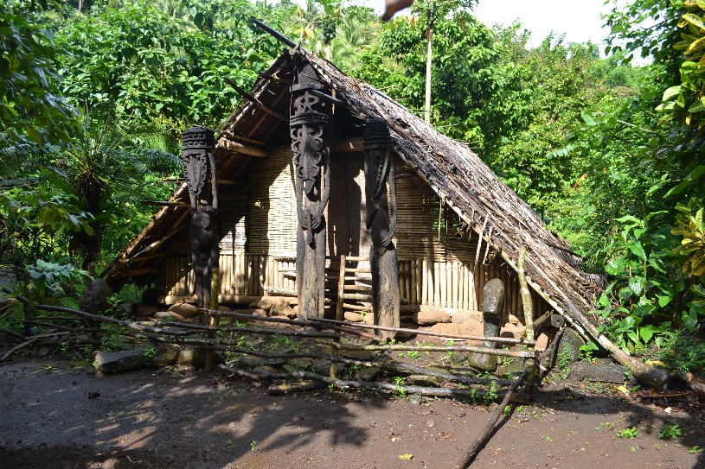
Workshop at Namasari Village
Group of men discussing
traditional ceremonies of Gaua
(Ontar Village)
Traditional men’s house (gamal) fully revived after evacuees returned to their village
(Dolap Village, West Gaua)

Slide 18
A Study of Emergency Protection of ICH in Conflict-Affected Countries
【Background】
Professional research and supports for ICH in conflict affected countries have not been much done so far
The actual situation of ICH after the war remains largely unknown
【Goals】
Investigate the actual situation of ICH including internal and external factors threatening ICH
Identify major challenges
Contribute to the enhancement of practical research related to the various measures for emergency protection of ICH in conflict-affected countries
Encourage positive discussions on the urgent safeguarding list of the Convention and practical safeguarding plans required for the inscriptions
【Activities】
Conduct research through questionnaires, interviews and archival surveys
Set up an international working group
Conduct further data collection in selected countries through field research or by inviting relevant local individuals for discussion in Japan or elsewhere

Slide 19
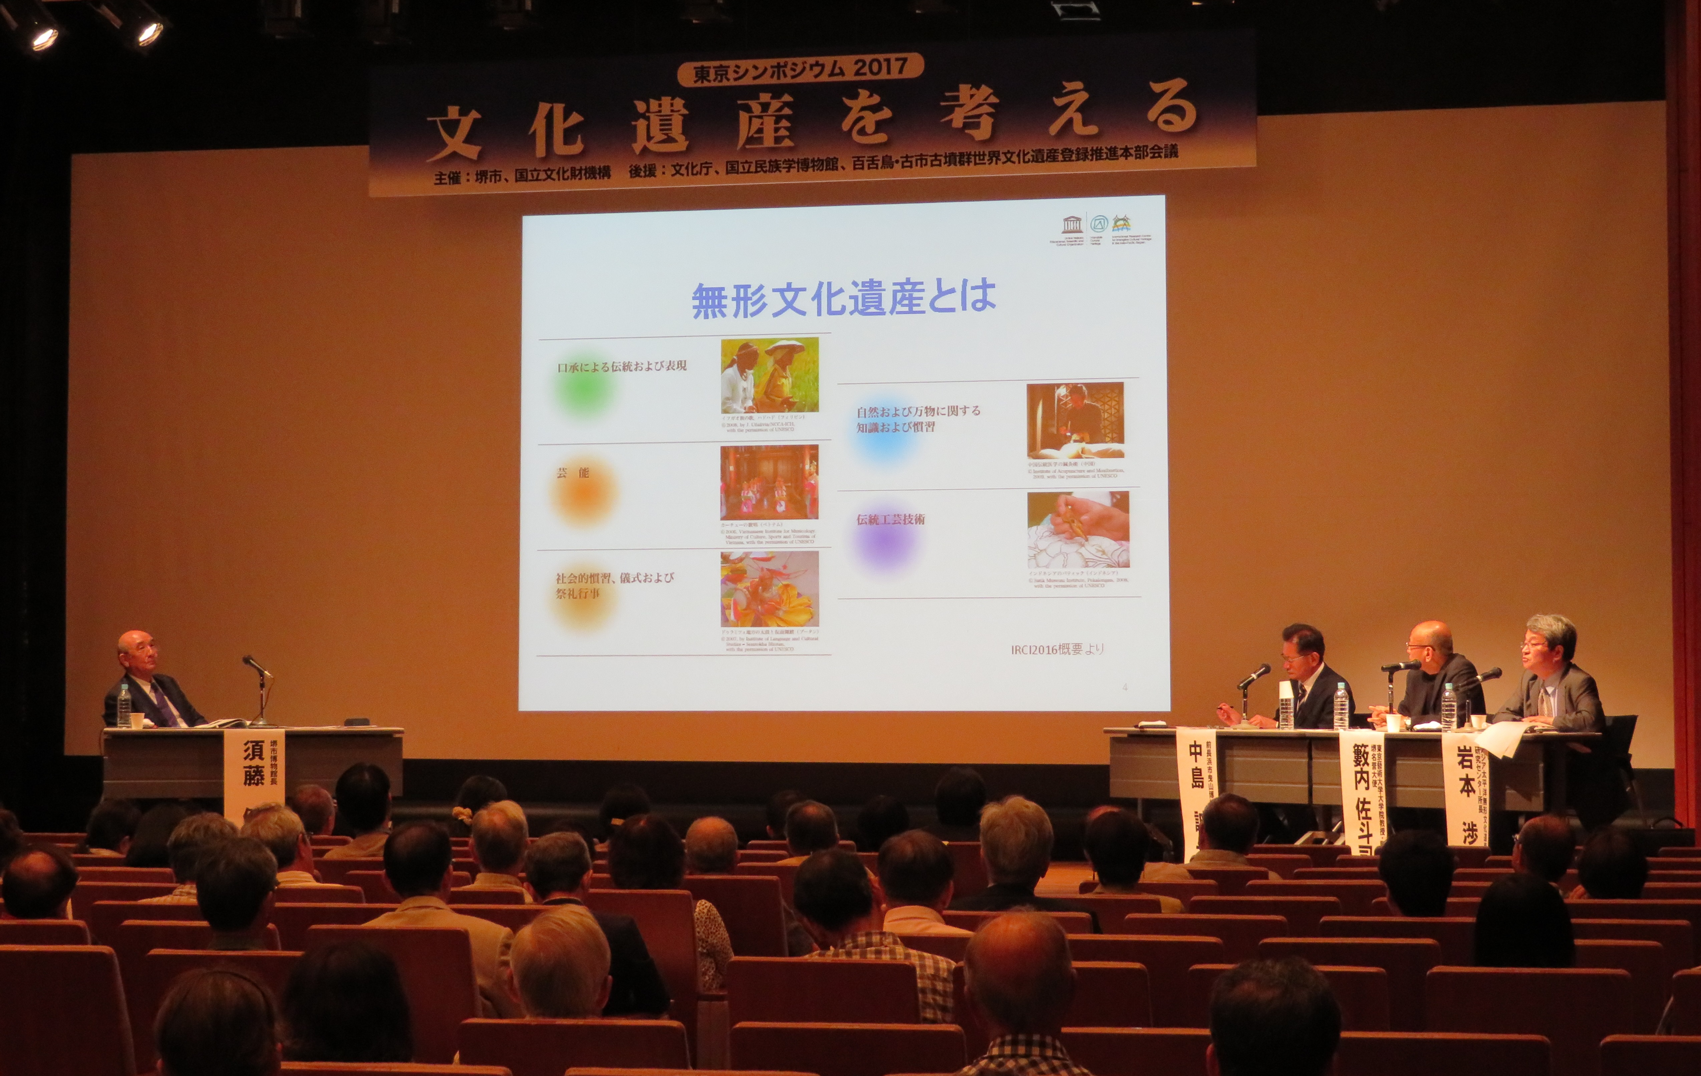
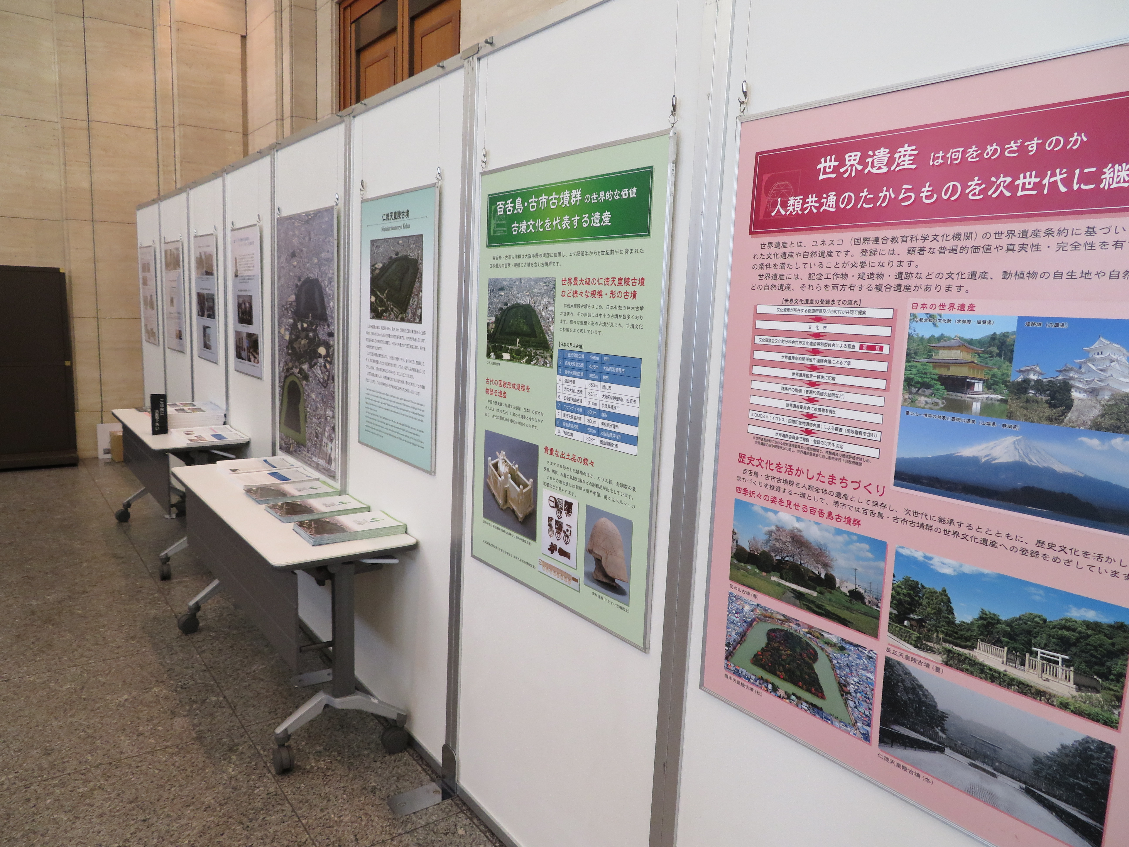
Cooperation with Sakai City
A symposium on Cultural Heritage in Tokyo (June 2017)
Presentation by Wataru IWAMOTO, Director-General, IRCI
Panel Introduction of IRCI at the lobby

Slide 20
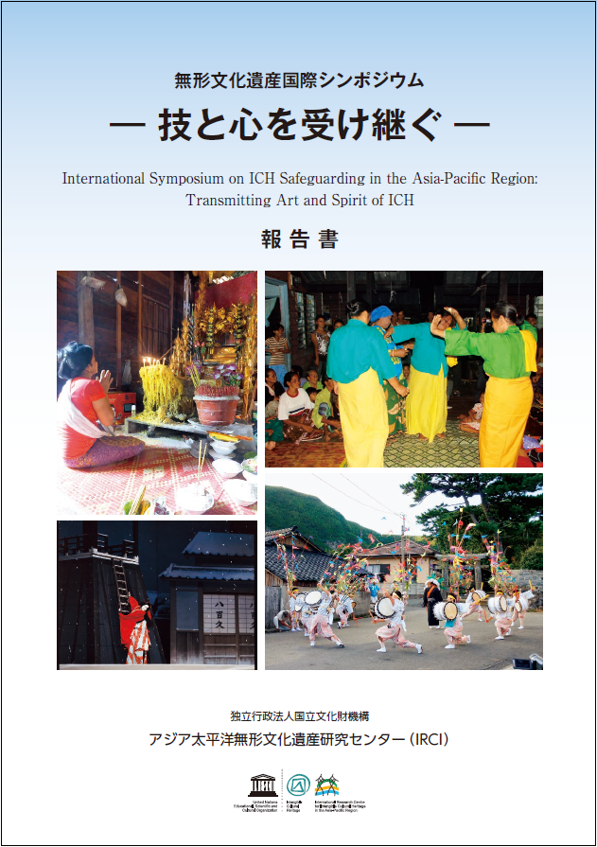
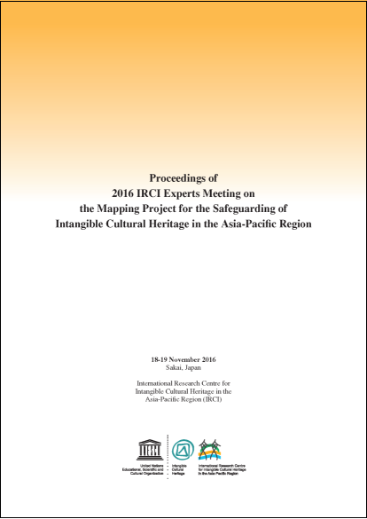
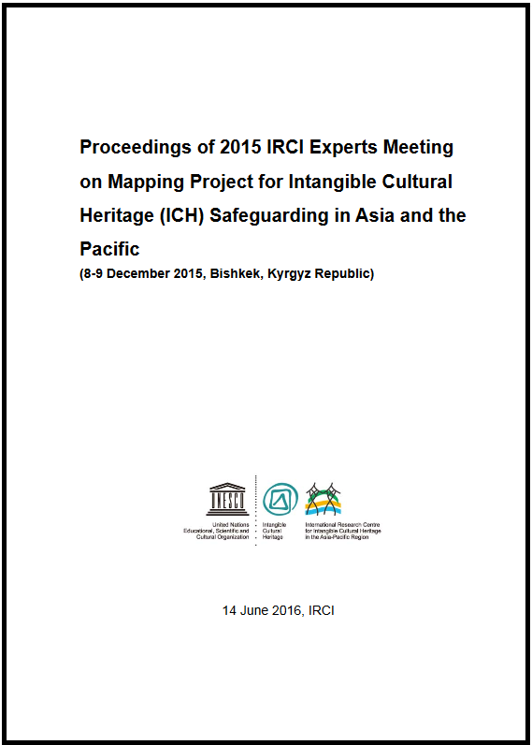
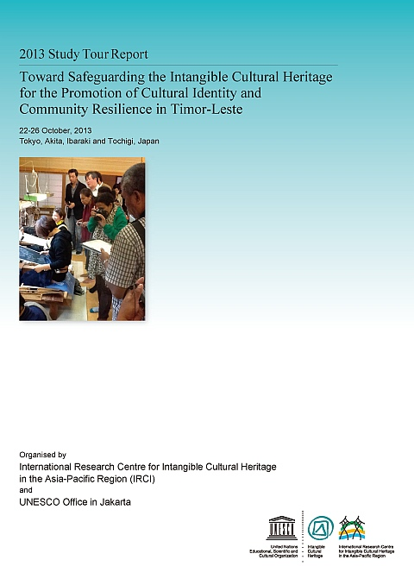
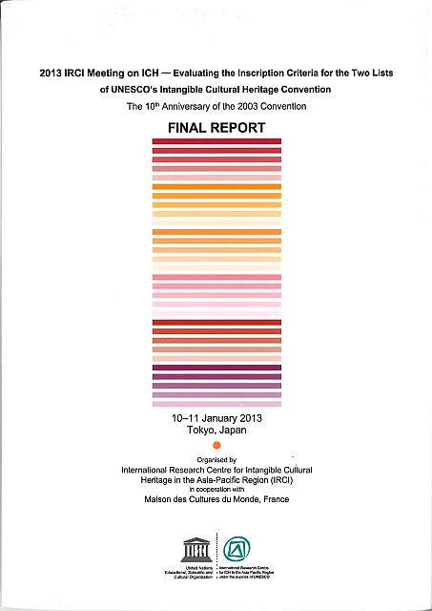
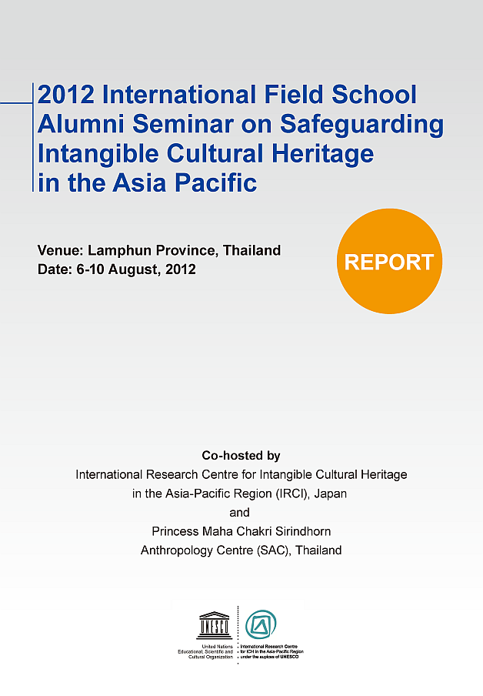
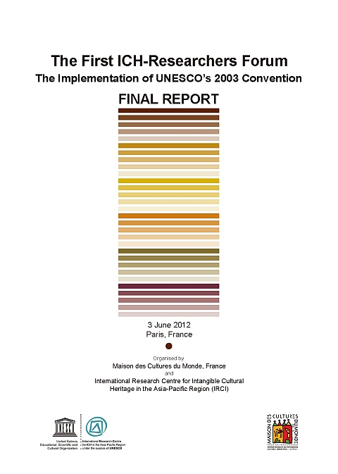
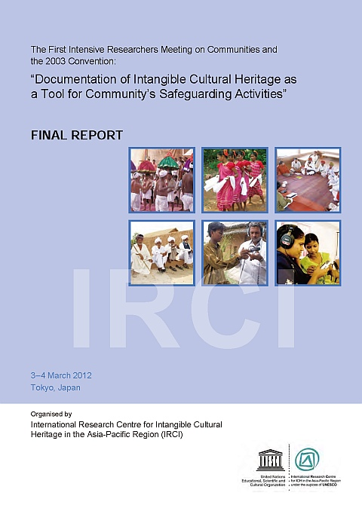
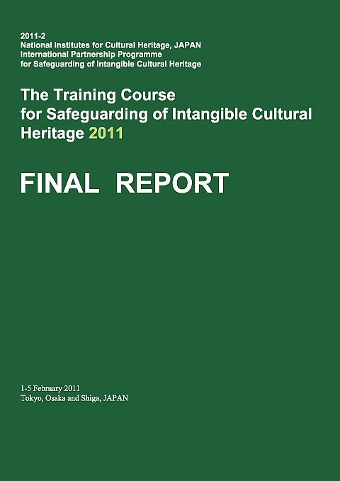
Ⅳ. Outcomes of IRCI’s Activities
IRCI’s Reports, Proceedings and Publications
International Symposium on ICH Safeguarding in the Asia-Pacific Region: Transmitting Art and Spirit of ICH
Proceedings of 2016 IRCI Experts Meeting on the Mapping Project for the Safeguarding of Intangible Cultural Heritage in the Asia-Pacific Region
Proceedings of 2015 IRCI Experts Meeting on Mapping Project for Intangible Cultural Heritage (ICH) Safeguarding in Asia and the Pacific
2013 Study Tour Report: Toward Safeguarding the Intangible Cultural Heritage for the Promotion of Cultural Identity and Community Resilience in Timor-Leste (Revised Edition)
2013 IRCI Meeting on ICH ­ Evaluating the Inscription Criteria for the Two of UNESCO’s Intangible Cultural Heritage Convention (Final Report)
The First Intensitive Researchers Meeting on Communities and the 2003 Convention: "Documentation of Intangible Cultural Heritage as a Tools for Community’s Safeguarding Activities"
The training course for safeguarding of intangible cultural heritage 2011 final report
2012 International Field School Alumni
Seminar on Safeguarding Intangible
Cultural Heritage in the Asia Pacific
The First ICH-Researchers Forum: "The Implementation of UNESCO's 2003 Convention"

Slide 21
International Meetings and Workshops
Project/Theme | Year | Month | International Meeting/Workshop | Co-Organiser
Mapping Studies on the Safeguarding of ICH | 2017 | 7 | International Symposium ‘Glocal Perspectives on Intangible Cultural Heritage : Local Communities, Researchers, States and UNESCO’
 | 2016 | 11 | IRCI Experts Meeting on Mapping Project for ICH Safeguarding in the Asia-Pacific Region
 | 2015 | 12 | IRCI Experts Meeting on Mapping Project for ICH Safeguarding in the Asia-Pacific Countries | Aigine Cultural Research Center, Bishkek, Kyrgyztan
 | 2015 | 1 | International Experts Meeting of the Project “Mapping Research on the Safeguarding of ICH in the Asia-Pacific Region” | Islamic Arts Museum Malaysia
 | 2014 | 2 | Preliminary Meeting of the Project “Exploring Research for the Safeguarding of ICH in the Asia-Pacific Region” | UNESCO Bangkok Office, Thailand
Study of Legal Systems related to ICH in the Greater Mekong Region | 2016 | 12 | IRCI Final Workshop on the Study of Legal Systems Related to ICH in the Greater Mekong Region
 | 2015 | 12 | IRCI Second Workshop on the Study of Legal Systems Related to ICH in the Greater Mekong Region
 | 2014 | 12 | IRCI First Workshop on the Study of Legal Systems Related to ICH in Southeast Asia | Faculty of Law, Kyushu University, Japan
Research for Safeguarding Intangible Cultural Heritage on the Verge of Extinction: Vietnamese ICH Element Dong Ho Woodblock Printing | 2015 | 1 | Workshop on the Roles of the Community Centre in ICH Revitalization: A Case Study of Dong Ho Woodblock Printing | Vietnam National Institute of Culture and Arts Studies (VICAS)
Research for Endangered Traditional Handicrafts in Post-Conflict States (Sri Lanaka) | 2015 | 12 | Discussion Meeting on Endangered Traditional Handicrafts in Sri Lanka

Slide 22
Project/Theme | Year | Month | International Meeting/Workshop | Co-Organiser
Documentation of ICH as a Tool for Community-led Safeguarding Activities | 2015 | 3 | Intensive Working Session on ICH Documentation as a Tool for Community-led Safeguarding Activities
 | 2014 | 2 | Workshop for Community’s Young Film Makers for ICH Audio-Visual Documentation
 | 2013 | 2 | Workshop on ICH Documentation as a Tool for Community Safeguarding Activities
 | 2012 | 3 | Intensive Research Meeting on Community and the 2003 Convention
Safeguarding the ICH for the Promotion of Cultural Identity and Community Resilience in Timor-Leste | 2013 | 10 | Study Tour for ICH Experts of East Timorese | UNESCO Jakarta Office, Indonesia
Research on the 2003 Convention | 2013 | 1 | 2013 IRCI Meeting on ICH – Evaluating the Inscription Criteria for the Two List of UNESCO’s ICH Convention
 | 2012 | 6 | The First ICH-Research Forum: The implementation of UNESCO’s 2003 Convention | Maison des Cultures du Monde (MCM), France
Current Status of ICH, in Particular, Research and Studies on ICH in Urgent Need of Safeguarding | 2012 | 8 | International Field School Alumni Seminar on Safeguarding ICH in the Asia-Pacific | Princess Maha Chalri Sirindhorn Anthropology Centre (SAC), Thailand
Symposiums in Cooperation with Sakai City, Osaka, Japan | 2016 | 11 | 2016 International Symposium on ICH Safeguarding in the Asia-Pacific Region “Transmitting Art and Spirit of ICH” | Agency for Cultural Affairs, Japan Sakai City
 | 2013 | 8 | International Symposium in Celebration of the 10th Anniversary of the Convention for the Safeguarding of ICH | Agency for Cultural Affairs, Japan Sakai City
 | 2013 | 2 | Symposium on ICH in the Asia-Pacific Region “ICH in the Asia-Pacific Region - Current Status and Important Issues” | Sakai City
 | 2011 | 10 | IRCI Opening Commemorative Symposium | Agency for Cultural Affairs, Japan Sakai City

Slide 23
Thank you
for your attention
irci@irci.jp

