Slide 1
Cooperation with Member States in planning and implementing programmes
3rd Coordinating Meeting of the World Category 2 Centres on ICH
6-8 July, 2015, Guiyang, China
Yadollah Parmoun
Director
Regional Research Centre for Safeguarding Intangible Cultural Heritage in west and Central Asia
Under the Auspices of UNESCO (Category 2)

Slide 2
Background
Geographical domain of Tehran ICH Centre
  States from three Electoral Groups
Conditions and developments over the Region
State of ICH over the Region
  Different interpretations of ICH
  Different orientations to ICH
  Inequality in levels of involvement (e.g. local community, women, NGO, etc.)
  Different orientations to ICH safeguarding
⇒
1. Need for sub-regional confidence
2. Need for awareness-raising
3. Need for capacity-building
4. Need for equal chances to be represented
5. Need for regional synergy, cooperation,

Slide 3
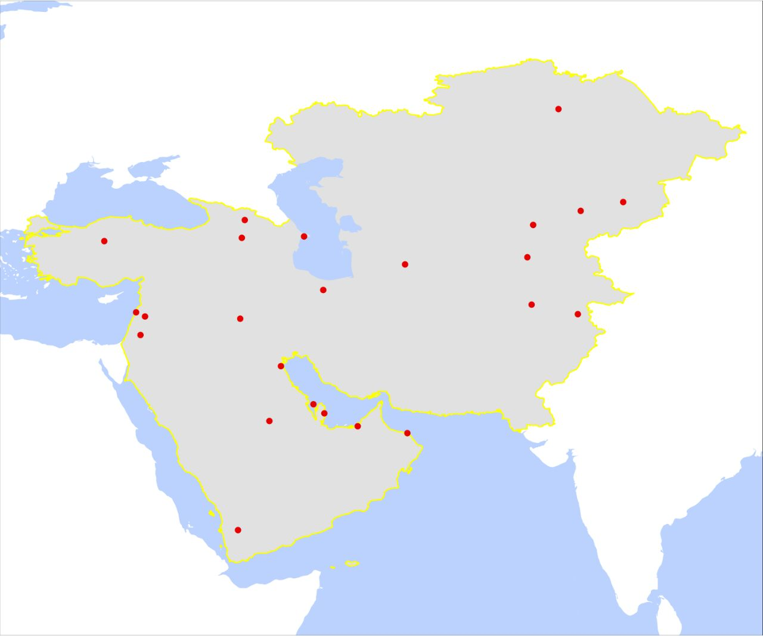
Geographical
Domain

Slide 4
UNESCO Guidelines
  Results-based Programming, Management, and Monitoring (RBM) approach as applied at UNESCO (Guiding Principles), June 2011
  BSP Guide for RBM
  37 C/4 (2014-2021): Medium-term Strategy
  37 C/5 (2014-2017): Approved Programme and Budget
  Integrated Comprehensive Strategy for Category 2 Institutes and Centres Under the Auspices of UNESCO, November 2013
  Excerpt from the draft 37 C/5 revised as of 22 July 2013
  Medium-term strategy for UNESCO’s cooperation with Category 2 Centres in the field of Intangible Cultural Heritage (2014-2021)
  37 C/5 MP IV Expected Result 6
  Integrated Comprehensive Strategy for Category 2 Institutes and Centres under the Auspices of UNESCO
  Training materials distributed in 1st and 2nd meetings of the World Category 2 Centres on ICH (Sozopol and Paris)

Slide 5
Activities on participation
The Agreement
Invitation with the collaboration of Iranian Natcom
  Participation by Kazakhstan, Iran, Tajikistan
  Two GC Meetings in 2012 and 2013
New initiatives
  Advice from UNESCO Headquarters, UNESCO Bangkok
  2014 Meeting of Ambassadors of the States over the Region
  Close collaboration with UTCO
  Correspondence with Permanent Delegations of the States of the Region to UNESCO
  Direct information-sharing at the level of UNESCO Natcomes and governmental organizations over the Region (namely, through correspondence, participation in events, etc.)
  ⇒
    Participation of 10 countries from the 3 Electoral Groups
    The 2015 GC Meeting with the participation of 10 Member States (Armenia, Kazakhstan, Kyrgyz Republic, Iran, Iraq, Lebanon, Palestine, Pakistan, Tajikistan, Turkey), and three Observer States (Afghanistan, Oman, Qatar)
    Participation issue followed eagerly in other states (e.g. Afghanistan, Azerbaijan, Georgia, Oman, Qatar, Syria, Turkmenistan, and Uzbekistan)

Slide 6
Some Initiatives
The Centre is working on a proposal on minor modifications in the Agreement to pave the way for all participating Electoral Groups to be represented in the GC and involved in the Centre’s decision-making processes and activities
Non-GC Member Observer States were actively involved in the discussions in the course of the last GC Meeting
Representatives from non-Member States on the Region were invited to the last GC Meeting as special guests to observe the debates and become acquainted with the nature of the Centre
The Centre is working on methods of establishing expert/consultative bodies affiliated to the Centre, and to invite representatives, especially from non-GC Member States to participate in their activities

Slide 7
Some Initiatives
Some attractive/promising programmes have been included in the 2015 Action Plan to point to the nature of the Centre, as a regional centre where all Member States have an equal share for being represented and involved
  The international competition on the design of the permanent logo of the Centre
  The special design of the Centre’s website (www.tichct.org), as a virtual space where all participating states enjoy equal opportunities to be represented
  The proposal on an interactive virtual calendar of the West and Central Asian ICH
  The 2015 expert meeting to be held with the participation of experts from the Region to discuss concrete measures to safeguard ICH

Slide 8
Some Initiatives
The Centre is closely cooperating with UNESCO Headquarters, UNESCO Bangkok, UTCO, as well as the Embassies, Permanent Delegations, Natcoms, and cultural organizations of its Member States in planning and implementing its activities;
  e.g.
    Cooperation with UTCO and UNESCO Bangkok in organizing two workshops for Turkmenistan
    Cooperation with Iraqi Cultural Centre in Tehran in organizing a workshop for Iraq
In the course of the last GC Meeting the Participating States were asked to make the Centre informed of their capacity-building needs, so that the Centre can be in a better position to draft its Action Plans for the coming years

Slide 12
Topics for discussion
What are the methods of encouraging membership of states within the geographical domain of a Category 2 Centre, and their involvement in planning and implementing its activities?
  Guaranteeing the participation of non-GC Members in its meetings as observers?
  Updating the GC Rules of Procedure in a way that all of the Electoral Groups are always represented among GC Members?
  Promoting the membership of natural persons from non-GC Members among GC Members?
  Drafting the Rules of Procedures of the Centre’s Executive Board in a way that non-GC Members can be members to it?
  Establishing “consultative bodies”, “expert committees”, etc, affiliated to the Centre, and guaranteeing the participation of representatives from countries on the region in them?
  …
Will cooperation with other Category 2 Centres contribute to promoting the involvement of states in the geographical domain of a Category 2 Centre in planning and implementing its activities? If yes, how?
  Cooperation according to the undertakings of the C2C’s?
  Cooperation justified based on overlaps in geographical domains?
  …

Slide 13
Topics for Discussion
Will a pilot (sub-)regional activity initiated and guided by a Category 2 Centre promote the involvement of the Member States in planning and implementing its activities?
  Creation of a (sub-)regional inventory for an ICH element (e.g. traditional games)?
  Drafting a multi-national nomination file with the participation of a majority of the Participating States?
  …
To what extent will distribution of questionnaires/other instruments among participating states on their needs will help in promoting their involvement in planning and implementing effective activities (e.g. questionnaires on their needs for capacity-building workshops)?

Slide 14
Topics for Discussion
Do direct contacts with governmental bodies always constitute a first reliable step to encourage their involvement in the activities of a Category 2 Centre?
Does the following constitute an exhaustive list of parties that can be consulted for support in encouraging involvement of states on a region in a Category 2 Centre’s activities? If yes, what order should be followed in consulting them?
  UNESCO Headquarters
  Permanent Delegations to UNESCO
  UNESCO Field Offices
  Natcoms
  Embassies of Participating States
  Cultural centres of Participating States
  Universities
  NGO’s
  Local communities
  Other Category 2 Centres

Slide 15
Topics for Discussion
Do regional/international gatherings help in promoting cooperation with Member States in planning and implementing programmes for a Category 2 Centre? If yes, at what level?
  Awareness Raising?
  Capacity-building?
  Expert meeting?
  Festival/cultural event?
  …

Slide 16
Topics for Reflection
Other methods to encourage effective cooperation with Member States to a Category 2 Centre in planning and implementing programmes
Topics for inclusion in an action plan best suitable for encouraging active involvement of Member States to a Category 2 Centre programming and implementation processes

