Slide 1
Major Challenges for the Safeguarding of ICH Information and Networking, Including Through the Web
HUH Kwon 許權
Director-General
ICHCAP

Slide 2
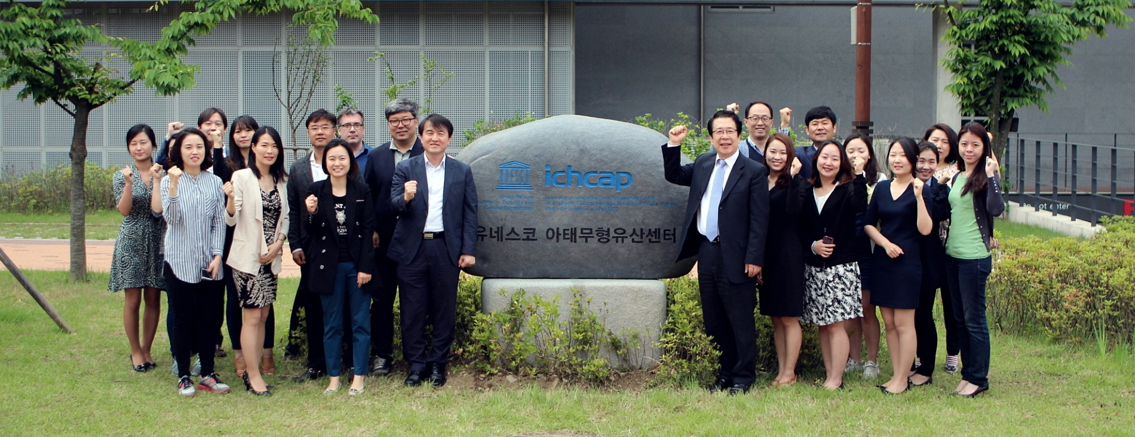
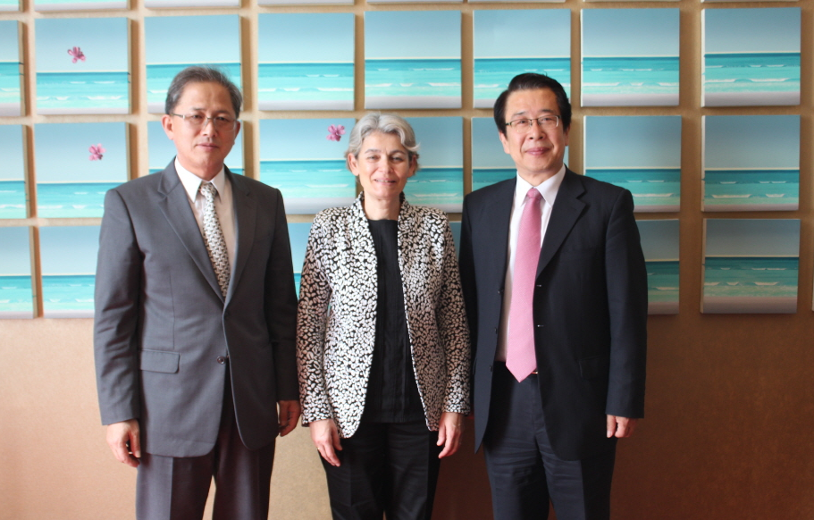

Slide 3
Contents
Implications in International Organizations
Information and Network in the 2003 Convention
Information and Networking in ICH Safeguarding
Problems in ICH Information-sharing and Network-building
What Kind of Information is Needed?
Network-building
Key Issues to Be Discussed

Slide 4
Implications in International Organizations
Functions of international organizations: collecting and sharing of information
Information function, Normative function, Rule-creating function, Rule-supervisory function, Operational function
- Harold K. Jacobson
Information
Peace
and Development
Promoting intellectual activities and strengthening exchange
4 / 12

Slide 5
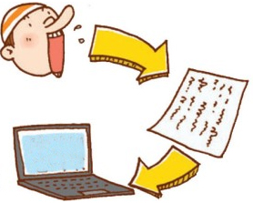
Implications in International Organizations
Intellectualization and knowledge revolution
Information — Knowledge — Intelligence
Urban revolution — Industrial revolution — Information revolution — Knowledge revolution
Diversification of medium
Spoken language
Letters
Prints
Byte
5 / 12

Slide 6
Implications in International Organizations
Challenges and Tasks of Organizations
Develop new modes of communication
Overcome the information divide
High cost (financial and human resources) of information collection, management, and distribution
Relationship and cooperation with NGO and civil society
Limitations in producing contents
Difficulties in operating SNS
6 / 12

Slide 7
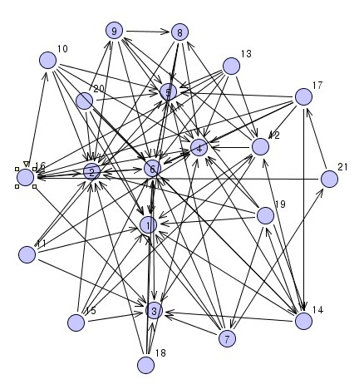
Implications in International Organizations
Importance of information and networking
Diffusion of knowledge, development, and mutual understanding stems from the sharing of information
7 / 12

Slide 8
Information and Network in the 2003 Convention
Article 19.1 – Cooperation
“…international cooperation includes, inter alia, the exchange of information and experience, joint initiatives, and the establishment of a mechanism of assistance to States Parties in their efforts to safeguard the intangible cultural heritage.”
8 / 12

Slide 9
Information and Networking in ICH Safeguarding
information
“a complex of all the knowledge and relevant materials that are useful for ICH and its safeguarding.”
Information activities
“all the actions that are taken in the processes of collecting, processing, preserving, and disseminating the information that happens both online and offline in terms of safeguarding, transmitting, and promoting ICH.”
- Evaluating ICHCAP’s Information Activities and Establishing Future Strategies project in 2014
9 / 12

Slide 10
Information and Networking in ICH Safeguarding
Networking
Developing and maintaining “networks among all relevant parties and organizations, both online and offline” in relation to promoting the ICH safeguarding
- Reviewing ICHCAP’s Networking Projects and Developing Future Strategies project in 2014
10 / 12

Slide 11
Problems in ICH Information-sharing and Network-building
Problems and issues
1. Weak academic foundations in the ICH field
2. Lack of awareness on ICH
3. Insufficient policies/approaches for ICH safeguarding encompassing humans, nature, and societies
4. Difficulty in identifying needs for ICH information
5. Information divide: vulnerable information society
*. No standards or specific guidelines
*. Large scale of funds required to provide and maintain
11 / 12

Slide 12
What Kind of Information is Needed?
Information activities need to be strengthened
Survey conducted under the 2014 projects*: 85 respondents from 200 people
*Evaluating ICHCAP’s Information Activities and Establishing Future Strategies;
and Evaluating ICHCAP’s Networking Projects and Establishing Future Strategies
12 / 12

Slide 13
What Kind of Information is Needed?
ICHCAP’s Database
Basic DB
country status, organizations, persons, publications, multimedia, research, exhibitions, and performances
Cooperative DB
Help of museums, educational institutions, relevant C2 centers, research institutes, etc
Thematic DB
Information generated by active networks in various fields of ICH
13 / 12

Slide 14
What Kind of Information is Needed?
Challenges ICHCAP discovered
Lack of useful information on ICH safeguarding
How to differentiate information by entities
Costs to collect useful and updated information
Language problem
14 / 12

Slide 15
Network-building
ICH Safeguarding
Documentation, research, preservation, protection, enhancement, transmission, and revitalization
Nation
Practitioner
Experts
…..
Local society
Organization
…..
15 / 12

Slide 16
Network-building
Sub-regional and national focal points
16 / 12

Slide 17
Network-building
Sub-regional focal points: organizational division
17 / 12

Slide 18
Key Issues to Be Discussed
1. What kind of information should be provided by C2 Centers?
Information for whom, question of priority
Is this information differentiated from that provided by Headquarters or regional offices?
What kind of information is this?
2. How should information be collected?
The production and collection of information (including audiovisual materials) is costly. Is there a more economical way?
Possible cooperation between C2 centers (joint projects, research)?
18 / 12

Slide 19
Key Issues to Be Discussed
3. Is it possible to build a global information system connecting UNESCO, etc?
Is it necessary to link independently operated databases at the respective C2 centers without the presence of an executive organization like the World Heritage Center?
Standardization of information, if any
Conducting basic research to create a system of cooperation?
4. Building healthy relationships between networks and partners?
Model case studies of network operation(online/offline)
Possible connections between networks (eg. culturellink)
Workshops on the reinforcement of C2 center functions
19 / 12

