Slide 1
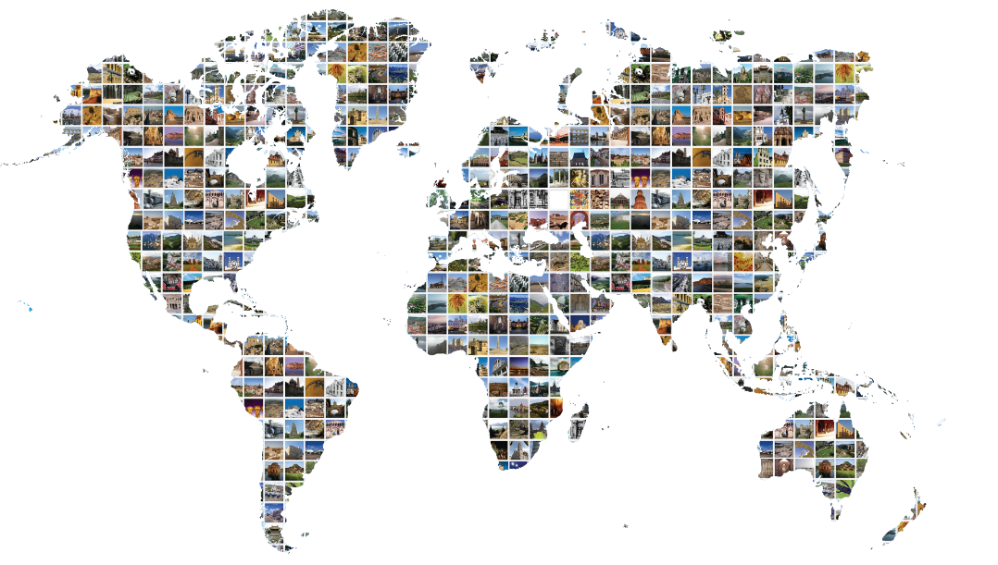
Module 1
Periodic Reporting for the World Heritage Convention
1
Periodic Reporting
Fundamentals

Slide 2

Learning objectives
At the end of the session, trainees:
Will gain a clear understanding of who is involved in the Periodic Reporting exercise and what the respective roles are.
Will gain a clear view about the new elements of the Third Cycle, the timing of the process, and the improvements made to the Periodic Reporting questionnaire.
Will be able to access tools, materials and offline/online sources of information available to answer the questions in the Periodic Reporting Questionnaire.

Slide 3

Module outline
II. New developments for the Third Cycle
Sustainable Development
Synergies with other Conventions
Monitoring Indicators and Analytical Framework
Training materials
Periodic Reporting Webpage and Third Cycle Platform
Other improvements
I. What is Periodic Reporting?
Objectives
Online questionnaire
Who are the actors?
What are the expected outcomes?
Reporting cycle: Reporting by region
Timeline

Slide 4

What is Periodic Reporting?
Watch video tutorial
Global conservation monitoring activity
Self reporting on the application of the World Heritage Convention at national level and property level
Statutory requirement of the World Heritage Convention (Article 29)
http://whc.unesco.org/include/tool_video.cfm?youtubeid=iiSFmP-InWw
Video explaining the Periodic Reporting exercise, a global conservation monitoring activity and a requirement of the World Heritage Convention.
Français
English
Français
Subtitled in Arabic

Slide 5
What is Periodic Reporting?
Objectives
Assessing the application of the World Heritage Convention by country
Determining whether Outstanding Universal Value has been maintained
Encouraging regional cooperation and networking
Helping update information on properties and record changes

Slide 6
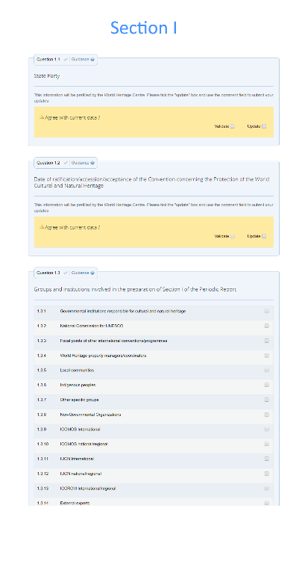
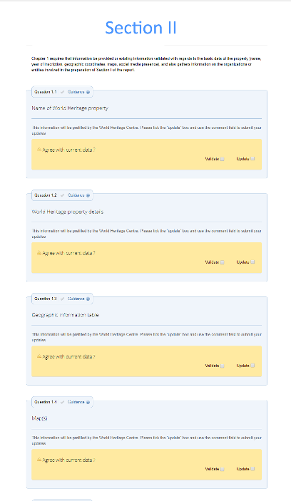
What is Periodic Reporting?
Online Questionnaire
Questionnaire can be accessed here: http://whc.unesco.org/en/periodicreporting/
Periodic Reports are compiled from information by means of an online questionnaire in two sections:
Section I (national level)
Section II (property level)
http://whc.unesco.org/include/tool_video.cfm?youtubeid=iiSFmP-InWw

Slide 7

What is Periodic Reporting?
Who are the actors?
Site Managers
Complete Section II of the questionnaire
National Focal Points
Complete Section I
Validates Section II
Submit the questionnaire to the World Heritage Centre
World Heritage Centre
UNESCO Field Offices
Advisory Bodies
Category 2 Centres
Civil society
Local communities

Slide 8
What is Periodic Reporting?
Expected outcomes
Regional Action Plans
tool for setting regional priorities for implementing the World Heritage Convention
a way of interpreting and translating the Periodic Reporting data into concrete goals following a set timeline.
formulated through a collaborative process that can involve national Focal Points, Site Managers, Advisory Bodies and the World Heritage Centre.
a user-generated tool that incorporates the specific needs of Site Managers and States Parties
Regional Reports
information on conservation of World Heritage in a region and the main challenges faced
trends related to regional or global phenomena
prepared by the World Heritage Centre in consultation with National Focal Points
presented to the World Heritage Committee

Slide 9
What is Periodic Reporting?
Reporting cycle: Reporting by region
Periodic Reporting is carried out on a region by region basis
  Promotes cooperation in the regions
  Responds to the specific characteristics of each region

Slide 10
What is Periodic Reporting?
Reporting by region: Timeline
Africa
Latin America & Caribbean
2018
2020
2022
2019
2021
Arab States
Asia & Pacific
Europe & North America

Slide 11
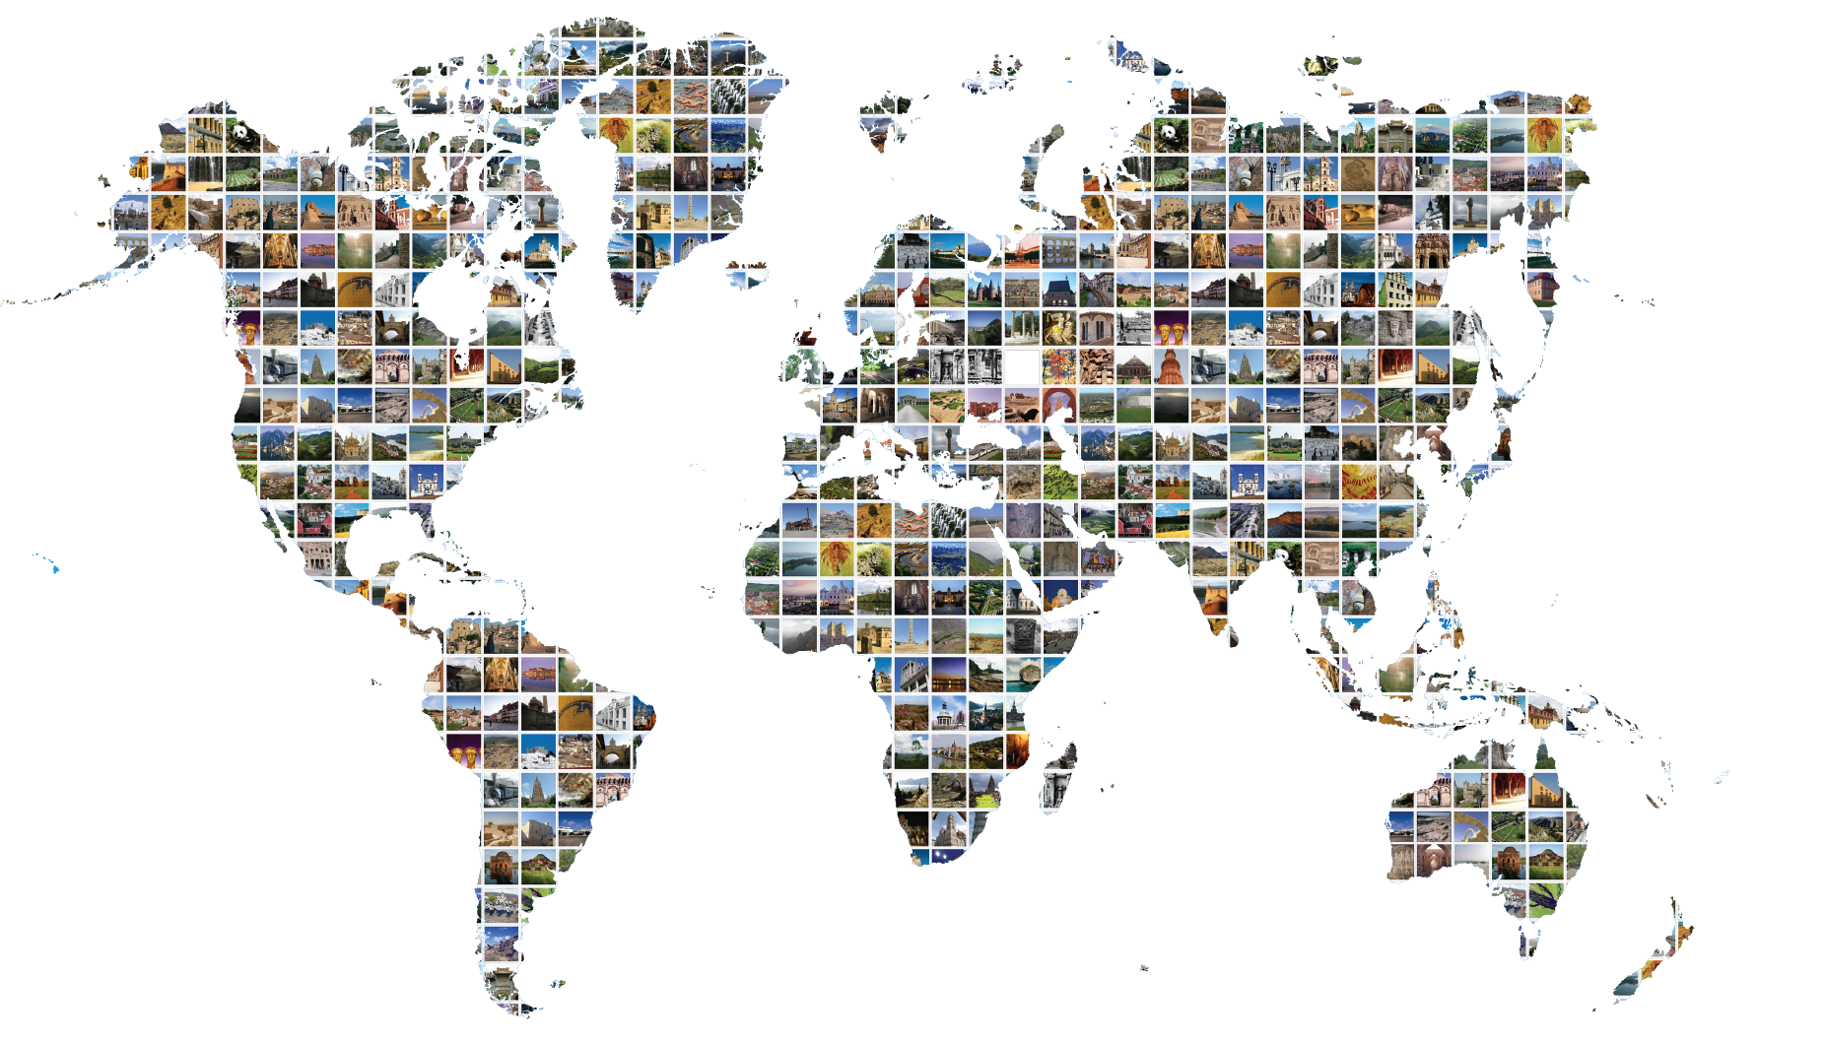
New developments for the Third Cycle

Slide 12
New developments for the Third Cycle

Slide 13
New developments for the Third Cycle
Outcomes of the Reflection Period (2015-2017)
A wide range of improvements and innovations have been introduced:
Sustainable development
Synergies with other Conventions
Monitoring Indicators and Analytical Framework
Periodic Reporting platform
Training materials

Slide 14

New developments for the Third Cycle
Sustainable Development
Sustainable Development Goal 11
http://whc.unesco.org/include/tool_video.cfm?youtubeid=iiSFmP-InWw
With SDG 11, countries have pledged to
“make cities and human settlements inclusive, safe, resilient and sustainable”
Within this goal, Target 11.4 aims to
“strengthen efforts to protect and safeguard the world’s cultural and natural heritage”

Slide 15
New developments for the Third Cycle
Synergies with other Conventions
Operational Guidelines
Section I
Questions cover extent of cooperation between culture and biodiversity-related conventions/programmes at both national and property level.
Particular emphasis is given to the Second Protocol of the 1954 Hague Convention and the 1972 Recommendation and Recommendation on the Historic Urban Landscape.
http://whc.unesco.org/include/tool_video.cfm?youtubeid=iiSFmP-InWw
The World Heritage Committee recognizes the benefits of enhancing synergies amongst the World Heritage Convention and other culture and biodiversity-related conventions.
Paragraph 41 of the Operational Guidelines for the Implementation of the World Heritage Convention
Section II
Questions relating to cooperation of Site Managers with the different conservation instruments and how overlapping protection is being used to ensure the conservation of heritage.
http://whc.unesco.org/en/guidelines/

Slide 16





New developments for the Third Cycle
Synergies with other UNESCO culture Conventions
1954 Hague Convention for the Protection of Cultural Property in the Event of Armed Conflict
Second Protocol to the 1954 Hague Convention for the Protection of Cultural Property in the Event of Armed Conflict
1970 Convention on the Means of Prohibiting and Preventing the Illicit Import, Export and Transfer of Ownership of Cultural Property
2001 Convention on the Protection of the Underwater Cultural Heritage
2003 Convention for the Safeguarding of the Intangible Cultural Heritage
2005 Convention on the Protection and Promotion of the Diversity of Cultural Expressions

Slide 17







New developments for the Third Cycle
Synergies with biodiversity-related Conventions and Programmes
Convention Concerning the Protection of the World Cultural and Natural Heritage
Convention on International Trade in Endangered Species in Wild Flora and Fauna (CITES)
Convention on the Conservation of Migratory Species of Wild Animals (CMS)
Convention on Biological Diversity (CBD)
International Treaty on Plant Genetic Resources for Food and Agriculture (ITPGRFA)
Convention on Wetlands of International Importance
(Ramsar Convention)
International Plant Protection Convention (IPPC)

Slide 18
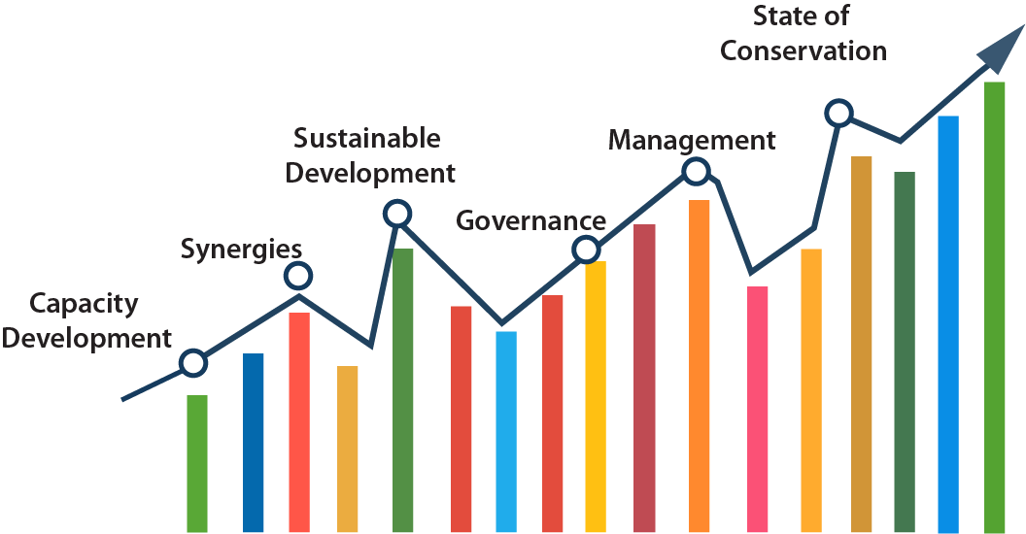
New developments for the Third Cycle
Monitoring Indicators and Analytical Framework
Indicators to measure trends and developments in World Heritage conservation.
Based on the six core thematic areas of the Periodic Reports.
Developed within the framework of the Periodic Reporting Reflection Period (2015-2017)
To improve the presentation of data for enhanced accessibility and usability, allowing States Parties to use it more effectively for their own monitoring activities
A global template for the analysis of data in all regions
To be used on a trial basis in the first regions to report

Slide 19
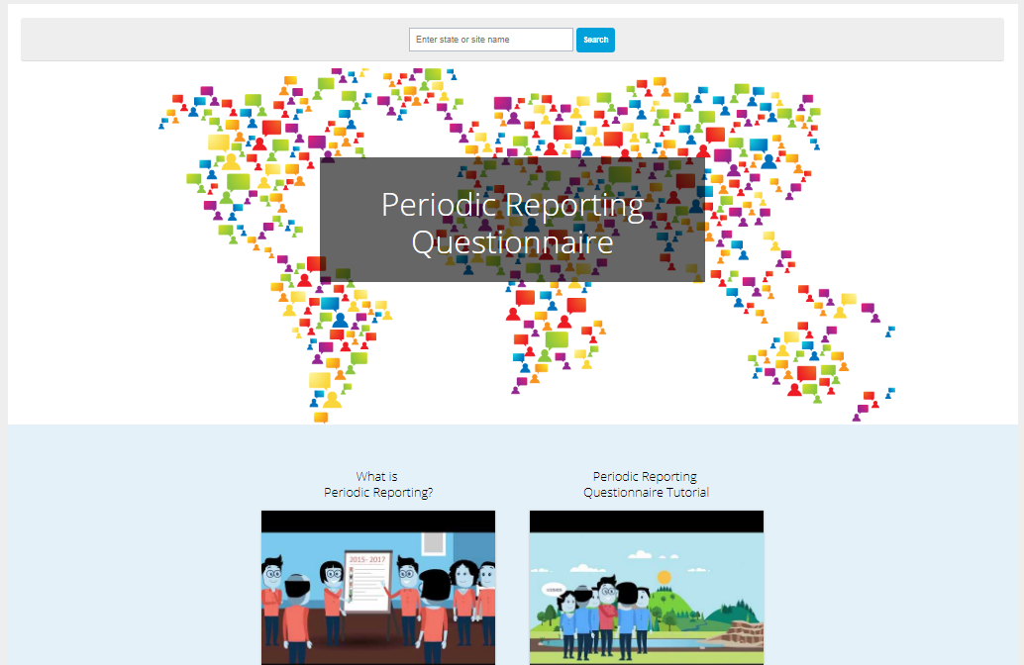
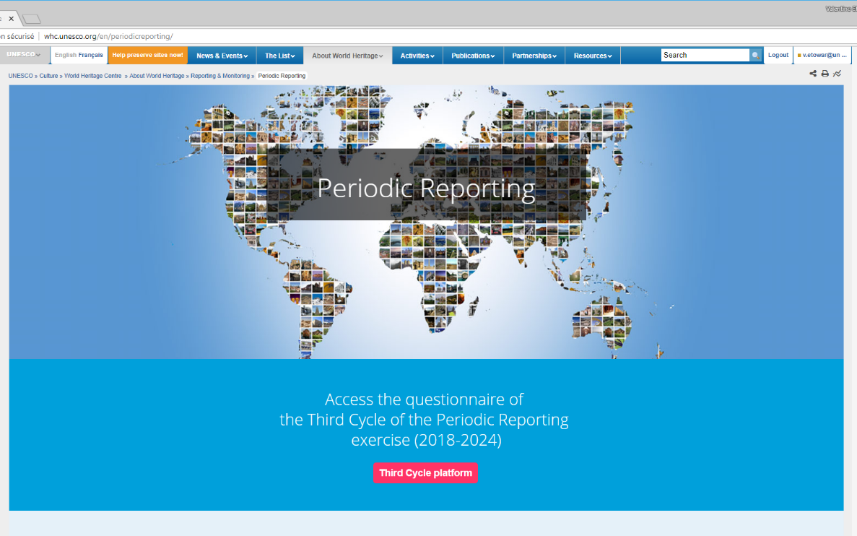
New developments for the Third Cycle
Periodic Reporting webpages
Periodic Reporting online
http://whc.unesco.org/include/tool_video.cfm?youtubeid=iiSFmP-InWw
Third Cycle Platform
http://whc.unesco.org/en/prcycle3/
- Access to the Questionnaire
- Training and guidance materials
General information on Periodic Reporting
whc.unesco.org/en/periodicreporting/

Slide 20




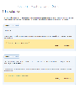
New developments for the Third Cycle
Training materials
Handbook for Site Managers
A set of training and guidance materials have been developed for the Third Cycle and continue to be updated.
Facilitate an autonomous and successful Periodic Reporting exercise
Support capacity-building activities
Adapted for use in a range of contexts
Accessible to a broad audience
Designed as user-friendly and intuitive tools
Applicable to all regions and sites
Video tutorials
1
2
Learning modules
3
Guidance & Index of key terms
Demo version of the Questionnaire

Slide 21
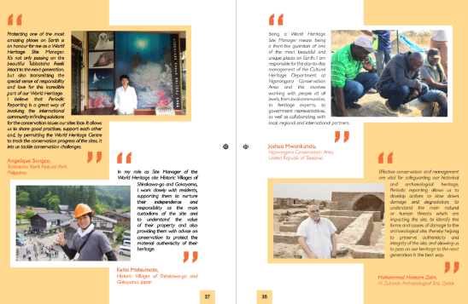
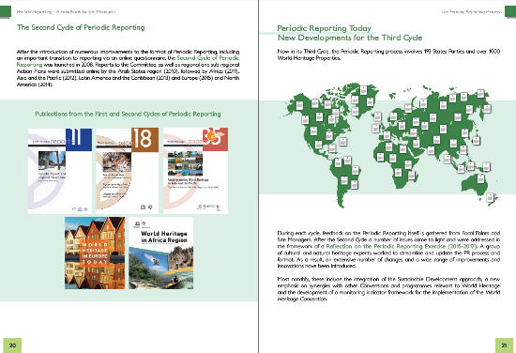
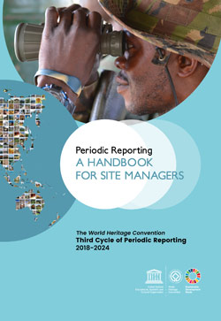
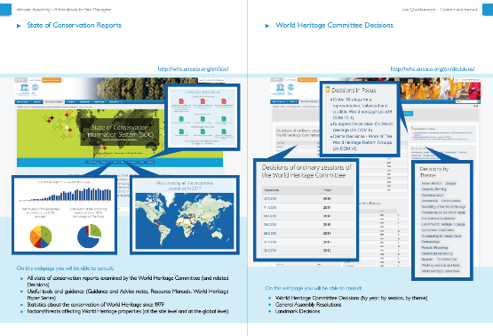
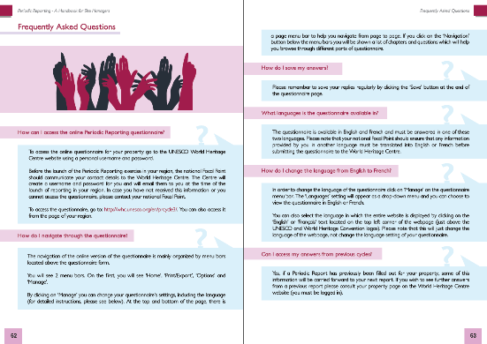
New developments for the Third Cycle
Training materials
Handbook for Site Managers
Explains the Periodic Reporting process and the broader context of World Heritage in clear language.
Provides an overview of Section II of the questionnaire.
Contains technical guidelines and FAQs.
Available in English, français and العربية
Translation in other languages is foreseen

Slide 22
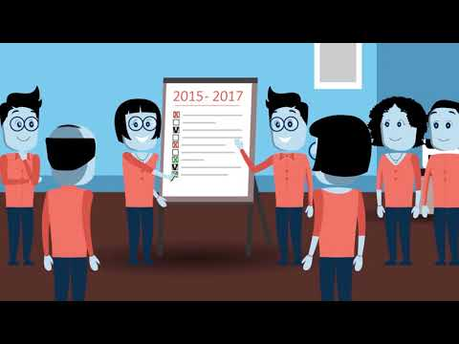

New developments for the Third Cycle
Training materials
Video tutorials
Animation video 1 explains the Periodic Reporting process in clear and simple terms.
Animation video 2 focuses on Section 2, explaining the key functionalities, the main concepts involved and the assistance available.
Aimed primarily at Site Managers, they offer an overview in plain language with engaging visuals
Available in English, French.
Arabic subtitles versions
Adapted Spanish, Chinese and Russian versions currently under development

Slide 23
New developments for the Third Cycle
Training materials
1
2
Training modules
1
3
Periodic Reporting Curriculum
Training
MODULE
2
A capacity-building tool for Periodic Reporting
Developed to facilitate trainings for those involved in Periodic Reporting
Draws on a large number of World Heritage resources
To be accessible in basic and advanced versions
Comprehensive nature will make it adaptable to many different World Heritage contexts
Training
MODULE
3
Training
MODULE
4
Training
MODULE
Training
Modules
World Heritage Convention

Slide 24
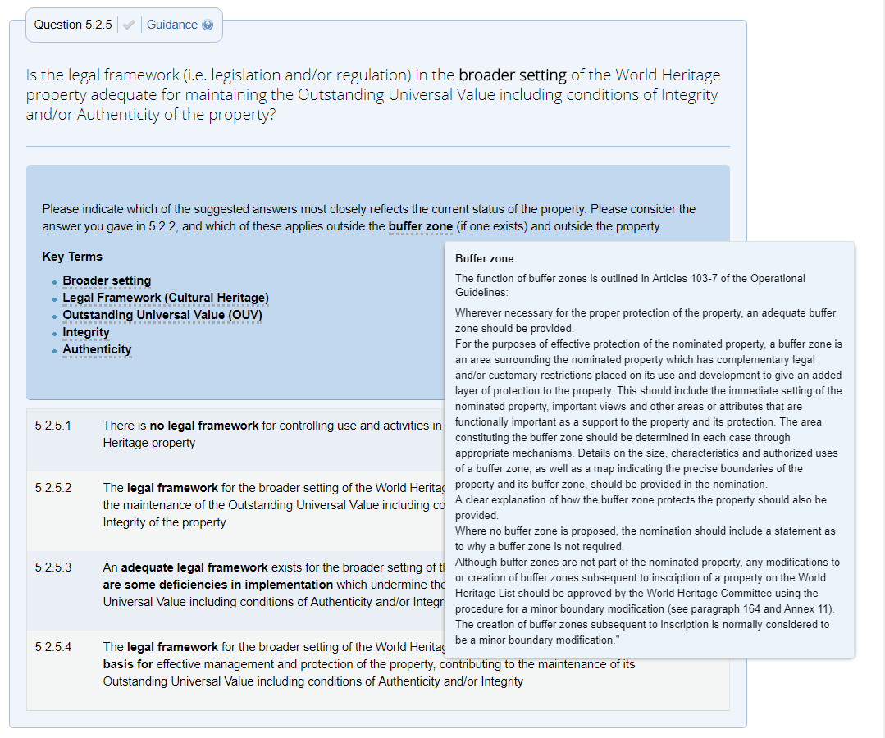
New developments for the Third Cycle
Training materials
Guidance and Index of key terms
Guidance/ Index of key terms
Integrated into the questionnaire to clarify questions and explain key concepts.
provides clarifications on the information sought in specific questions
provide context and background to the thematic areas covered
a dynamic resource within the questionnaire
Will be made available online and for download in PDF format

Slide 25
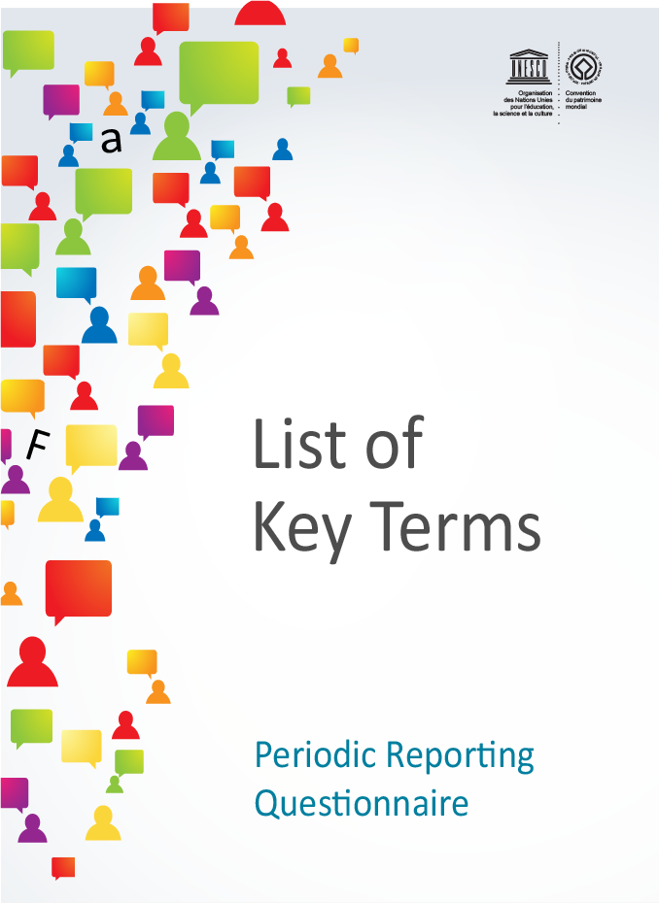
New developments for the Third Cycle
Training materials
List of key terms
List of key terms
A list of terms supplements the guidance and provides definitions of key terms
Available in English and French
Will be made available online and for download in PDF format

Slide 26
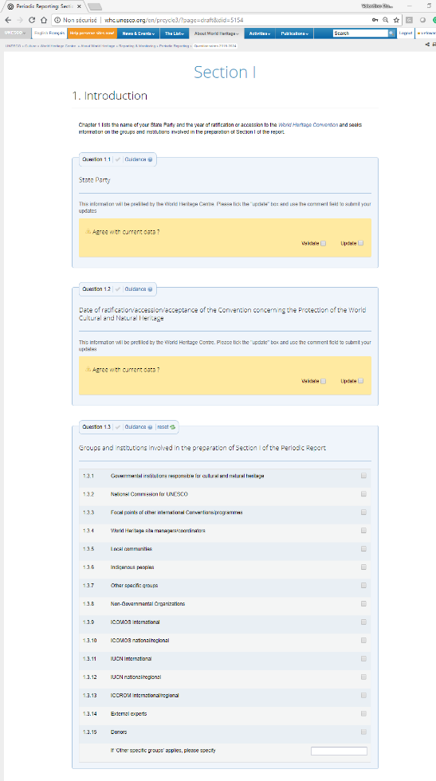
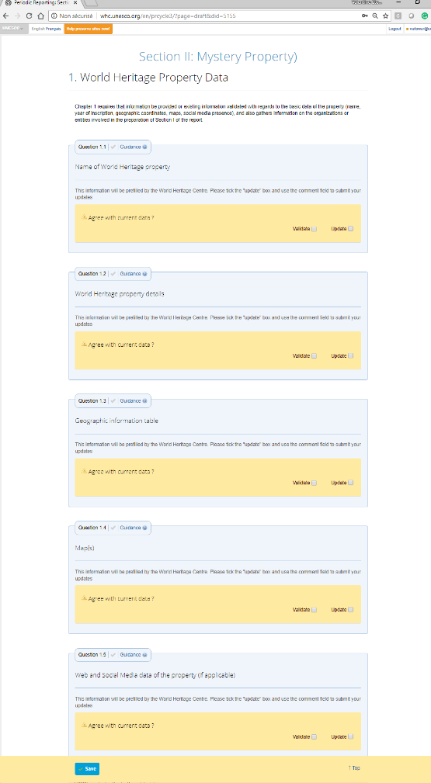
New developments for the Third Cycle
Training materials
Demo version of the Questionnaire
Demo version of the questionnaire
The demo version of the questionnaire (Section I Mystery Land and Section II Mystery Property) allows you to practice using the questionnaire and gain familiarity with its functions.
It can be exported to Word and PDF

Slide 27
New developments for the Third Cycle
Other improvements to the Questionnaire
Report positive achievements
More emphasis on attributes of OUV as an important element of World Heritage system
Positive as well as negative, potential as well as actual factors to be taken into account in assessing condition and context of properties
More information on actual and predicted trends gathered (attributes and factors)
Factors now linked to State of Conservation database
Technical improvements to online tool

Slide 28

Contact
wh-periodicreporting@unesco.org

