Slide 1

模块 2
世界遗产公约定期报告
定期报告
调查问卷
2

Slide 2
Module 2
Periodic Reporting for the World Heritage Convention
2
Periodic Reporting
Questionnaire

Slide 3

世界遗产公约定期报告
模块2
定期报告调查问卷

Slide 4
Periodic Reporting for the World Heritage Convention
Module 2
The Periodic Reporting Questionnaire

Slide 5
学习目标
学习本单元后，学员能够：
了解调查问卷所涉及的主题领域，熟悉问卷第一、二部分各章所涉及的主题。
了解调查问卷的技术功能
能够获得可用于回答定期报告调查问卷问题的工具、材料和离线/在线信息

Slide 6
Learning objectives
At the end of the session, trainees:
Will understand the thematic areas covered by the questionnaire and become familiar with the subjects covered by each chapter of the questionnaire Section I and Section II
Will understand the technical functions of the questionnaire
Will be able to access tools, materials and offline/online sources of information available to answer the questions in Periodic Reporting (PR) Questionnaire.

Slide 7
模块大纲
问卷概览
关键信息(界面、问题类型、问卷功能、常见问题、指南和关键术语)
第一部分概览
第二部分概览
工具与指南– 准备填写定期报告调查问卷

Slide 8
Module outline
Overview of the Questionnaire
  Key Information (Interface, Question types, Questionnaire functions, Frequently Asked Questions, Guidance and key terms)
Overview of Section I
Overview of Section II
Tools and Guidance – Preparing to fill the Periodic Reporting Questionnaire

Slide 9
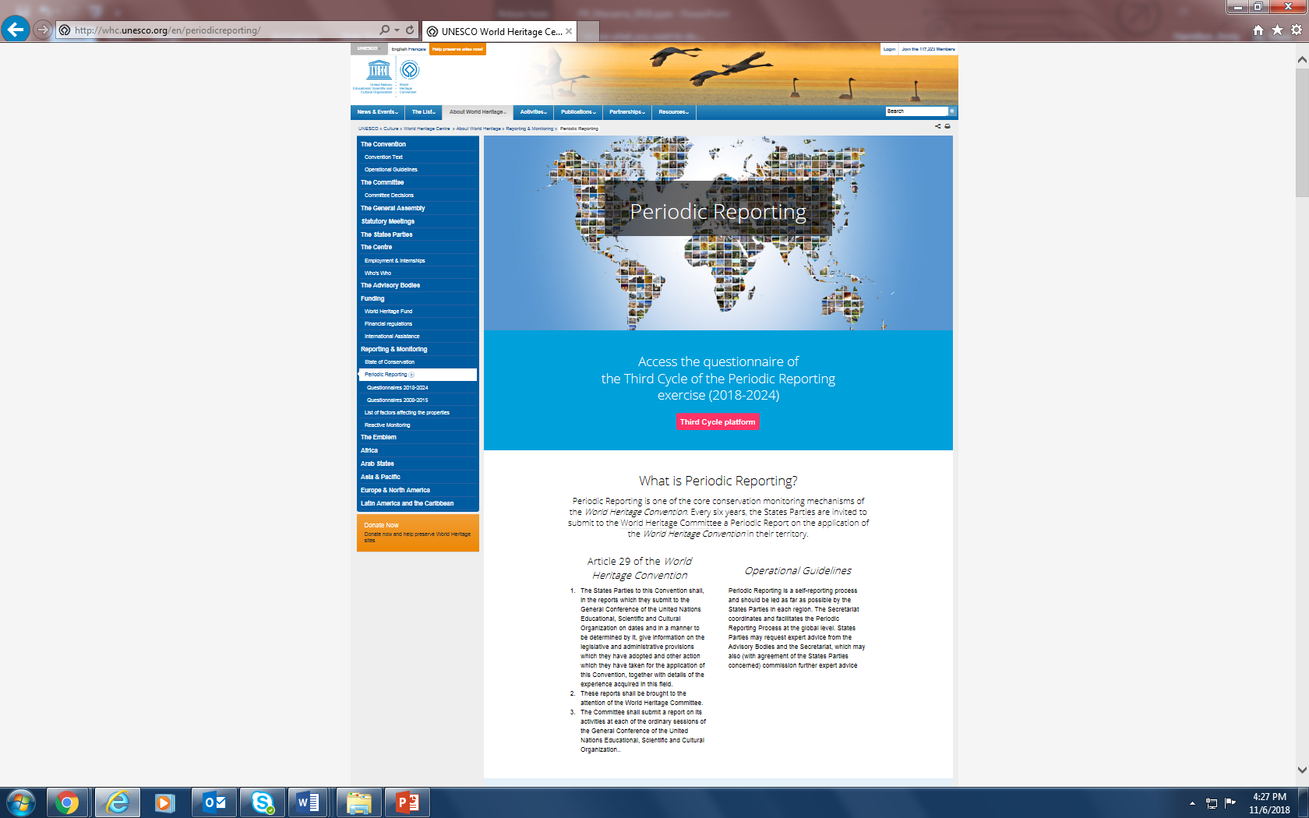
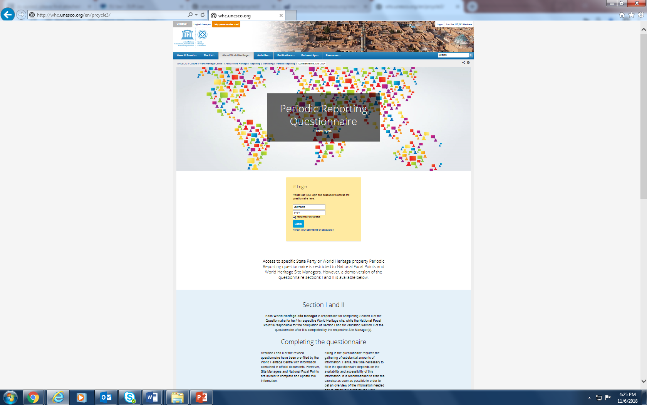
定期报告调查问卷概览
在哪里可以获得调查问卷？

Slide 10
Overview of the Periodic Reporting Questionnaire
Where to access the questionnaire?

Slide 11
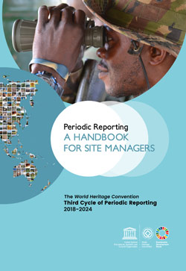
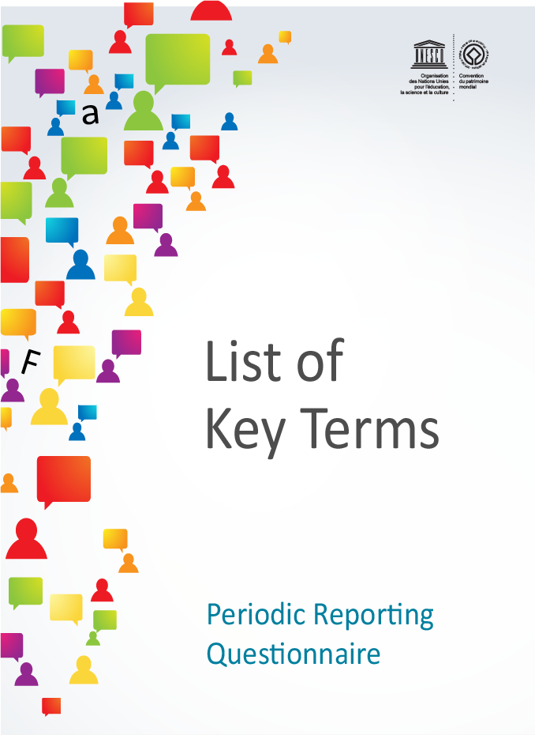
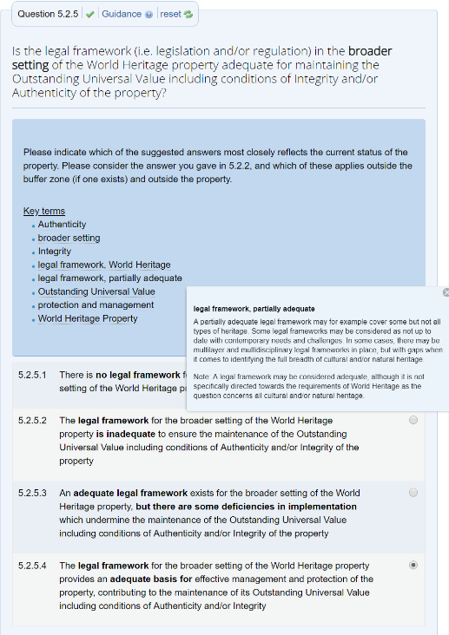
定期报告调查问卷概览
  培训和指导工具
遗产地管理者手册
关键术语（在线和PDF格式）

Slide 12
Overview of the Periodic Reporting Questionnaire
Training and guidance tools
Site Managers Handbook
Key terms (online and in PDF)

Slide 13
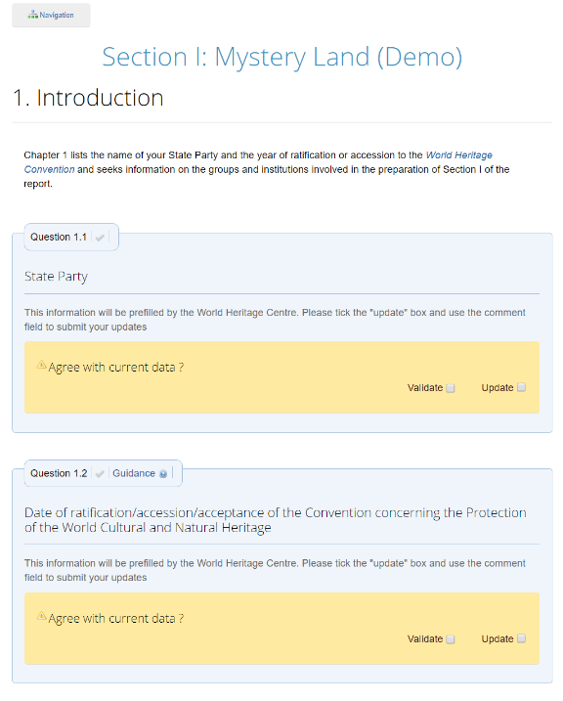
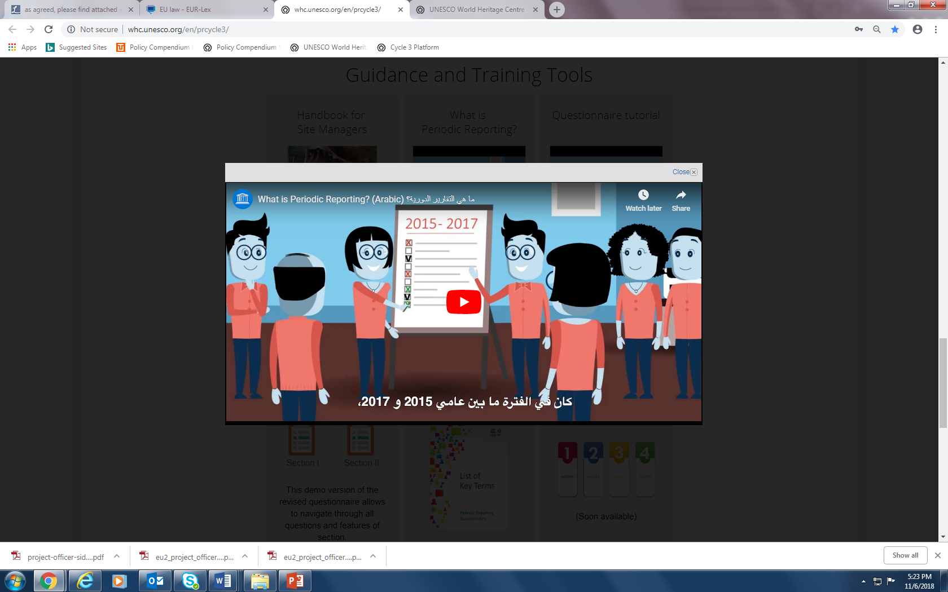
定期报告调查问卷概览
  培训和指导工具
问卷演示版
视频教程

Slide 14
Overview of the Periodic Reporting Questionnaire
Training and guidance tools
Demo version of questionnaire
Video tutorials

Slide 15

定期报告调查问卷概览
培训和指导工具
Watch video tutorial
http://whc.unesco.org/include/tool_video.cfm?youtubeid=iiSFmP-InWw
Video tutorial aimed primarily at World Heritage Site Managers explaining Section II of the Periodic Reporting questionnaire.
Français
English
Français
Subtitled in Arabic

Slide 16
Overview of the Periodic Reporting Questionnaire
Training and guidance tools
Watch video tutorial
http://whc.unesco.org/include/tool_video.cfm?youtubeid=iiSFmP-InWw
Video tutorial aimed primarily at World Heritage Site Managers explaining Section II of the Periodic Reporting questionnaire.
Français
English
Français
Subtitled in Arabic

Slide 17
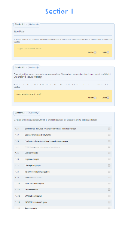
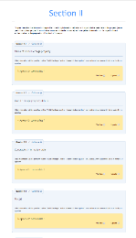
定期报告调查问卷概览
第一部分
缔约国为实施《公约》而通过的法律法规及其采取的其他行动，以及在这一领域取得的详细经验。
这尤其涉及《公约》具体条款中规定的一般义务。
网站
我在哪里可以找到关于定期报告的信息？
综合信息:
whc.unesco.org/en/periodicreporting/
第三轮定期报告平台:
whc.unesco.org/en/prcycle3/
定期报告调查问卷(演示版):
whc.unesco.org/en/prcycle3/
第二部分
位于缔约国境内的各个世界遗产的保护状况。
每项世界遗产都应填写本部分。
来源：操作指南 206段

Slide 18
Overview of the Periodic Reporting Questionnaire
Websites
Section I
the legislative and administrative provisions which the State Party has adopted and other actions which it has taken for the application of the Convention, together with details of the experience acquired in this field.
This particularly concerns the general obligations defined in specific articles of the Convention.
Where do I find information about
Periodic Reporting?
General page:
whc.unesco.org/en/periodicreporting/
Third Cycle platform:
whc.unesco.org/en/prcycle3/
PR Questionnaire (Demo version):
whc.unesco.org/en/prcycle3/
Section II
the state of conservation of specific World Heritage properties located on the territory of the State Party concerned.
This Section should be completed for each World Heritage property.
Source: Para. 206 of the Operational Guidelines

Slide 19
调查问卷概览
关键信息
用户名和密码 ? 可以更改登录信息吗？
问卷的语言是什么？
有哪些类型的问题？
用户？我们可以同时填写吗？
保存，保存，保存！
有多少个问题？需要多长时间？
谁有权限获取问卷？谁有最终决定权？
导出/Word版本？
我只能在线上工具中填写吗？
以前定期报告的回答？
被注销...！？
评论框中的字符限制
跨境/系列遗产的问卷？
帮助？

Slide 20
Overview of the Questionnaire
Key information
Login and Password ? Can login information be changed?
What languages is the questionnaire in?
What types of question are there?
Users ? Can we work on it simultaneously?
Save, save, save!
How many questions? How long will it take?
Who has access to the questionnaire? Who has the final say?
Export/Word version?
Should I work only in the online tool?
Answers from previous reporting cycles?
Getting logged out ..!?
Character limit in the comment boxes
Questionnaire for serial/transnational sites
Help?

Slide 21
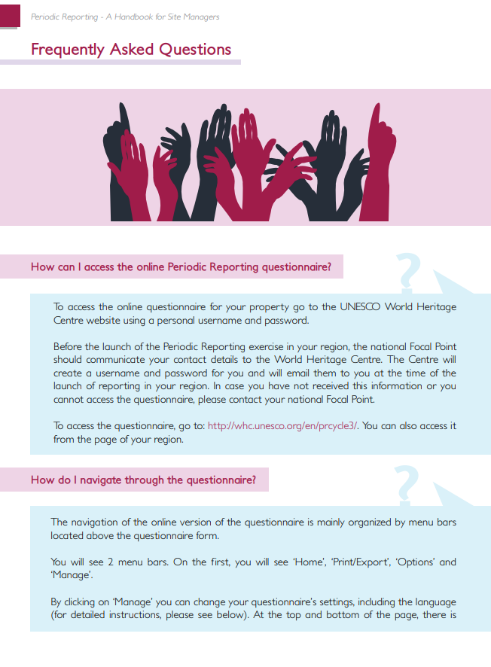
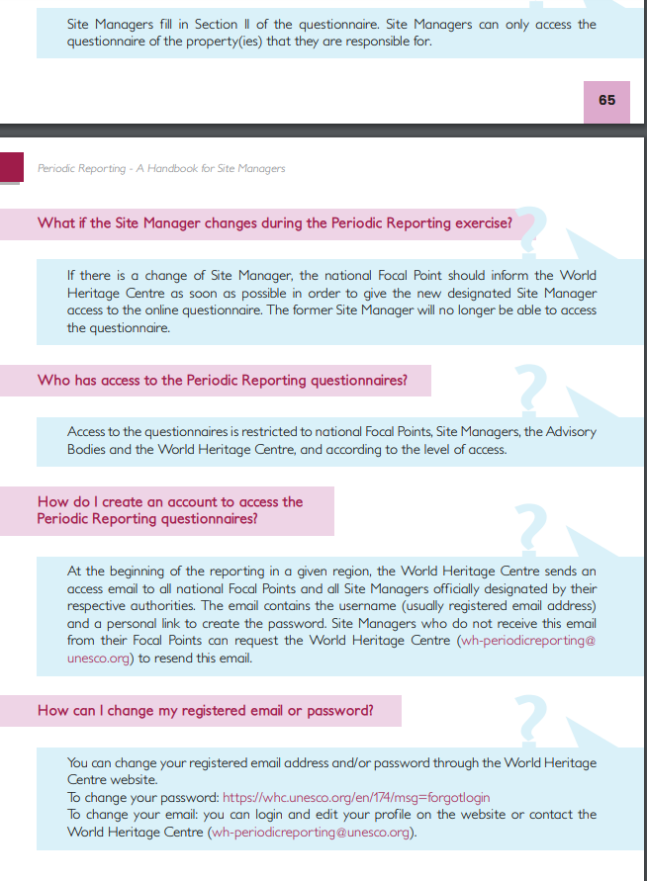
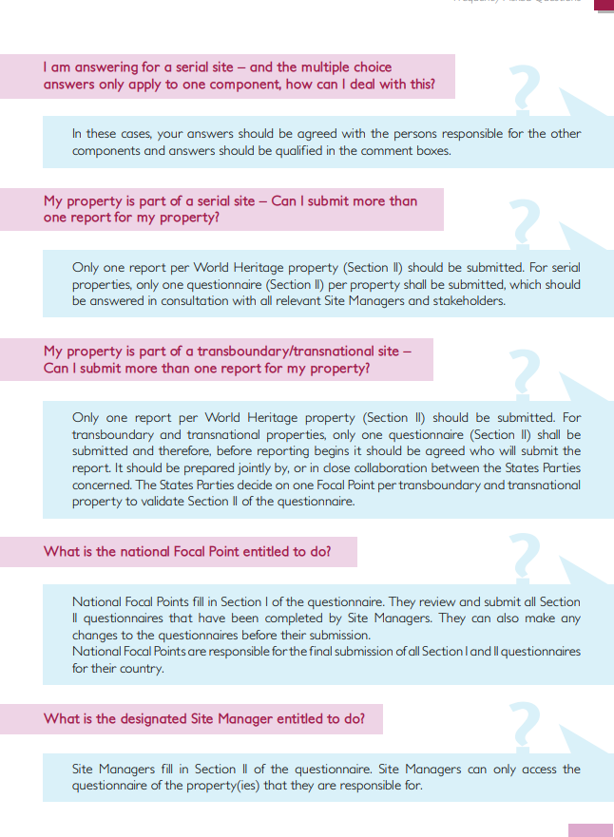
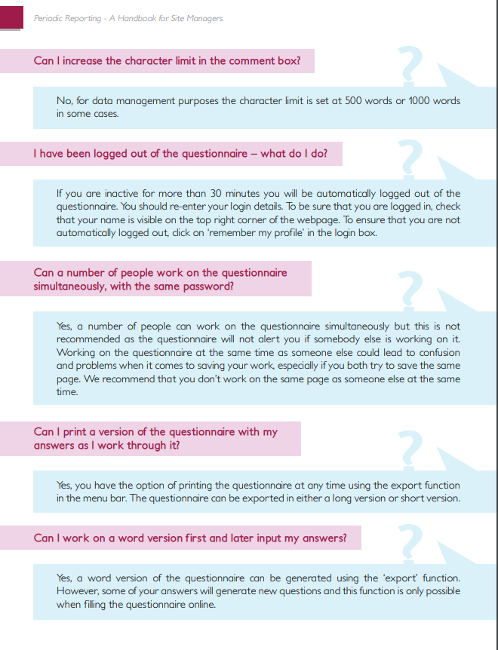
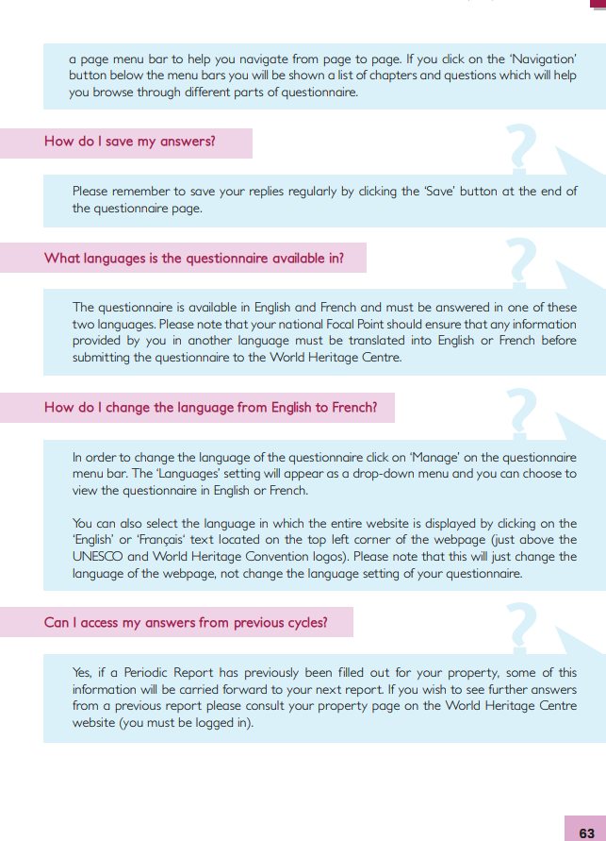
定期报告调查问卷-常见问题
培训和指导工具
说明：这些问题及其它问题的答案可在《遗产地管理者手册》中找到
Notes:
Answers to these and other questions can be found in the Site Managers Handbook

Slide 22
Periodic Reporting Questionnaire – Frequently Asked Questions
Training and guidance tools
Notes:
Answers to these and other questions can be found in the Site Managers Handbook

Slide 23
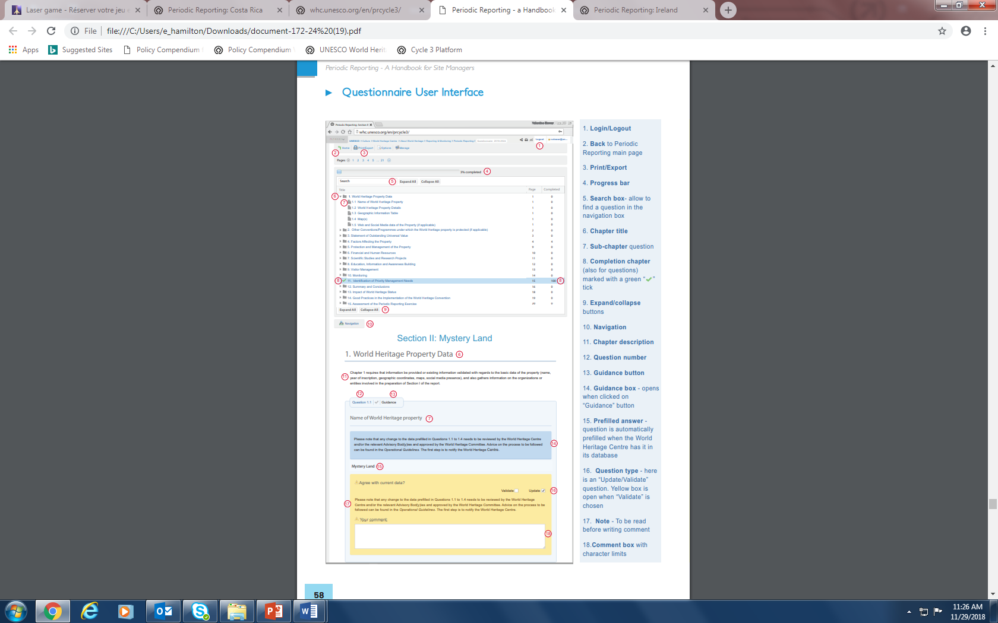
调查问卷概述
关键信息-界面
登录/注销
退回至主页
打印/导出
进度
搜索框
章节标题
各章内问题
已完成章节
展开/缩起
导航
章节说明
问题序号
指导按钮
指导框
预填内容
问题类型
笔记
评论框
Notes:
Login/Logout
Back to main PR page
Print/export
Progress
Search box
Chapter title
Sub-chapter question
Completion chapter
Expand/collapse
10. Navigation
Chapter description
Question number
Guidance button
Guidance box
Prefilled answer
Question type
Note
Comment box

Slide 24
Overview of the Questionnaire:
Key information - Interface
Notes:
Login/Logout
Back to main PR page
Print/export
Progress
Search box
Chapter title
Sub-chapter question
Completion chapter
Expand/collapse
10. Navigation
Chapter description
Question number
Guidance button
Guidance box
Prefilled answer
Question type
Note
Comment box

Slide 25
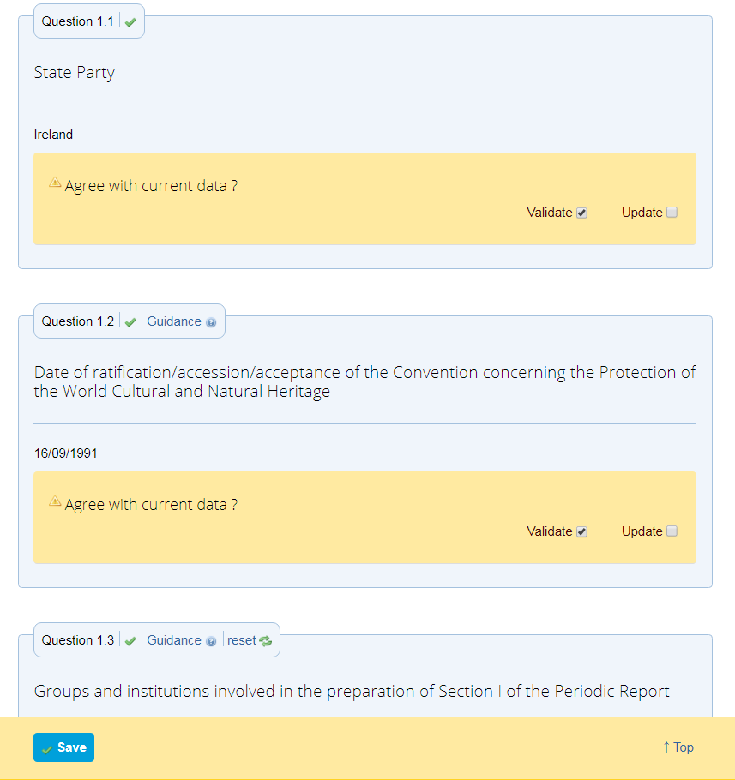
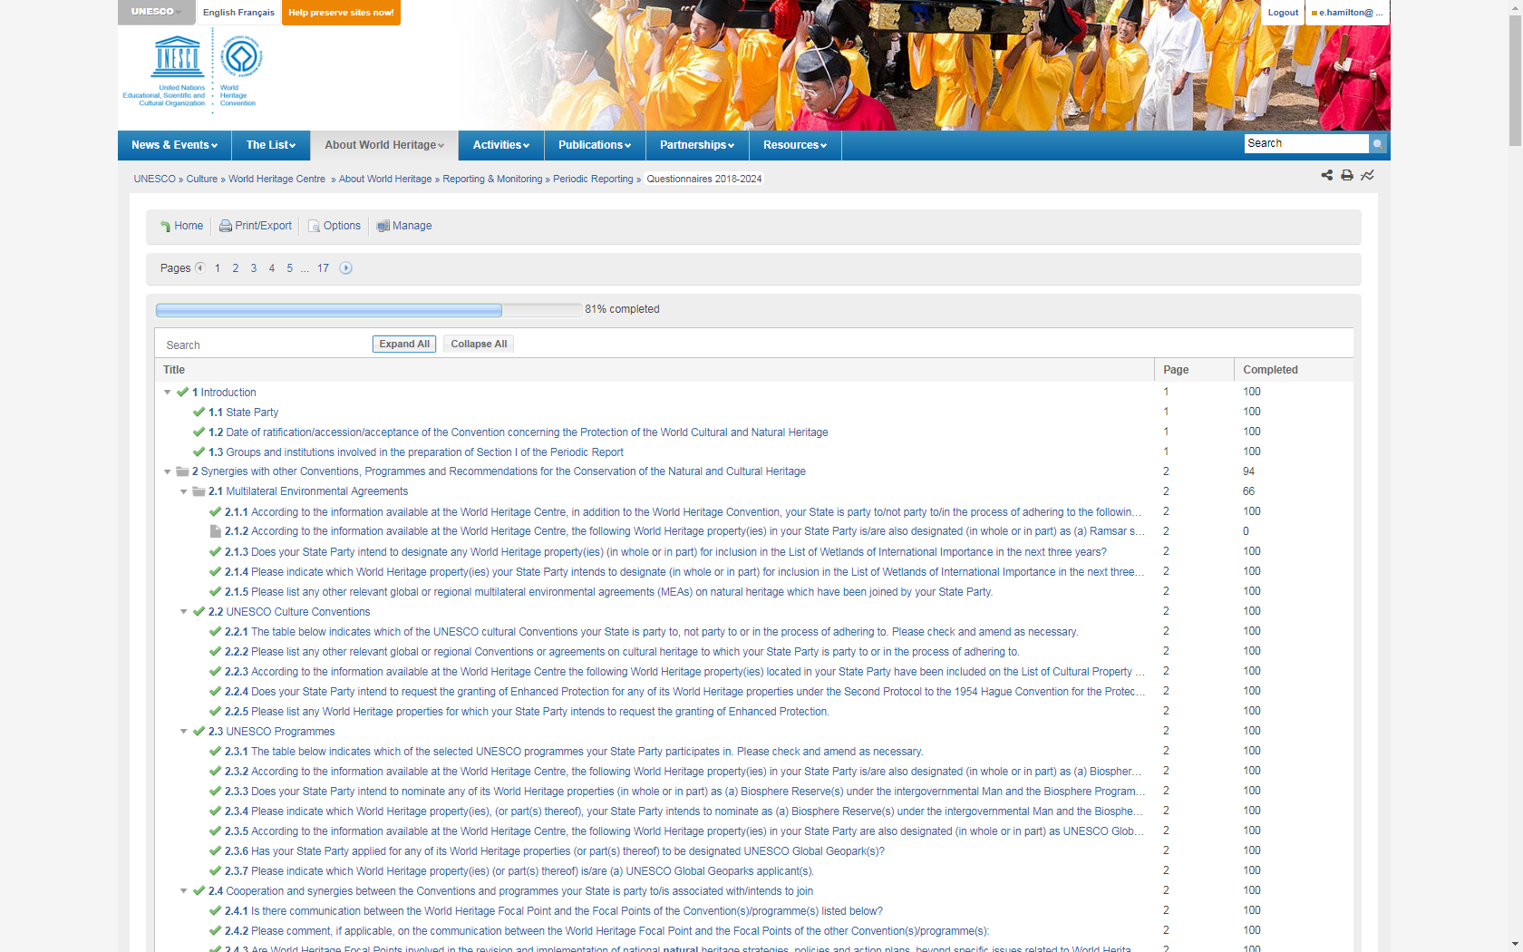
调查问卷概述:关键信息-界面
导出Word/PDF
切换语言
填报进程
指南与关键术语
搜索关键词
保存
回到首页

Slide 26
Periodic Reporting Questionnaire: Key information - Interface
Export to Word/PDF
Change language
Guidance and key terms
Progress
Search key terms
Save
Go to top of page

Slide 27
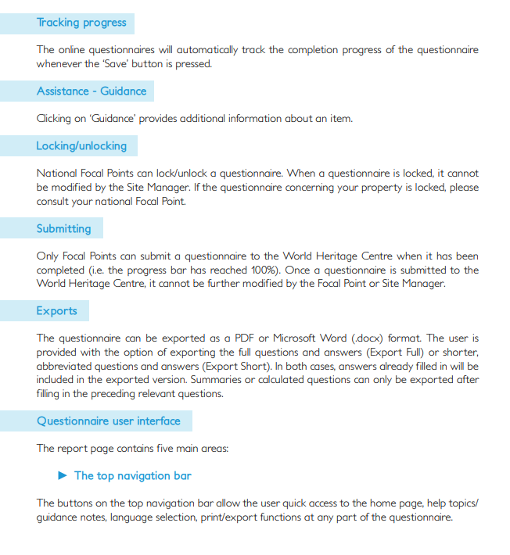
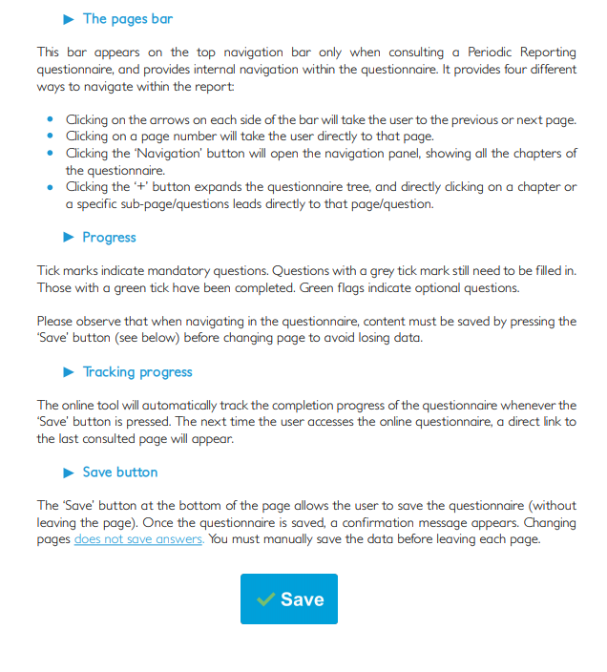
调查问卷概述:关键信息-界面
说明：这些功能的列表可以在《遗产地管理者手册》中找到
Notes:
A list of these functions is available in the SM handbook

Slide 28
Periodic Reporting Questionnaire: Key information - Interface
Notes:
A list of these functions is available in the SM handbook

Slide 29
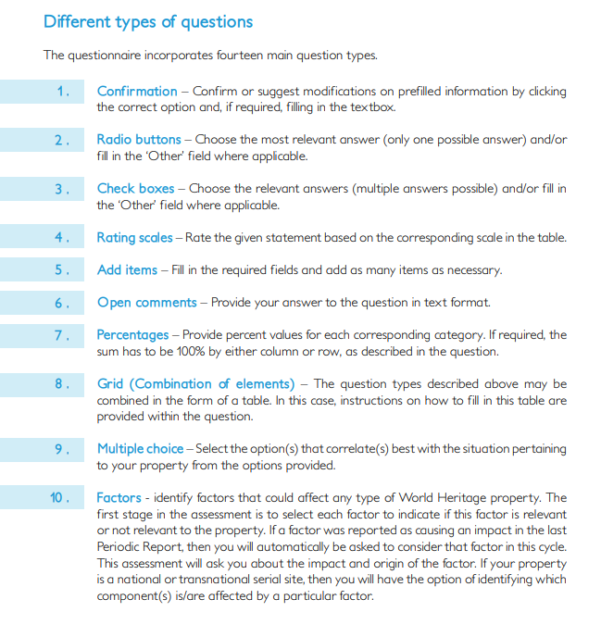
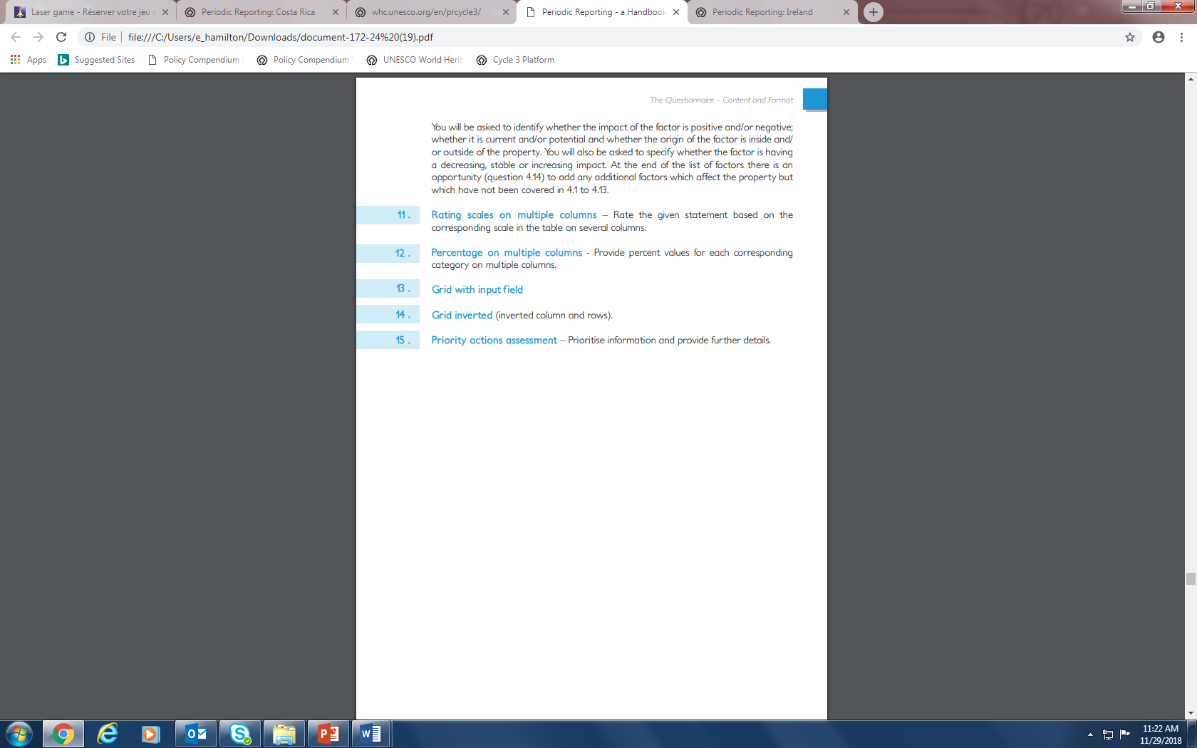
调查问卷概述: 问题类型
不同类型的问题
确认
单选
复选
打分
增加项目
开放式评论
百分比
综合（以上提到的几种类型组合）
多选
影响因素
多项打分
多项百分比
带输入域的网格
反向网格
优先行动评估

Slide 30
Periodic Reporting Questionnaire: Question types

Slide 31
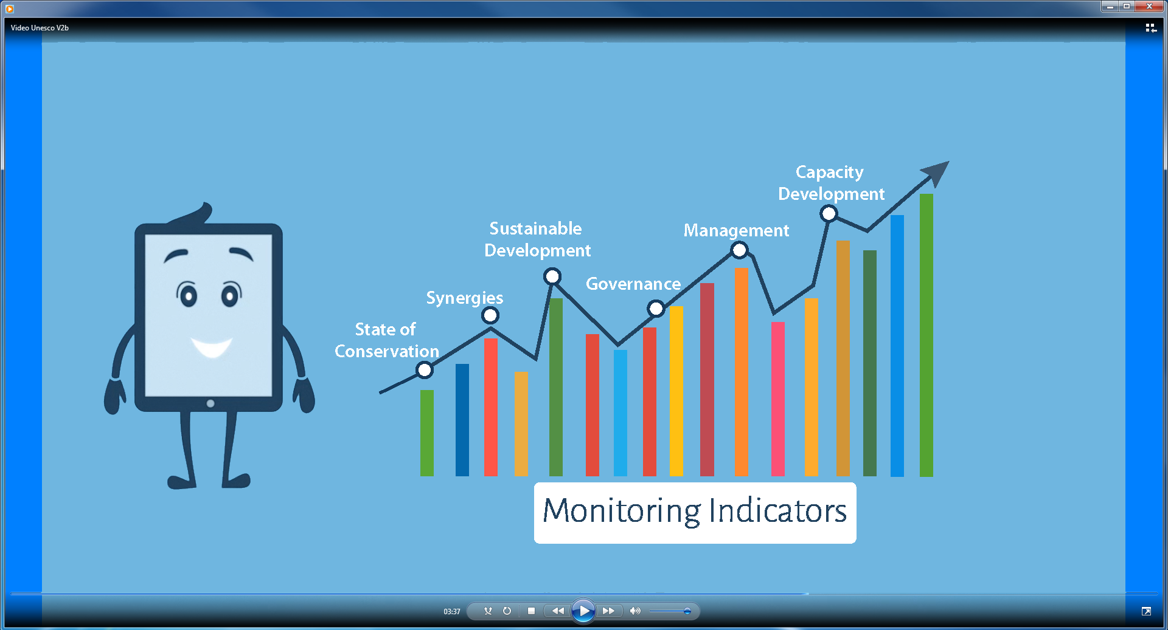
定期报告调查问卷的核心主题
保护状况
协作
可持续发展
治理
管理
能力发展

Slide 32
Core themes of the Periodic Reporting Questionnaire
State of Conservation
Synergies
Sustainable Development
Governance
Management
Capacity Development

Slide 33
定期报告调查问卷概览– 第一部分
介绍
与其他关于保护自然和文化遗产的公约、项目和建议的协同作用
预备名录
申报
一般政策制定
记录文化和自然遗产的清单/名录等
自然和文化遗产的认定、保护、保存和展示状况
财务和人力资源
能力发展
针对世界遗产的政策和资源配置
国际合作
教育、信息传播和建立保护意识
结论和建议采取的行动
实施《世界遗产公约》的优秀实践
对定期报告工作的评估
第一部分

Slide 34
Overview of the Periodic Reporting Questionnaire – Section I
Introduction
Synergies with other Conventions, Programmes and Recommendations for the Conservation of the Natural and Cultural Heritage
Tentative List
Nominations
General Policy Development
Inventories/Lists/Registers of Cultural and Natural Heritage
Status of Services for the Identification, Protection, Conservation and Presentation of Natural and Cultural Heritage
Financial Status and Human Resources
Capacity Development
Policy and Resourcing of World Heritage Properties
International Cooperation
Education, Information and Awareness Building
Conclusions and Recommended Actions
Good Practice in the Implementation of the World Heritage Convention
Assessment of the Periodic Reporting Exercise
Section I

Slide 35
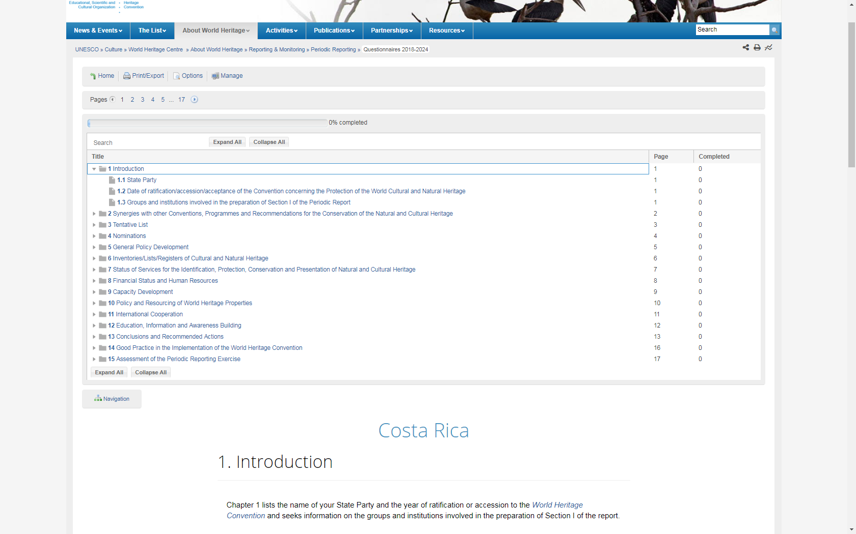
第一部分
第一章：介绍
说明：第一章内容包括待确认的基本信息;例如缔约国批准《公约》的年份，以及谁参与了报告的编写工作（通过咨询等其它方式）。
Notes:
The first questions of Chapter 1 contain basic information to be validated; such as the year the State Party ratified the Convention and also asks who was involved in the preparation of the report (through consultations etc.):

Slide 36
Section I
Chapter 1: Introduction
Notes:
The first questions of Chapter 1 contain basic information to be validated; such as the year the State Party ratified the Convention and also asks who was involved in the preparation of the report (through consultations etc.):

Slide 37
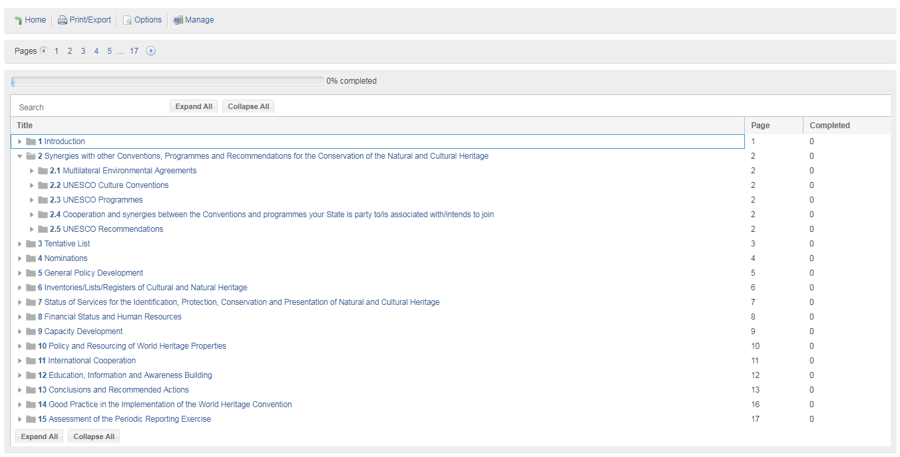
第一部分
第二章: 与其他关于保护自然和文化遗产的公约、项目和建议的协同作用
说明：收集缔约国参与的协议信息。它提供了世界遗产中心记录在案并可验证或更新的信息，包括多边环境协定和教科文组织保护文化公约；问题还涉及缔约国参与的教科文组织计划，人与生物圈计划，和UNSECO全球地质公园；还会进一步问及制定国家政策或战略时是否参考《关于城市历史景观的建议书》和《关于在国家层面保护文化与自然遗产的建议》（1972）。
Notes:
Gathers information on the agreements the State Party is involved in; it presents the information that the World Heritage Centre has on record and can be validated or updated; this covers multilateral environmental agreements and UNESCO cultural Conventions; there are also questions on the State Party’s engagement with UNESCO programmes; Man and the Biosphere and UNESCO Global Geoparks; further questions ask whether the Historic Urban Landscape Recommendation and the 1972 Recommendation are being used to set national policies or strategies:

Slide 38
Section I
Chapter 2: Synergies with other Conventions, Programmes and Recommendations
Notes:
Gathers information on the agreements the State Party is involved in; it presents the information that the World Heritage Centre has on record and can be validated or updated; this covers multilateral environmental agreements and UNESCO cultural Conventions; there are also questions on the State Party’s engagement with UNESCO programmes; Man and the Biosphere and UNESCO Global Geoparks; further questions ask whether the Historic Urban Landscape Recommendation and the 1972 Recommendation are being used to set national policies or strategies:

Slide 39
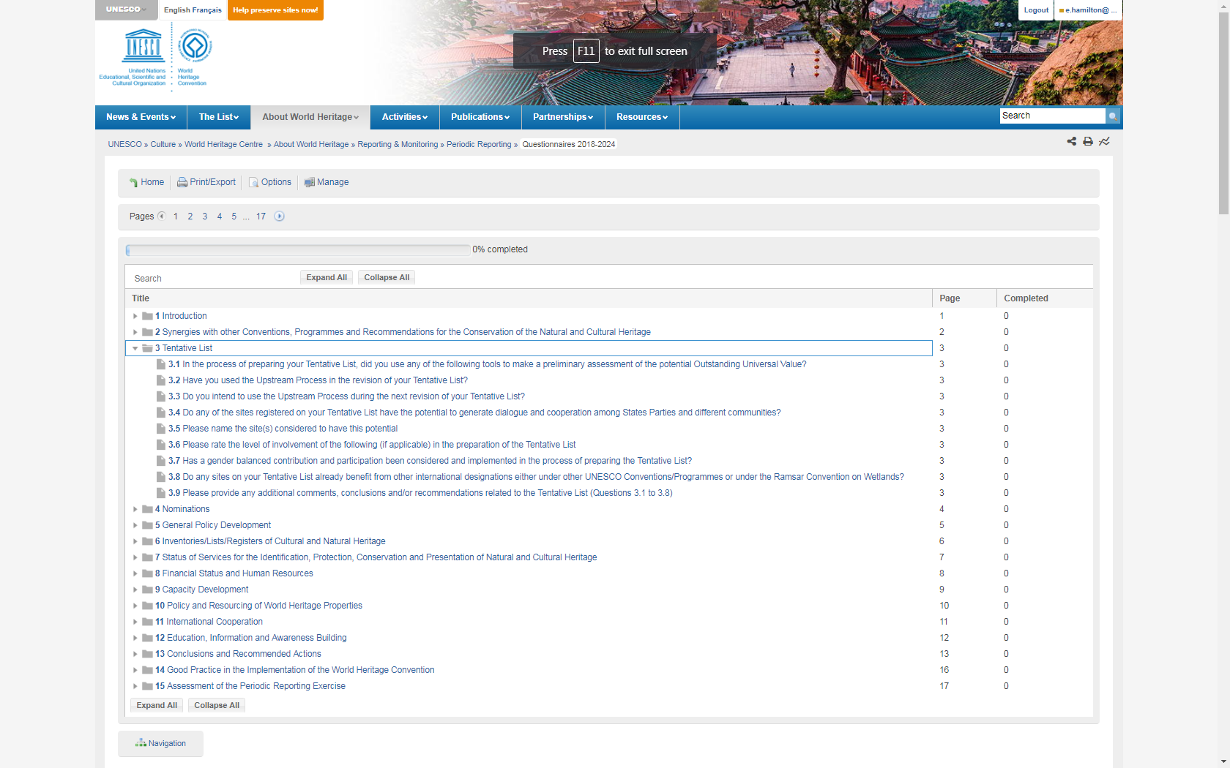
第一部分
第三章：预备清单
说明：关注《预备清单》。询问编制《预备清单》所使用的工具和方法；《预备清单》是否采用可持续发展的方法；是否有协同的潜力；《预备清单》上的遗产地是否已列入其他公约。
Notes:
Looks at the Tentative List; asks about the tools and approaches used to compile it; about whether it has a sustainable development approach; and if there are potential synergies; Are sites on the Tentative List already designated under other conventions

Slide 40
Section I
Chapter 3: Tentative List
Notes:
Looks at the Tentative List; asks about the tools and approaches used to compile it; about whether it has a sustainable development approach; and if there are potential synergies; Are sites on the Tentative List already designated under other conventions

Slide 41
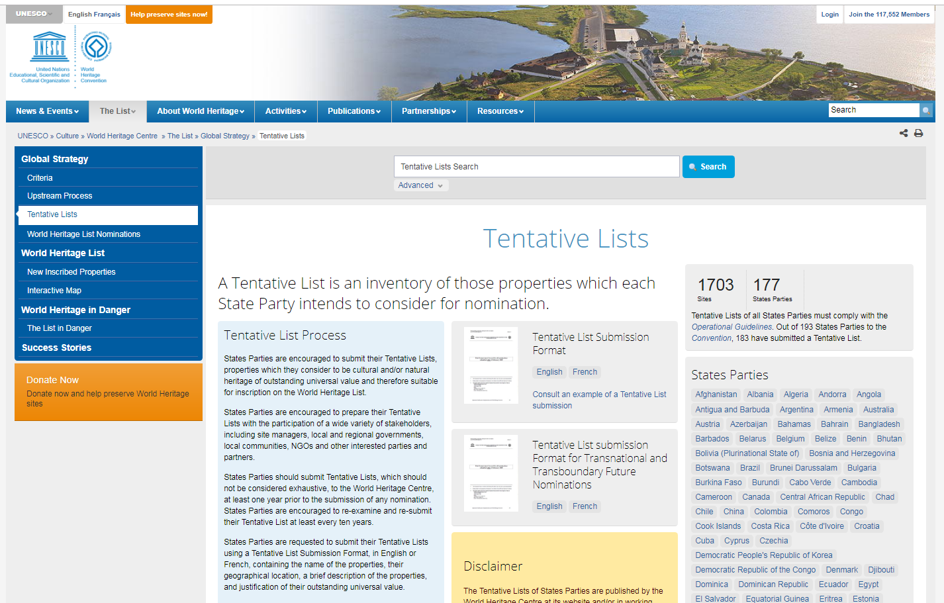
第一部分
第三章：预备清单 – 哪里可以找到您的预备清单?——https://whc.unesco.org/en/tentativelists/
Notes:
Tentative lists can be found at https://whc.unesco.org/en/tentativelists/

Slide 42
Section I
Chapter 3: Tentative List – Where to find your Tentative List?
Notes:
Tentative lists can be found at https://whc.unesco.org/en/tentativelists/

Slide 43
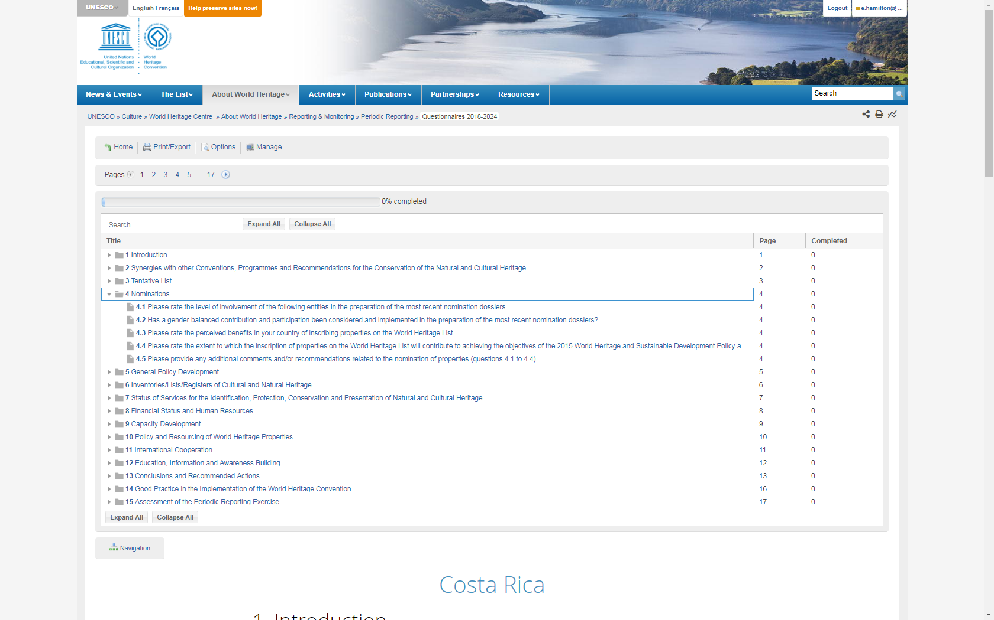
第一部分
第四章：申报
说明：询问申报过程是否具有包容性，谁参与了这一过程；缔约国对世界遗产的态度（即：认为列入《名录》的益处）；如果列入《名录》将如何支持可持续发展。
Notes:
Asks about whether the nomination process has been inclusive, who was involved in the process. Asks about attitudes to World Heritage in the country (ie: the perceived benefits of being on the List), asks how inscription will support sustainable development.

Slide 44
Section I
Chapter 4: Nominations
Notes:
Asks about whether the nomination process has been inclusive, who was involved in the process. Asks about attitudes to World Heritage in the country (ie: the perceived benefits of being on the List), asks how inscription will support sustainable development.

Slide 45
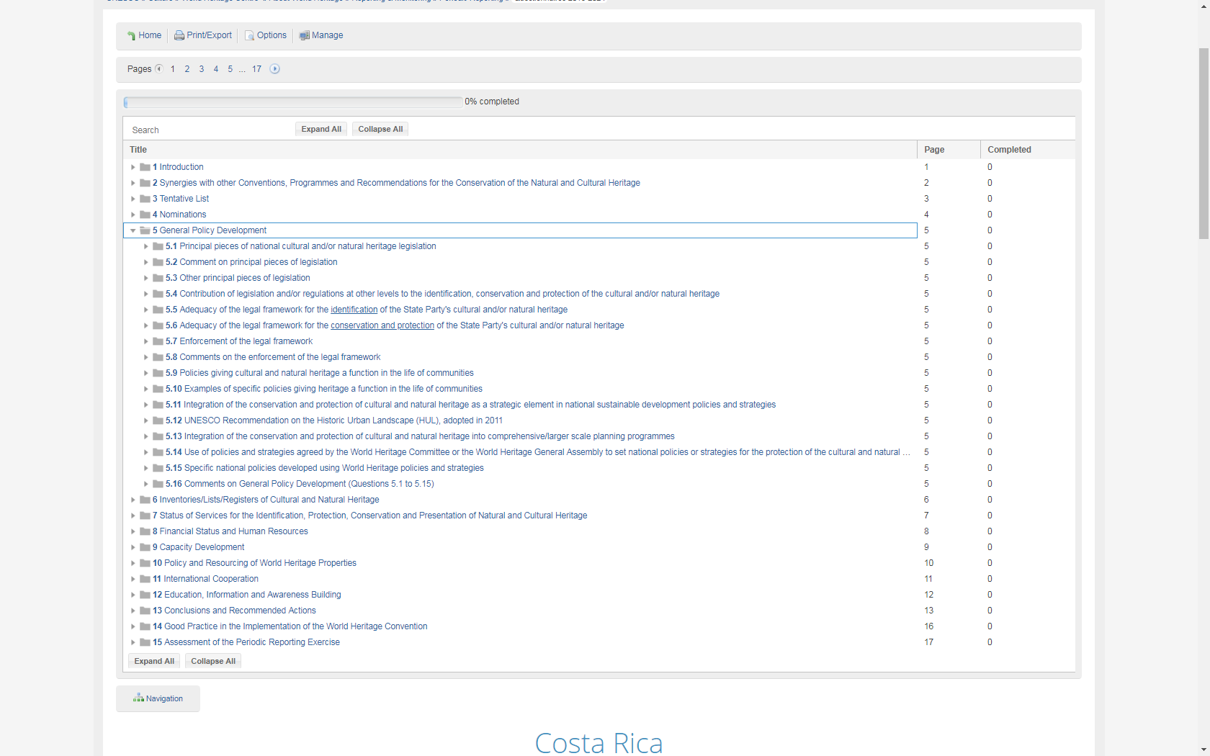
第一部分
第五章：一般政策制定
一般政策的制定=缔约国的所有文化和自然遗产。
说明：审视遗产保护的法律框架及其实施的有效性。将问及缔约国的主要立法及其是否能够执行；遗产保护是否被纳入国家可持续发展战略，是否使用《关于城市历史景观的建议书》，以及是否使用世界遗产委员会的战略或政策来制定国家政策或战略。
Notes:
Looks at Legal Framework for the protection and conservation of heritage and the effectiveness of its implementation, you will be asked about the principal legislation in your country and whether it can be enforced, whether heritage protection is integrated into national sustainable development strategies, whether the Historic Urban Landscape Recommendation is being used and whether strategies or policies of the World Heritage Committee are used to set national policies or strategies.

Slide 46
Section I
General policy development = all cultural and natural heritage in the State Party
Chapter 5: General Policy Development
Notes:
Looks at Legal Framework for the protection and conservation of heritage and the effectiveness of its implementation, you will be asked about the principal legislation in your country and whether it can be enforced, whether heritage protection is integrated into national sustainable development strategies, whether the Historic Urban Landscape Recommendation is being used and whether strategies or policies of the World Heritage Committee are used to set national policies or strategies.

Slide 47
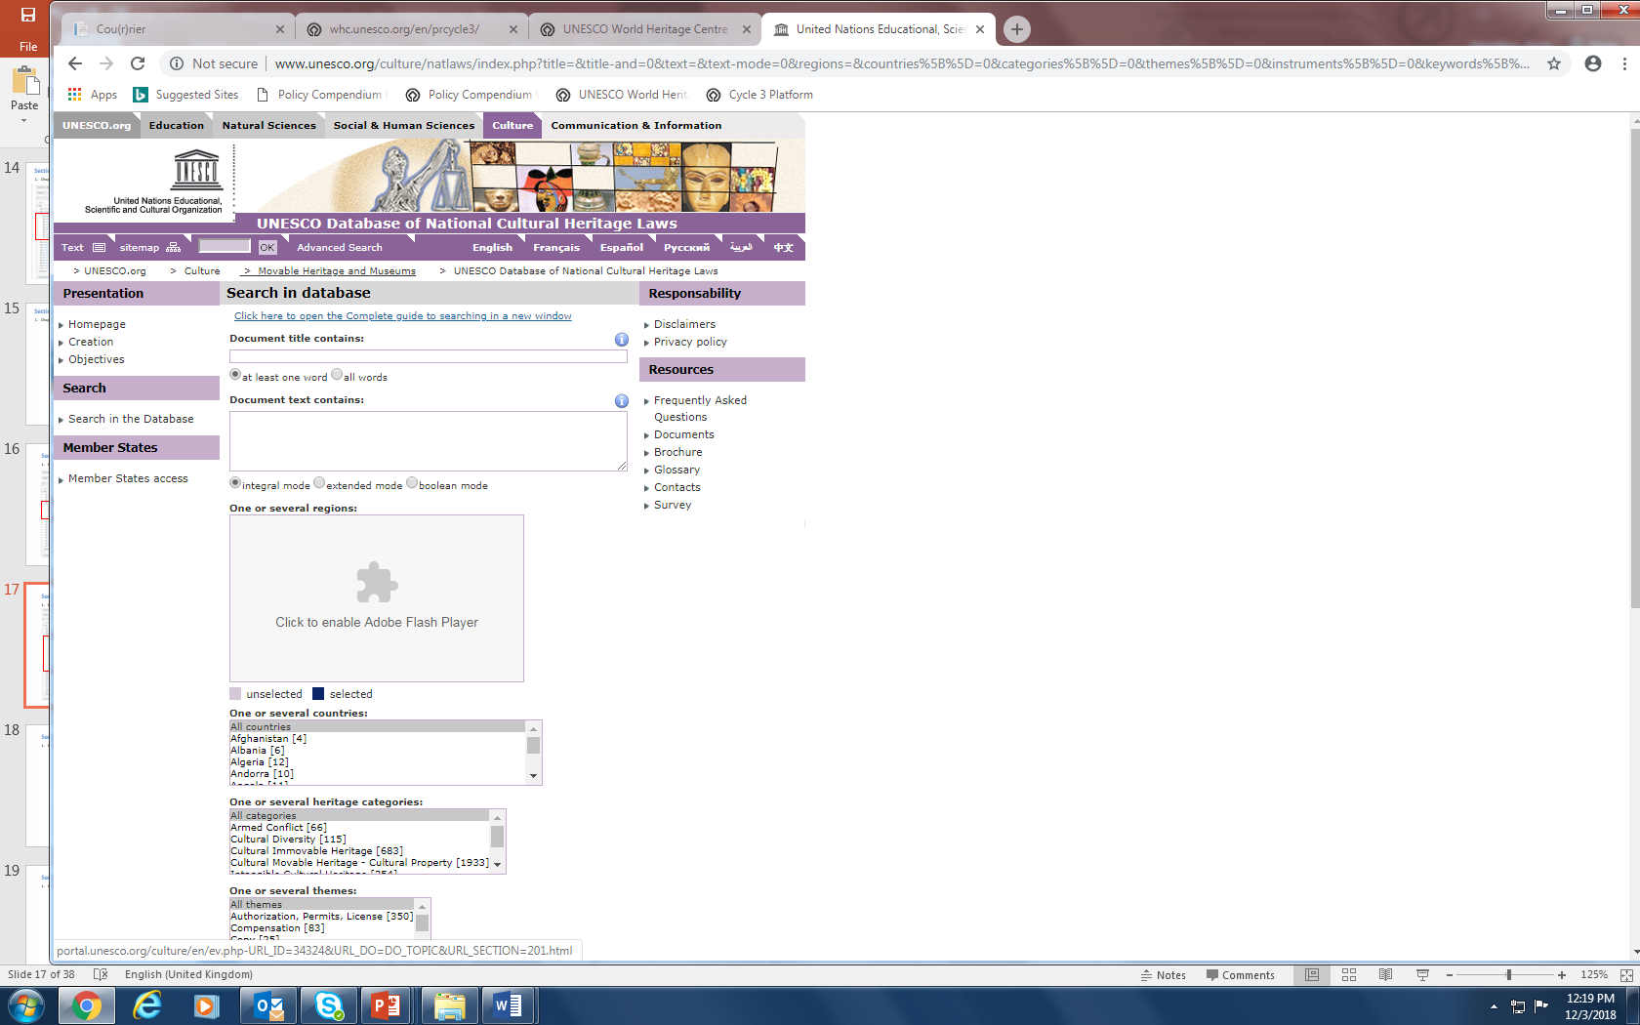
第一部分
第五章：一般政策制定
第5章中的主要国家立法已尽可能从教科文组织的文化遗产法律数据库中预先填入。

Slide 48
Section I
Chapter 5: General Policy Development
Principal pieces of national legislation in Chapter 5 are prefilled where possible from the UNESCO database of Cultural Heritage laws.

Slide 49
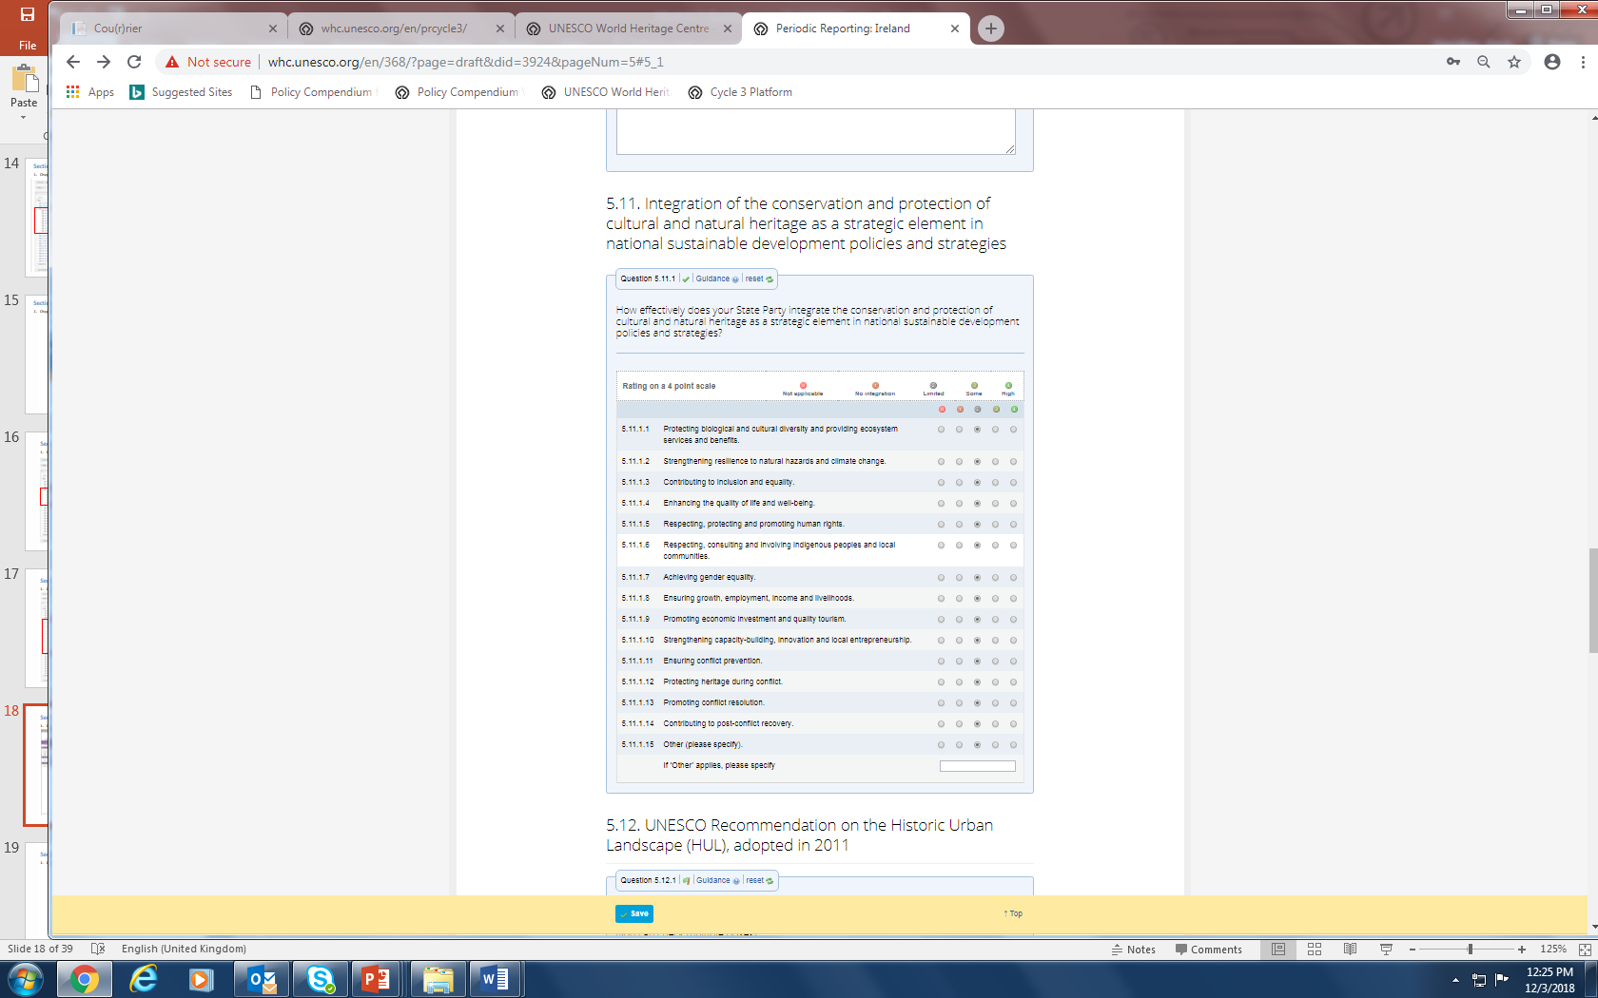
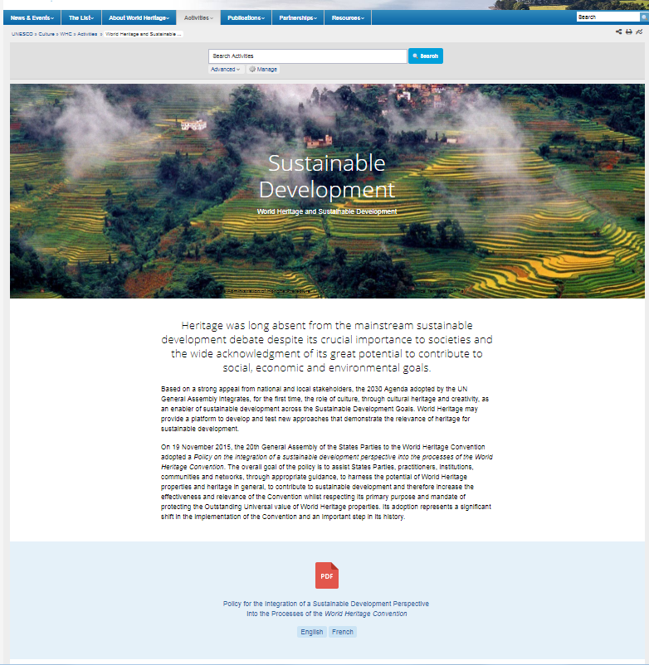
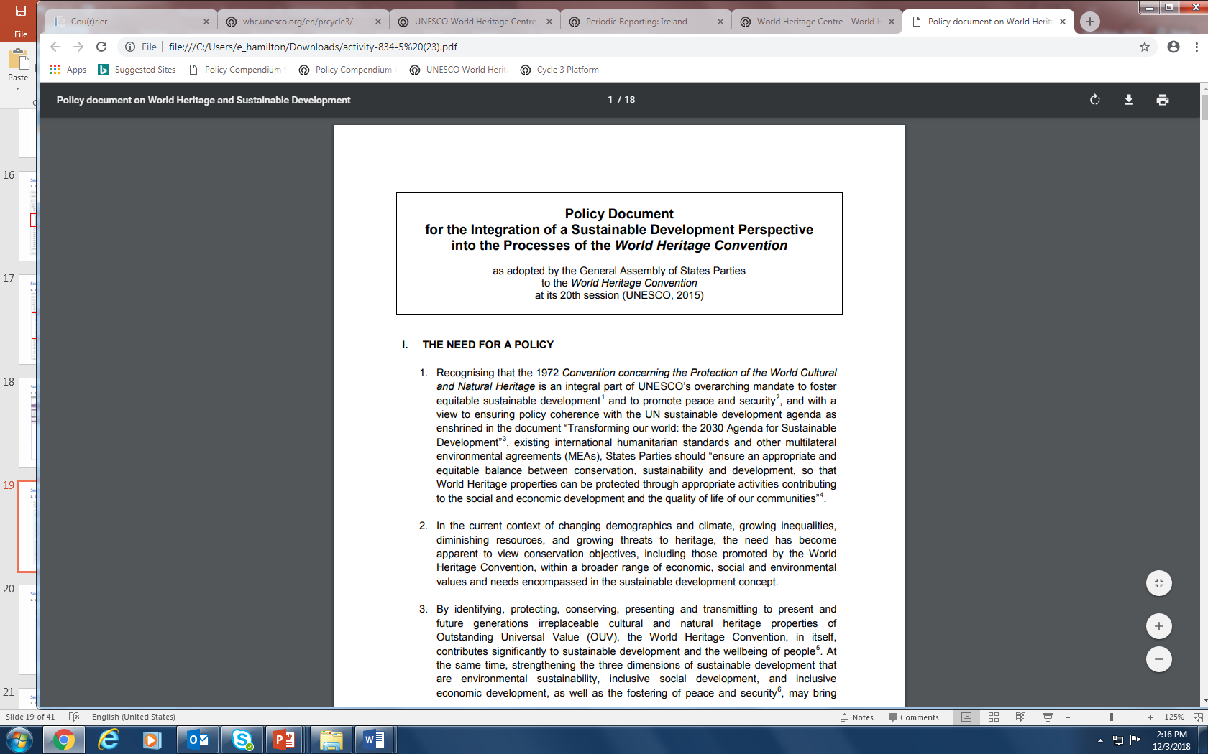
第一部分
第五章：一般政策制定
https://whc.unesco.org/en/sustainabledevelopment/
说明：本章和其他章节中的一些问题基于世界遗产可持续发展政策提出。在最新的第三轮定期报告问卷中已经新加入了可持续发展方面的内容。
Notes:
Certain questions in this and other chapters are based on the World Heritage Sustainable Development Policy. This Sustainable Development aspect has been newly integrated into the questionnaire for the Third Cycle of Periodic Reporting.

Slide 50
Section I
Chapter 5: General Policy Development
https://whc.unesco.org/en/sustainabledevelopment/
Notes:
Certain questions in this and other chapters are based on the World Heritage Sustainable Development Policy. This Sustainable Development aspect has been newly integrated into the questionnaire for the Third Cycle of Periodic Reporting.

Slide 51
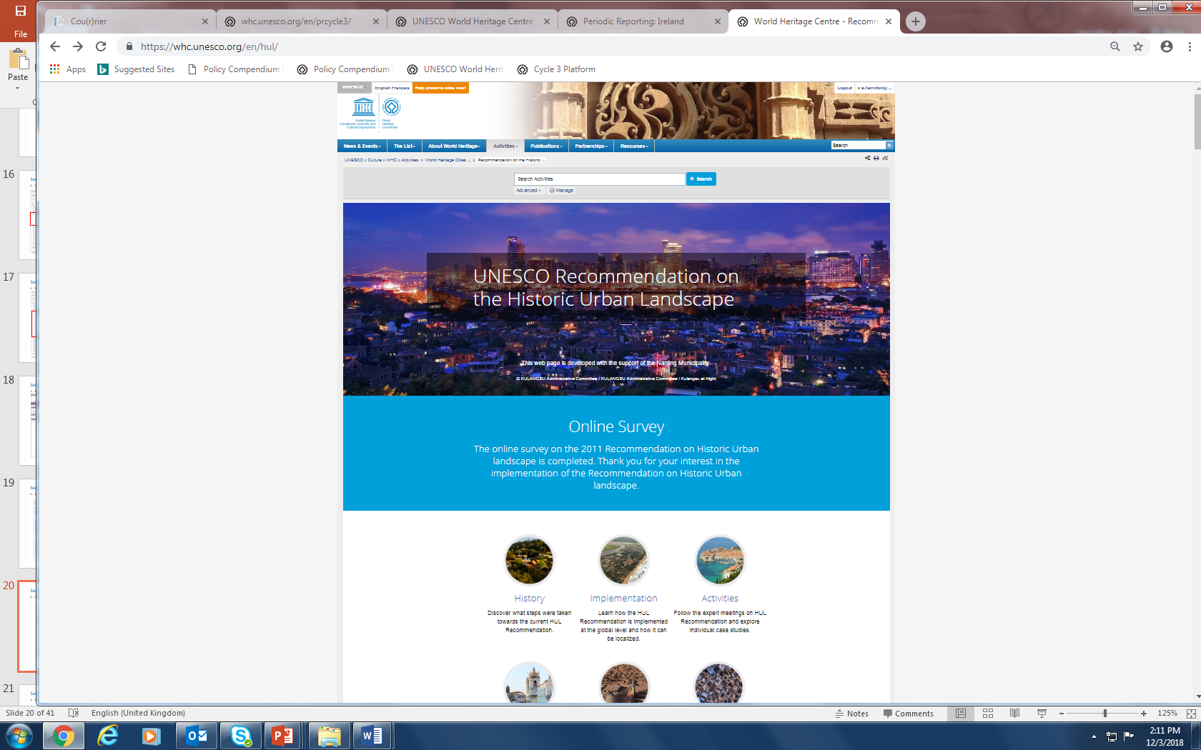
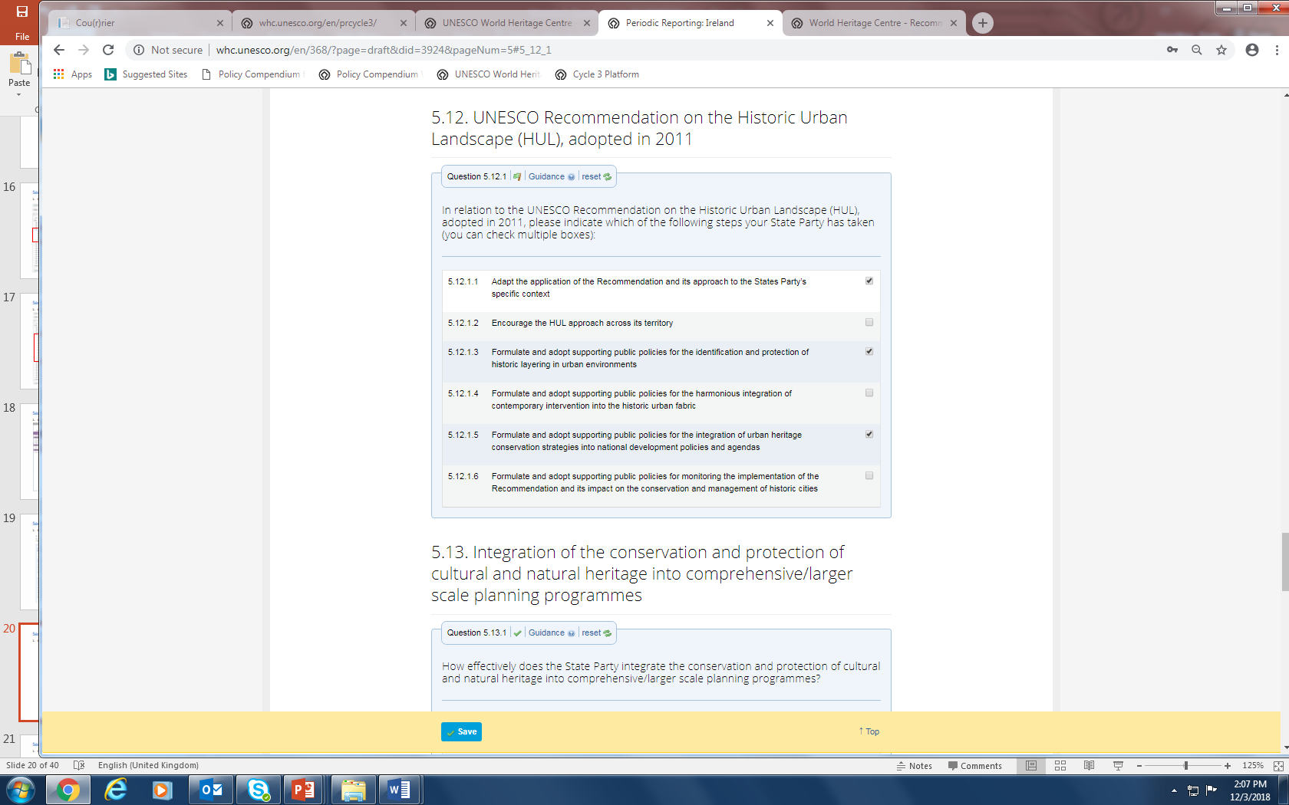
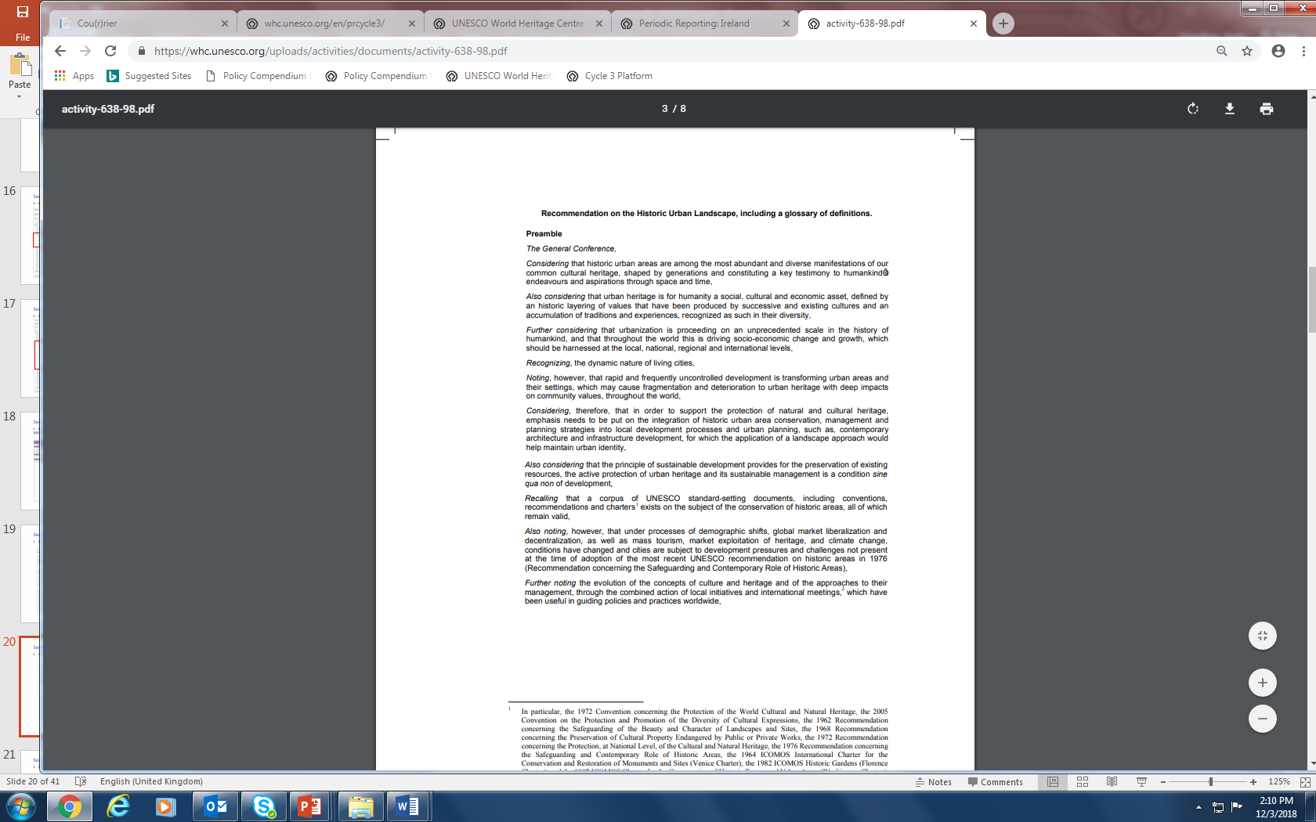
第一部分
第五章：一般政策制定
说明：这个问题根据2011年通过的《关于城市历史景观的建议书》提出。更多信息可以在世界遗产网页上找到，
http://historicurbanlandscape.com/themes/196/userfiles/download/2016/6/7/wirey5prpznidqx.pdf。
Notes:
This question is based on the Recommendation on the Historic Urban Landscape which was adopted in 2011. More information can be found on the World Heritage HUL pages and also in the HUL Guidebook http://historicurbanlandscape.com/themes/196/userfiles/download/2016/6/7/wirey5prpznidqx.pdf

Slide 52
Section I
Chapter 5: General Policy Development
Notes:
This question is based on the Recommendation on the Historic Urban Landscape which was adopted in 2011. More information can be found on the World Heritage HUL pages and also in the HUL Guidebook http://historicurbanlandscape.com/themes/196/userfiles/download/2016/6/7/wirey5prpznidqx.pdf

Slide 53
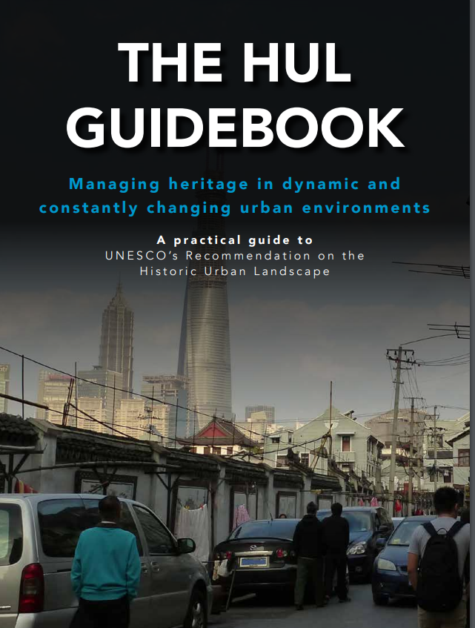
第一部分
第五章：一般政策制定
出版物
http
在动态化与不断变化城市环境中的遗产保护
下载链接:
https://bit.ly/2aZ2nwA
Notes:
This question is based on the Recommendation on the Historic Urban Landscape which was adopted in 2011. More information can be found on the World Heritage HUL pages and also in the HUL Guidebook http://historicurbanlandscape.com/themes/196/userfiles/download/2016/6/7/wirey5prpznidqx.pdf

Slide 54
Section I
Chapter 5: General Policy Development
Publication
http
Managing heritage in dynamic and
constantly changing urban environments
Download link:
https://bit.ly/2aZ2nwA
Notes:
This question is based on the Recommendation on the Historic Urban Landscape which was adopted in 2011. More information can be found on the World Heritage HUL pages and also in the HUL Guidebook http://historicurbanlandscape.com/themes/196/userfiles/download/2016/6/7/wirey5prpznidqx.pdf

Slide 55
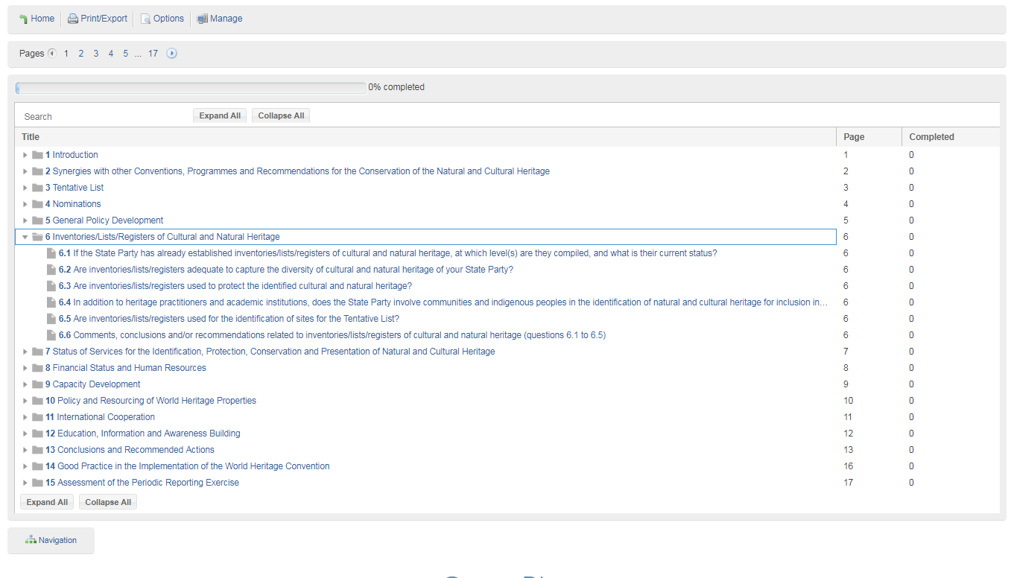
第一部分
第六章:记录文化和自然遗产的清单/名录等
说明：清单或名录是如何编制及使用的，是否融入了可持续发展的方法。
Notes:
How these inventories are compiled, how they are used, do they integrate a sustainable development approach

Slide 56
Section I
Chapter 6: Inventories/Lists/Registers of Cultural and Natural Heritage
Notes:
How these inventories are compiled, how they are used, do they integrate a sustainable development approach

Slide 57
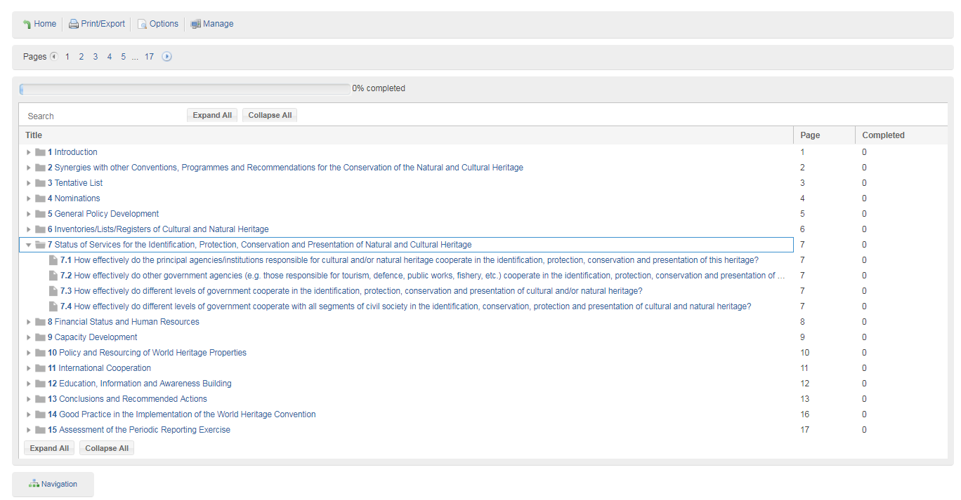
第一部分
第七章: 自然和文化遗产的认定、保护、保存和展示状况
说明：文化/自然遗产各个机构在国家层面如何合作，并且如何与其他政府机构合作。
Notes:
How do agencies for cultural/natural heritage cooperate at national level and also with other government agencies

Slide 58
Section I
Chapter 7: Status of Services for the Identification, Protection, Conservation and Presentation of Natural and Cultural Heritage
Notes:
How do agencies for cultural/natural heritage cooperate at national level and also with other government agencies

Slide 59
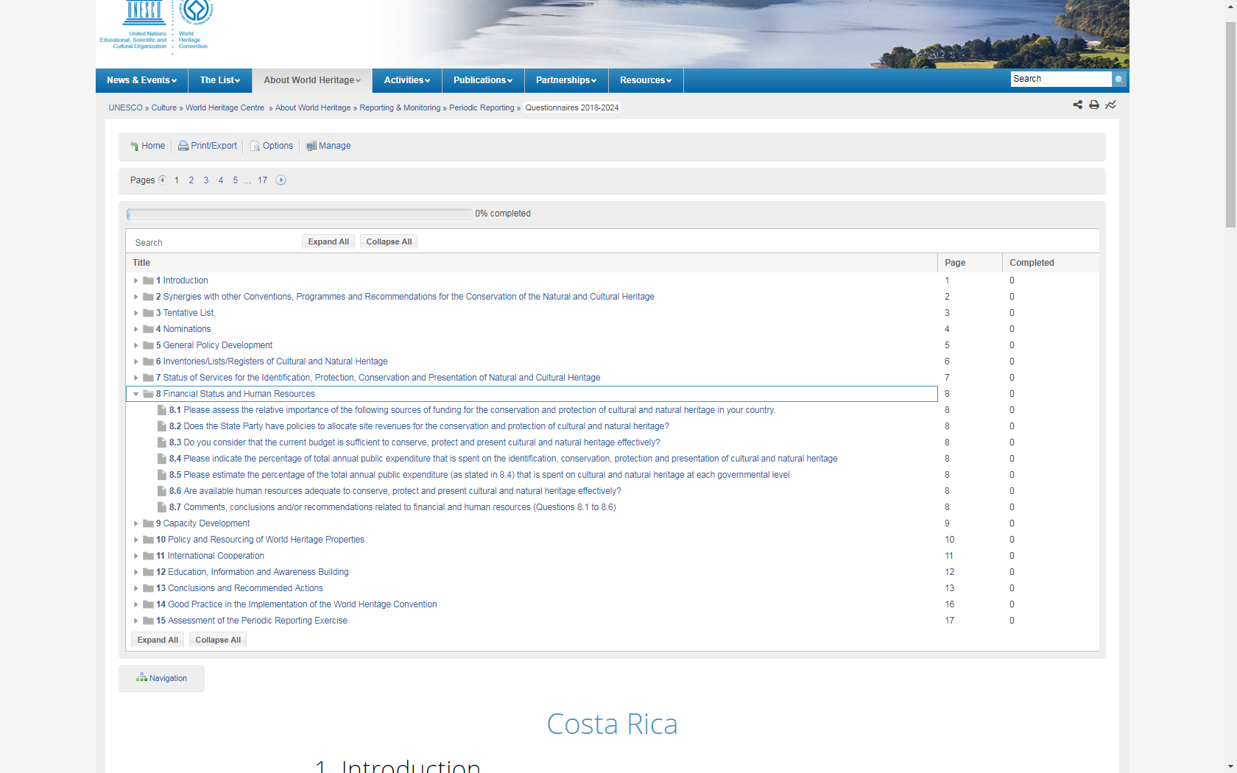
第一部分
第8章: 财务状况和人力资源
说明：问及遗产的资金问题，国家现有的资金来源，预算是否充足，年度公共开支总额中用于遗产保护的百分比（所有遗产而不仅仅是世界遗产）。
Notes:
Asks about financing of heritage, the funding sources available in the country, whether the budget is sufficient, the percentage of total annual public expenditure devoted to heritage purposes (all heritage not just World Heritage) –

Slide 60
Section I
Chapter 8: Financial Status and Human Resources
Notes:
Asks about financing of heritage, the funding sources available in the country, whether the budget is sufficient, the percentage of total annual public expenditure devoted to heritage purposes (all heritage not just World Heritage) –

Slide 61

第一部分
第9章：能力发展
说明：要求优先考虑国家的能力建设需求和培训目标，并询问是否正在使用世界遗产能力建设战略。
Notes:
Requires you to prioritise capacity building needs and the training objectives of Capacity Building in the country and asks whether the World Heritage and Capacity Building Strategy is being used.

Slide 62
Section I
Chapter 9: Capacity Development
Notes:
Requires you to prioritise capacity building needs and the training objectives of Capacity Building in the country and asks whether the World Heritage and Capacity Building Strategy is being used.

Slide 63
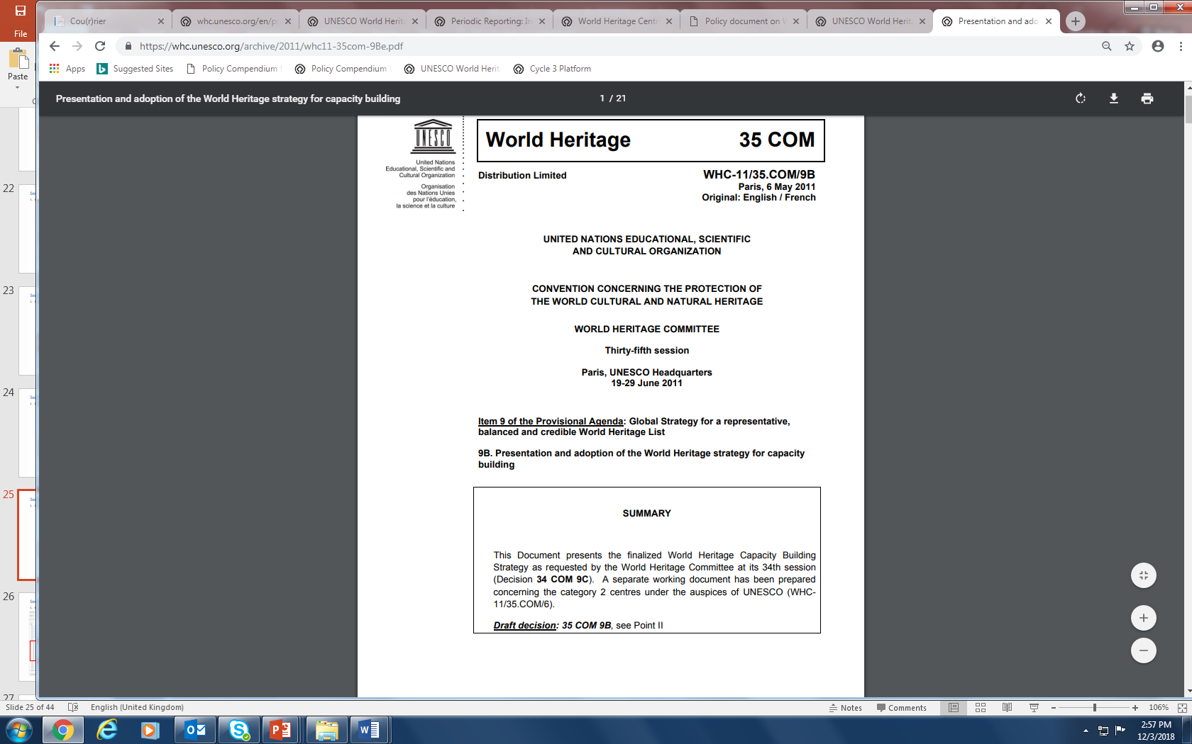
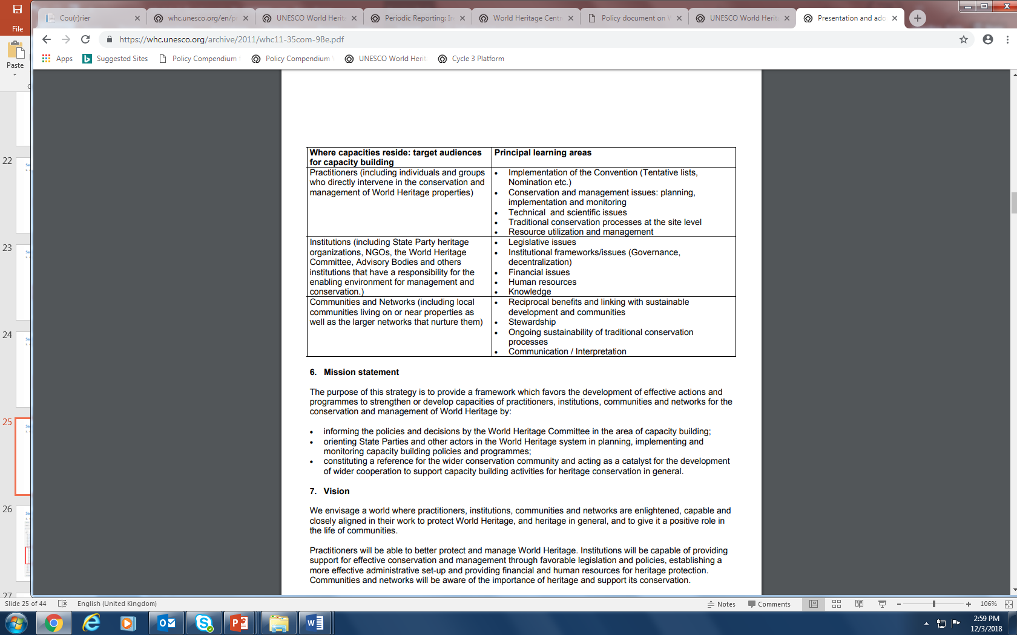
第一部分
第9章：能力发展
Notes:
Requires you to prioritise capacity building needs and the training objectives of Capacity Building in the country and asks whether the World Heritage and Capacity Building Strategy is being used.

Slide 64
Section I
Chapter 9: Capacity Development
Notes:
Requires you to prioritise capacity building needs and the training objectives of Capacity Building in the country and asks whether the World Heritage and Capacity Building Strategy is being used.

Slide 65
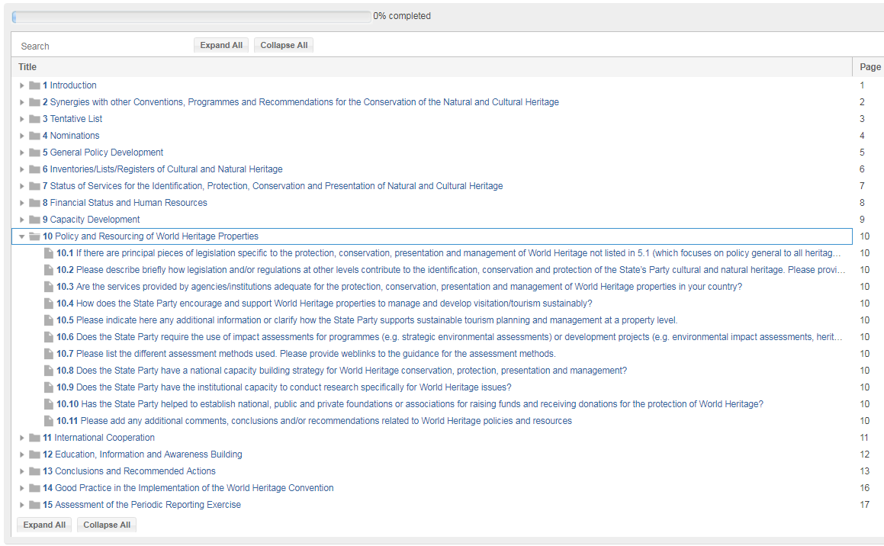
第一部分
第10章: 针对世界遗产的政策和资源配置
世界遗产公约第 5 条
为保证为保护、保存和展出本国领土内的文化和自然遗 产采取积极有效的措施，本公约各缔约国应视本国具体情况尽力做到 以下几点 ： （a）通过一项旨在使文化和自然遗产在社会生活中起一定作用 并把遗产保护工作纳入全面规划计划的总政策； （b）如本国内尚未建立负责文化和自然遗产的保护、保存和展 出的机构，则建立一个或几个此类机构，配备适当的工作人员和为履 行其职能所需的手段； （c）发展科学和技术研究，并制订出能够抵抗威胁本国文化或 自然遗产的危险的实际方法； （d）采取为确定、保护、保存、展出和恢复这类遗产所需的适 当的法律、科学、技术、行政和财政措施； （e）促进建立或发展有关保护、保存和展出文化和自然遗产的 国家或地区培训中心，并鼓励这方面的科学研究。
说明：询问有关世界遗产的具体立法，国家机构提供的遗产服务是否有效，是否规划和实施了可持续旅游。
Notes:
Asks about legislation specific to World Heritage (different from chapter 5)
Whether heritage services provided by national agencies are effective, asks whether sustainable tourism is being planned and implemented

Slide 66
Section I
Chapter 10: Policy and Resourcing of World Heritage Properties
Article 5 of the World Heritage Convention
To ensure that effective and active measures are taken for the protection, conservation and presentation of the cultural and natural heritage situated on its territory, each State Party to this Convention shall endeavor, in so far as possible, and as appropriate for each country:
to adopt a general policy which aims to give the cultural and natural heritage a function in the life of the community and to integrate the protection of that heritage into comprehensive planning programmes;
to set up within its territories, where such services do not exist, one or more services for the protection, conservation and presentation of the cultural and natural heritage with an appropriate staff and possessing the means to discharge their functions; to develop scientific and technical studies and research and to work out such operating methods as will make the State capable of counteracting the dangers that threaten its cultural or natural heritage; to take the appropriate legal, scientific, technical, administrative and financial measures necessary for the identification, protection, conservation, presentation and rehabilitation of this heritage; and
to foster the establishment or development of national or regional centres for training in the protection, conservation and presentation of the cultural and natural heritage and to encourage scientific research in this field.
Notes:
Asks about legislation specific to World Heritage (different from chapter 5)
Whether heritage services provided by national agencies are effective, asks whether sustainable tourism is being planned and implemented

Slide 67
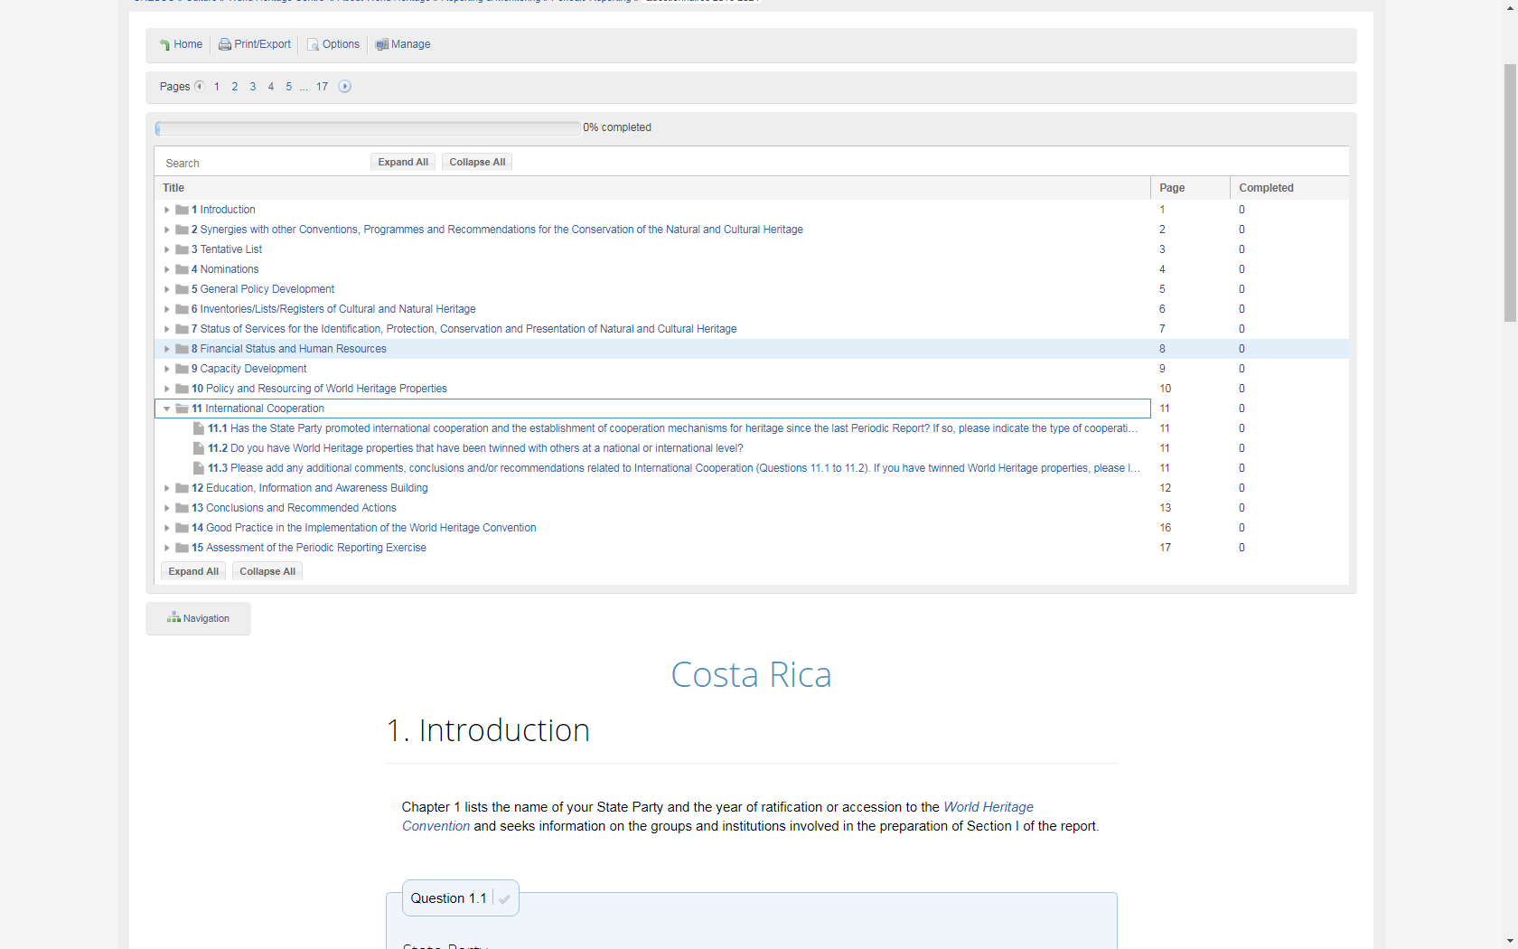
第一部分
第11章：国际合作
世界遗产公约
第 4 条 本公约缔约国均承认，保证第 1 条和第 2 条中提及的、 本国领土内的文化和自然遗产的确定、保护、保存、展出和遗传后代， 主要是有关国家的责任。该国将为此目的竭尽全力，最大限度地利用 本国资源，必要时利用所能获得的国际援助和合作，特别是财政、艺 术、科学及技术方面的援助和合作。
说明：是否规划并实施了国际合作的活动或机制
Notes:
Whether international cooperation activities and mechanisms are planned and implemented

Slide 68
Section I
Chapter 11: International Cooperation
Article 4 of the World Heritage Convention
Each State Party to this Convention recognizes that the duty of ensuring the identification, protection, conservation, presentation and transmission to future generations of the cultural and natural heritage referred to in Articles 1 and 2 and situated on its territory, belongs primarily to that State. It will do all it can to this end, to the utmost of its own resources and, where appropriate, with any international assistance and co-operation, in particular, financial, artistic, scientific and technical, which it may be able to obtain.
Notes:
Whether international cooperation activities and mechanisms are planned and implemented

Slide 69
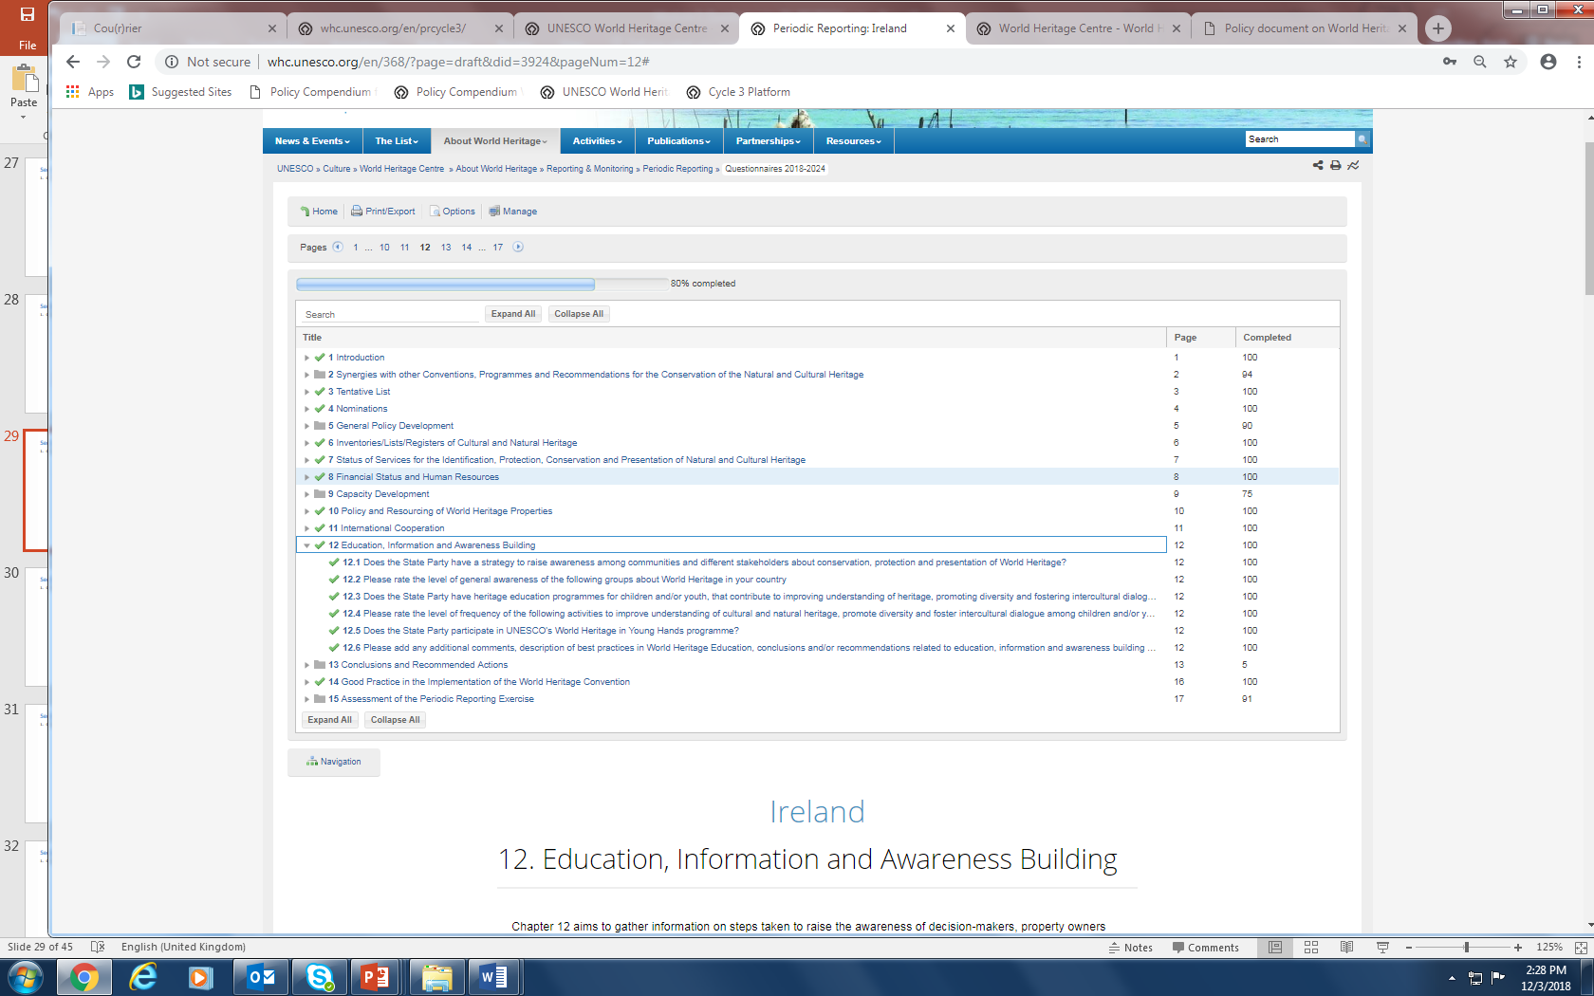
第一部分
第12章: 教育、信息传播和建立保护意识
说明：缔约国对于世界遗产的意识以及推动世界遗产的努力。
Notes:
Awareness of World Heritage in the State Party and efforts taken to promote this

Slide 70
Section I
Chapter 12: Education, Information and Awareness Building
Notes:
Awareness of World Heritage in the State Party and efforts taken to promote this

Slide 71
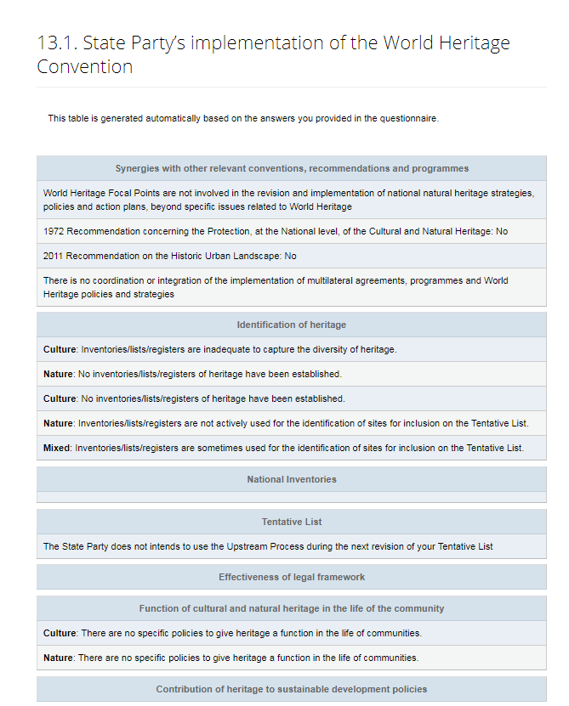
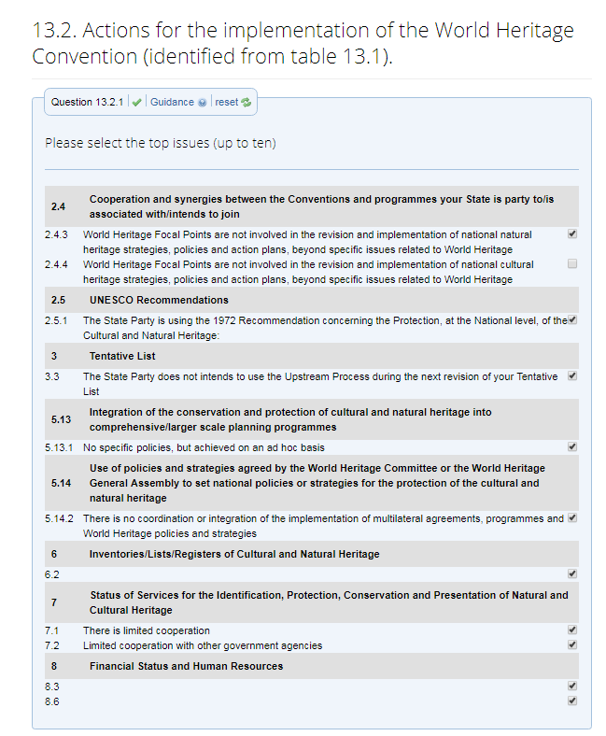
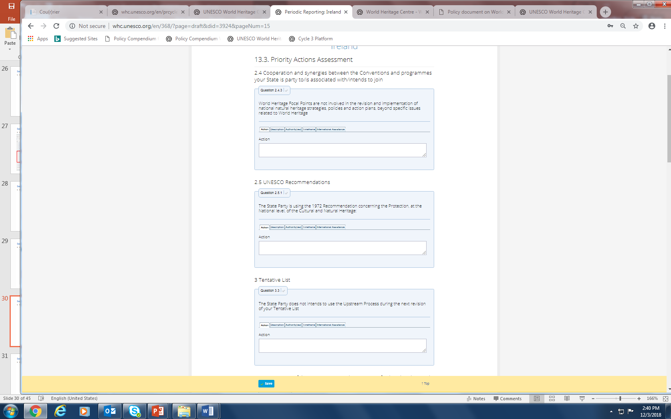
第一部分
第13章: 结论和建议采取的行动
1
2
3
审查您的问卷调查的主要结果
选择关键问题
提供进一步的详细资料
Notes:
Automatically generates the main results of answers given in the questionnaire
If priority areas are identified these will be highlighted and you will be asked to identify relevant actions that can be taken

Slide 72
Section I
Chapter 13: Conclusions and recommended actions
1
2
3
Review the main results of your questionnaire
Select the key issues
Provide further details
Notes:
Automatically generates the main results of answers given in the questionnaire
If priority areas are identified these will be highlighted and you will be asked to identify relevant actions that can be taken

Slide 73
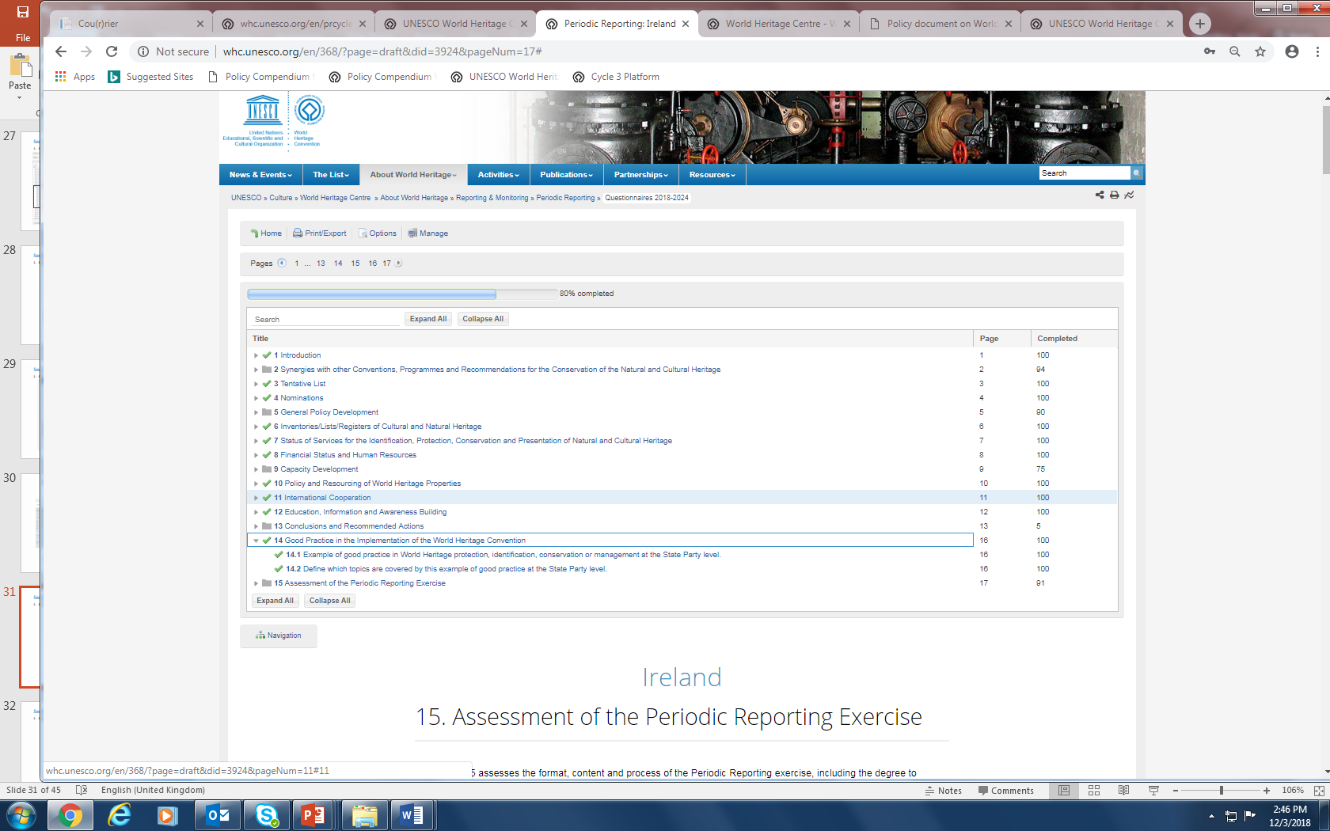
第一部分
第14章：实施《世界遗产公约》的优秀实践
Notes:
Provide good practices in World Heritage governance, management, conservation in your country

Slide 74
Section I
Chapter 14: Good Practice in the Implementation of the World Heritage Convention
Notes:
Provide good practices in World Heritage governance, management, conservation in your country

Slide 75
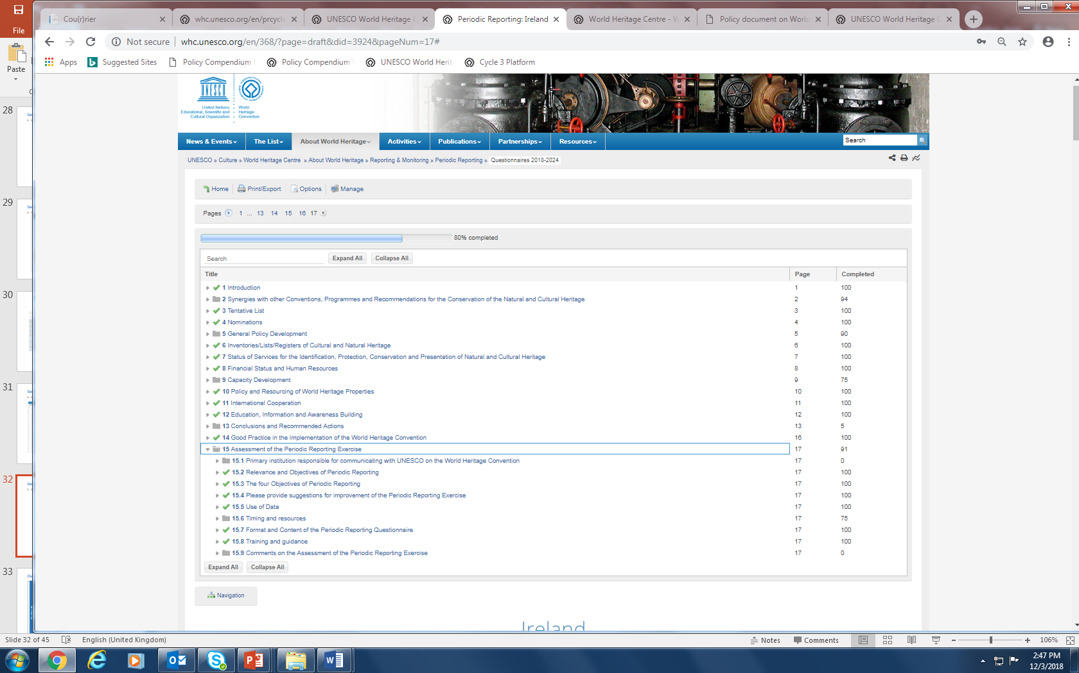
第一部分
第15章：对定期报告工作的评估
Notes:
Suggestions for improvements, how data will be used, the training and support received etc.

Slide 76
Section I
Chapter 15: Assessment of the Periodic Reporting Exercise
Notes:
Suggestions for improvements, how data will be used, the training and support received etc.

Slide 77
定期报告调查问卷概述– 第二部分
世界遗产地数据
保护世界遗产地的其他公约/项目（如适用）。
突出普遍价值声明
影响遗产地的因素
遗产地的保护和管理
财务和人力资源
科学研究和研究项目
教育、信息传播和建立保护意识
游客管理
监测
确定管理的首要任务
总结和结论
世界遗产身份的影响
实施《世界遗产公约》的优秀实践
对定期报告工作的评估
第二部分

Slide 78
Overview of the Periodic Reporting Questionnaire – Section I
World Heritage Property Data
Other Conventions/Programmes under which the World Heritage property is protected (if applicable)
Statement of Outstanding Universal Value
Factors Affecting the Property
Protection and Management of the Property
Financial and Human Resources
Scientific Studies and Research Projects
Education, Information and Awareness Building
Visitor Management
Monitoring
Identification of Priority Management Needs
Summary and Conclusions
Impact of World Heritage Status
Good Practice in the Implementation of the World Heritage Convention
Assessment of the Periodic Reporting Exercise
Section II

Slide 79
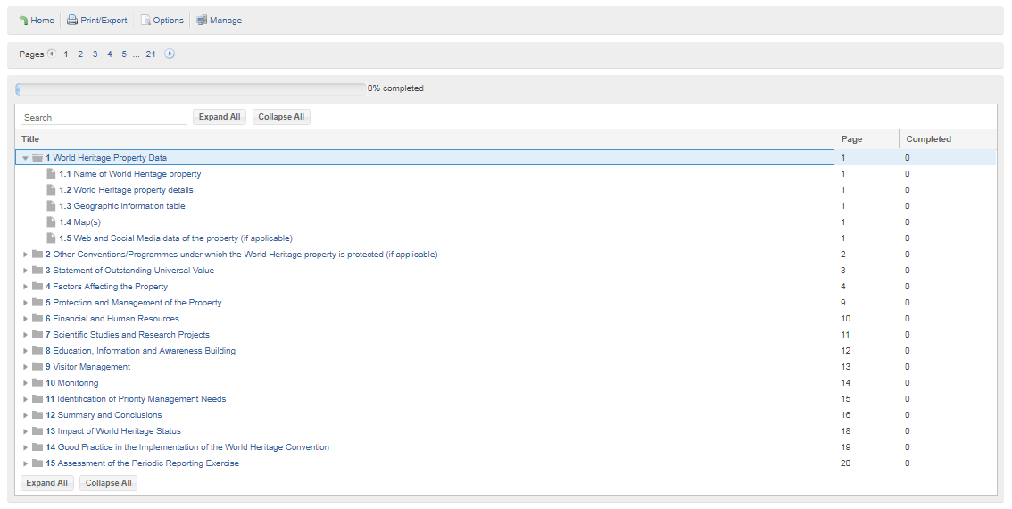
第二部分
第一章: 世界遗产地数据
说明：该部分由世界遗产中心预先填写，包括遗产名称、遗产类型、遗产编码、登录年份、是否属于濒危名录等。
Notes:
Prefilled as far as possible by WHC
– Name, type of property, ID number, inscription year, danger listing
Geographic Information Table
Maps
In these cases the update + comment box is intended for use to alert to any errors – proposed changes should go SP-WHC-COM
1.5 Web/Social Media presence

Slide 80
Section II
Chapter 1: World Heritage Property Data
Notes:
Prefilled as far as possible by WHC
– Name, type of property, ID number, inscription year, danger listing
Geographic Information Table
Maps
In these cases the update + comment box is intended for use to alert to any errors – proposed changes should go SP-WHC-COM
1.5 Web/Social Media presence

Slide 81

第二部分
第二章: 保护世界遗产地的其他公约/项目（如适用）
Notes:
Prefilled where possible, extent of synergies (designation/plans for designation) Ramsar/1954/Geoparks/MAB = site based designations
-Cooperation between Site Manager + Focal Points of other designation
-Elements on Representative List in intangible heritage
-Documentary heritage

Slide 82
Section II
Chapter 2: Other Conventions/Programmes under which the World Heritage Property is protected
Notes:
Prefilled where possible, extent of synergies (designation/plans for designation) Ramsar/1954/Geoparks/MAB = site based designations
-Cooperation between Site Manager + Focal Points of other designation
-Elements on Representative List in intangible heritage
-Documentary heritage

Slide 83

第二部分
第3章: 突出普遍价值声明
Notes:
(suggestions for improvements, how data will be used, the training and support received etc.)

Slide 84
Section II
Chapter 3: Statement of Outstanding Universal Value
Notes:
(suggestions for improvements, how data will be used, the training and support received etc.)

Slide 85

第二部分
第3章: 突出的普遍价值声明
突出的普遍价值
http://whc.unesco.org/include/tool_video.cfm?youtubeid=iiSFmP-InWw
突出普遍价值在世界遗产公约的实施导则中定义为：
"具有特殊的文化和/或自然意义，超越国界，对全人类的今世后代具有共同的重要性。因此，对这一遗产的永久保护对整个国际社会至关重要"。
(第 49段)
Notes:
(suggestions for improvements, how data will be used, the training and support received etc.)

Slide 86
Section II
Chapter 3: Statement of Outstanding Universal Value
Outstanding Universal Value
http://whc.unesco.org/include/tool_video.cfm?youtubeid=iiSFmP-InWw
Outstanding Universal Value is defined in the Operational Guidelines for the Implementation of the World Heritage Convention as the
"cultural and/or natural significance which is so exceptional as to transcend national boundaries and to be of common importance for present and future generations of all humanity. As such, the permanent protection of this heritage is of the highest importance to the international community as a whole”.
(para. 49)
Notes:
(suggestions for improvements, how data will be used, the training and support received etc.)

Slide 87


第二部分
第3章: 突出普遍价值声明 – 价值特征要素认定

Slide 88
Section II
Chapter 3: Statement of Outstanding Universal Value – Identifying attributes

Slide 89

第二部分
第3章: 突出普遍价值声明 – 价值特征要素认定
价值特征要素
根据《世界遗产申报筹备》资源手册，价值特征要素是包括遗产所具备的与突出的普遍价值有关的或表现突出的普遍价值的各个方面。属性既可以是物质的，也可是非物质的。《操作指南》中指出了可能与突出的普遍价值相关的属性的范围，包括：
外形与设计
材料与材质
用途与功能
传统、技术和管理体系
位置和环境
语言和其它形式的非物质遗产
精神与感觉（第82段）
这一列表是一个指导。重点是遗产地的价值特征要素应该从突出普遍价值和列入理由出发。价值特征要素必须明确，因为它与理解遗产的真实性、完整性休戚相关、且是保护、保存和管理的焦点。
对于自然遗产来说，更多的时候谈论的是“特征”，“价值特征要素”只是偶尔使用。自然遗产的价值特征要素可能包括：
观赏或审美意义
物理特征或自然栖息地的规模
物理或生态进程的完整性
然性以及自然系统的完整性
珍稀物种的生存能力
罕见性
来源： 《世界遗产申报筹备》资源手册（第二版，UNESCO 2011)
Notes:
(suggestions for improvements, how data will be used, the training and support received etc.)

Slide 90
Section II
Chapter 3: Statement of Outstanding Universal Value – Identifying attributes
Notes:
(suggestions for improvements, how data will be used, the training and support received etc.)

Slide 91

第二部分
第3章: 突出普遍价值声明 – 价值特征要素认定
根据世界遗产委员会在申遗时通过的 “突出的普遍价值声明 ”确定其价值特征要素。

Slide 92
Section II
Chapter 3: Statement of Outstanding Universal Value – Identifying attributes
Identify attributes on the basis of the Statement of Outstanding Universal Value adopted by the World Heritage Committee at the time of inscription

Slide 93

第二部分
第3章: 突出普遍价值声明 – 评估价值特征要素的状况
按4级评估各价值特征要素的状况。

Slide 94
Section II
Chapter 3: Statement of Outstanding Universal Value – Assessing the condition of attributes
Assess the condition of the attributes based on the 4-point scale

Slide 95

第二部分
第 4章: 影响遗产地的因素
说明：调查问卷第二部分的核心内容是收集目前影响或极有可能影响遗产的一系列因素，包括正面的和负面的。
Notes:
Core part of Section II questionnaire gathers information on the range of factors that are currently affecting or have strong potential to affect the property, both positively and negatively.

Slide 96
Section II
Chapter 4: Factors Affecting the Property
Notes:
Core part of Section II questionnaire gathers information on the range of factors that are currently affecting or have strong potential to affect the property, both positively and negatively.

Slide 97
第二部分
第 4章: 遗产地的影响因素
4. 遗产地的影响因素
影响遗产地的因素
第4章收集了目前正在影响或极有可能影响该遗产地的各种因素的信息，包括积极的和消极的。
本章为您提供了一份通用清单，该清单是为确定可能影响任何类型世界遗产的因素而制定的。这些影响因素分为 13 类，并配有简要解释。每一类都在标题下列出了一系列影响因素。
这些影响因素与世界遗产保护状况数据库中列出的影响因素是一致的(http://whc.unesco.org/en/factors/)。
评估的第一步需点击每个因素下面的方框，明确该因素是否与该遗产相关。如果一个因素在上一次定期报告中造成影响，那么在本周期内将自动要求考虑该因素。请注意，这种评估既涉及积极因素，也涉及消极因素。
如果该影响因素不相关，则转到下一个因素；如果该影响因素相关，则会出现第二行评估问题。
评估会要求提供该因素的影响和来源。如果你的遗产地是一个国家级或跨境的系列遗产，在回答问题4.15/4.16时，可以选择受到影响的遗产构成部分和具体影响因素。
你需要确定该因素的影响是积极的和/或消极的；是当前的和/或潜在的；以及该因素的来源是遗产地内部和/或外部。 你还需要具体说明该因素的影响是在递减、稳定还是增加。
在影响因素清单的末尾，你可以（通过问题4.14）补充任何对遗产地有影响但在4.1至4.13中没有涉及的其他因素。
http://whc.unesco.org/include/tool_video.cfm?youtubeid=iiSFmP-InWw
影响遗产地的因素可能是积极的，也可能是消极的，但威胁仅为消极影响因素。
说明：如果该遗产已经有遗产保存状况的报告，在本章开端将会有一个相关链接。
Notes:
If the property has been the subject of a state of conservation report a link to the report will appear at the beginning of the chapter.

Slide 98
Section II
Chapter 4: Factors Affecting the Property
4. Factors Affecting the Property
Factors affecting the property
Chapter 4 gathers information on the range of factors that are currently affecting or have strong potential to affect the property, both positively and negatively.
This chapter provides you with a generic list which has been developed to identify factors that could affect any type of World Heritage property. The factors are grouped into 13 headings, which are then briefly explained. Beneath each heading a list of factors appears
The set of factors is parallel to the set of threats in the World Heritage State of Conservation database (http://whc.unesco.org/en/factors/).
The first stage in the assessment is to click the box below each factor to indicate if this factor is relevant or not relevant to the property. If a factor was reported as causing an impact in the last Periodic Report, then you will automatically be asked to consider that factor in this cycle. Please note that this assessment is about both positive and negative factors.
If the factor is not relevant, then move on to the next factor; if the factor is relevant then a second line of assessment questions will appear.
This assessment will ask you about the impact and origin of the factor. If your property is a national or transnational serial site, then you will have the option of identifying which component(s) is/are affected by a particular factor in your answers to questions 4.15/4.16.
You will be asked to identify whether the impact of the factor is positive and/or negative; whether it is current and/or potential and whether the origin of the factor is inside and/or outside of the property. You will also be asked to specify whether the factor is having a decreasing, stable or increasing impact.
At the end of the list of factors there is an opportunity (question 4.14) to add any additional factors which affect the property but which have not been covered in 4.1 to 4.13.
http://whc.unesco.org/include/tool_video.cfm?youtubeid=iiSFmP-InWw
Factors affecting the property might have positive or negative impacts while threats only refer to negative factors
Notes:
If the property has been the subject of a state of conservation report a link to the report will appear at the beginning of the chapter.

Slide 99
第二部分
第 4章: 影响遗产地的因素
第4章收集了目前正在影响或极有可能影响该遗产地的各种因素的信息，包括积极的和消极的。
本章为您提供了一份通用清单，该清单是为确定可能影响任何类型世界遗产的因素而制定的。这些影响因素分为 13 类，并配有简要解释。每一类都在标题下列出了一系列影响因素。
这些影响因素与世界遗产保护状况数据库中列出的影响因素是一致的(http://whc.unesco.org/en/factors/)。
评估的第一步需点击每个因素下面的方框，明确该因素是否与该遗产相关。如果一个因素在上一次定期报告中造成影响，那么在本周期内将自动要求考虑该因素。请注意，这种评估既涉及积极因素，也涉及消极因素。
如果该影响因素不相关，则转到下一个因素；如果该影响因素相关，则会出现第二行评估问题。
评估会要求提供该因素的影响和来源。如果你的遗产地是一个国家级或跨境的系列遗产，在回答问题4.15/4.16时，可以选择受到影响的遗产构成部分和具体影响因素。
你需要确定该因素的影响是积极的和/或消极的；是当前的和/或潜在的；以及该因素的来源是遗产地内部和/或外部。 你还需要具体说明该因素的影响是在递减、稳定还是增加。
在影响因素清单的末尾，你可以（通过问题4.14）补充任何对遗产地有影响但在4.1至4.13中没有涉及的其他因素。
反应性监测
http://whc.unesco.org/include/tool_video.cfm?youtubeid=iiSFmP-InWw
如果在反应性监测程序的框架内，您的遗产地已有提交给世界遗产委员会的保护状况的报告，则该链接将打开世界遗产中心的世界遗产保护状况信息系统的相关条目。这将提醒你，过去哪些因素对遗产地产生了严重影响，以至于需要提交给世界遗产委员会。该数据库使用的因素分类与定期报告中使用的相同。请注意，稍后将向你询问有关世界遗产委员会决定的后续行动。
Notes:
If the property has been the subject of a state of conservation report a link to the report will appear at the beginning of the chapter.

Slide 100
Section II
Chapter 4: Factors Affecting the Property
Chapter 4 gathers information on the range of factors that are currently affecting or have strong potential to affect the property, both positively and negatively.
This chapter provides you with a generic list which has been developed to identify factors that could affect any type of World Heritage property. The factors are grouped into 13 headings, which are then briefly explained. Beneath each heading a list of factors appears
The set of factors is parallel to the set of threats in the World Heritage State of Conservation database (http://whc.unesco.org/en/factors/).
The first stage in the assessment is to click the box below each factor to indicate if this factor is relevant or not relevant to the property. If a factor was reported as causing an impact in the last Periodic Report, then you will automatically be asked to consider that factor in this cycle. Please note that this assessment is about both positive and negative factors.
If the factor is not relevant, then move on to the next factor; if the factor is relevant then a second line of assessment questions will appear.
This assessment will ask you about the impact and origin of the factor. If your property is a national or transnational serial site, then you will have the option of identifying which component(s) is/are affected by a particular factor in your answers to questions 4.15/4.16.
You will be asked to identify whether the impact of the factor is positive and/or negative; whether it is current and/or potential and whether the origin of the factor is inside and/or outside of the property. You will also be asked to specify whether the factor is having a decreasing, stable or increasing impact.
At the end of the list of factors there is an opportunity (question 4.14) to add any additional factors which affect the property but which have not been covered in 4.1 to 4.13.
Reactive Monitoring
http://whc.unesco.org/include/tool_video.cfm?youtubeid=iiSFmP-InWw
If your property has been the subject of a State of conservation report to the World Heritage Committee, within the framework of the Reactive Monitoring process, this link will open up the relevant entry in the World Heritage Centre’s Information System on the State of Conservation of World Heritage properties. This will provide you with a reminder of the factors which have affected your property in the past sufficiently seriously for it to be referred to the World Heritage Committee. The database uses the same classification of factors as that used in Periodic Reporting. Please note that you will be asked later about follow-up to decisions of the World Heritage Committee.
Notes:
If the property has been the subject of a state of conservation report a link to the report will appear at the beginning of the chapter.

Slide 101



第二部分
第 4章: 影响遗产地的因素
保护状况数据库中的威胁/因素清单 https://whc.unesco.org/en/soc/
说明：被问及的影响因素与世界遗产保护状况数据库（http://whc.unesco.org/en/factors/）中的威胁因素相同。影响世界遗产突出普遍价值的威胁/因素清单包括一系列因素，分为14个大类，每一大类下还有若干小类。
Notes:
The set of factors you are asked about is parallel to the set of threats in the World Heritage State of Conservation database (http://whc.unesco.org/en/factors/).
The standard list of threats/factors affecting the Outstanding Universal Value of World Heritage properties consists of a series of 14 primary factors, encompassing each a number of secondary factors.

Slide 102
Section II
List of Factors equivalent to threats/factors on the State of Conservation database https://whc.unesco.org/en/soc/
Chapter 4: Factors Affecting the Property
Notes:
The set of factors you are asked about is parallel to the set of threats in the World Heritage State of Conservation database (http://whc.unesco.org/en/factors/).
The standard list of threats/factors affecting the Outstanding Universal Value of World Heritage properties consists of a series of 14 primary factors, encompassing each a number of secondary factors.

Slide 103

第二部分
第 4章: 影响遗产地的因素
说明：点击每个影响因素下面的方框，以表明该因素是否与遗产相关。如果某个因素在上一次定期报告中被认为对遗产造成影响，那么你会看到之前填报的信息。
如果该因素不相关，则进入下一个因素；如果该因素相关，则会出现第二行评估问题。这道评估题会问该因素的影响和来源。要求说出该因素的影响是积极的和/或消极的；是当前的和/或潜在的，以及该因素的来源是在遗产内和/或遗产外，是否具有递减、稳定或增加的影响。
影响因素的例子
如果该因素在前轮报告中报告为相关因素
Notes:
The first stage in the assessment is to click the box below each factor to indicate if this factor is relevant or not relevant to the property. If a factor was reported as causing an impact in the last Periodic Report, then you will be shown what the previous answer was.
If the factor is not relevant, then move on to the next factor; if the factor is relevant then a second line of assessment questions will appear.
This assessment will ask you about the impact and origin of the factor.
You will be asked to say whether the impact of the factor is positive and/or negative; whether it is current and/or potential and whether the origin of the factor is inside and/or outside of the property/ having a decreasing, stable or increasing impact.

Slide 104
Section II
Chapter 4: Factors Affecting the Property
Examples of the factor
If the factor was reported relevant in previous reports
Notes:
The first stage in the assessment is to click the box below each factor to indicate if this factor is relevant or not relevant to the property. If a factor was reported as causing an impact in the last Periodic Report, then you will be shown what the previous answer was.
If the factor is not relevant, then move on to the next factor; if the factor is relevant then a second line of assessment questions will appear.
This assessment will ask you about the impact and origin of the factor.
You will be asked to say whether the impact of the factor is positive and/or negative; whether it is current and/or potential and whether the origin of the factor is inside and/or outside of the property/ having a decreasing, stable or increasing impact.

Slide 105

第二部分
第 4章: 影响遗产地的因素
4. 第 4章: 影响遗产地的因素 (问题 4.15)
说明：在本章结束时将自动生成影响因素摘要。
Notes:
A Factors summary will be automatically generated at the end of the chapter.

Slide 106
Section II
Chapter 4: Factors Affecting the Property
4. Factors Affecting the Property (Questions 4.15)
Notes:
A Factors summary will be automatically generated at the end of the chapter.

Slide 107

第二部分
第 4章: 影响遗产地的因素- 评估当前和潜在的积极和消极因素
影响遗产地的因素
http://whc.unesco.org/include/tool_video.cfm?youtubeid=iiSFmP-InWw
第12章 “总结和结论 ”与第4章有关联性。无论您选择何种顺序填写问卷--您必须在第12章之前填写第4章。
Notes:
You will then be asked for further details on the factors reported.

Slide 108
Section II
Chapter 4: Factors Affecting the Property - Assessment of current and potential positive and negative factors
Factors affecting the property
http://whc.unesco.org/include/tool_video.cfm?youtubeid=iiSFmP-InWw
Chapter 12 ‘Summary and Conclusions’ is linked to Chapter 4 . No matter what order you choose to fill out the questionnaire – you must fill out Chapter 4 before Chapter 12
Notes:
You will then be asked for further details on the factors reported.

Slide 109

第二部分
第 4章: 影响遗产地的因素- 受影响的世界遗产标准和价值特征要素
4.影响遗产地的因素 (问题 4.15)
影响遗产地的因素
http://whc.unesco.org/include/tool_video.cfm?youtubeid=iiSFmP-InWw
第12章 “总结和结论 ”与第4章有联系。无论您选择何种顺序填写问卷--您必须在第12章之前填写第4章。
说明：要求明确世界遗产的哪条价值标准和相关的价值特征要素受到影响，以及准备采取的行动。
Notes:
And asked to specify which World Heritage criteria and attributes are affected and what the poposed actions are.

Slide 110
Section II
Chapter 4: Factors Affecting the Property - World Heritage criteria and attributes affected
4. Factors Affecting the Property (Questions 4.15)
Factors affecting the property
http://whc.unesco.org/include/tool_video.cfm?youtubeid=iiSFmP-InWw
Chapter 12 ‘Summary and Conclusions’ is linked to Chapter 4 . No matter what order you choose to fill out the questionnaire – you must fill out Chapter 4 before Chapter 12
Notes:
And asked to specify which World Heritage criteria and attributes are affected and what the poposed actions are.

Slide 111

第二部分
第 4章: 影响遗产地的因素- 特殊情况
说明：如果遗产地是一个系列遗产，需要在评论框中回答受到影响的具体构成要素受及影响因素。
Notes:
If your property is a national or transnational serial site, then you will have the option of identifying which component(s) is/are affected by a particular factor in your answers to questions 4.15/4.16 (comment box).

Slide 112
Section II
Chapter 4: Factors Affecting the Property - Special cases
Notes:
If your property is a national or transnational serial site, then you will have the option of identifying which component(s) is/are affected by a particular factor in your answers to questions 4.15/4.16 (comment box).

Slide 113

第二部分
第 4章: 影响遗产地的因素- 预测6年后的保护状况
说明：在本章最后，要求预测在下一轮定期报告中（即6年后），遗产地保护状况将会如何。
Notes:
At the very end of the chapter you will be asked to predict what the state of conservation of your property will be at the next cycle of Periodic Reporting, ie. in 6 years.

Slide 114
Section II
Chapter 4: Factors Affecting the Property - Predicting the state of conservation in 6 years time
Notes:
At the very end of the chapter you will be asked to predict what the state of conservation of your property will be at the next cycle of Periodic Reporting, ie. in 6 years.

Slide 115

第二部分
第5章: 遗产地的保护和管理

Slide 116
Section II
Chapter 5: Protection and Management of the Property

Slide 117

第二部分
第5章: 遗产地的保护和管理
Notes:
Boundaries and buffer zones, whether these are known/effective
Legal framework – legal protection/whether it is adequate/how it works in practice
Management system/plan
-Historic Urban Landscape Recommendation
-Policy Document on the impacts of Climate Change
-Strategy for reducing Risks from Disasters
-Sustainable Development Policy

Slide 118
Section II
Chapter 5: Protection and Management of the Property
Notes:
Boundaries and buffer zones, whether these are known/effective
Legal framework – legal protection/whether it is adequate/how it works in practice
Management system/plan
-Historic Urban Landscape Recommendation
-Policy Document on the impacts of Climate Change
-Strategy for reducing Risks from Disasters
-Sustainable Development Policy

Slide 119


第二部分
第5章: 遗产地的保护和管理
出版物
网页
http
http
关于气候变化对世界遗产影响的政策文件(2006)
Development of Policy Document on Impacts of Climate Change and World Heritage
下载链接：
whc.unesco.org/en/CC-policy-document/
Website:
whc.unesco.org/en/CC-policy-document/
Chapter 5. Protection and Management of the Property – Policy Document Climate Change (2006)

Slide 120
Section II
Chapter 5: Protection and Management of the Property
Publication
Website
http
http
Development of Policy Document on Impacts of Climate Change and World Heritage (2006)
Development of Policy Document on Impacts of Climate Change and World Heritage
Download link:
whc.unesco.org/en/CC-policy-document/
Website:
whc.unesco.org/en/CC-policy-document/
Chapter 5. Protection and Management of the Property – Policy Document Climate Change (2006)

Slide 121

第二部分
第6章：资金

Slide 122
Section II
Chapter 6: Funding

Slide 123

世界遗产公约第 5 条
为保证为保护、保存和展示本国领土内的文化和自然遗 产采取积极有效的措施，本公约各缔约国应视本国具体情况尽力做到 以下几点 ：
（a）通过一项旨在使文化和自然遗产在社会生活中起一定作用 并把遗产保护工作纳入全面规划计划的总政策；
（b）如本国内尚未建立负责文化和自然遗产的保护、保存和展示的机构，则建立一个或几个此类机构，配备适当的工作人员和为履 行其职能所需的手段；
（c）发展科学和技术研究，并制订出能够抵抗威胁本国文化或 自然遗产的危险的实际方法；
（d）采取为确定、保护、保存、展示和恢复这类遗产所需的适 当的法律、科学、技术、行政和财政措施；
（e）促进建立或发展有关保护、保存和展示文化和自然遗产的 国家或地区培训中心，并鼓励这方面的科学研究。
第二部分
第7章: 科学研究和研究项目

Slide 124
Section II
Chapter 7: Scientific Studies and Research Projects
Article 5
To ensure that effective and active measures are taken for the protection, conservation and presentation of the cultural and natural heritage situated on its territory, each State Party to this Convention shall endeavor, in so far as possible, and as appropriate for each country:
to adopt a general policy which aims to give the cultural and natural heritage a function in the life of the community and to integrate the protection of that heritage into comprehensive planning programmes;
to set up within its territories, where such services do not exist, one or more services for the protection, conservation and presentation of the cultural and natural heritage with an appropriate staff and possessing the means to discharge their functions; to develop scientific and technical studies and research and to work out such operating methods as will make the State capable of counteracting the dangers that threaten its cultural or natural heritage; to take the appropriate legal, scientific, technical, administrative and financial measures necessary for the identification, protection, conservation, presentation and rehabilitation of this heritage; and
to foster the establishment or development of national or regional centres for training in the protection, conservation and presentation of the cultural and natural heritage and to encourage scientific research in this field.

Slide 125

第二部分
第8章：教育、信息传播和建立保护意识

Slide 126
Section II
Chapter 8: Education, Information and Awareness building

Slide 127

第二部分
第9章：游客管理
Notes:
(suggestions for improvements, how data will be used, the training and support received etc.)

Slide 128
Section II
Chapter 9: Visitor Management
Notes:
(suggestions for improvements, how data will be used, the training and support received etc.)

Slide 129

第二部分
第10章：监测

Slide 130
Section II
Chapter 10: Monitoring

Slide 131

第二部分
第11章: 确定优先管理需求

Slide 132
Section II
Chapter 11: Identification of Priority Management Needs

Slide 133

第二部分
第12章:总结与结论

Slide 134
Section II
Chapter 12: Summary and Conclusions

Slide 135

第二部分
第13章: 世界遗产身份的影响

Slide 136
Section II
Chapter 13: Impact of World Heritage Status

Slide 137

第二部分
第14章: 实施《世界遗产公约》的优秀实践

Slide 138
Section II
Chapter 14: Good practices in the Implementation of World Heritage Convention

Slide 139

第二部分
第14章: 实施《世界遗产公约》的优秀实践
优秀实践
http
伊斯坦布尔历史区是土耳其提交的优秀实践，案例值得关注的方面包括：
区域更新项目、公众参与和更新区的划定。
缔约国提交的概述
更新区占地90,942.16平方米，位于埃迪尔内卡皮（Edirnekapı）和瓦坦大道（Vatan Avenue）之间的城墙保护区内。项目区域覆盖了12个片区和378个地块。其中46处为登录的遗产点，富有民居建筑特色，15处为纪念性建筑。该项目还包括了市政府所有的13,000平方米区域，目的是建造住房并充分满足住房需求。
更新目标是避免该区域内的拆迁，并根据有关物理空间的更新模式将其与城市重新融合，且允许业主享有其产权。
在项目准备期间，充分考虑了已登录的遗产点。因此，当时的已登录的遗产点从24处增加到了30处，包括市政府提议登录的遗产点。该遗产地的更新实施项目是根据2007年11月2日批准的设计草案起草的。更新区的保护委员会于2010年批准了以地块为基础实施更新项目。更新实施项目起草的同时，项目进一步分析了遗产点，其他建筑也进行了登记。因此以民居建筑风格为特色登录的遗产增加到了46处。起草并批准了更新区域内所有登记遗产进行的调查、补偿和修复项目，所有登记遗产将按照已批准的项目进行修复。在基金会总会和伊斯坦布尔市政府的合作下，遗产地内文化遗产修复的研究已经开始，比如重要的清真寺和喷泉。
了解更多: https://whc.unesco.org/en/list/356/bestpractice
©Ministry of Culture and Tourism of Turkey/Umut Özdemir
Notes:
Summary provided by State Party
The Renewal Area covers an area of 90,942.16 m², and situated within the Protection Zone of Land Walls, between Edirnekapı and Vatan Avenue. The project site covers 12 plots and 378 parcels. 46 of the registered properties feature civil architecture styles, while 15 are monumental structures. A 13,000 m² area owned by our Municipality has also been included in the project, in order to build and sufficiently meet the amount of housing needed.
The target here is to avoid demolishing taking place inside the area and reintegrate it with the city, based on a renewal model regarding the physical space, and allowing property owners to enjoy their property rights.
Registered properties were taken into great account during preparation of projects. As a result, 24 registered properties of that time were increased up to 30, together with the properties our Municipality proposed for registration. Renewal implementation project for the site was drawn up according to the draft design approved on 02.11.2007. The Conservation Board for Renewal Areas granted a plot-based approved in 2010. Properties were further analyzed while renewal implementation projects were drafted, and other structures were also spotted for registration. Thus, the number of registered properties featuring civil architecture styles increased to 46. Survey, restitution and restoration projects for all the registered properties within the renewal area were drafted and approved. All registered properties will be restored in accordance with approved projects. Studies have also started for restoration of the cultural properties within the site, such as monumental mosques and fountains, with the cooperation of the General Directorate of Foundations and Istanbul Metropolitan Municipality.

Slide 140
Section II
Chapter 14: Good practices in the Implementation of World Heritage Convention
Exemple of good practice
http
Historic Areas of Istanbul, proposed by Turkey as a best practice, is interesting as a case study for the following aspects: district renewal projects, public involvement, declaration of renewal areas.
Summary provided by State Party
The Renewal Area covers an area of 90,942.16 m², and situated within the Protection Zone of Land Walls, between Edirnekapı and Vatan Avenue. The project site covers 12 plots and 378 parcels. 46 of the registered properties feature civil architecture styles, while 15 are monumental structures. A 13,000 m² area owned by our Municipality has also been included in the project, in order to build and sufficiently meet the amount of housing needed.
The target here is to avoid demolishing taking place inside the area and reintegrate it with the city, based on a renewal model regarding the physical space, and allowing property owners to enjoy their property rights.
Registered properties were taken into great account during preparation of projects. As a result, 24 registered properties of that time were increased up to 30, together with the properties our Municipality proposed for registration. Renewal implementation project for the site was drawn up according to the draft design approved on 02.11.2007. The Conservation Board for Renewal Areas granted a plot-based approved in 2010. Properties were further analyzed while renewal implementation projects were drafted, and other structures were also spotted for registration. Thus, the number of registered properties featuring civil architecture styles increased to 46. Survey, restitution and restoration projects for all the registered properties within the renewal area were drafted and approved. All registered properties will be restored in accordance with approved projects. Studies have also started for restoration of the cultural properties within the site, such as monumental mosques and fountains, with the cooperation of the General Directorate of Foundations and Istanbul Metropolitan Municipality.
Read more : https://whc.unesco.org/en/list/356/bestpractice
©Ministry of Culture and Tourism of Turkey/Umut Özdemir

Slide 141

第二部分
第15章：对定期报告工作的评估

Slide 142
Section II
Chapter 15: Assessment of the Periodic Reporting Exercise

Slide 143

第二部分
导出Word/PDF版本

Slide 144
Section II
Export in Word/PDF version

Slide 145
工具与指导 - 准备填写定期报告调查问卷
在线工具与指导
我在哪里可以找到关于定期报告的信息？
综合信息:
whc.unesco.org/en/periodicreporting/
第三轮定期报告平台:
whc.unesco.org/en/prcycle3/
定期报告调查问卷(演示版):
whc.unesco.org/en/prcycle3/

Slide 146
Tools and Guidance - Preparing to fill the Periodic Reporting Questionnaire
Online tools and guidance
Where do I find information about
Periodic Reporting?
General page:
whc.unesco.org/en/periodicreporting/
Third Cycle platform:
whc.unesco.org/en/prcycle3/
PR Questionnaire (Demo version):
whc.unesco.org/en/prcycle3/

Slide 147





工具与导则 - 准备填写定期报告调查问卷
在线工具与指导
遗产地管理者手册– 英、法、阿拉伯语
视频教程-英法双语、阿拉伯语字幕
调查问卷 示范版
关键术语列表 英法双语

Slide 148
Tools and Guidance - Preparing to fill the Periodic Reporting Questionnaire
Online tools and guidance
Site Managers Handbook
– English, French and Arabic
Video Tutorials
English, French with Arabic subtitles
Questionnaire
In demo version
List of Key Terms
In English and French

Slide 149


联系我们
wh-periodicreporting@unesco.org

