Slide 1
1
2
Fundamentals
Introduction
Periodic Reporting
Curriculum
Questionnaire
3
4
Synergies
Sustainable Development

Slide 2
Rationale
The Third Cycle questionnaire is “no longer an isolated tool focusing solely on one process of the Convention, but has a far broader reach and scope and reflects the Convention as it is today; extending to include numerous relevant World Heritage policies, forging links with other conventions, programmes and recommendations, as well as core processes such as the State of Conservation reports, the Upstream Process and approaches such as the World Heritage Capacity Building Strategy ”
(ref. WHC/17/41.COM/10A)
Periodic Reporting
Curriculum
01
02
03
04
Training Modules
World Heritage Convention

Slide 3
Aim and objectives
Objective: to provide States Parties with a ready-to-use resource for the training and development of capacities of stakeholders involved in reporting for the Third Cycle of Periodic Reporting
Aim: to complement the scope of the Guidance and the Glossary
Target audience: trainers (Category2Centres; National Focal Points and National Commissions) and other stakeholders involved in reporting for the Third Cycle of Periodic Reporting
Specific objective: to operationally assist National Focal Points and World Heritage Site Managers in the process of filling in the Third Cycle PR Questionnaire
Periodic Reporting
Curriculum
01
02
03
04
Training Modules
World Heritage Convention

Slide 4
Structure
Periodic Reporting Curriculum
01
02
The curriculum consists of :
4 core modules
7 focus modules
03
04
Training
Modules
World Heritage Convention

Slide 5
Curriculum formats – Standard to Full
Standard training
1-day training
4 core modules + Focus 1
Full training
2.5 days training
4 core modules + Focus modules 1-7
Customize training to different timeframes =
Standard training
(4 core + Focus 1) + choose any number of Focus modules from 1-7
Notes:
Focus 1: Statement of Outstanding Universal Value and identifying attributes (core)
Focus 2: Monitoring Indicators and Analytical Framework (optional)
Focus 3: Boundary Clarifications, Boundary Modifications and other changes (optional)
Focus 4: Factors affecting the property (optional)
Focus 5: From WHCBS to Regional Action Plans (optional)
Focus 6: Tourism Management (optional)
Focus 7: Disaster Risk Reduction and Risk Preparedness (optional)

Slide 6
Overview of the Modules
Periodic Reporting
Module 1
01
02
The Periodic Reporting exercise fundamentals
03
04
Training
Modules
World Heritage Convention
Notes:
Module 1 explains the fundamentals of the Periodic Reporting exercise such as the definition and objectives of the Periodic Reporting, the questionnaire, the actors in the Periodic Reporting exercise and the timeline of the process.
It also gives information about the new elements of the third cycle and improvements made to the questionnaire.
This module gives an opportunity to the trainees to access the tools, instruments and offline/ online resources available to answer the questions in the questionnaire by providing information on the Periodic Reporting webpage and platform and training materials.

Slide 7
Overview of the Modules
Periodic Reporting
01
02
Module 2
03
The Third Cycle questionnaire: a thematic overview with an operational focus
04
Training
Modules
World Heritage Convention
Notes:
Module 2 provides an overview of section I and II of the Periodic Reporting questionnaire and an illustration of the main Periodic Reporting questions by theme, which are state of conservation of World Heritage properties, management, governance and capacity development.
It also gives information on format and technical features of the questionnaire.
This module gives an opportunity to the trainees to access the relevant information on some of the core thematic areas of the Periodic Report when filling in the questionnaire.

Slide 8
Overview of the Modules
Periodic Reporting
01
02
03
Module 3
04
Synergies with other Conventions and Programmes
Training
Modules
World Heritage Convention
Notes:
Module 3 gives information on biodiversity-related conventions and programmes, culture conventions and programmes and synergies among these conventions and programmes. It also explains multiple designations and questions regarding synergies in the Periodic Reporting questionnaire.
This module gives an opportunity to the trainees to understand the main objectives, obligations and benefits in relation to different conventions and programmes, the relevance of maintaining contact with national focal points from other conventions and the benefits and challenges of multiple designations.

Slide 9
Overview of the Modules
Periodic Reporting
01
02
03
04
Module 4
Training
Modules
Sustainable Development
World Heritage Convention
Notes:
Module 4 provides an overview of the 2030 Agenda for Sustainable Development and explains questions regarding sustainable development in the Periodic Reporting questionnaire by focusing on contribution of the World Heritage Convention to sustainable development, monitoring Sustainable Development Goals (SDGs), sustainable tourism, gender balance/ equity and involvement of communities. This module gives an opportunity to the trainees to become aware of the context set by the 2030 Agenda and how each State Party at the national level might contribute to the achievement of SDGs through implementation of the World Heritage Convention as well as other UNESCO Conventions and programmes.

Slide 10
Periodic Reporting
01
02
03
04
Training
Modules
Focus
World Heritage Convention
Notes:
Seven Focus Modules
Focus 1: Statement of Outstanding Universal Value and identifying attributes (core)
Focus 2: Monitoring Indicators and Analytical Framework (optional)
Focus 3: Boundary Clarifications, Boundary Modifications and other changes (optional)
Focus 4: Factors affecting the property (optional)
Focus 5: From WHCBS to Regional Action Plans (optional)
Focus 6: Tourism Management (optional)
Focus 7: Disaster Risk Reduction and Risk Preparedness (optional)

Slide 11
Periodic Reporting
Focus 1: Statement of Outstanding Universal Value and identifying attributes (core)
01
02
Focus 2: Monitoring Indicators and Analytical Framework
03
Focus 3: Boundary Clarifications, Boundary Modifications and other changes
04
Focus 4: Factors Affecting the Property
Focus 5: From WHCBS to Regional Action Plans
Training
Modules
Focus
Focus 6: Tourism Management
Focus 7: Disaster Risk Reduction and Risk Preparedness
World Heritage Convention
Notes:
Focus 1: Statement of Outstanding Universal Value and identifying attributes (core)
Focus 2: Monitoring Indicators and Analytical Framework (optional)
Focus 3: Boundary Clarifications, Boundary Modifications and other changes (optional)
Focus 4: Factors affecting the property (optional)
Focus 5: From WHCBS to Regional Action Plans (optional)
Focus 6: Tourism Management (optional)
Focus 7: Disaster Risk Reduction and Risk Preparedness (optional)

Slide 12
Thematic areas
The curriculum design and theme selection reflect the six core thematic areas of the Periodic Reports and the newly established Monitoring Indicators:
State of Conservation of World Heritage properties
Management
Governance
Capacity Development
2
MODULE
3
Synergies
MODULE
4
Sustainable Development
MODULE
provides an overview of the PR exercise fundamentals, clarifying the objectives, main actors and operational framework. It also provides information about the new elements of the third cycle, the timing of the process, and the improvement made to the PR questionnaire.
1
MODULE
Notes:
Focus 1: Statement of Outstanding Universal Value and identifying attributes (core)
Focus 2: Monitoring Indicators and Analytical Framework (optional)
Focus 3: Boundary Clarifications, Boundary Modifications and other changes (optional)
Focus 4: Factors affecting the property (optional)
Focus 5: From WHCBS to Regional Action Plans (optional)
Focus 6: Tourism Management (optional)
Focus 7: Disaster Risk Reduction and Risk Preparedness (optional)

Slide 13
New training Modules for new themes
Synergies with other cultural and biodiversity-related Conventions and programmes
to raise awareness on the possible coordination room, as a first step to promote or reinforce synergies in action.
Synergies as crucial for an integrated approach to sustainable development from the perspective of World Heritage (ref. IOS/EVS/PI/145 REV.5 )
3
MODULE
Integration of the Sustainable Development approach
where, in the questionnaire, that perspective is operationalized, in order to both acquire measurable data and raise awareness on this topic
4
MODULE
Notes:
Focus 1: Statement of Outstanding Universal Value and identifying attributes (core)
Focus 2: Monitoring Indicators and Analytical Framework (optional)
Focus 3: Boundary Clarifications, Boundary Modifications and other changes (optional)
Focus 4: Factors affecting the property (optional)
Focus 5: From WHCBS to Regional Action Plans (optional)
Focus 6: Tourism Management (optional)
Focus 7: Disaster Risk Reduction and Risk Preparedness (optional)

Slide 14
Focus Modules
Focus modules focus on the various aspects of Periodic Reporting for the application of the World Heritage Convention, such as:
Statement of Outstanding Universal Value (SOUV)
Attributes
Monitoring Indicators
Boundary Clarifications
Factors Affecting the Property
Regional Action Plans
Tourism Management
Disaster Risk Reduction
Risk Preparedness
Focus
Modules
Notes:
Focus 1: Statement of Outstanding Universal Value and identifying attributes (core)
Focus 2: Monitoring Indicators and Analytical Framework (optional)
Focus 3: Boundary Clarifications, Boundary Modifications and other changes (optional)
Focus 4: Factors affecting the property (optional)
Focus 5: From WHCBS to Regional Action Plans (optional)
Focus 6: Tourism Management (optional)
Focus 7: Disaster Risk Reduction and Risk Preparedness (optional)

Slide 15
Contents of a Module
Subjects
Learning objectives
Level
Core/Optional
Pre-requisites
Suggested timing
References to the Index of key terms
Case studies and best practices
Operational content
Reference package for trainees
Teaching Resources package for trainers
Notes:
Focus 1: Statement of Outstanding Universal Value and identifying attributes (core)
Focus 2: Monitoring Indicators and Analytical Framework (optional)
Focus 3: Boundary Clarifications, Boundary Modifications and other changes (optional)
Focus 4: Factors affecting the property (optional)
Focus 5: From WHCBS to Regional Action Plans (optional)
Focus 6: Tourism Management (optional)
Focus 7: Disaster Risk Reduction and Risk Preparedness (optional)

Slide 16
Standard 1-day training (4 core + Focus 1)
 | Subjects | Learning objectives for trainees | Suggested Timing
 | Introduction | To gain an overview of the curriculum, the objectives and methodology of the modules and the use of the resources proposed. To define learning expectations in relation to the training. | 10'
Module 1 | The Periodic Reporting exercise fundamentals | To gain a clear understanding of who is involved in the PR exercise and what the respective roles are. To gain a clear view about the new elements of the third cycle, the timing of the process, and the improvement made to the PR questionnaire. To be able to access tools, instruments and offline/online source of information available to answer the questions in the PR Questionnaire. | 20'
Focus 1 | Statement of Outstanding Universal Value and identifying attributes | To understand the concepts of integrity and authenticity. To relate the Statement of Outstanding Universal Value and the justification for the criteria to the list of Attributes. To understand why the identification of attributes is vital for understanding authenticity and integrity, and why these are the focus of protection, conservation and management. To understand the difference between Retrospective Statement of Outstanding Universal Value and Statement of Outstanding Universal Value and the review process of RSOUV. | 45'
Module 2 | The Third Cycle questionnaire: a thematic overview with an operational focus | To be able to access the relevant information when facing any obstacles in the process of filling in the questionnaire regarding some of the core thematic areas of the Periodic Report (State of Conservation of World Heritage properties; Management; Governance; Capacity Development), using both the online and offline resources available. | 90'
Module 3 | Synergies with other Conventions and programmes | To understand the main objectives, obligations and benefits in relation to different conventions and programmes To become aware of the existence of similar Reporting/Periodic reporting mechanisms To become aware of the relevance of maintaining contact with national Focal Points from other Conventions To become aware of opportunities for harmonizing reporting and information management between different Conventions and to start collaboration on national and regional levels on this topic to facilitate access to shared information. | 1h
Module 4 | Sustainable Development | To become aware of the context set by the 2030 Agenda and how each State Party at the national level might contribute to the achievement of SDG in the framework of the implementation of the World Heritage Convention as well as through other UNESCO Conventions and programmes. To be able to check the progress made at the global level for the achievement of the relevant SDG. | 1h
Notes:
Focus 1: Statement of Outstanding Universal Value and identifying attributes (core)
Focus 2: Monitoring Indicators and Analytical Framework (optional)
Focus 3: Boundary Clarifications, Boundary Modifications and other changes (optional)
Focus 4: Factors affecting the property (optional)
Focus 5: From WHCBS to Regional Action Plans (optional)
Focus 6: Tourism Management (optional)
Focus 7: Disaster Risk Reduction and Risk Preparedness (optional)

Slide 17
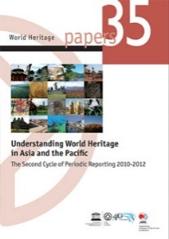
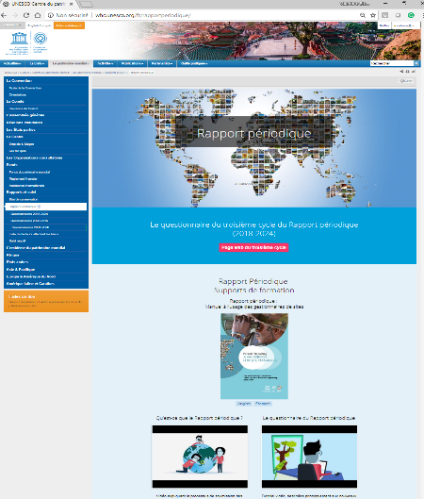
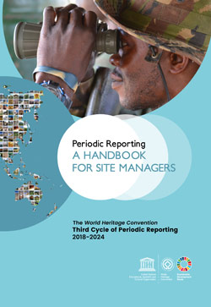
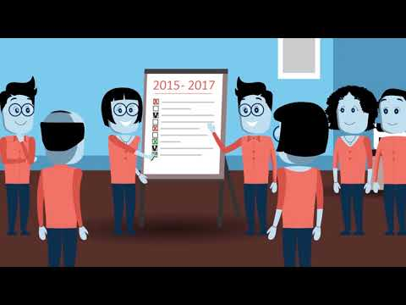
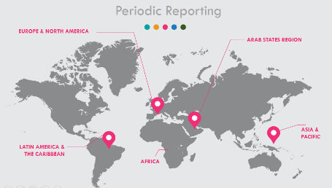
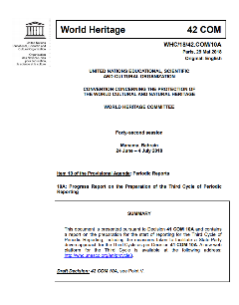
Teaching resources
Modules include different types of teaching resources
MODULE
PowerPoints
World Heritage documents & manuals
Video tutorials
Links to online platforms
Notes:
All modules include different types of teaching resources (PPTs, videos, World Heritage documents, manuals, online platforms, etc.)

Slide 18
Teaching resources
These teaching resources are grouped under the following categories:
Reference package
Operational content
Main teaching resources
Other teaching resources
Case studies and best practices
Notes:
All modules include different types of teaching resources (PPTs, videos, World Heritage documents, manuals, online platforms, etc.)

