Slide 1

Module 4
Sustainable Development
Periodic Reporting for the implementation
of the World Heritage Convention
4
Sustainable Development

Slide 2
Learning objectives
At the end of the session, trainees:
Will be able to access relevant information on Sustainable Development in the process of filling in the questionnaire, using both the online and offline resources available.
Will know the relevant Sustainable Development Goals (SDGs) for planning and advocacy.
Will be able to check the progress made at the global level for the achievement of the relevant SDG.
Will be aware of the context set by the 2030 Agenda and how each State Party at the national level might contribute to the achievement of SDG in the framework of the implementation of the World Heritage Convention as well as through other UNESCO Conventions and programmes.

Slide 3
Module outline
The 2030 Agenda for Sustainable Development
      Key Information
World Heritage and Sustainable Development
      WH-SD Policy
      Contribution of the World Heritage Convention to Sustainable Development Agenda
Exemples of Sustainable Development in the Periodic Reporting Questionnaire
      Sustainable Tourism
      Monitoring Sustainable Development Goals
      Gender balance/equity
      Involvement of communities

Slide 4
1. The 2030 Agenda for Sustainable Development
https://sustainabledevelopment.un.org
Notes:
The 2030 Agenda for Sustainable Development, adopted by all United Nations Member States in 2015, provides a shared blueprint for peace and prosperity for people and the planet, now and into the future. At its heart are the 17 Sustainable Development Goals (SDGs), which are an urgent call for action by all countries - developed and developing - in a global partnership. They recognize that ending poverty and other deprivations must go hand-in-hand with strategies that improve health and education, reduce inequality, and spur economic growth – all while tackling climate change and working to preserve our oceans and forests

Slide 5
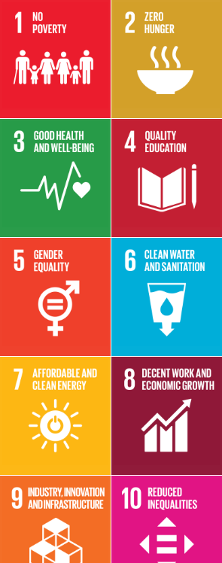
1. The 2030 Agenda for Sustainable Development
What is Sustainable Development?
Sustainable development has been defined as development that meets the needs of the present without compromising the ability of future generations to meet their own needs.
Sustainable development calls for concerted efforts towards building an inclusive, sustainable and resilient future for people and planet.

Slide 6
1. The 2030 Agenda for Sustainable Development
What is Sustainable Development?
For sustainable development to be achieved, it is crucial to harmonize three core elements: economic growth, social inclusion and environmental protection. These elements are interconnected and all are crucial for the well-being of individuals and societies.
Eradicating poverty in all its forms and dimensions is an indispensable requirement for sustainable development. To this end, there must be promotion of sustainable, inclusive and equitable economic growth, creating greater opportunities for all, reducing inequalities, raising basic standards of living, fostering equitable social development and inclusion, and promoting integrated and sustainable management of natural resources and ecosystems.

Slide 7
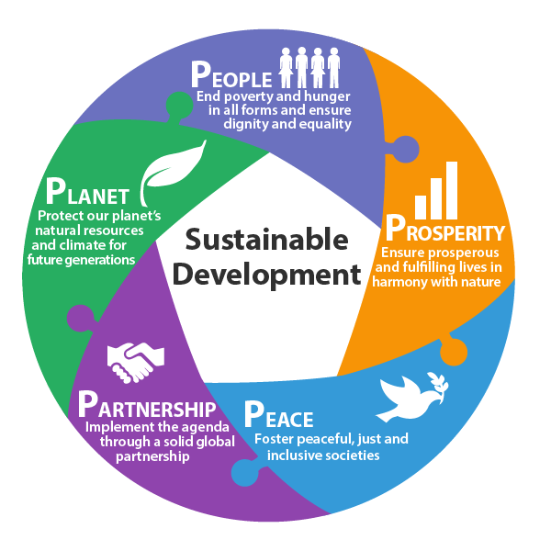
1. The 2030 Agenda for Sustainable Development
One way to measure progress is to focus on the “5 Ps” that shape the SDGs: People, Planet, Prosperity, Peace, and Partnerships. The 5 Ps highlight how the SDGs are an intertwined framework instead of a group of siloed goals.
Notes:
The second framework which will be incorporate in the World Heritage Periodic Reporting Questionnaire is the 2030 Agenda for Sustainable Development, adopted last September by the United Nations General Assembly with its 17 Sustainable Development Goals and five “Ps”, for People, Planet, Prosperity, Peace and Partnership.
Other important frameworks were also taken into account , such as the Sendai Framework for Disaster Risk Reduction, adopted in Japan last March, existing Multilateral Environmental Agreements and the policy already adopted by the GA on World Heritage and Climate Change.
This will be highlighted later in the presentation.

Slide 8
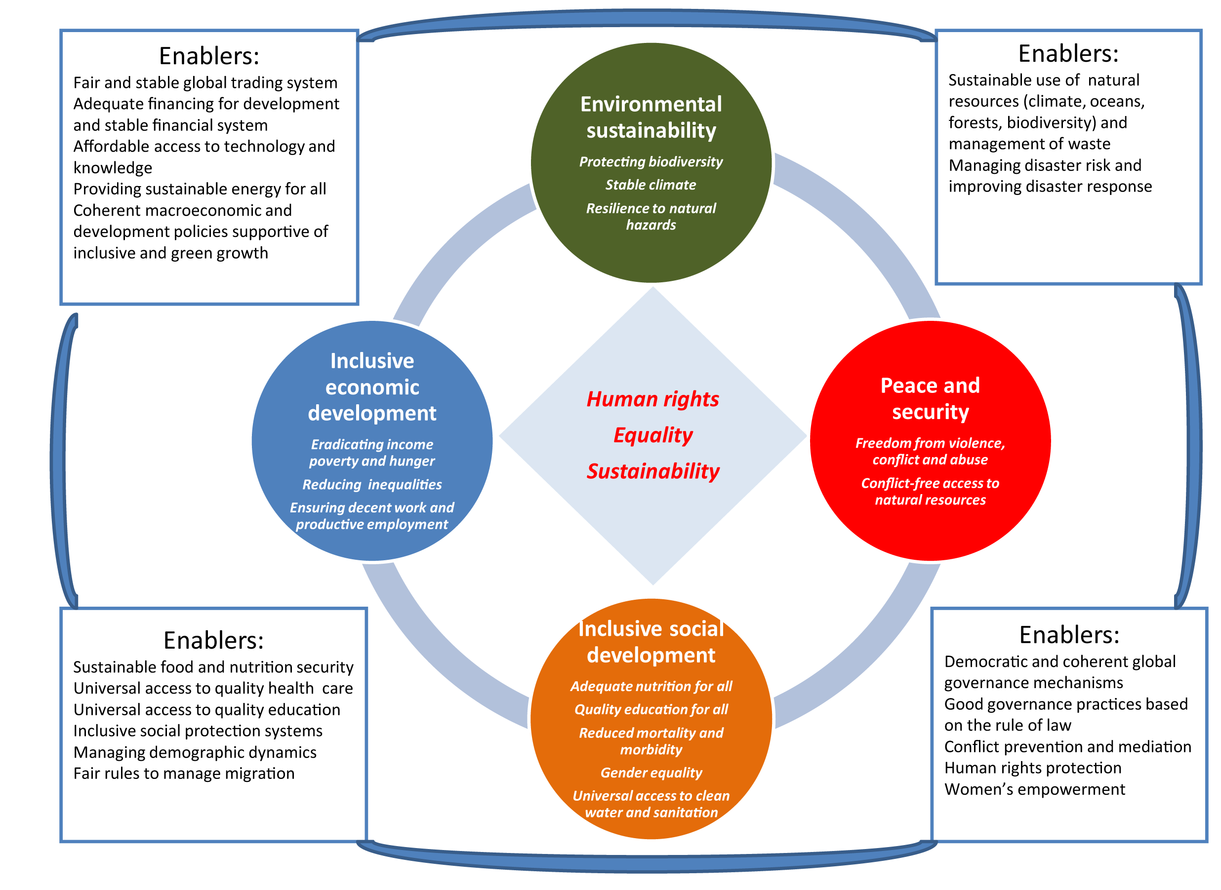
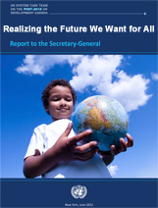
Post-2015 vision: the future we want for all
Source:
Realizing the Future We Want for All
Report to the Secretary-General
UN System Task Team on the Post-2015 UN Developement Agenda
New York, June 2012
Notes:
Post-2015 vision: the future we want for all
The central challenge of the post-2015 UN development agenda is to ensure that globalization becomes a positive force for all the worlds’ peoples of present and future generations. Globalization offers great opportunities, but its benefits are at present very unevenly shared. The continuous striving for improvements in material welfare is threatening to surpass the limits of the natural resource base unless there is a radical shift towards more sustainable patterns of consumption and production and resource use. Persistent inequalities and struggles over scarce resources are among key determinants of situations of conflict, hunger, insecurity and violence, which in turn are key factors that hold back human development and efforts to achieve sustainable development.
Accordingly, this first report prepared by the UN System-wide Task Team on the Post-2015 UN Development Agenda recommends:
• A vision for the future that rests on the core values of human rights, equality and sustainability.
• An agenda format based on concrete end goals and targets, one of the key strengths of the MDG framework should be retained, but reorganized along four key dimensions of a more holistic approach:
inclusive social development;
inclusive economic development;
environmental sustainability; and
peace and security.
This focused approach is consistent with the principles of the Millennium Declaration which set out a vision of freedom from want and fear for present and future generations and builds on the three pillars of sustainable development.

Slide 9
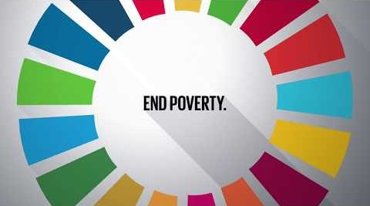
Video: Numbers in Action
http://whc.unesco.org/include/tool_video.cfm?youtubeid=iiSFmP-InWw
.
Watch online: https://youtu.be/Mdm49_rUMgo
Notes:
“Numbers in Action” is a short film shown during the “SDG Moment”, a special session at the Opening of the General Assembly. SDG Advocate Richard Curtis oversaw the production of the film as well as the preparation for the SDG Moment. (2016)

Slide 10
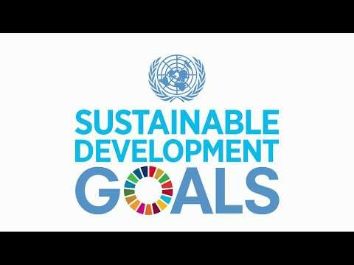
1. The 2030 Agenda for Sustainable Development
Video: Do you know all the 17 SDGs?
http://whc.unesco.org/include/tool_video.cfm?youtubeid=iiSFmP-InWw
Watch online: https://youtu.be/0XTBYMfZyrM
Notes:
Do you know all 17 SDGs? Is a short video on the Sustainable Development Goals (SDGs) call to action to end poverty, protect the planet and 1ensure that all people enjoy peace and prosperity. Our focus later in the presentation will be on the Goal 1 (more precisely Goal 11.4 related to the strengthen efforts to protect and safeguard the world’s cultural and natural heritage.

Slide 11

“
UNESCO actively contributed to the shaping of the 2030 Agenda for Sustainable Development – adopted by the UN General Assembly in 2015 – drawing on its humanist mandate, and mobilizing all of its partners and stakeholders.
Notes:
Designed as an agenda of the people, by the people and for the people, it highlights the vital importance of human capacities, skills and knowledge to adapt and respond to the challenges and opportunities of the present and the future, many of which are still unknown.
It places national ownership and support at the country level as a cornerstone for its successful implementation. Building upon the achievements and lessons learned of the Millennium Development Goals (MDGs), it seeks to address their unfinished business.
The 2030 Agenda is a universal roadmap that is strategically linked to the Sendai Framework for Disaster Risk Reduction, the Paris Climate Change Agreement, the Addis Ababa Action Agenda and the Quito Declaration on Sustainable Cities and Human Settlements for All.

Slide 12
UNESCO ensures that the role of culture is recognized through a majority of the Sustainable Development Goals (SDGs), including those focusing on quality education, sustainable cities, the environment, economic growth, sustainable consumption and production patterns, peaceful and inclusive societies, gender equality and food security.
Notes:
Designed as an agenda of the people, by the people and for the people, it highlights the vital importance of human capacities, skills and knowledge to adapt and respond to the challenges and opportunities of the present and the future, many of which are still unknown.
It places national ownership and support at the country level as a cornerstone for its successful implementation. Building upon the achievements and lessons learned of the Millennium Development Goals (MDGs), it seeks to address their unfinished business.
The 2030 Agenda is a universal roadmap that is strategically linked to the Sendai Framework for Disaster Risk Reduction, the Paris Climate Change Agreement, the Addis Ababa Action Agenda and the Quito Declaration on Sustainable Cities and Human Settlements for All.

Slide 13
From cultural heritage to cultural and creative industries, Culture is both an enabler and a driver of the economic, social and environmental dimensions of sustainable development.
UNESCO's work promoting cultural diversity, and UNESCO’s Culture Conventions, are key to the implementation of the 2030 Agenda for Sustainable Development.
Notes:
Designed as an agenda of the people, by the people and for the people, it highlights the vital importance of human capacities, skills and knowledge to adapt and respond to the challenges and opportunities of the present and the future, many of which are still unknown.
It places national ownership and support at the country level as a cornerstone for its successful implementation. Building upon the achievements and lessons learned of the Millennium Development Goals (MDGs), it seeks to address their unfinished business.
The 2030 Agenda is a universal roadmap that is strategically linked to the Sendai Framework for Disaster Risk Reduction, the Paris Climate Change Agreement, the Addis Ababa Action Agenda and the Quito Declaration on Sustainable Cities and Human Settlements for All.

Slide 14
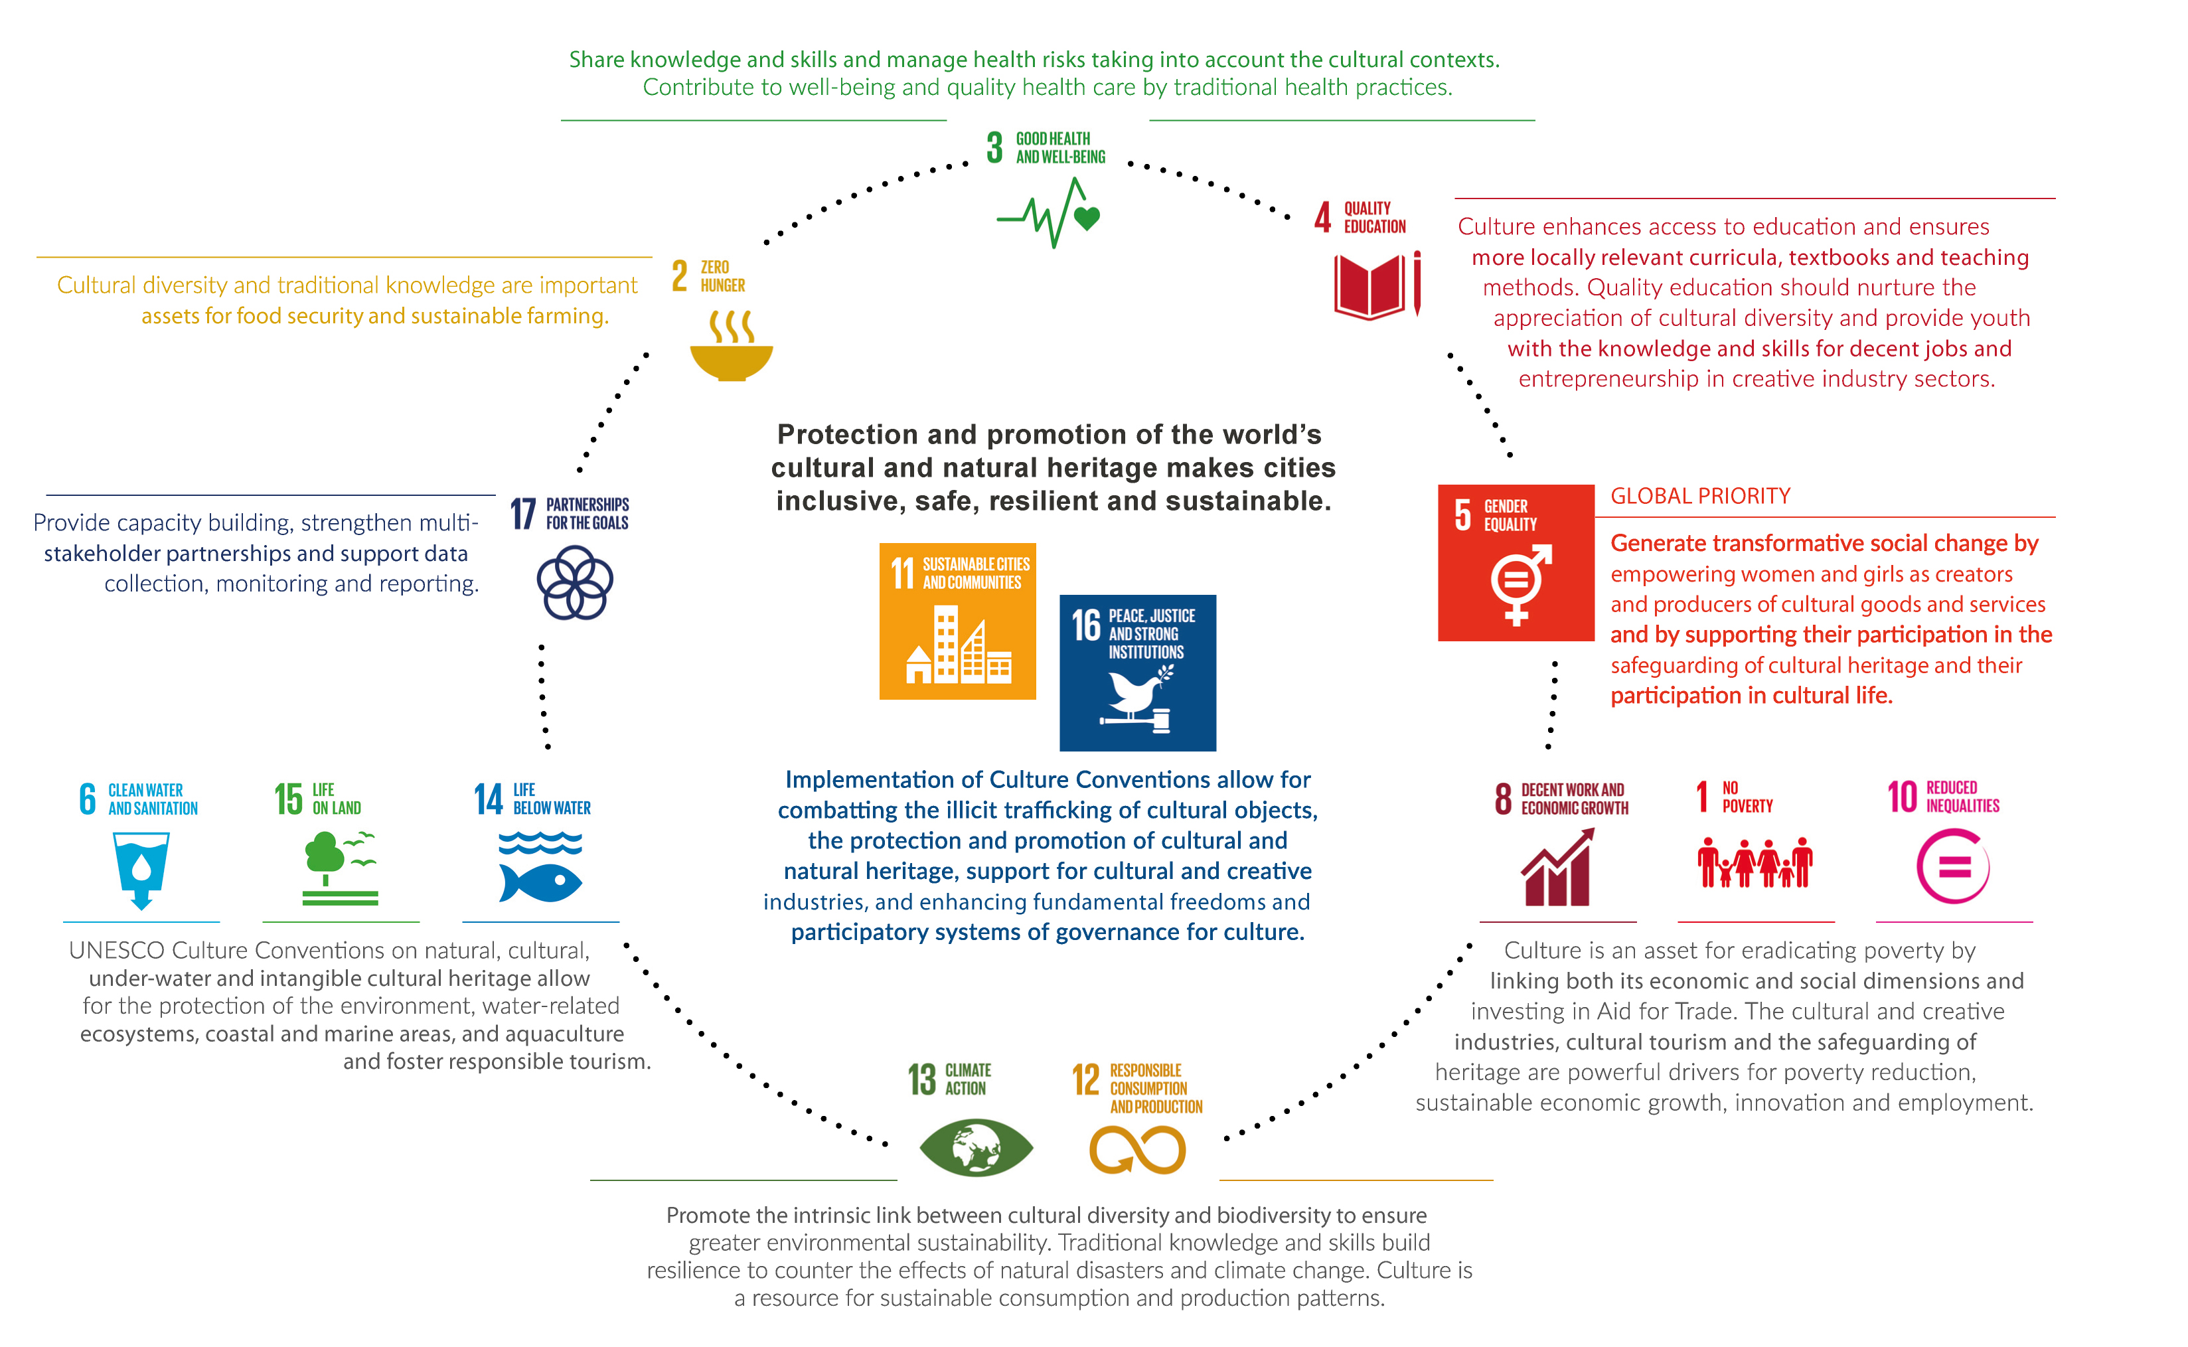
Culture as a driver and enabler for sustainable development
Source: UNESCO moving forward the 2030 Agenda for Sustainable Development. ©UNESCO, 2017
Notes:
UNESCO contributes significantly to nine SDGs through an integrated approach, drawing on all of its areas of specialized expertise and in close partnership with UN entities and partners from the public and private sector.
Therefore Goal 11’s (Sustainable cities and communities) target 11.4 will be promoted and implemented through quality education for all, safeguarding cultural heritage, innovation and creativity, promoting environmental sustainability and building resilience to the effects of climate change, disasters and conflicts.

Slide 15
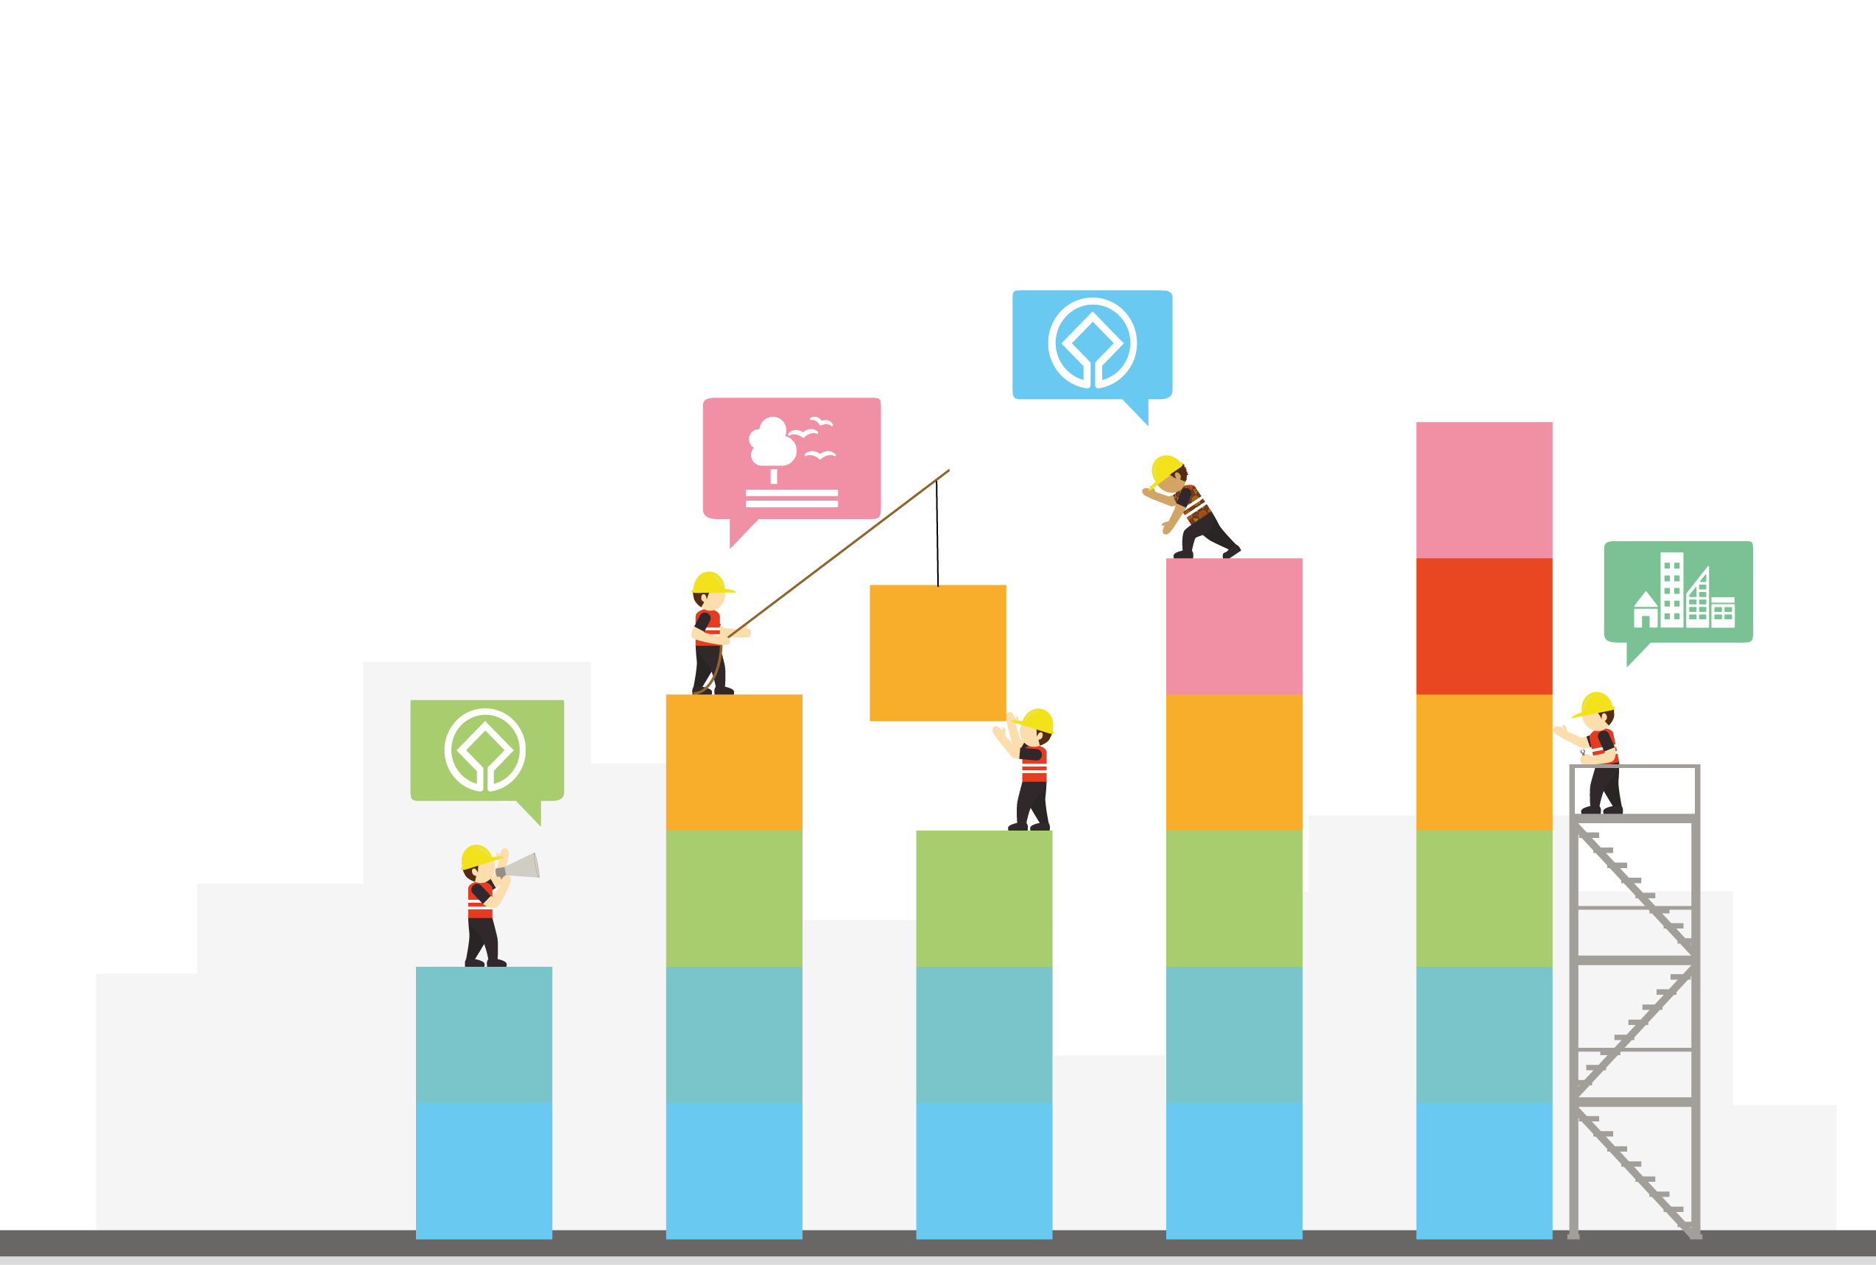
The fundamental contribution of quality, inclusive education at all levels and to the importance of lifelong learning opportunities for all (SDG 4).
Acknowledges the growing importance of science, technology and innovation for sustainable development (SDG 9).
Ambitious goals in the areas of freshwater (SDG 6), biodiversity (SDG 15), the ocean (SDG 14), and climate change (SDG 13).
Public access to information and the safety of journalists in accelerating development opportunities and in promoting good governance and the rule of law (SDG 16).
Notes:
The 2030 Agenda is a universal roadmap that is strategically linked to the Sendai Framework for Disaster Risk Reduction, the Paris Climate Change Agreement, the Addis Ababa Action Agenda and the Quito Declaration on Sustainable Cities and Human Settlements for All.
The 2030 Agenda gives new impetus to UNESCO’s actions at the global, regional and national levels.
UNESCO ensures that the role of culture is recognized through a majority of SDGs, including those focusing on quality education, sustainable cities, the environment, economic growth, sustainable consumption and production patterns, peaceful and inclusive societies, gender equality and food security.

Slide 16
Promotion of culture, through heritage and creativity, as a key enabler of sustainable development. It acknowledges the value of creating inclusive, safe, resilient and sustainable cities, and contains targets on the preservation of natural and cultural heritage (SDG 11), as well as on the recovery and return of stolen assets (SDG 16), which also include the illicit trafficking of cultural objects.
Upholds a vision of just, peaceful, equitable and inclusive societies recognizing the value of knowledge, heritage and diversity. It promotes human rights and has a strong focus on gender equality (SDG 5).
Notes:
The 2030 Agenda is a universal roadmap that is strategically linked to the Sendai Framework for Disaster Risk Reduction, the Paris Climate Change Agreement, the Addis Ababa Action Agenda and the Quito Declaration on Sustainable Cities and Human Settlements for All.
The 2030 Agenda gives new impetus to UNESCO’s actions at the global, regional and national levels.
UNESCO ensures that the role of culture is recognized through a majority of SDGs, including those focusing on quality education, sustainable cities, the environment, economic growth, sustainable consumption and production patterns, peaceful and inclusive societies, gender equality and food security.

Slide 17
Promotion of culture, through heritage and creativity, as a key enabler of sustainable development. It acknowledges the value of creating inclusive, safe, resilient and sustainable cities, and contains targets on the preservation of natural and cultural heritage (SDG 11), as well as on the recovery and return of stolen assets (SDG 16), which also include the illicit trafficking of cultural objects.
Upholds a vision of just, peaceful, equitable and inclusive societies recognizing the value of knowledge, heritage and diversity. It promotes human rights and has a strong focus on gender equality (SDG 5).
* Culture Conventions and Programmes
Notes:
Designed as an agenda of the people, by the people and for the people, it highlights the vital importance of human capacities, skills and knowledge to adapt and respond to the challenges and opportunities of the present and the future, many of which are still unknown.
It places national ownership and support at the country level as a cornerstone for its successful implementation. Building upon the achievements and lessons learned of the Millennium Development Goals (MDGs), it seeks to address their unfinished business.
The 2030 Agenda is a universal roadmap that is strategically linked to the Sendai Framework for Disaster Risk Reduction, the Paris Climate Change Agreement, the Addis Ababa Action Agenda and the Quito Declaration on Sustainable Cities and Human Settlements for All.

Slide 18
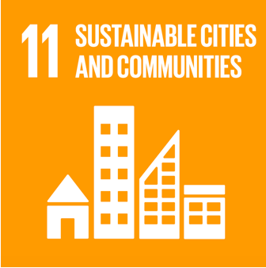
“
Promote inclusive sustainable cities through safeguarding cultural heritage, innovation and creativity, promoting environmental sustainability and building resilience to the effects of climate change, disasters and conflicts.
In particular, target 11.4:
Strengthen efforts to protect and safeguard the world’s cultural and natural heritage

Slide 19
The text of the World Heritage Convention, adopted in 1972, does not make any specific mention of the term “sustainable development”. It has been argued, however, that the Convention “carries in itself the spirit and promise of sustainability,…in its insistence that culture and nature form a single, closed continuum of the planet’s resources, the integrated stewardship of which is essential to successful long-term sustainable development – and indeed to the future of life on the Earth as we know it” (Richard Engelhardt).

Slide 20

Policy for the Integration of a Sustainable Development Perspective into the Processes of the World Heritage Convention (2015)
In line with the “2030 Agenda for Sustainable Development”, adopted by the United Nations General Assembly, the policy revolves around the three dimensions of sustainable development, namely:
environmental sustainability,
inclusive social development
inclusive economic development
complemented by the fostering of peace and security.
Notes:
On 19 November 2015, the 20th General Assembly of the States Parties to the World Heritage Convention adopted the Policy on the integration of a sustainable development perspective into the processes of the World Heritage Convention, generally known by now as the World Heritage Sustainable Development Policy.
States Parties in implementing the Convention should consider the three dimensions of sustainable development, namely environmental sustainability, inclusive social development and inclusive economic development, together with the fostering of peace and security. These reflect the concern for “planet, people, prosperity and peace”, identified as areas of critical importance in the 2030 UN Agenda for Sustainable Development
The overall goal of the policy is to assist States Parties, practitioners, institutions, communities and networks, through appropriate guidance, to harness the potential of World Heritage properties and heritage in general, to contribute to sustainable development and therefore increase the effectiveness and relevance of the Convention whilst respecting its primary purpose and mandate of protecting the Outstanding Universal value of World Heritage properties.

Slide 21
Policy for the Integration of a Sustainable Development Perspective into the Processes of the World Heritage Convention (2015)
Environment sustainability
by valuing and conserving places of outstanding natural heritage value, containing exceptional biodiversity, geodiversity or other exceptional natural features, which are essential for human well-being.
Notes:
Environmental Sustainability
The World Heritage Convention promotes sustainable development, and in particular environmental sustainability, by valuing and conserving places of outstanding natural heritage value, containing exceptional biodiversity, geodiversity or other exceptional natural features, which are essential for human well-being.
A concern for environmental sustainability, however, should equally apply to cultural and mixed World Heritage properties, including cultural landscapes.
.

Slide 22
Policy for the Integration of a Sustainable Development Perspective into the Processes of the World Heritage Convention (2015)
Environment sustainability
involves a responsible interaction with the environment in both cultural and natural properties, to avoid depletion or degradation of natural resources, ensuring long-term environmental quality and the strengthening of resilience to disasters and climate change.
Notes:
In implementing the Convention, States Parties should therefore promote environmental sustainability more generally to all World Heritage properties to ensure policy coherence and mutual supportiveness with other multilateral environmental agreements. This involves a responsible interaction with the environment in both cultural and natural properties, to avoid depletion or degradation of natural resources, ensuring long-term environmental quality and the strengthening of resilience to disasters and climate change.

Slide 23

Policy for the Integration of a Sustainable Development Perspective into the Processes of the World Heritage Convention (2015)
Inclusive social development
States Parties should recognise that inclusive social development is at the heart of the implementation of this provision of the World Heritage Convention.
Notes:
Inclusive social development
The World Heritage Convention in Article 5 calls upon States Parties to “adopt a general policy which aims to give the cultural and natural heritage a function in the life of the community”. States Parties should recognise that inclusive social development is at the heart of the implementation of this provision of the Convention.
States Parties should further recognise that full inclusion, respect and equity of all stakeholders, including local and concerned communities and indigenous peoples, together with a commitment to gender equality, are a fundamental premise for inclusive social development. Enhancing quality of life and well-being in and around World Heritage properties is essential, taking into account communities who might not visit or reside in or near properties but are still stakeholders. Inclusive social development must be underpinned by inclusive governance

Slide 24
Policy for the Integration of a Sustainable Development Perspective into the Processes of the World Heritage Convention (2015)
Inclusive social development
States Parties should further recognise that full inclusion, respect and equity of all stakeholders, including local and concerned communities and indigenous peoples, together with a commitment to gender equality, are a fundamental premise for inclusive social development.
Notes:
Inclusive social development
The World Heritage Convention in Article 5 calls upon States Parties to “adopt a general policy which aims to give the cultural and natural heritage a function in the life of the community”. States Parties should recognise that inclusive social development is at the heart of the implementation of this provision of the Convention.
…
States Parties should further recognise that full inclusion, respect and equity of all stakeholders, including local and concerned communities and indigenous peoples, together with a commitment to gender equality, are a fundamental premise for inclusive social development. Enhancing quality of life and well-being in and around World Heritage properties is essential, taking into account communities who might not visit or reside in or near properties but are still stakeholders. Inclusive social development must be underpinned by inclusive governance

Slide 25
Policy for the Integration of a Sustainable Development Perspective into the Processes of the World Heritage Convention (2015)
Inclusive social development
Contributing to inclusion and equity
Enhancing quality of life and well-being
Respecting, protecting and promoting human rights
Respecting, consulting and involving indigenous peoples and local communities
Achieving gender equality
Notes:
States Parties should ensure that the conservation and management of World Heritage properties is based on recognition of cultural diversity, inclusion and equity.
World Heritage properties have the potential to enhance quality of life and wellbeing of all stakeholders, and in particular local communities.
To ensure policy coherence in conserving and managing World Heritage properties, States Parties should commit to uphold, respect and contribute to the implementation of the full range of international human rights standards as a pre-requisite for effectively achieving sustainable development.
The World Heritage Committee specifically encourages the effective and equitable involvement and participation of indigenous peoples and local communities in decision-making, monitoring and evaluation of World Heritage properties and the respect of indigenous peoples’ rights in nominating, managing and reporting on World Heritage properties in their own territories
Achieving gender equality and empowering all women and girls is essential for achieving sustainable development, and is one of the post-2015 sustainable development goals.

Slide 26
Policy for the Integration of a Sustainable Development Perspective into the Processes of the World Heritage Convention (2015)
Inclusive economic developement
World Heritage properties, offer great potential to alleviate poverty and enhance sustainable livelihoods of local communities, including those of marginalized populations.
Notes:
World Heritage properties, offer great potential to alleviate poverty and enhance sustainable livelihoods of local communities, including those of marginalized populations.

Slide 27
Policy for the Integration of a Sustainable Development Perspective into the Processes of the World Heritage Convention (2015)
Inclusive economic development
As an indispensable requirement for sustainable development and the well-being of present and future generations, the Convention gears to contribute to promoting sustainable forms of inclusive and equitable economic development, productive and decent employment and income-generating activities for all.
Notes:
As an indispensable requirement for sustainable development and the well-being of present and future generations, the Convention gears to contribute to promoting sustainable forms of inclusive and equitable economic development, productive and decent employment and income-generating activities for all, while fully respecting the OUV of World Heritage properties

Slide 28
Policy for the Integration of a Sustainable Development Perspective into the Processes of the World Heritage Convention (2015)
Inclusive economic development
Ensuring growth, employment, income and livelihoods
Promoting economic investment and quality tourism
Strengthening capacity-building, innovation and local entrepreneurship
Notes:
The management and conservation of World Heritage properties should contribute to fostering inclusive local economic development and enhancing livelihoods, compatibly with the protection of their OUV.
World Heritage properties are important travel destinations that, if managed properly, have great potential for inclusive local economic development, sustainability and strengthening social resilience. Sustainable forms of tourism development, including community-based initiatives, should be accompanied by inclusive and equitable economic investment to ensure benefit sharing in and around World Heritage properties.
States Parties should recognise that inclusive economic development is a long-term commitment based on a holistic approach to World Heritage properties and their associated cultural and creative industries and intangible heritage. In this view, States Parties should develop educational and capacity-building programmes based on innovation and local entrepreneurship, aimed in particular at small/medium/micro scale levels, to promote sustainable economic benefits for local communities.

Slide 29

Policy for the Integration of a Sustainable Development Perspective into the Processes of the World Heritage Convention (2015)
Fostering peace and security
Ensuring conflict prevention
Protecting heritage during conflict
Promoting conflict resolution
Contributing to post-conflict recovery
Notes:
States Parties have a critically important role to play in ensuring that the implementation of the World Heritage Convention, including the establishment of the World Heritage List and management of inscribed properties, are used to prevent conflicts between and within States Parties and to promote respect for cultural diversity within and around World Heritage properties.
During armed conflict, States Parties must refrain from any use of World Heritage properties and their immediate surroundings for purposes which are likely to expose them to destruction or damage. They must also refrain from any act of hostility directed against World Heritage properties.
The inherent potential of World Heritage properties and of their conservation to contribute favourably to conflict resolution and the re-establishment of peace and security should be acknowledged and harnessed.
During a conflict and in the post-conflict transition phase, World Heritage properties and their wider settings can make a significant contribution to recovery and socioeconomic reconstruction.

Slide 30
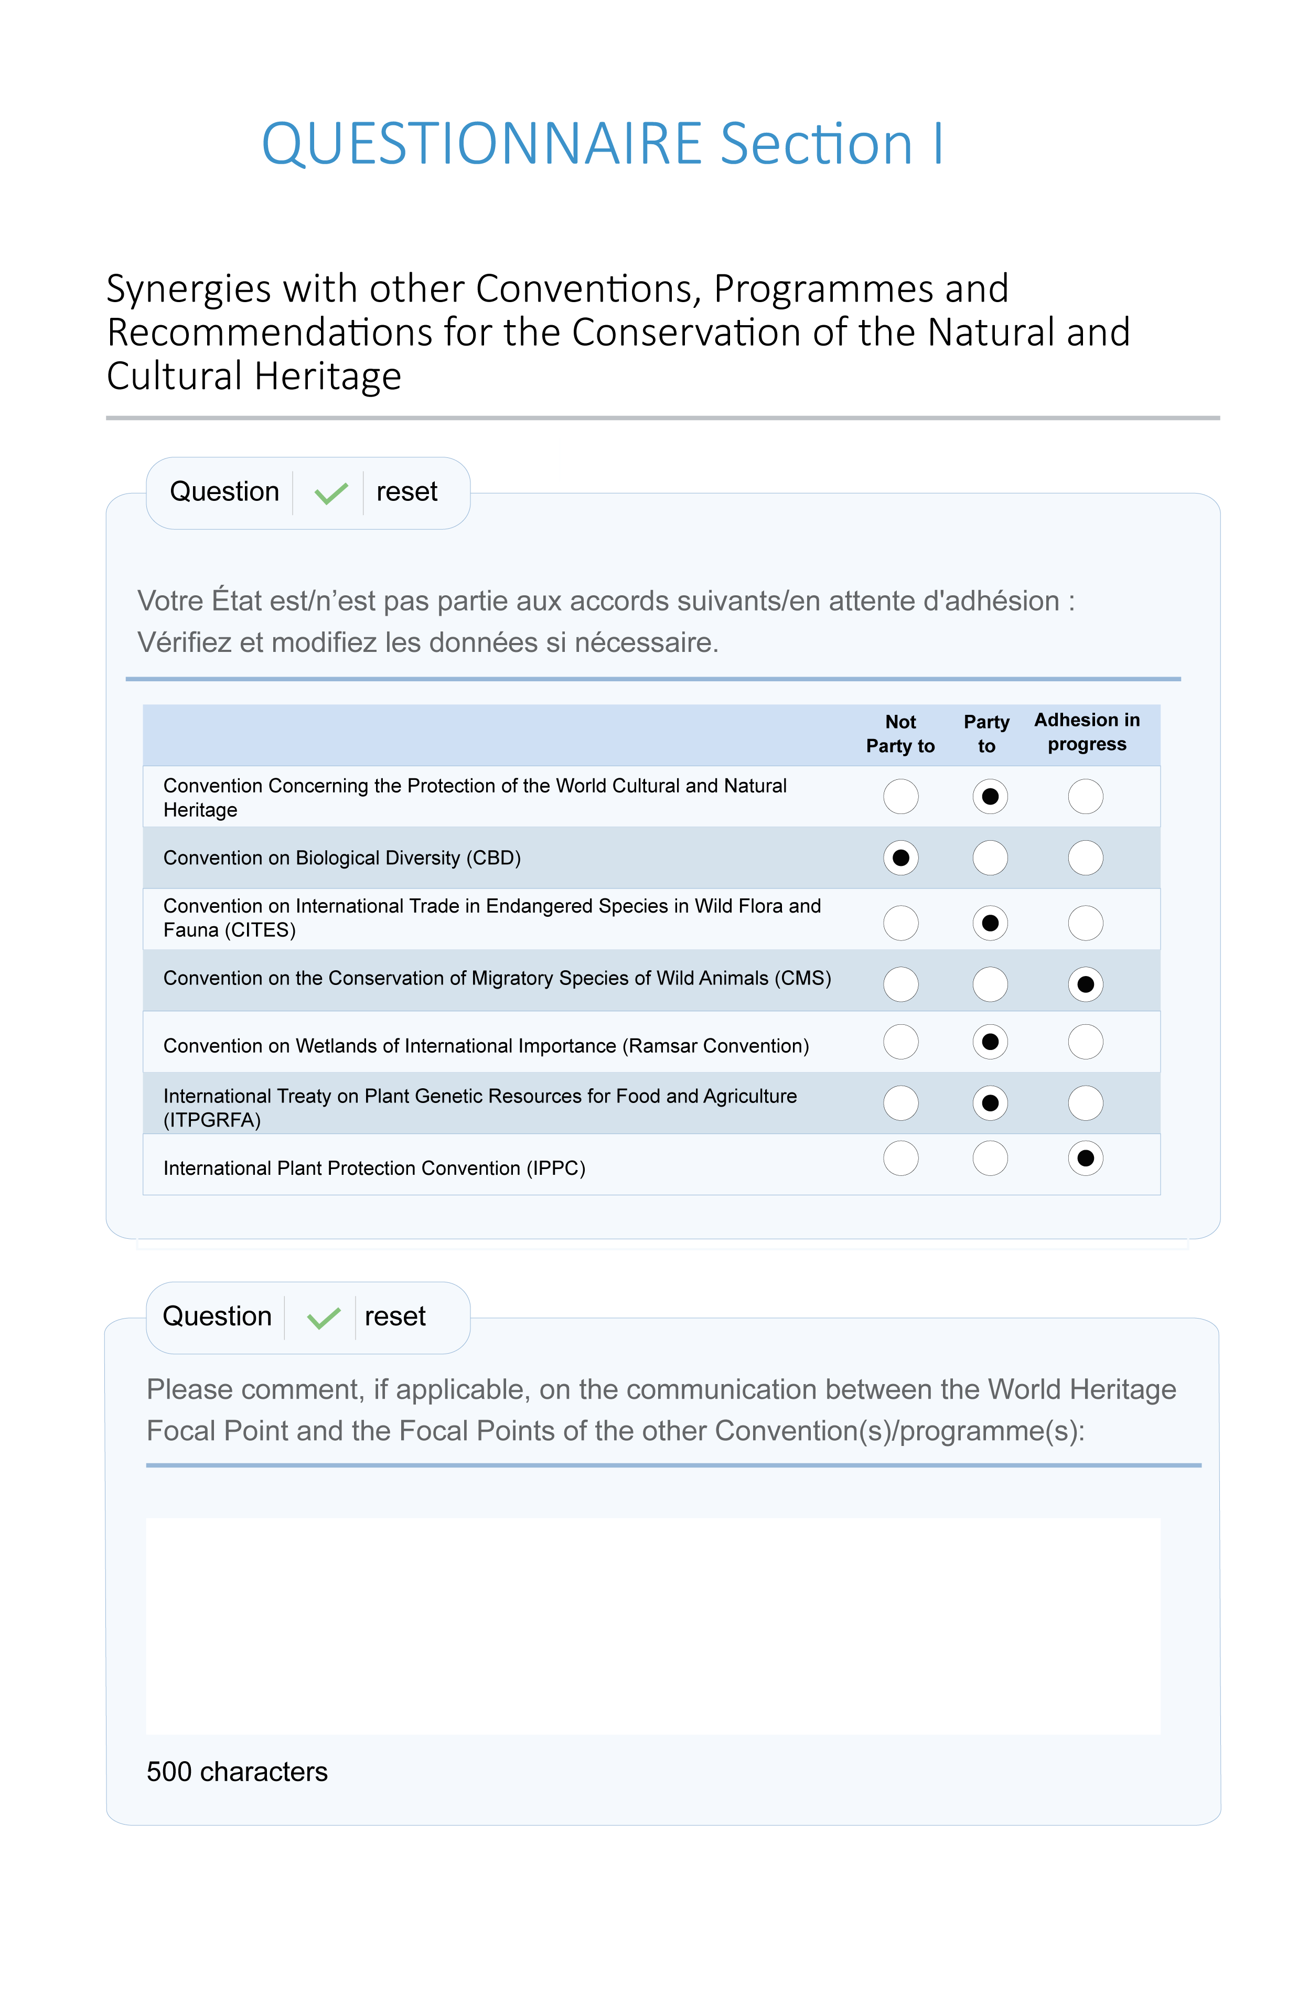
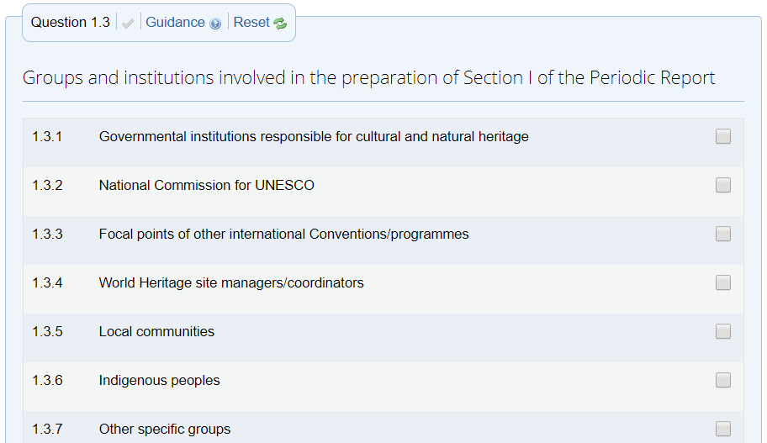

3. Sustainable Development and Periodic Reporting
Example of relevant questions in Section I (State Party level)
1.3. Groups and institutions involved in the preparation of Section I of the Periodic Report - Involvement of communities

Slide 31
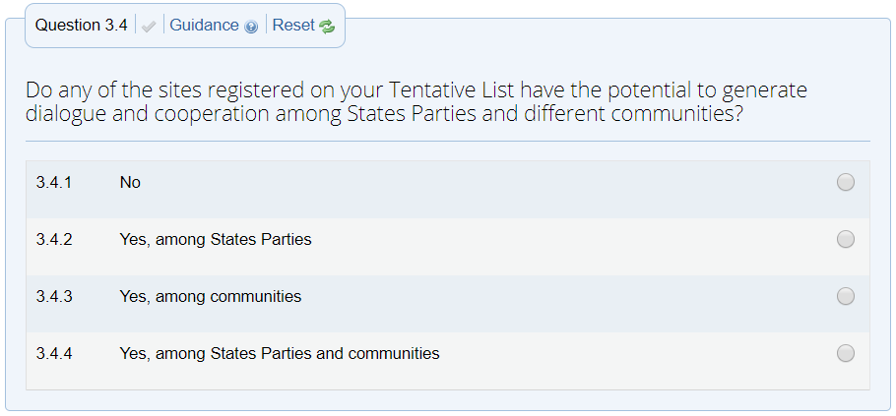
3. Sustainable Development and Periodic Reporting
Example of relevant questions in Section I (State Party level)
3.4 Do any of the sites registered on your Tentative List have the potential to generate dialogue and cooperation among States Parties and different communities? - Conflict prevention and respect for cultural diversity

Slide 32
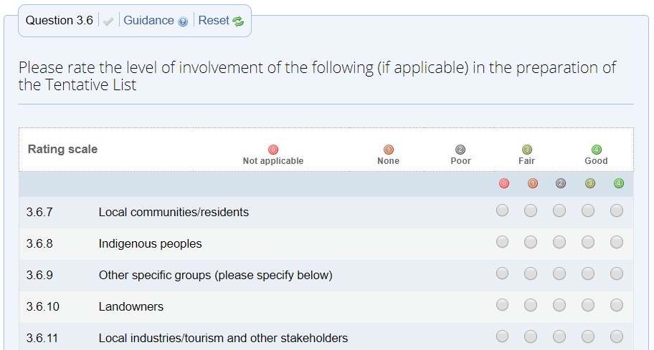
3. Sustainable Development and Periodic Reporting
Example of relevant questions in Section I (State Party level)
3.6 Please rate the level of involvement of the following (if applicable) in the preparation of the Tentative List - Gender balance/equity

Slide 33
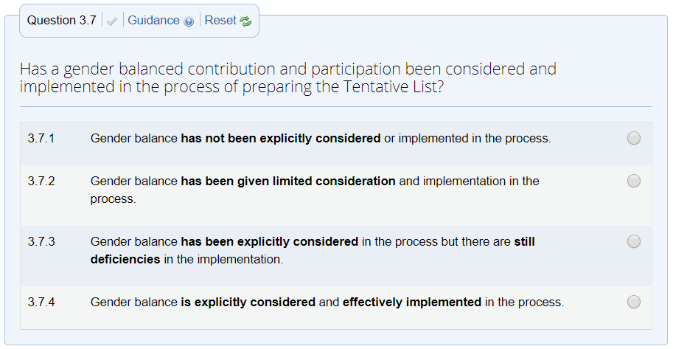
3. Sustainable Development and Periodic Reporting
Example of relevant questions in Section I (State Party level)
3.7 Has a gender balanced contribution and participation been considered and implemented in the process of preparing the Tentative List? - Gender balance/equity

Slide 34
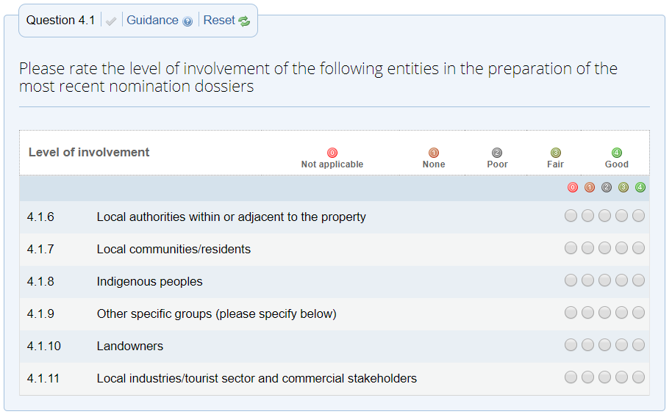
3. Sustainable Development and Periodic Reporting
Example of relevant questions in Section I (State Party level)
4.1 Please rate the level of involvement of the following entities in the preparation of the most recent nomination dossiers - Involvement of communities

Slide 35
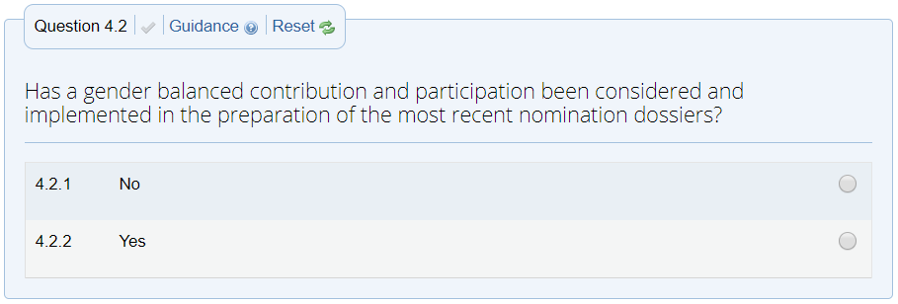
3. Sustainable Development and Periodic Reporting
Example of relevant questions in Section I (State Party level)
4.2 Has a gender balanced contribution and participation been considered and implemented in the preparation of the most recent nomination dossiers? Gender balance/equity

Slide 36
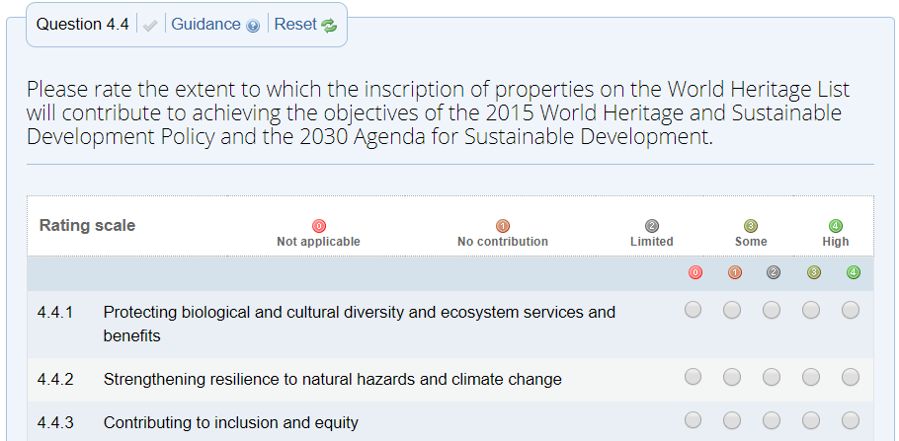
3. Sustainable Development and Periodic Reporting
Example of relevant questions in Section I (State Party level)
4.4 Please rate the extent to which the inscription of properties on the World Heritage List will contribute to achieving the objectives of the 2015 World Heritage and Sustainable Development Policy and the 2030 Agenda for Sustainable Development. Contribution of the Convention to Sustainable development / Monitoring Sustainable Development Goals

Slide 37
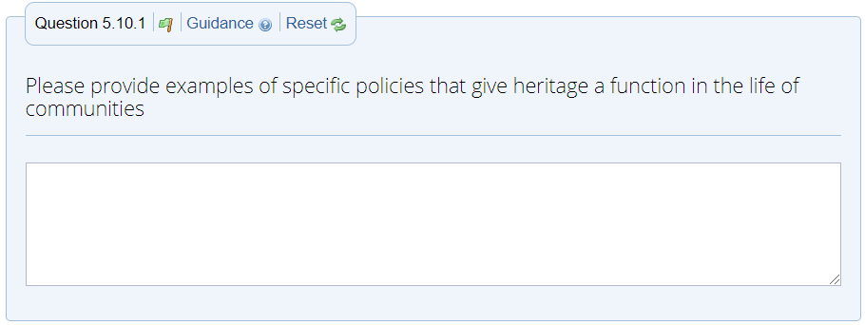
3. Sustainable Development and Periodic Reporting
Example of relevant questions in Section I (State Party level)
5.10 Please provide examples of specific policies that give heritage a function in the life of communities - Contribution of the Convention to Sustainable development/involvement of communities

Slide 38
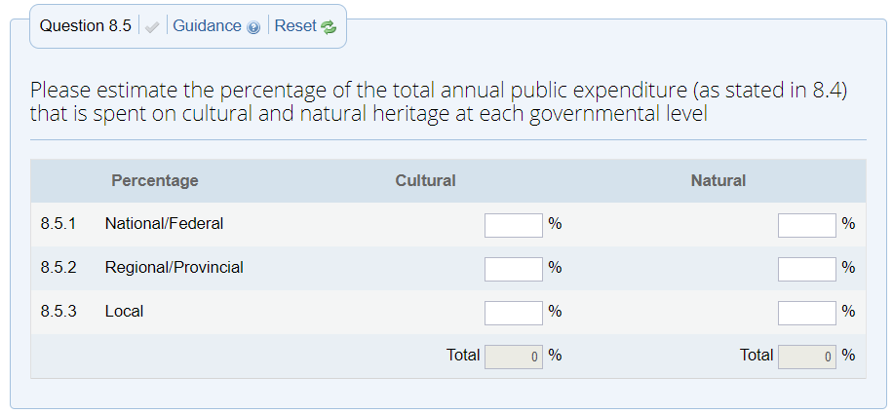
3. Sustainable Development and Periodic Reporting
Example of relevant questions in Section I (State Party level)
8.5 Please estimate the percentage of the total annual public expenditure that is spent on cultural and natural heritage at each governmental leveMonitoring Sustainable Development Goals

Slide 39
3. Sustainable Development and Periodic Reporting
Example of relevant questions in Section I (State Party level)
8.5 Please estimate the percentage of the total annual public expenditure that is spent on cultural and natural heritage at each governmental leveMonitoring Sustainable Development Goals

Slide 40
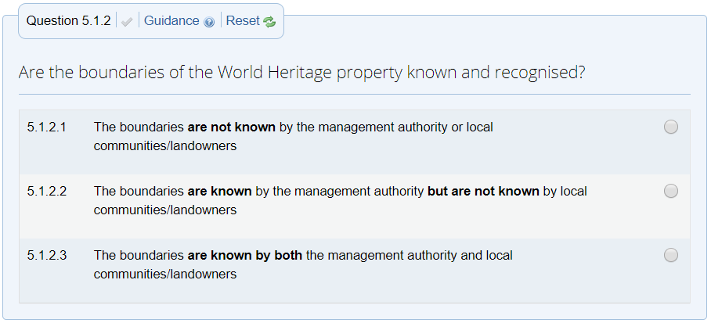
3. Sustainable Development and Periodic Reporting
Example of relevant questions in Section II (World Heritage property)
5.1.2 Are the boundaries of the World Heritage property known and recognised? Involvement of communities

Slide 41
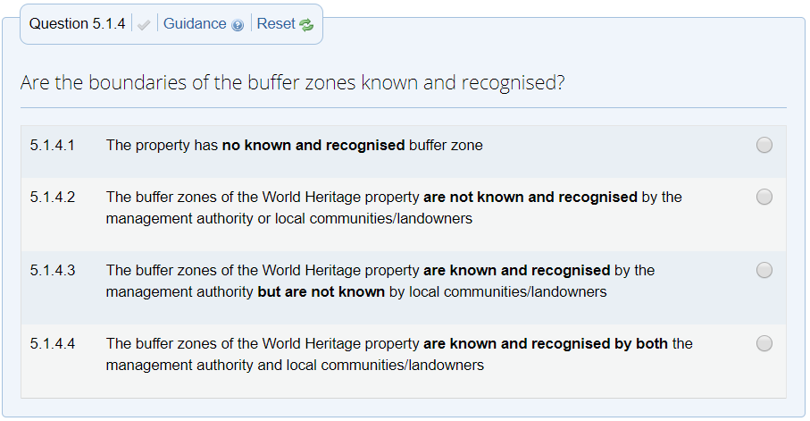
3. Sustainable Development and Periodic Reporting
Example of relevant questions in Section II (World Heritage property)
5.1.4 Are the boundaries of the buffer zones known and recognised? Involvement of communities

Slide 42
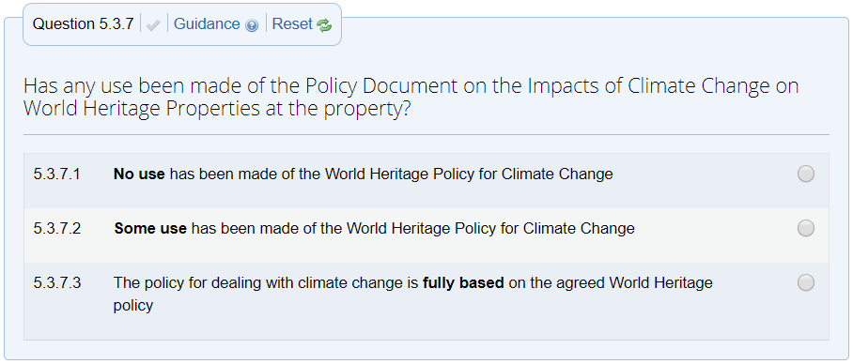
3. Sustainable Development and Periodic Reporting
Example of relevant questions in Section II (World Heritage property)
5.3.7 Has any use been made of the Policy Document on the Impacts of Climate Change on World Heritage Properties at the property? Climate Change

Slide 43
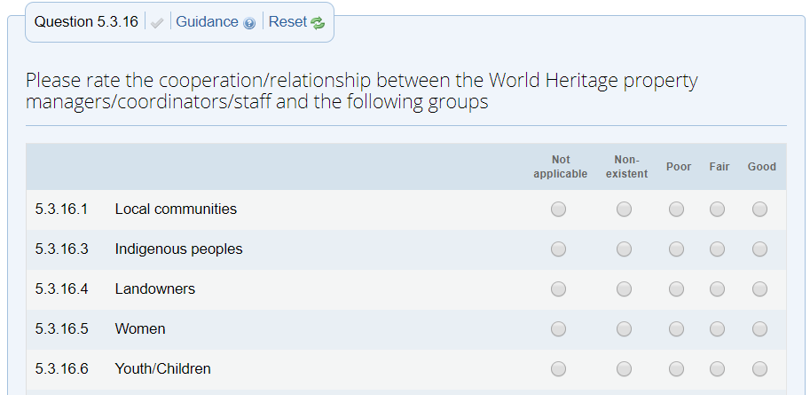
3. Sustainable Development and Periodic Reporting
Example of relevant questions in Section II (World Heritage property)
5.3.16 Please rate the cooperation/relationship between the World Heritage property managers/coordinators/staff and the following groups Involvement - Involvement of communities

Slide 44
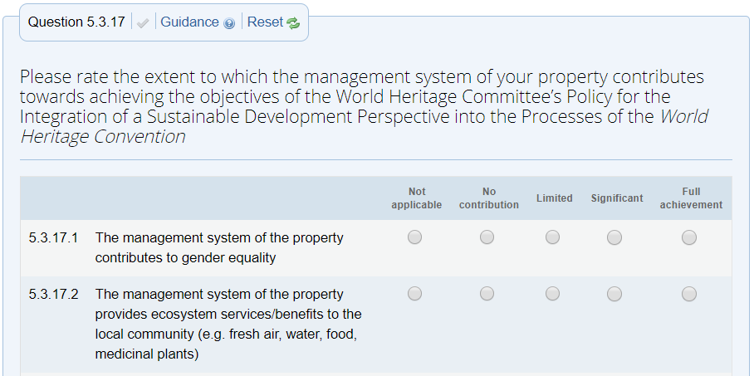
3. Sustainable Development and Periodic Reporting
Example of relevant questions in Section II (World Heritage property)
5.3.17 Please rate the extent to which the management system of your property contributes towards achieving the objectives of the World Heritage Committee’s Policy for the Integration of a Sustainable Development Perspective into the Processes of the World Heritage Convention - Contribution of the Convention to Sustainable development

Slide 45
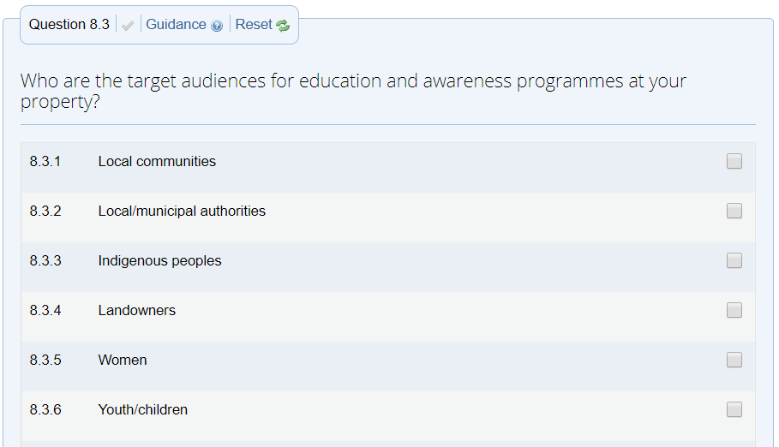
3. Sustainable Development and Periodic Reporting
Example of relevant questions in Section II (World Heritage property)
8.3 Who are the target audiences for education and awareness programmes at your property? Gender balance/equity

Slide 46
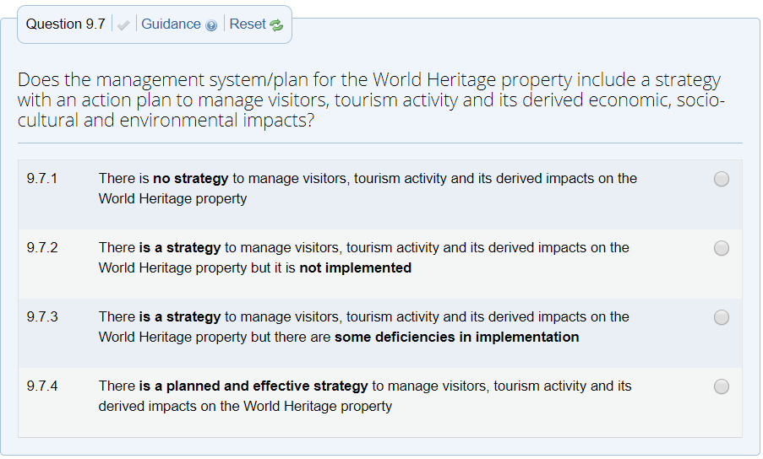
3. Sustainable Development and Periodic Reporting
Example of relevant questions in Section II (World Heritage property)
9.7 Does the management system/plan for the World Heritage property include a strategy with an action plan to manage visitors, tourism activity and its derived economic, socio-cultural and environmental impacts? Sustainable Tourism

Slide 47
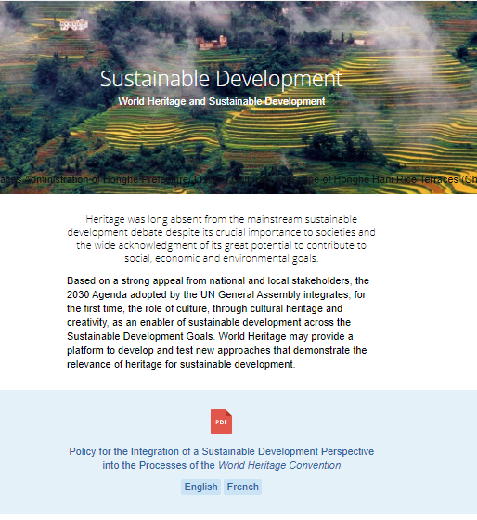
Selected websites: Sustainable Development
World Heritage and Sustainable Development.
This dedicated webpages of the World Heritage Centre gives information pertaining the contribution of the Policy for the Integration of a sustainable Development Policy into the Processes of the World Heritage Convention and activities carried out in the development of sustainable development.
Website available in English and French :
whc.unesco.org/en/sustainabledevelopment/

Slide 48
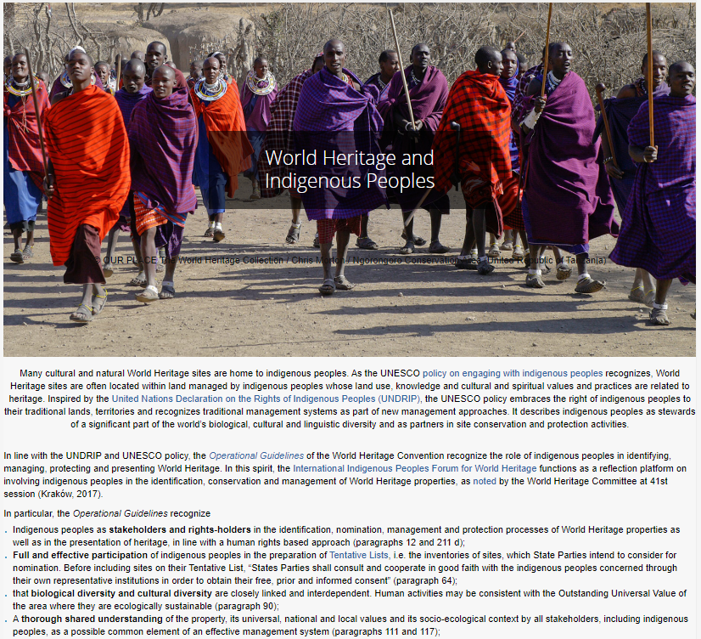

Selected websites: World Heritage and Indigenous Peoples
Best practice approaches to sustainable economic development through tourism.
UNESCO policy embraces the right of indigenous peoples to their traditional lands, territories and recognizes traditional management systems as part of new management approaches. It describes indigenous peoples as stewards of a significant part of the world’s biological, cultural and linguistic diversity and as partners in site conservation and protection activities.
Website available in English and French:
whc.unesco.org/en/activities/496/

Slide 49
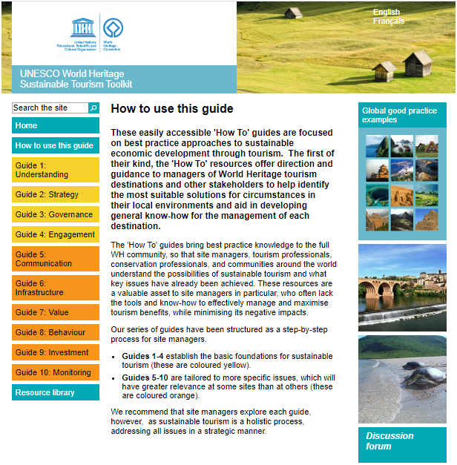
Selected websites: Sustainable Tourism Toolkit
Best practice approaches to sustainable economic development through tourism.
This UNESCO World Heritage Sustainable Development Tourism Toolkit 'How To' resources offers direction and guidance to managers of World Heritage tourism destinations and other stakeholders to help identify the most suitable solutions for circumstances in their local environments and aid in developing general know-how for the management of each destination.
Website available in English and French :
whc.unesco.org/sustainabletourismtoolkit/how-use-guide
"Tourism that takes full account of its current and future economic, social and environmental impacts, addressing the needs of visitors, the industry, the environment and host communities“ (UNWTO)

Slide 50
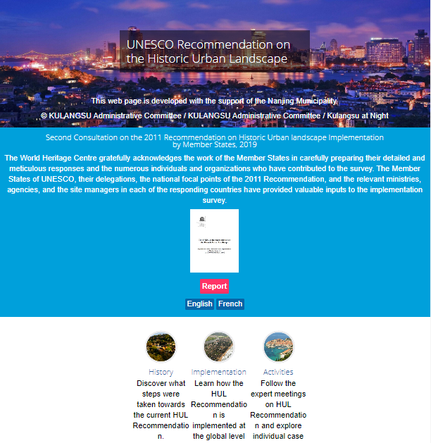
Selected websites: Historic Urban Landscape
UNESCO Recommendation on the Historic Urban Landscape.
Urban heritage, including its tangible and intangible components, constitutes a key resource in enhancing the liveability of urban areas, and fosters economic development and social cohesion in a changing global environment. As the future of humanity hinges on the effective planning and management of resources, conservation has become a strategy to achieve a balance between urban growth and quality of life on a sustainable basis.
The urban area understood as the result of a historic layering of cultural and natural values and attributes, extending beyond the notion of “historic centre” or “ensemble” to include the broader urban context and its geographical setting.
Website available in English and French :
http://whc.unesco.org/en/hul/

Slide 51
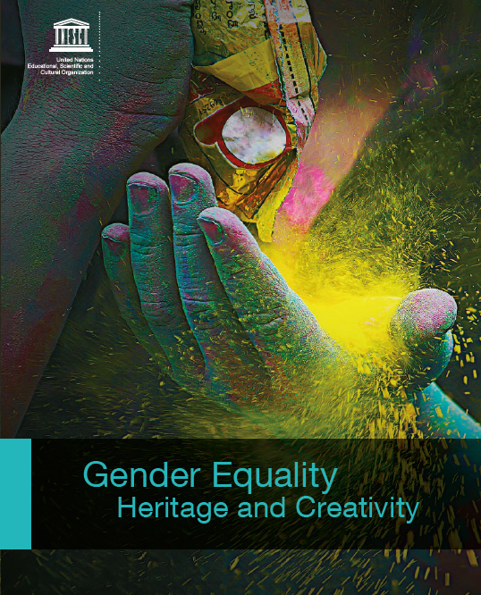
Case studies: Gender Equality
Recognition of women’s roles in the management and conservation of heritage:
Kasubi Tombs, World Heritage property, Uganda
Publication
As the burial site of the previous four Kabakas - or rulers - of the Buganda kingdom, the Kasubi Tombs are a renowned spiritual centre for the Baganda people. Rituals related to Ganda culture are frequently carried out at the tombs, which are visited by numerous Baganda medicine men and women who consult the Kabaka’s spirits for blessings in their trade. As the traditional custodians and guardians of this site, women have been recognized for their vital role in the spiritual significance, conservation and management of the site. The Kasubi Tombs are under the overall guardianship of the Nalinya, the titular sister of the king of the Baganda people and the spiritual guardian of the site.
The management of the heritage site has remained under the responsibility of the Buganda kingdom, namely the Nalinya, as well as the custodians – the Kabaka’s widows, the guards and the thatchers. The women are responsible for the transmission of stories and spiritual values of the tombs by practising the rituals and ensuring that traditions are respected. In 2010 a fire destroyed the main tomb, known as the Muzibu Mzaala Mpanga. By subsequently placing the site on the List of World Heritage in Danger, the international community emphasized the vital role and profile of the custodians and artisans in relation to their knowledge of traditional practices as well as to ensure they have appropriate living and working conditions. 17 Most of year the women live within their communities, but one month each year they assume their roles on-site as the Kabaka widows. While the women have been appointed these special spiritual and management roles, they receive no financial remuneration, and it still needs to be understood how their key spiritual roles at the site affect their status in their communities, and whether they are ‘empowered’ by these roles.
http
Gender Equality
Heritage and Creativity
Download link:
https://bit.ly/2wjBEvg

Slide 52
Case studies: Gender Equality
Implementing labour policies for gender equality and women’s empowerment:
Serra da Capivara National Park region, Brazil
Publication
A gender-responsive labour policy introduced by the management of the World Heritage site of Serra da Capivara National Park in Brazil has highlighted the benefits of boosting women’s roles in the management of heritage sites to catalyse social transformations and dialogue over gender roles, thereby strengthening the social position of women and ensuring the sustainable and efficient protection of heritage sites. The labour policy was introduced in 2002 to hire women for surveillance activities and to guard the entrances to the park in view of improving productivity and demonstrating that women were also capable of carrying out traditionally male-orientated functions. The female staff performed their work with responsibility and efficiency, and their economic independence enabled them to provide for their families.
Today, FUMDHAM employs 140 employees, including 104 women. Of these, 58 women are entrance booth staff or rangers that deal directly with the flow of visitors to the Serra da Capivara National Park and help protect its assets. Women also hold positions in architecture, coordination, administration, accounting, research laboratories, archaeology and archiving. The Serra da Capivara National Park, through its management entity, has made a deliberate choice to promote gender equality by assisting women, with mutual benefits, and strengthening their social position. This example shows that there are different ways to protect heritage, provide financial freedom for women and generate positive impacts on local development.
Anne-Marie Pessis, Niéde Guidon, Gabriela Martin
Fundação Museu do Homem Americano – FUMDHAM
(Museum of the American Man Foundation), Brazil
http
Gender Equality
Heritage and Creativity
Download link:
https://bit.ly/2wjBEvg

Slide 53
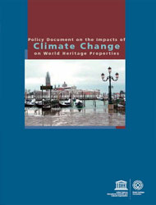
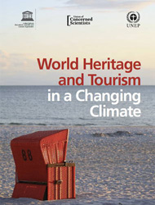
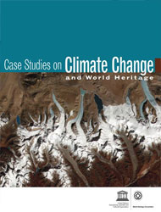
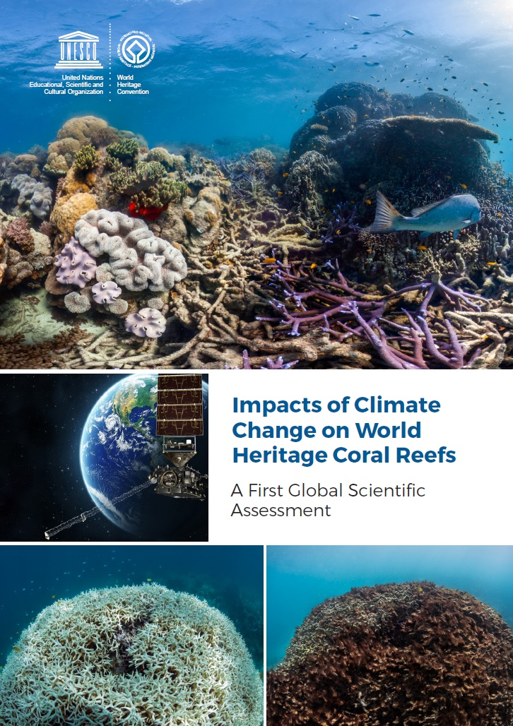
Publications: Climate Change
World Heritage resources for responding to climate change
UNESCO has been at the forefront of exploring and managing the impacts of climate change on World Heritage. In 2006, under the guidance of the World Heritage Committee, it prepared a report on Predicting and Managing the Effects of Climate Change on World Heritage (2007), followed by a compilation of Case Studies on Climate Change and World Heritage, and a Policy Document on the Impacts of Climate Change on World Heritage Properties in 2008. In May 2014, it published a practical guide to Climate Change Adaptation for Natural World Heritage Sites and continues to build the capacity of site managers to deal with climate change.
Website
Where do I find information about Climate
whc.unesco.org/en/climatechange/
Policy Document on the Impacts of Climate Change on World Heritage Properties
Impacts of Climate Change on World Heritage Coral Reefs
Case Studies on Climate Change and World Heritage
World Heritage and Tourism in a Changing Climate

Slide 54


wh-periodicreporting@unesco.org

Slide 55
Module 4
Sustainable Development
Periodic Reporting for the implementation
of the World Heritage Convention
4
Sustainable Development

