Slide 1
#CountOnMe
@GEMReport

Slide 2
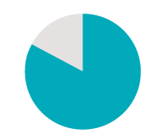
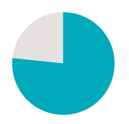
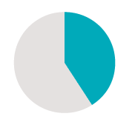
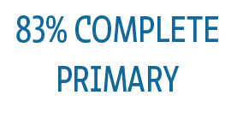
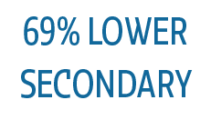
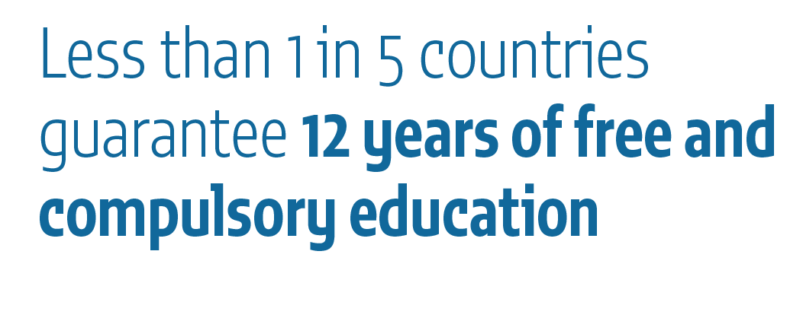
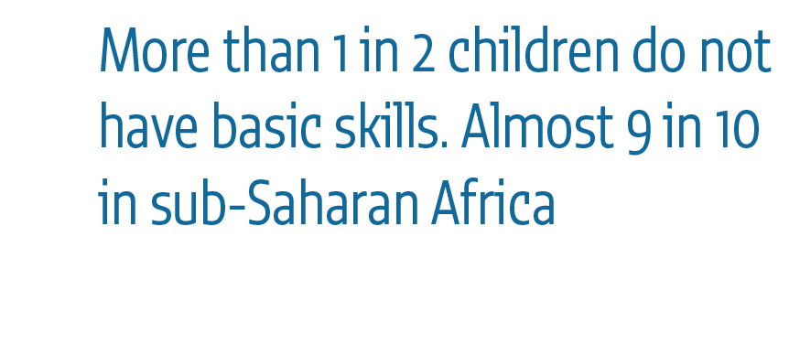
Notes:
1. Target 4.1 is to achieve free quality universal primary and secondary education Yet 264 million children are still not in school today. And being in school does not guarantee graduation anyway.
From 2010-2015 shows that completion rates were 83% for primary, 69% for lower secondary and 45% for upper secondary education.
Figure This figure shows these global averages reflected across countries: Fewer complete lower secondary than primary, and even fewer than that complete upper secondary, which governments agreed should be universal by 2030.
2. The global measure for progress against this target is learning levels in reading and mathematics. There is no globally agreed standard for measuring reading and mathematics proficiency yet, but substantial efforts have been made since 2016 through the Global Alliance to Monitor Learning. Using an interim approach, the UIS have estimated that more than 1 in 2 children of primary school graduation age do not have basic skills. This rises to almost 9 in 10 children in sub-Saharan Africa.
3. Ensuring 12 years of free education of which 9 should be compulsory is another key commitment. Currently less than 1 in 5 countries guarantee 12 years of free and compulsory education.

Slide 3
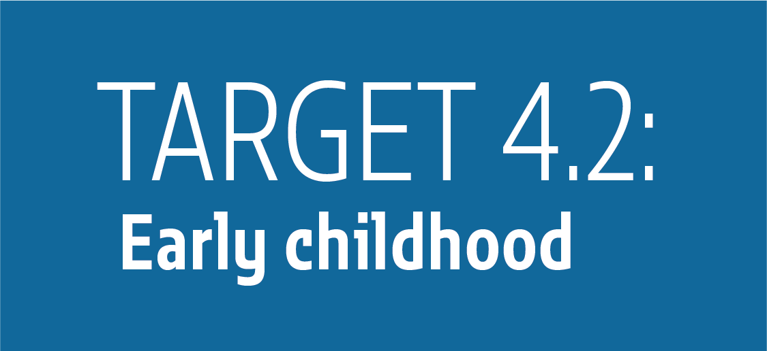
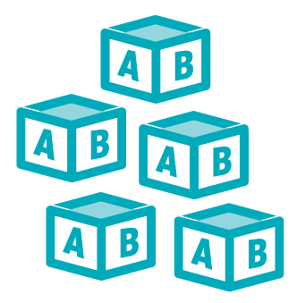
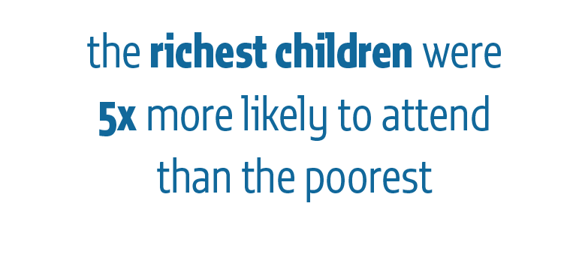
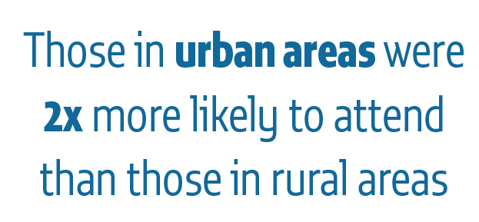
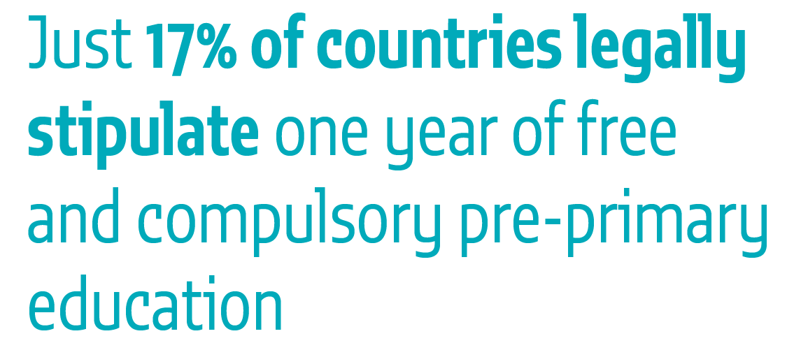
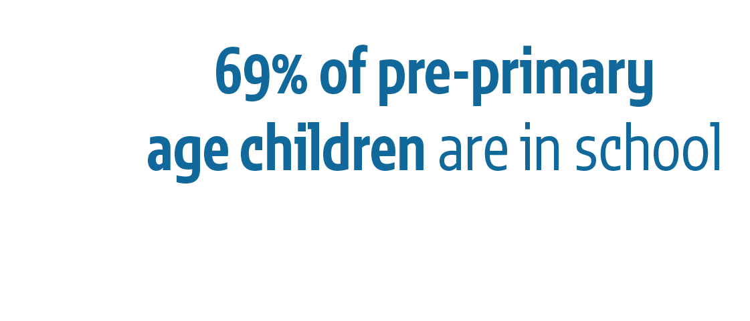
Notes:
Target 4.2 recognizes the importance of the early years of education in providing the foundation for cognitive and emotional development.
1. In 2015, 69% of children were in school or preschool one year before official primary entry age according to the UIS. Regional figures ranged from highs of 95% in Latin America and the Caribbean and in Europe and Northern America to a low of 42% in sub-Saharan Africa.
2. But the disadvantaged are being left behind. In low and middle income countries between 2010 and 2015, the richest 3- to 4-year-old children were 5 times more likely to attend early childhood education than the poorest, and those from urban areas were two times more likely than those from rural areas.
3. The increases in global average enrolment have happened even though just 17% of countries legally stipulate at least one year of free and compulsory early childhood education.
vvvvvvvvvvvvv

Slide 4
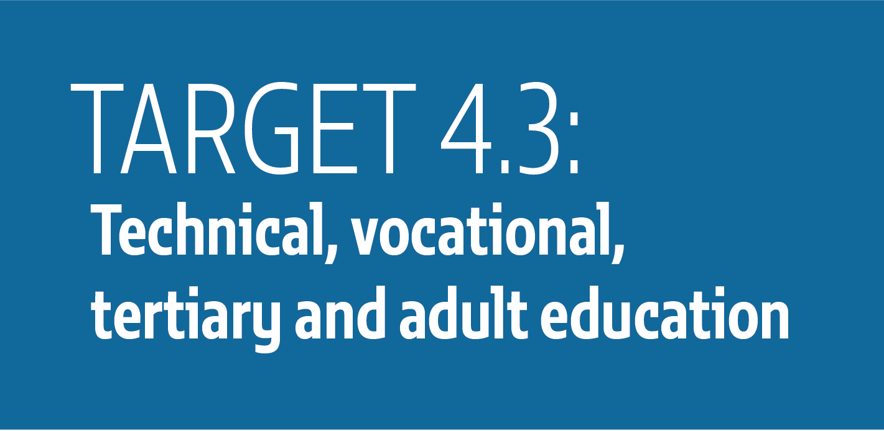
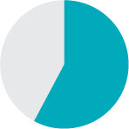
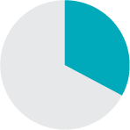
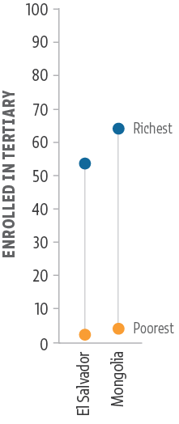
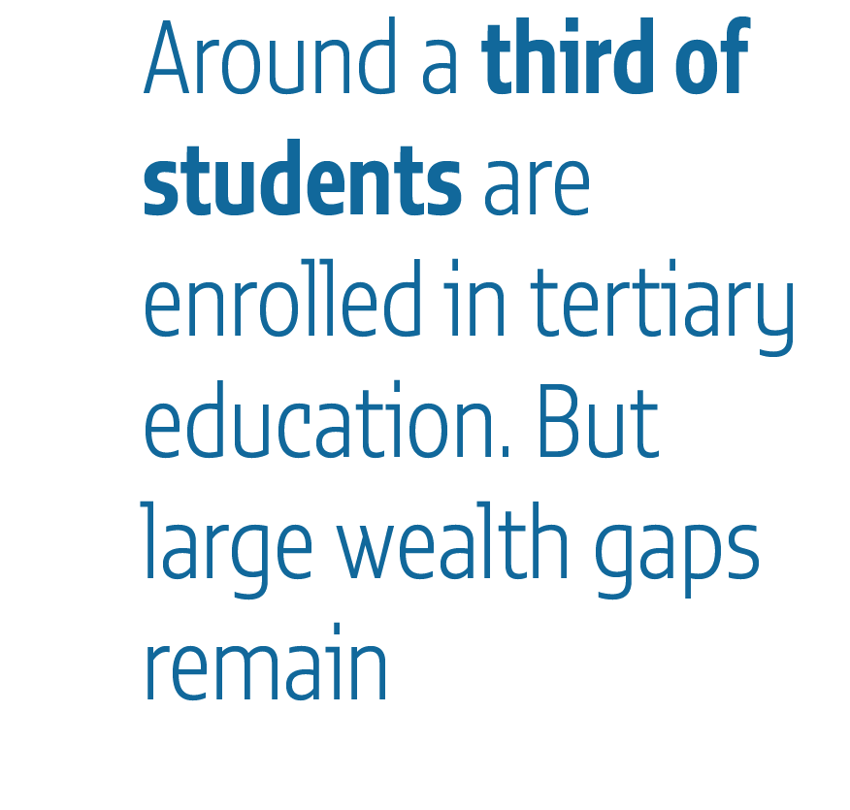
Notes:
Target 4.3 is aimed at achieving equal access to TVET, Tertiary and adult education
1. In 2015, just over a third of students were enrolled in tertiary education.
Figure But, as this figure shows, large wealth gaps in enrollment remain. In El Salvador, for example, 51% of the richest fifth but less than 2% of the poorest fifth attended any form of post-secondary education. In Mongolia, the respective shares were 67% and 3%.
2. And while more women than men graduate from tertiary education, fewer women than men graduate with science, technology, engineering and mathematics degrees. In Chile, Ghana and Switzerland, women account for less than one-quarter of these STEM degrees.
3. Very few adults who have not completed primary education go back to school. In Mozambique, just 20% of adults had completed primary but only 0.5% were enrolled in formal education. However, in some upper middle income countries, such as Brazil and Thailand, adult enrolment is above 4%.

Slide 5
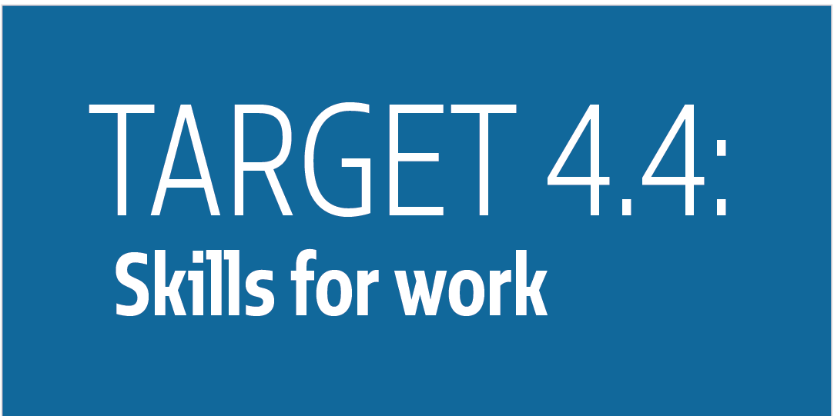
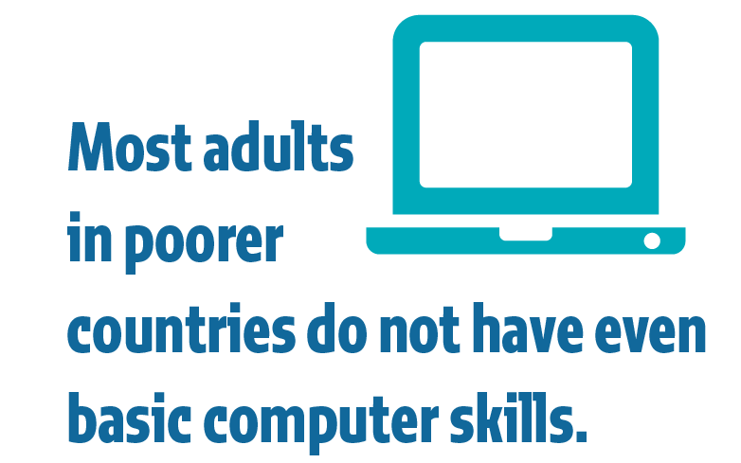
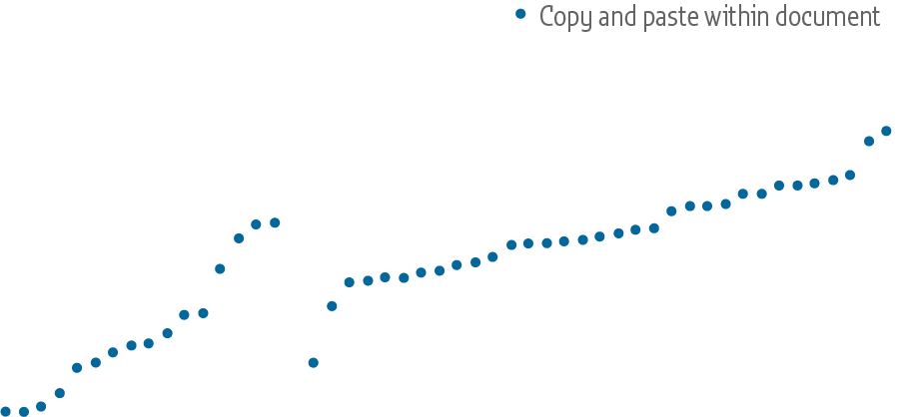
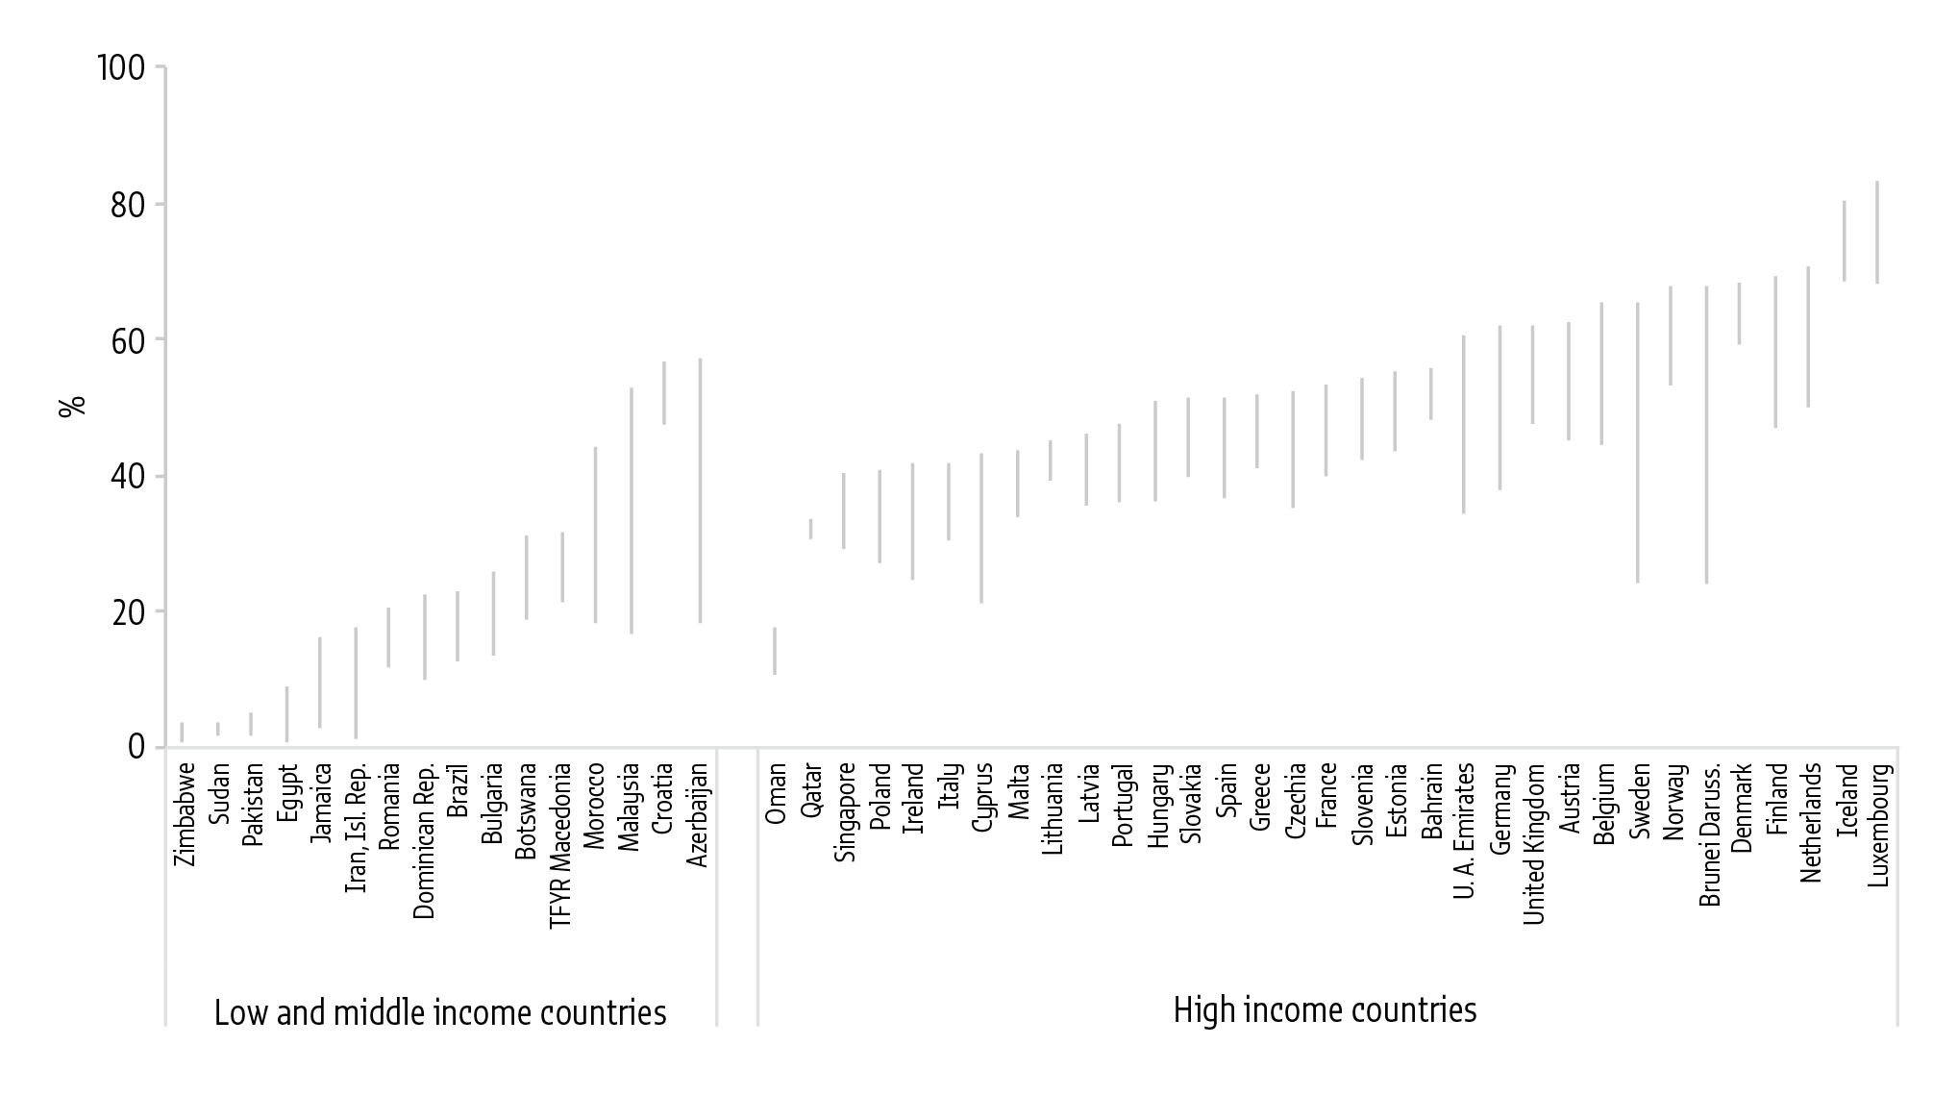
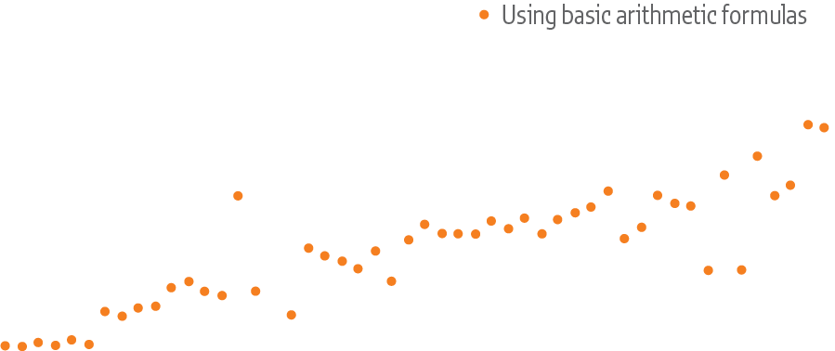
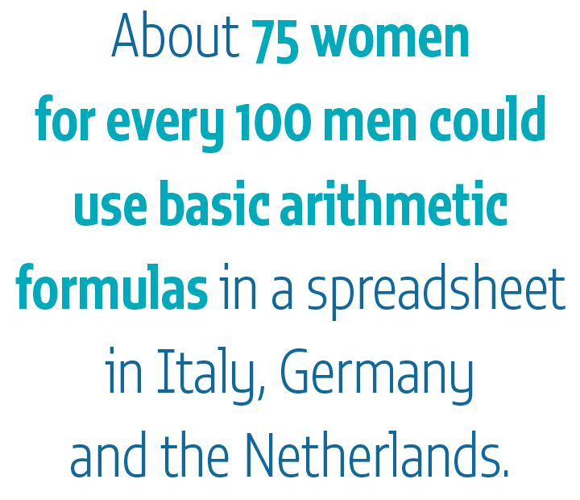
Notes:
This target is aimed at providing skills for decent work.
1. The global indicator on skills for work refers to self-assessed computer skills. Most adults in low and middle income countries do not have even basic computer skills.
FIGURE This figure shows the percentage of computer skills among adults in different countries. On the left are low income countries and on the right are high income. On the left hand side, then, we can see that only 4% of adults in Sudan and Zimbabwe could copy and paste files – the blue dot on this figure – while 2% to 4% in Egypt, Jamaica and Pakistan could use basic arithmetic formulas in a spreadsheet – the orange dot.
Even in high income countries, these skills are often lacking. Less than half of adults in Poland, Ireland and Italy, for example, can copy and past files within a document, according to Eurostat data.
2. Particularly striking is the gender gap, which is wide even in simple ICT skills. About 75 women for every 100 men could use basic arithmetic formulas in a spreadsheet in Italy, Germany and the Netherlands.

Slide 6
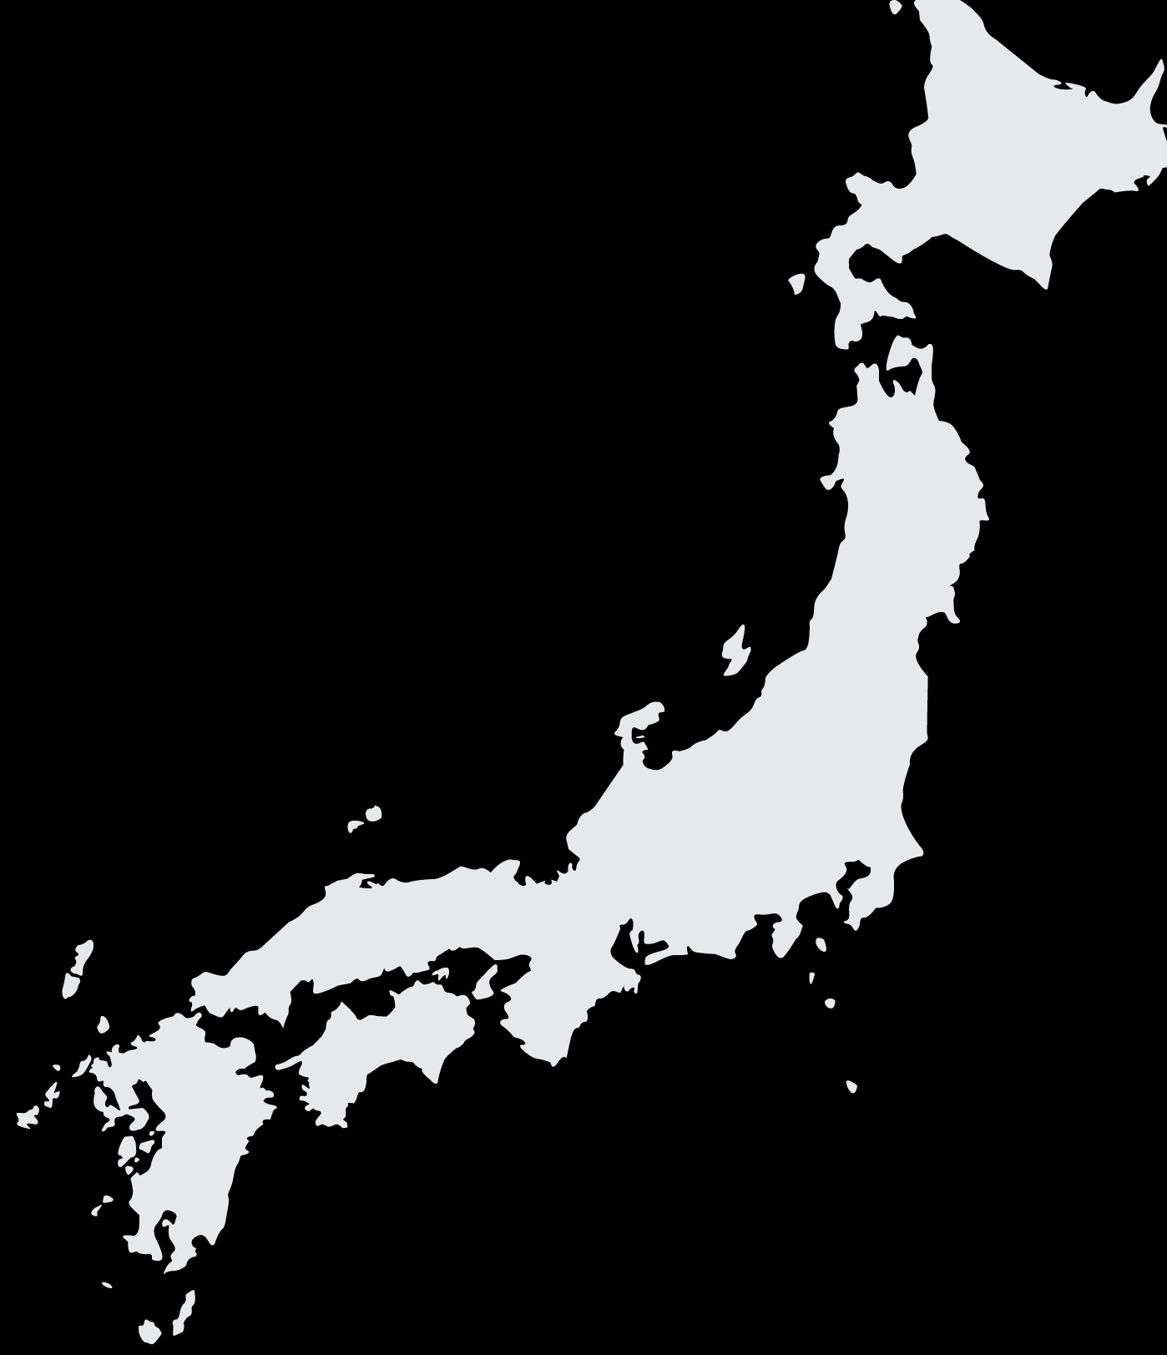
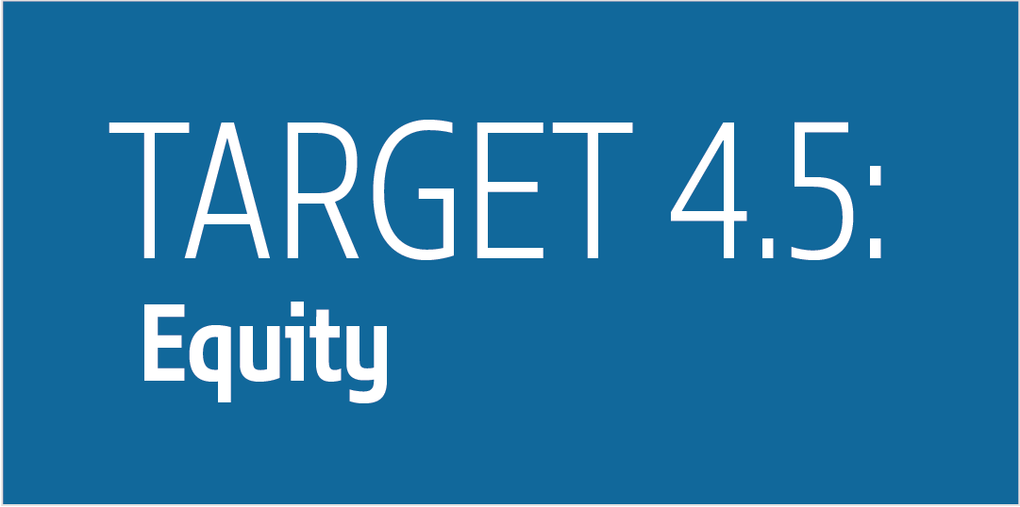
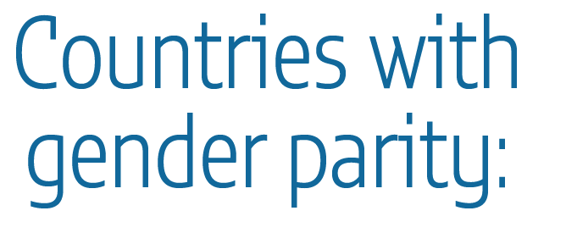
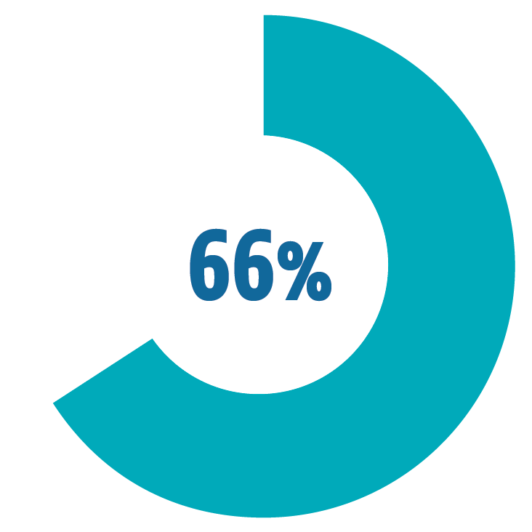
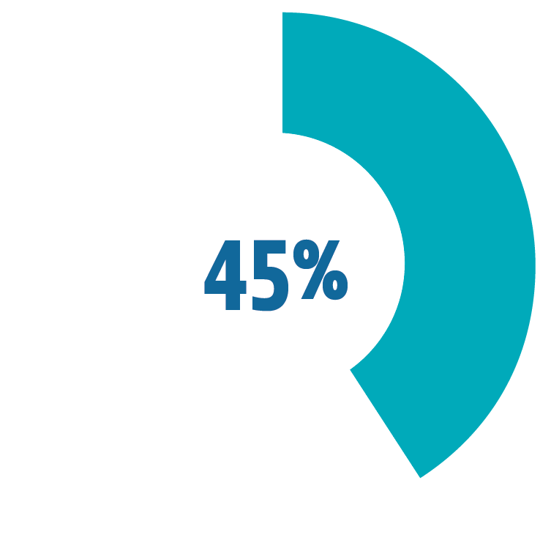
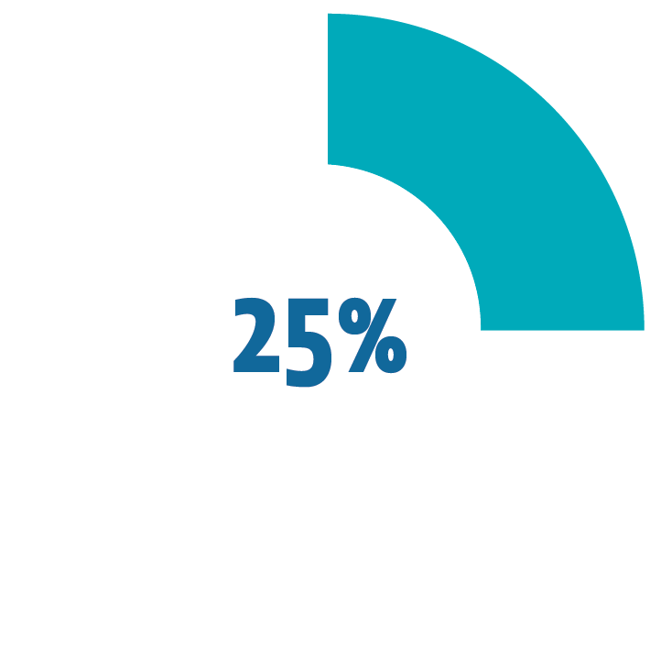
Notes:
The SDG agenda requires a major shift in monitoring and reporting on inequality to ensure no one is left behind. Target 4.5 reflects concerns about equity in education.
1. While there is gender parity in those going to school, global averages mask gaps between countries: only 66% have achieved gender parity in primary education, 45% in lower secondary and 25% in upper secondary.
2. And parity in enrolments is only dimension of gender equality in education. There tend to be more female than male teachers but far fewer women than men become school leaders. In Japan, while 39% of lower secondary teachers were female, only 6% of school leaders were
3. Household surveys allow us to monitor location and wealth gaps in education. For example, we know that, globally, for every 100 adolescents in urban areas who completed lower secondary school, only 75 adolescents did so in rural areas.
Moreover, the report reminds us that inequality in education is underestimated because household surveys do not capture many vulnerable populations, including seasonal workers, homeless people, refugees and populations in conflict zones. It is estimated that around 250 million people worldwide are excluded as a result of survey design, and a further 100 million are under-represented, including slum dwellers.

Slide 7
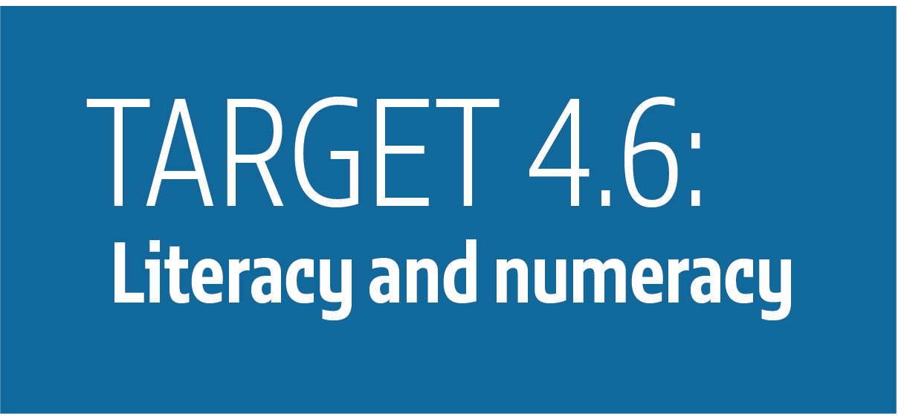
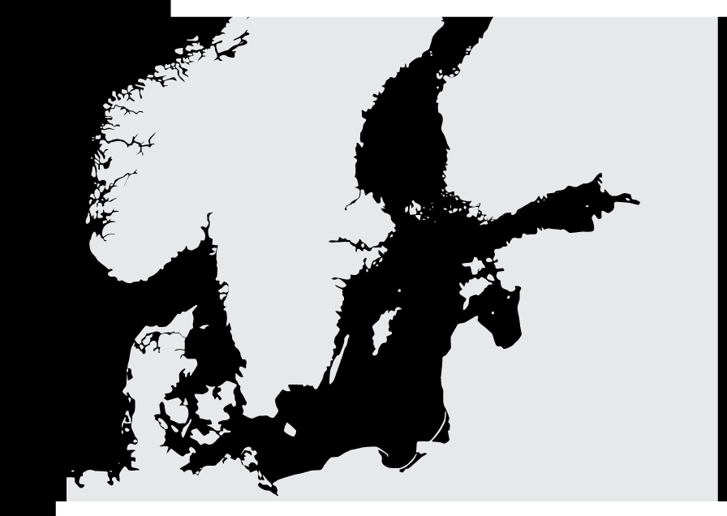
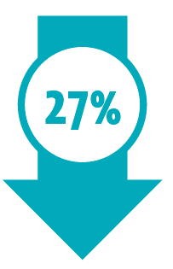
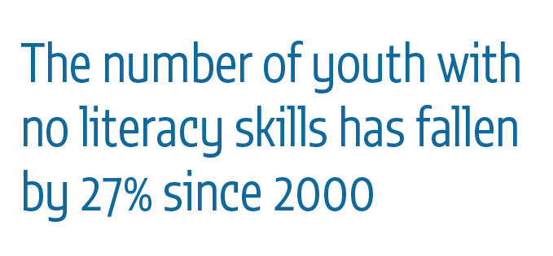
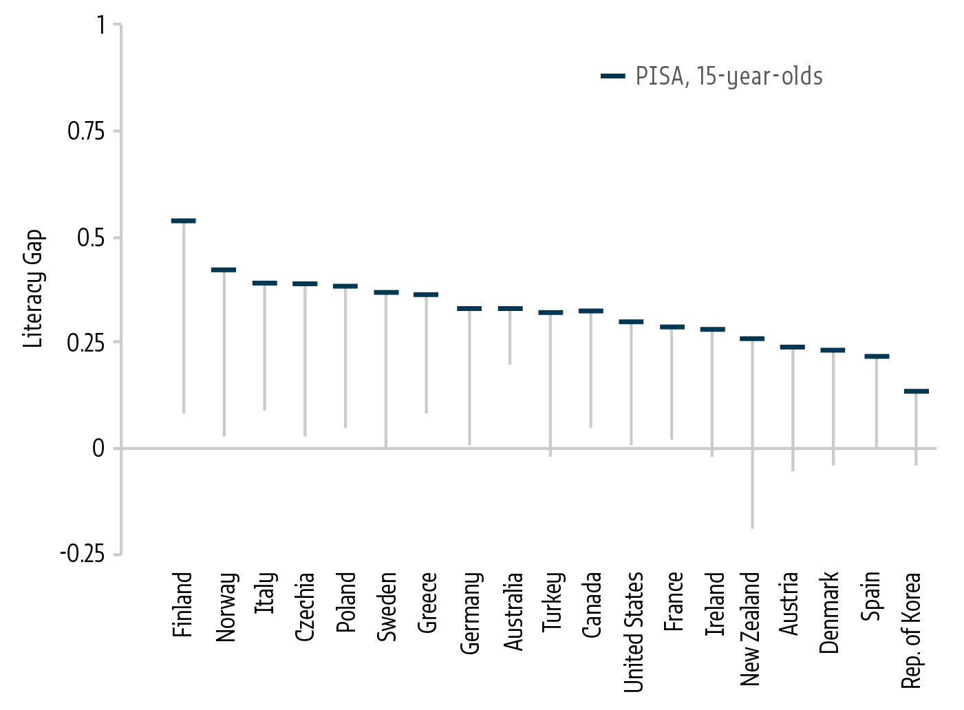
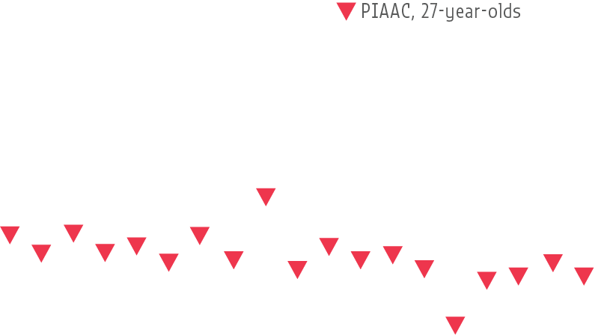
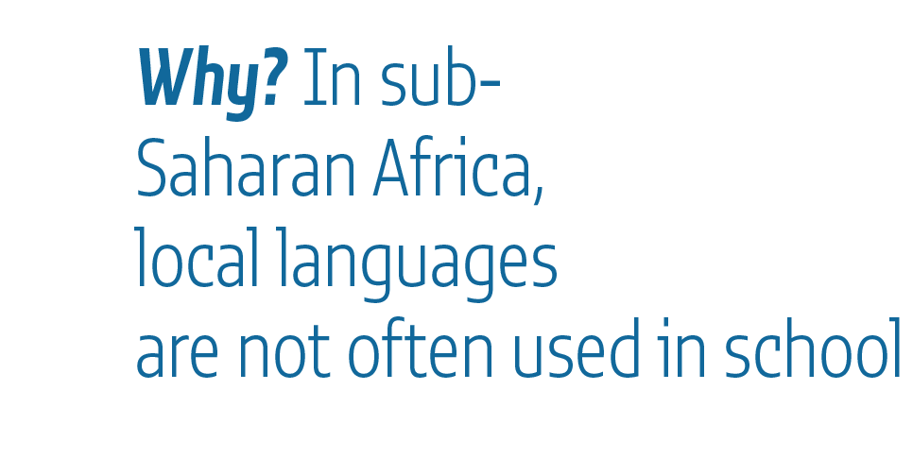
Notes:
Target 4.6 refers to literacy and numeracy skills
1. While the number of adults without literacy skills has barely fallen since 2000, and leaving 750 million still unable to read or write, the number of youths with no literacy skills has fallen by 27%. Yet, still, more than 100 million young people cannot read.
2. Insufficient use of local languages in teaching is one possible reason for low literacy in sub-Saharan Africa. GEM Report analysis shows huge literacy gaps between those that were taught in their local languages, and those that were educated partly or wholly in colonial languages.
3.There is also some evidence that literacy and numeracy levels may be declining in high income countries, including Denmark, Germany, Norway and Sweden. Reduced reading at work, even in high-skill jobs, is a potential reason for this decline.
4. Figure In high income countries, gaps in literacy between men and women almost completely disappear from adolescence, aged 15, to young adulthood, age 27. On the flip side, and not represented here on this slide, the gaps between rich and poor increase over time.

Slide 8
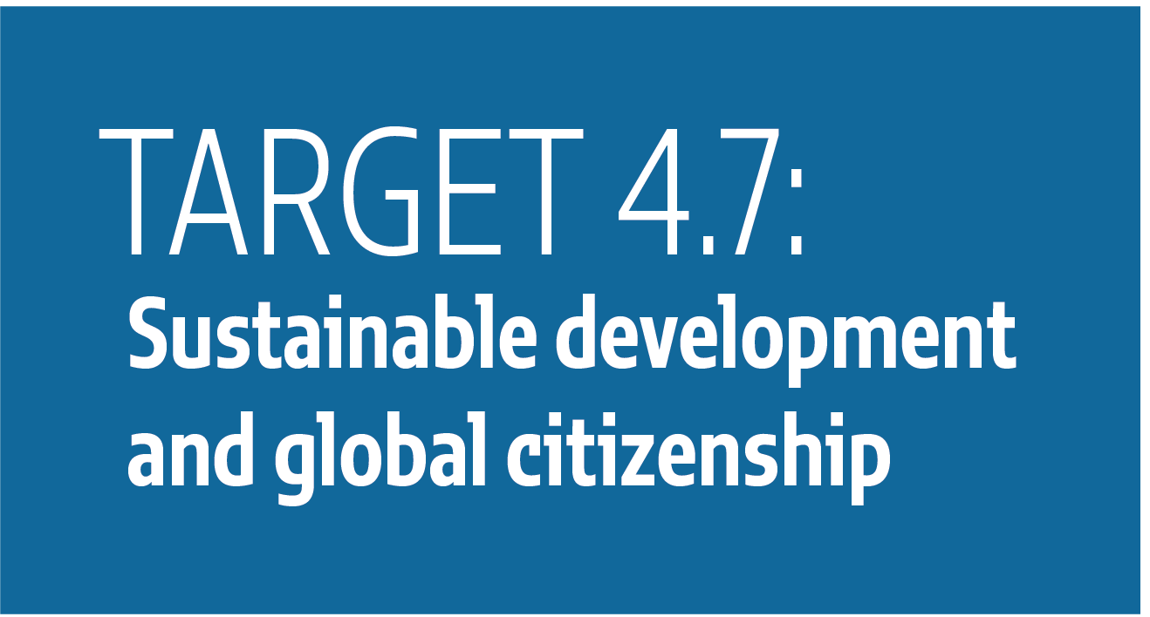
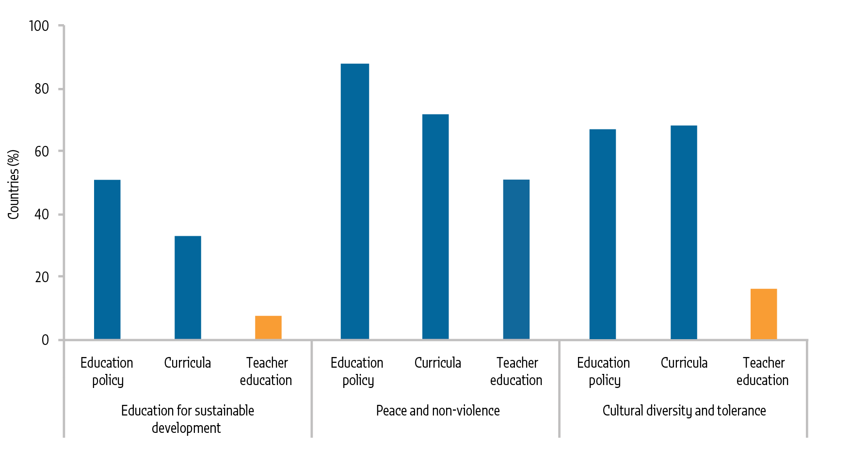
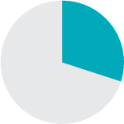
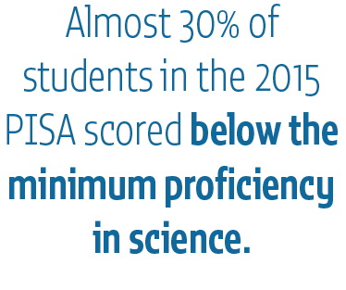
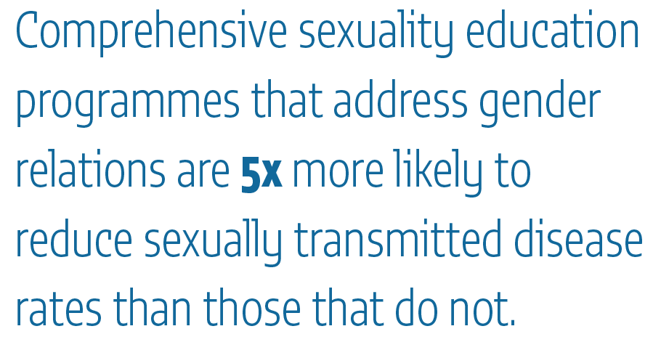
Notes:
Target 4.7 is on education for sustainable development and global citizenship.
1. Progress towards target 4.7 is measured through national reports on the implementation of the 1974 UNESCO Recommendation on Education for International Understanding, Co-operation and Peace and Education relating to Human Rights and Fundamental Freedoms.
Figure Analysis of 57 national reports from the previous reporting cycle showed that only 7% of countries covered education for sustainable development and 16% covered cultural diversity and tolerance in teacher education programmes.
There is still no consensus on what outcomes education for sustainable development and global citizenship education should achieve. Measuring scientific knowledge is one straightforward option. Almost 30% of students in 2015 performed below the minimum proficiency level on the science domains of earth and space systems. In Estonia and Japan, at least 90% of students achieved that level compared to less than 50% in Brazil, the Dominican Republic, Peru, Qatar and Tunisia.
3. A 48-country review found that almost 80% had supportive policies for sexuality education but they were not always implemented. And comprehensive sexuality education programmes addressing gender relations are five times as likely to reduce sexually transmitted disease rates as those that do not.

Slide 9
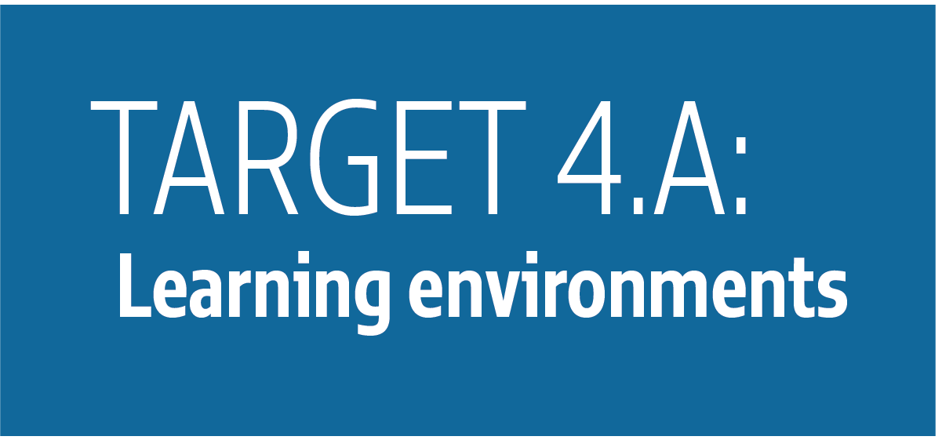
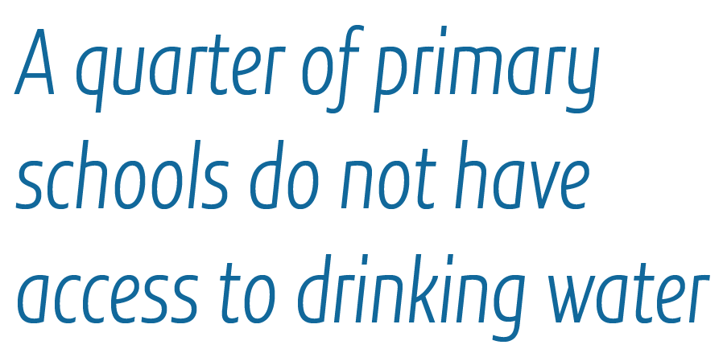
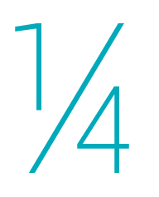
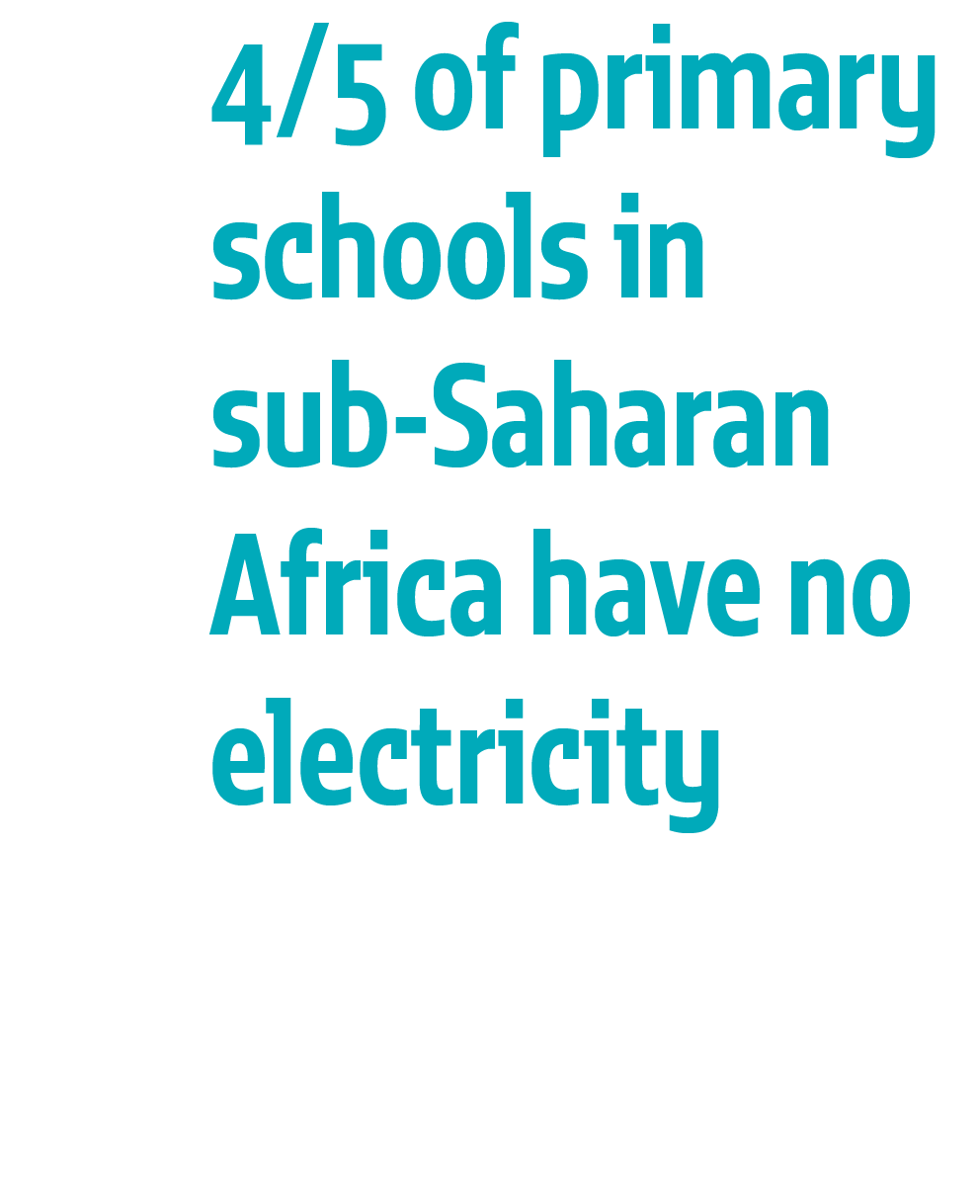
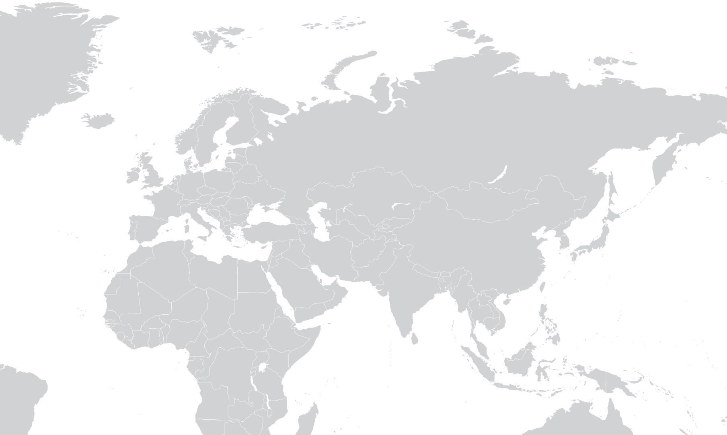
Notes:
Target 4a is based on the principles of a child-friendly school – child-centredness, democratic participation and inclusiveness
1. The global indicator for target 4.a spans several dimensions, making it difficult to give a quick snapshot of a country’s school infrastructure situation. In sub-Saharan Africa, four fifths of primary schools have no electricity.
2. Globally, a quarter of primary schools do not have access to drinking water. Poor infrastructure matters: schools surveys show that infrastructure shortages often hinder learning in countries at all income levels, particularly in disadvantaged schools.
3. Finally, teachers and education institutions have been increasingly targeted by attacks. There has been a sharp uptick in attacks on schools since 2004, disproportionately affecting Southern Asia, Northern Africa and Western Asia. In Nigeria, at least 19,000 teachers were forced to flee between 2009 and 2015. By 2016, the Syrian Arab Republic had lost more than one-quarter of its schools.

Slide 10
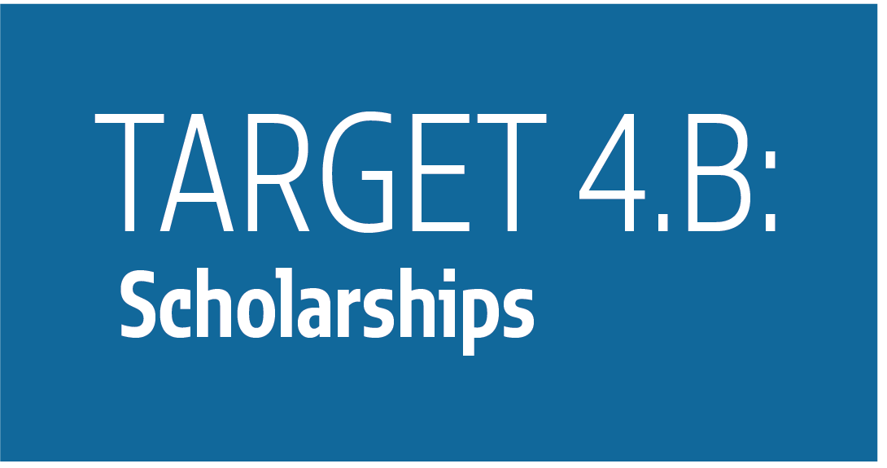
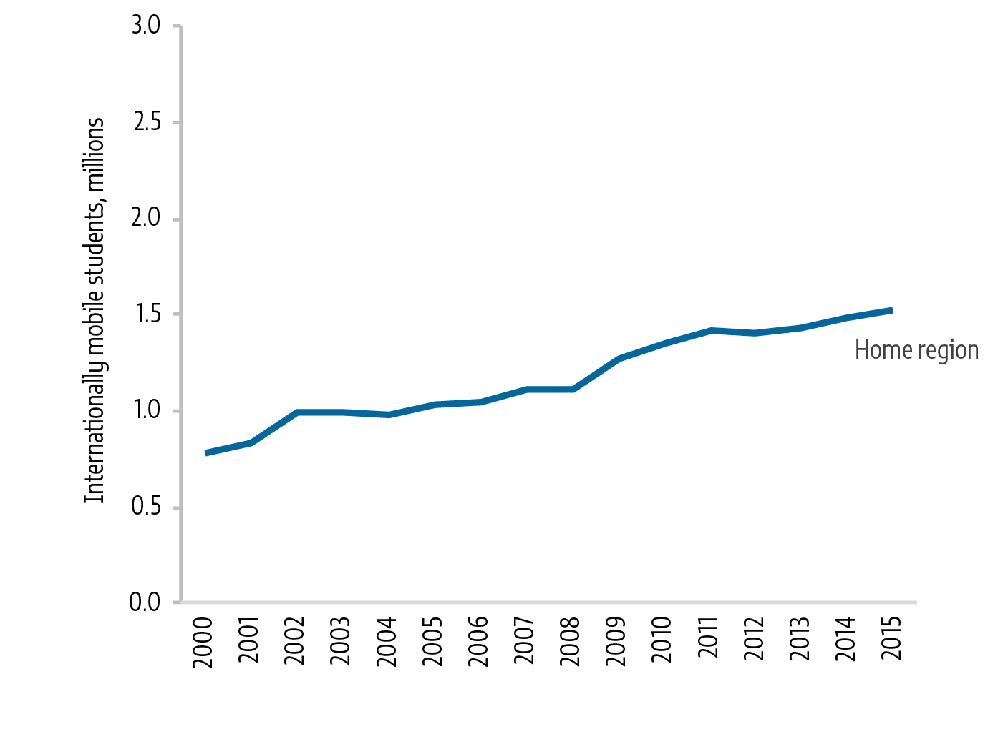
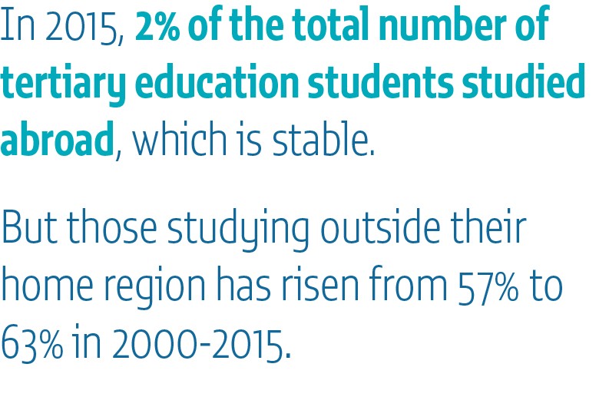
Notes:
1. Target 4.b explicitly calls for the number of tertiary education scholarships to increase. Currently, there is only data on total official development assistance for scholarships, which provides only partial information as only some donor countries include scholarships in their aid budgets. In total, aid spending on scholarships decreased by 4% from 2010 to 2015, on a par with the overall decrease in aid to education.
2. We have figures for how much students receive for scholarships but these are an underestimate as almost 40% of scholarships funded from aid cannot be assigned to students from a given country.
3. In 2015, 4.6 million tertiary education students, 2% of the total, studied abroad.
Figure While this rate has remained constant, the percentage of those studying outside their home region increased from 57% in 2000 to 63% in 2015. Students from sub-Saharan Africa and Southern Asia are most likely to leave their region of origin.

Slide 11
Notes:
Target 4c is to increase the supply of qualified teachers
1. Globally, 86% of primary school teachers are trained, but the proportion is lower in Southern Asia (77%), the Caribbean (70%) and sub-Saharan Africa (62%). Even so, major difficulties remain in comparing definitions of what makes a trained teacher across countries. There are undocumented differences in minimum requirements to qualify as a trained teacher, including admission criteria, course duration, induction period, or curriculum content, among many factors.
2. Figure Strikingly, while there has been a positive trend in trained teachers in many sub-Saharan African countries, in others, including Eritrea, Ghana and Niger, the percentage has decreased since 2000.
3. Information on teacher salaries – one of the thematic indicators for this target – is scarce. Where such data emerge, gaps are revealed. In OECD countries, primary school teachers earn 81% of what other full-time working professionals with tertiary education earn.

Slide 12
Notes:
Education is key to achieving the Sustainable Development Goals (SDGs). Yet it is reflected in only five global indicators besides SDG 4 suggesting that its importance for meeting the SDG goals may not be sufficiently recognized.
1. For instance, a global shortage of 17.4 million healthcare workers was estimated in 2013. Yet, only 2% of healthcare expenditure went to their education.
2. Education is critical not only for fighting communicable but also non-communicable diseases. Tobacco is a leading cause of preventable deaths worldwide. Those with no formal education are more than 6 times as likely to smoke as those with at least secondary education in poorer countries.
3. Informal education can also affect smoking habits. Hard hitting health warnings are among the most effective deterrent, which perhaps explains why the number of countries running mass media anti-tobacco campaigns rose from 23 to 39 from 2009 to 2014.

Slide 13
Notes:
1. Finally, coming to finance, a key means for implementation, which is recognized n the Framework for Action, one in four countries did not reach either education funding benchmark of spending at least 4% of GDP and 15% of public expenditure on education.
2. Meanwhile, aid to education was 4% below 2010 levels. And its share of total aid went down for a sixth year in a row to less than 7%.
3. New UIS estimates show the extent to which education spending is being borne by households. Those in high income countries cover 18% of education expenditure, compared to 33% for those in low income countries. In Cambodia – the furthest on the right in this figure – households were carrying 69% of total education expenditure.

Slide 14
@GEMReport
#CountOnMe
Bit.ly/GEM2017
Notes:
Year after year, our GEM Report documents the most pressing education challenges for achieving our global education goal.
As these challenges are exposed, governments often look to accountability as a possible way forward. This is one of the reasons the GEM report looked at accountability in education as a way of meeting our commitments to SDG 4.
I will now present the findings from that research, starting with an animation showing how accountability in education currently works around the world.

