Slide 1
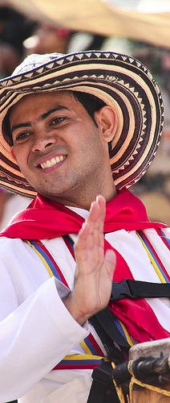
Welcome to the Ori of Blika
Unit 46 Ori PowerPoint presentation
UNESCO
Intangible Cultural Heritage Section
Barranquilla Carnival (c) 2011 Matt Wootton
Notes:
"Barranquilla Carnival" [https://www.flickr.com/photos/mattwootton/5530270690/] by Matt Wootton [https://www.flickr.com/photos/mattwootton/] is licensed under CC BY-NC-SA 2.0 [https://creativecommons.org/licenses/by-nc-sa/2.0/]

Slide 2
The Ori, a new minority in Blika
1960/1970s - 80.000 Ori arrive in Blika
Ori - 1 out of 5 officially recognized new minorities
Approximately 200,000 Ori in Blika (no statistics)
4 old minorities – together approximately 100,000 people
80% Blika majority speak Blikanese
Many young people identify themselves as Ori and Blika without feeling half Ori
Notes:
Shawn Harquail
https://www.flickr.com/photos/harquail/18050590713/

Slide 3
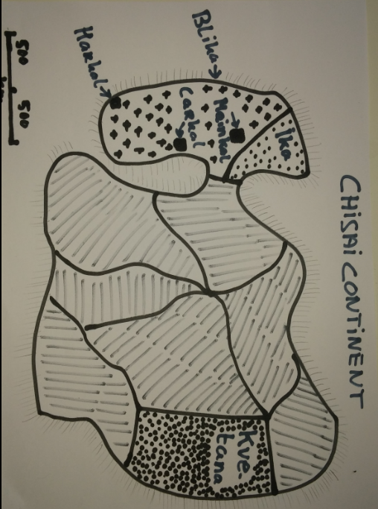
Map of the Chisai continent

Slide 4
Integration, assimilation, intolerance, indifference
Ori men work in factories; women in nurseries
Integration centres and assimilation classes in schools ensured quick integration
1980/2000: economy in depression - assimilationist policies and majority population rather hostile towards immigrants
Today attitude turning into indifference
Few contacts among minorities
Notes:
Shawn Harquail
https://www.flickr.com/photos/harquail/18050590713/

Slide 5
In between
Immigrants can receive Blika citizenship after ten years – have to adopt the Blika naming system practice
Ori unhappy they cannot use their own name giving system, their ‘real’ names
Ori created coffee houses (mainly for men) and tea gardens for traditional weddings
Ori continue speaking Ori among them, having their tattoos, and prefer marrying among them.
Ori remember well the ‘years of intolerance’, which for many are not really over.
Notes:
Shawn Harquail
https://www.flickr.com/photos/harquail/18050590713/

Slide 6
Since 2000: Policies, public opinion, profile
    Beginning of economic revival
    Policies becoming more tolerant, though not the regulations
    Blika public opinion still between indifferent and intolerant
    Ori live mainly in 3 major towns
    Ori are well integrated
    Ori keep low profile in public space
    They maintain contacts with Ika and Kvetana
Notes:
Shawn Harquail
https://www.flickr.com/photos/harquail/18050590713/

Slide 7
Blika policies towards immigrants
1960s-1970s: Ori immigration into Blika from Kvetana
1970s: Social integration centres created in Blika
1960-2005: Government in Blika generally adopts assimilationist public policies
1985-2000: less tolerance by government and Blika majority towards minorities
2005: Government policies more favourable to minorities in Blika

Slide 8
Ori organize themselves
About 12 cultural clubs/associations/NGOs
Many archery clubs for men and women
Many top ball clubs, but only 2 adapted fields
10 to 15 % non-Ori members in archery and top ball clubs
Bilingual Ori Cultural Portal, informs about Blika events and culture; other Ori websites and blogs
Ori Language Support organizes Ori courses in all major towns – attended by young Ori (literacy courses) and non-Ori partners of Ori
Notes:
Shawn Harquail
https://www.flickr.com/photos/harquail/18050590713/

Slide 9
Ori in Blika, Ika and Kvetana
Contacts among Ori in Blika and Ika
Change of regime in Kvetana but hardly any Ori returned, some visit relatives in Kvetana
Kvetana ratified the Convention in 2005: only 11 Ori elements out of 200 on the country inventory (Ori 20% of total population)
From vibrant to declining: Top ball; rope-walking; wedding dance/music; Ori language; improvised poetry; tattooing; archery; story-telling; cock fighting; lace making; falconry; traditional healing
Notes:
Shawn Harquail
https://www.flickr.com/photos/harquail/18050590713/

Slide 10
Blika ratifies in 2013
Ministry and UNESCO: several capacity-building workshops
Authorities identify 10 communities to start implementation at the national level
Five landed immigrant groups (incl. Ori), 4 old minorities; 80% Blika majority
Ministry created Blika ICH Council: 24 members, all experts; 12 from the minorities
Ori SafeCom: safeguarding committee
Blika ICH Council manages preliminary inventory of ICH in Blika
Notes:
Shawn Harquail
https://www.flickr.com/photos/harquail/18050590713/

Slide 11
Blika implements the Convention
2013: Blika ratifies the Convention
2014: Training workshops about the Convention and its implementation
Late 2014: Blika ICH Council created to oversee and guide the implementation of the Convention
Community Safeguarding Committees (SafeComs) created to identify important ICH and plan safeguarding initiatives

Slide 12
Soon a 2-day meeting of Ori SafeCom
SafeComs were asked to:
draft lists of ICH
prepare safeguarding plan for endangered ICH
propose 2 to 4 ICH elements of Ori ICH for the preliminary inventory
Ori SafeCom drew up list of 11 elements of Ori ICH
Organizes two-day meeting: 6 Ori SafeCom members with 6 other (Ori) experts deal with points (b) and – time allowing – (c)
Notes:
Shawn Harquail
https://www.flickr.com/photos/harquail/18050590713/

Slide 13
Meet your neighbours 1
President Ori Women’s Association
History and geography teacher
Tea garden owner
Electric equipment shop owner
Head baker
Bookseller and writer
Webmaster Ori Culture Portal

Slide 14
Meet your neighbours 2
Sociologist
General Practitioner
Journalist
Heritage official Ministry of Culture
Member of Blika NATCOM for UNESCO
External consultant

Slide 15
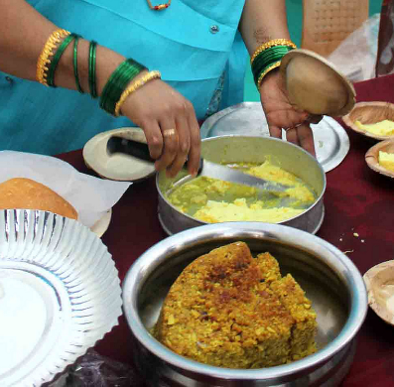
President of Ori Women’s Association
Born around 1975
Human rights lawyer
Published two books on Ori foodways
Wants Ori name-giving tradition recognized
Believes Ori wedding celebrations are important for Ori identity
Notes:
"Goan Sweet Dishes“ [https://www.flickr.com/photos/52243088@N00/11865301045/] by Joel's Goa Pics [https://www.flickr.com/photos/52243088@N00/] is licensed under CC BY-SA 2.0 [https://creativecommons.org/licenses/by-sa/2.0/]

Slide 16
History and geography teacher
Young Ori
Recorded songs, memories and life stories of first generation Ori in Blika
Recorded Ori fairy tales, but these are not allowed to be public
Social member of Archery association
Parents traumatized by the treatment of minorities in Blika

Slide 17
Harkal Tea garden Owner
50 years old, owns Harkal tea garden
Organizes Ori weddings
Good traditional and non-traditional singer
Central figure in haf (mutual assistance) arrangements
Wants more public broadcasts of Ori music and dance
Wants more public respect for Ori ICH

Slide 18
Electric equipment shop owner
40 years old, Ori, citizen of Carkal
Good storyteller and writer in Ori language
Shop sells electrical equipment and Ori bows and arrows
Shop was attacked in 2004 after publication of bilingual Ori/Blika announcements
Wants to promote language-related human rights in Blika through the Convention

Slide 19
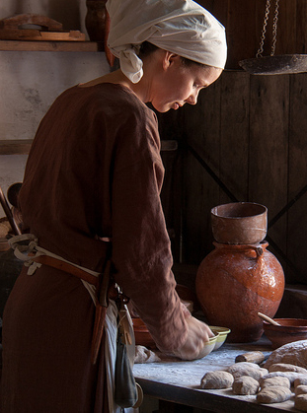
Head baker
24 years old, lives in Harkal
Ori father and Blika mother
Head of a bakery department in a supermarket
Sells own Ori-Ori-Rap on internet
Active member of the Ori Youth Association
Performs as a DJ
Notes:
"at the bakery" [https://www.flickr.com/photos/archeon/7300054632/] by Hans Splinter [https://www.flickr.com/photos/archeon/] is licensed under CC BY-ND 2.0 [https://creativecommons.org/licenses/by-nd/2.0/]

Slide 20
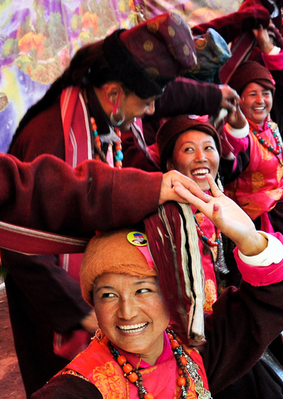
Bookseller and writer
Arrived in Blika aged 7
Owns a bookshop in Mainkal and writes Ori novels
Frequent visitor to Ori coffee houses and tea gardens
Wants to revitalize the Ori chain dance and train more singers and musicians
Notes:
"Traditional ladakhi dance“ [https://www.flickr.com/photos/praveenpn4u/4848749312/] by Praveen [https://www.flickr.com/photos/praveenpn4u/] is licensed under CC BY 2.0 [https://creativecommons.org/licenses/by/2.0/]

Slide 21
Webmaster Ori Culture Portal
22 years old
Both Ori and Blika heritage
Learned Ori lacemaking and archery
BA in General History of the Chisai Continent at Harkal University
Coordinates bilingual Ori Culture Portal
Encouraging ‘old minority’ students to set up their own portals

Slide 22
Sociologist
28 years old, of Kvetana origin
As child assimilated into Ori group in Blika
Studied the role of culture in the history of immigration in Blika
Plays traditional Ori musical instruments
Wants non-formal education to promote transmission of Ori dancing, singing, poetry and lace making

Slide 23
General Practitioner
Born in 1975 in Carkal and works in a small town
Founding member of the Ori Students Association
Documents Ori traditional medicine practices
Publishes on Ori Culture Portal
Wants better treatment and equal rights for minorities

Slide 24
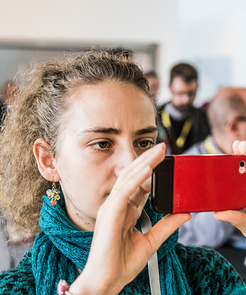
Journalist
Age 40, lives in Mainkal with Blika partner; families speaks Blika and Ori
Editor of the cultural pages in Mainkal Herald, covering Blika culture
Interviews Ori performers for the bilingual Ori Blika Monthly
Publishes Ori oral poetry
Wants better appreciation of ICH, improved training facilities and remuneration for traditional artists
Notes:
"Welcome and lunch for journalists: 'EU Regional Policy and Challenges Ahead' [https://www.flickr.com/photos/opendays/21924609369/] by OPEN DAYS [https://www.flickr.com/photos/opendays/] is licensed under CC BY-NC 2.0 [https://creativecommons.org/licenses/by-nc/2.0/]

Slide 25
Heritage official Ministry of Culture
Ori aged 38 years
Lives with Mora (Traveller minority) partner in Mainkal
Ori archer and lead dancer; plays Mora indoor games
MA in heritage studies at Harkal University on heritage of Old Minorities
Would like the various minorities in Blika to be more interested in each other’s ICH
Believes Ori wedding parties are important for Ori identity and transmission of ICH

Slide 26
Member of Blika NATCOM for UNESCO
Blika, 40 years old, lives in Harkal
Ori partner died at 35
Speaks some Ori, collects Ori proverbs and practises Ori archery
Lobbied in Blika for the adoption of the 2003 and 2005 Conventions
Would like museums to pay attention to minorities
Wants better relations between all Blika citizens

Slide 27
External consultant
Blika national
Facilitated some of the capacity-building workshops in Blika
Has many Ori friends
In front of you

Slide 28
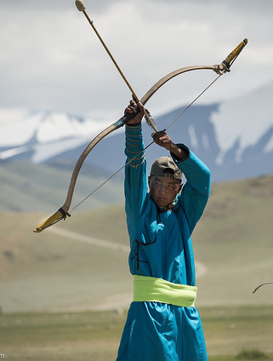
Ori ICH in Blika
Traditional Ori wedding
Top ball game
Haf – mutual assistance
Ori name-giving
Ori new year and cooking
Ori fortune-telling and traditional healing
Ori midwifery
Ori improvised poetry
Ori traditional dancing
Ori traditional music and singing
Ori archery
Notes:
"Naadam Archer" [https://www.flickr.com/photos/david_baxendale/15318330855/] by www.davidbaxendale.com [https://www.flickr.com/photos/david_baxendale/] is licensed under CC BY-ND 2.0 [https://creativecommons.org/licenses/by-nd/2.0/]

Slide 29
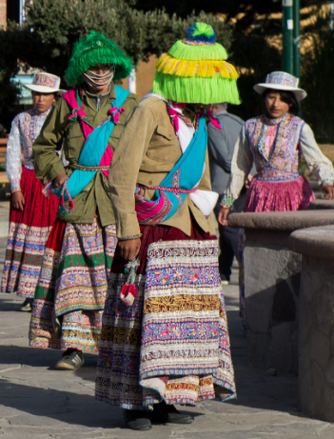
Traditional Ori wedding
The ‘backbone’ of Ori ICH in Blika
Weekend events in Ori tea gardens or restaurants
Many guests, long tables
Singing, speeches, games, dances (circle dances; rarely chain dancing), gifts, jokes
Not enough large venues
Non-Ori venues do not like the noise and uncountable cars parking
Not enough musicians and singers
Too expensive for many young Ori
Notes:
"Peruvian Wititi Traditional Love Dance" [https://www.flickr.com/photos/harquail/18050590713/] by Shawn Harquail [https://www.flickr.com/photos/harquail/] is licensed under CC BY-NC 2.0 [https://creativecommons.org/licenses/by-nc/2.0/]

Slide 30
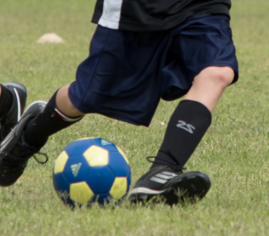
Top ball game
Played on a field laid out in a circle
Teams of 9 men or women
Over 20 top ball clubs but only two special fields in Blika
Competitions since the 1990s; students organize Blika-Ika championship
Ori fruit drinks and fatty snacks served at games
10% non-Ori members
Notes:
"Soccer-2014-04-19-20" [https://www.flickr.com/photos/104251811@N02/13932102672/] by Joel Agee [https://www.flickr.com/photos/104251811@N02/] is licensed under CC BY-NC-ND 2.0 [https://creativecommons.org/licenses/by-nc-nd/2.0/]

Slide 31
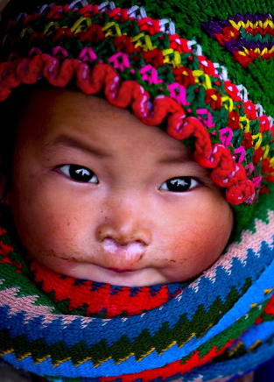
Ori name giving
Ori infants given names during a ceremony three months after birth
Ori first names linked to seasons or circumstances
Surname of all children in an Ori family follows the gender of the parent of the first born
On obtaining Blika citizenship, one has to adapt surname; first name for newborn to be to selected from a list Blika names
Blika citizens must take their father’s surname
Notes:
"H'Mong babygirl - mũ mèo nhỏ" [https://www.flickr.com/photos/linhngan/3048514778/] by Bùi Linh Ngân [https://www.flickr.com/photos/linhngan/] is licensed under CC BY 2.0 [https://creativecommons.org/licenses/by/2.0/]

Slide 32
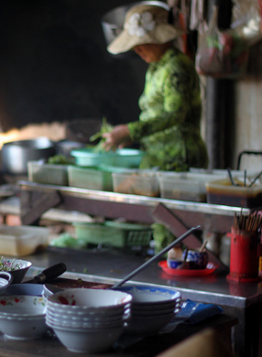
Ori new year and cooking
Ori dishes: roast mutton, sugar duck, dumplings, sour cabbage salad and pies, pancakes and cookies
New year celebrations:
      8pm: Ori new year (midnight in Kvetana)
      Traditional dancing, singing
      Renewal of haf relations
      12pm: Blika new year with lots of fireworks and dancing
Notes:
"Local Market" [https://www.flickr.com/photos/beth19/7201956148/] by Βethan Phillips [https://www.flickr.com/photos/beth19/] is licensed under CC BY-NC-ND 2.0 [https://creativecommons.org/licenses/by-nc-nd/2.0/]

Slide 33
Haf – mutual assistance
Mutual assistance between friends and relatives (services, loans, adoption, repairs)
Agreements usually concluded in the presence of a haf witness
Not all haf agreements are legal under Blika law
Notes:
https://www.flickr.com/photos/95213174@N08/12933932545/

Slide 34
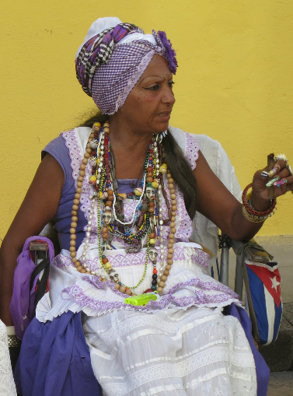
Ori fortune-telling and traditional healing
Practiced by women
Fortune tellers read tea leaves and palms
Healers use laying on of hands and singing
For problems like headache, backache, allergies, sleeplessness and grief after separation
Blika tax authorities are interested in undeclared income
In Kvetana traditional healing is forbidden by law as being non-scientific
Notes:
"Fortune Teller, Old Havana, Cuba, 2012" [https://www.flickr.com/photos/travfotos/8390517222/] by Terry Feuerborn [https://www.flickr.com/photos/travfotos/] is licensed under CC BY-NC 2.0 [https://creativecommons.org/licenses/by-nc/2.0/]

Slide 35
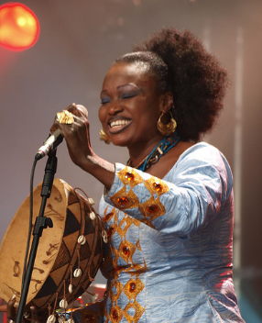
Ori improvised poetry
Common in Kvetana and Blika
No restrictions
In Blika only 7-8 male and female semi-professional poets – not enough for weddings and other functions
Practiced by amateurs – for fun
Contests and festivals
Thought to be endangered
Notes:
"The Cambridge Folk Festival 2009" [https://www.flickr.com/photos/sjr-images/3801999278/] by Sean Rowe [https://www.flickr.com/photos/sjr-images/] is licensed under CC BY-NC-ND 2.0 [https://creativecommons.org/licenses/by-nc-nd/2.0/]

Slide 36
Ori midwifery
Two thirds of Ori mothers give birth at home
Assisted by trained Ori midwives
Post-birth ceremonies at home
No increased health risks for Ori home births; fewer mental health problems among Ori mothers after birth
Public health authorities in Blika want to reduce home births
Notes:
https://www.flickr.com/photos/dfid/5567859369/

Slide 37

Ori traditional dancing (in Blika)
Circle and chain dance
Danced at weddings and other social events
Diversity of the Ori circle dance diminishing
Chain dance is rarely danced anymore
Official permission is still required – and not easily given – for dancing in public spaces
Notes:
"Traditional ladakhi dance“ [https://www.flickr.com/photos/praveenpn4u/4848749312/] by Praveen [https://www.flickr.com/photos/praveenpn4u/] is licensed under CC BY 2.0 [https://creativecommons.org/licenses/by/2.0/]

Slide 38
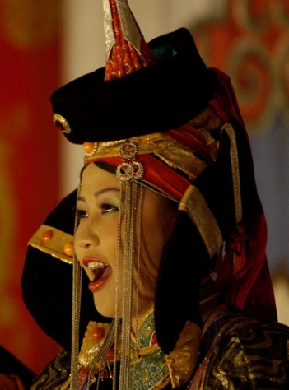
Ori traditional music and singing
Ori accordion, the Utur flute and the Ori wooden clappers used in Blika
Instruments bought in Kvetana
Traditional lullabies, choral wedding songs and polyphonic naming ceremony songs
Decline in improvisation
Not enough (semi-) professional musicians and singers available for hire or training
Notes:
"traditional singing" [https://www.flickr.com/photos/jerrold/238390149/] by Jerrold Bennett [https://www.flickr.com/photos/jerrold/] is licensed under CC BY-NC-ND 2.0 [https://creativecommons.org/licenses/by-nc-nd/2.0/]

Slide 39

Ori Archery
Common pastime for men in Kvetana
Blika has no indigenous archery tradition
Ori archery clubs also accept non-Ori
Practiced in wooden structures attached to Ori coffee houses, not outdoors
Women train with men
Some structures dilapidated; may get closed by municipality
Notes:
"Naadam Archer" [https://www.flickr.com/photos/david_baxendale/15318330855/] by www.davidbaxendale.com [https://www.flickr.com/photos/david_baxendale/] is licensed under CC BY-ND 2.0 [https://creativecommons.org/licenses/by-nd/2.0/]

