Slide 1
X
ASPnet National Coordinator Briefing
National Focus Group Consultations

Slide 2
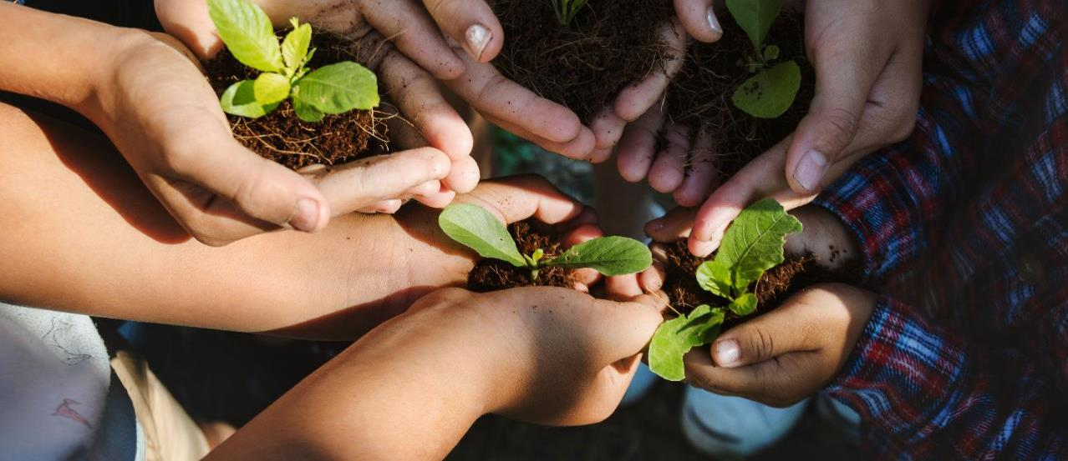
Futures of Education – Learning to Become
A global initiative to reimagine how knowledge and learning can shape the future of humanity and the planet
Notes:
In September 2019, UNESCO launched the Futures of Education initiative, an ambitious undertaking to reimagine how knowledge and learning can shape the future of humanity and the planet.

Slide 3
Futures of Education – The aim
To generate an agenda for global debate and action on the futures of education, learning and knowledge in a world of increasing complexity, uncertainty, and precarity.
Notes:
The initiative aims to generate an agenda for global debate and action on the futures of education, learning and knowledge in a world that is increasingly complex, uncertain and precarious. Let’s take a moment to find out a little bit more about the Futures of Education initiative by watching the video.
https://www.youtube.com/watch?v=7865y7hbehY

Slide 4
https://www.youtube.com/watch?v=7865y7hbehY

Slide 5
Building on UNESCO’s humanistic tradition
Notes:
As we understood from the video we just watched, the Futures of Education initiative is about sparking reflections and discussions about the futures we want, and more specifically about education in the future.
Debate is important to design change but action is crucial to drive change: this is why UNESCO will carefully review all received inputs to prepare its next global report on the Futures of Education, that will be released in late 2021; this flagship report will aim to share a forward-looking vision education and learning, and to serve as an agenda for policy dialogue and action at multiple levels.
The report will build on the humanistic approach to education laid out in previous UNESCO reports. Indeed, this forthcoming report is part of a long-standing UNESCO tradition and commitment to education.
The first of these reports, Learning to Be: the world of education today and tomorrow (1972) already warned of the risks of inequalities, privation and suffering, and emphasized the need for the continued expansion of education and for lifelong learning.
This was followed by the 1996 Learning: The treasure within report that proposed an integrated vision of education around the four pillars: learning to be, learning to know, learning to do, and learning to live together in a lifelong perspective.
More recently, the 2015 Rethinking Education: Towards a Global Common Good report reframed the purpose of education as enhancing and sustaining the dignity and capacity of the human person in relation to others and to nature.
Out of these reports, important changes happened: states started to commit to provide free education for a minimum of 9 years; learning institutions addressing adults started to emerge, supporting the concept of lifelong learning … UNESCO wants the 2021 report to also drive important, positive and sustainable changes and it is inviting US to share OUR hopes, fears and demands and to take part in the design of this new report. So let’s say to UNESCO what we think!

Slide 6
Futures of Education – A global consultation
A broad, open consultative process that involves youth, educators, civil society, governments, business and other stakeholders
Notes:
What is different about this 2021 global report, is the process in which it is being developed. It will emerge from an inclusive process of consultation, debate, research and engagement, which involves YOU!

Slide 7
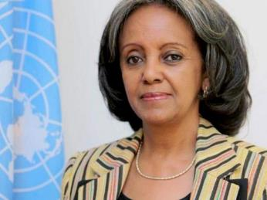
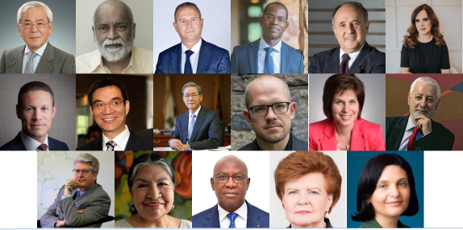
Futures of Education – The International Commission
H.E. Ms Sahle-Work Zewde
President of the Federal Democratic Republic of Ethiopia
Chair of the International Commission on the Futures of Education
Members of the International Commission
Thought-leaders from the worlds of politics, academia, the arts, science, business, and education;
bringing diverses perspectives from across the globe
Notes:
It’s also important to mention that UNESCO has convened an independent International Commission of thought-leaders from the worlds of politics, academia, the arts, science, business, and education. The Commission will work under the leadership of the President of Ethiopia, Her Excellency President Sahle-Work Zewde, and lead the development of the global report.
The Commission will carefully consider inputs received through the consultation process that involves youth, educators, civil society, governments, business and other stakeholders.
If requested, facilitator can name the Commission Members (listed here as featured from left to right, top row downwards):
Mr Masanori Aoyagi, Chairman of the Culture and Education Commission of the 2020 Olympic Games Committee, Japan
Mr Arjun Appadurai, Goddard Professor in Media, Culture and Communication, New York University
Mr Abdel Basset Ben Hassen, President, Arab Institute for Human Rights
Mr Patrick Awuah, Founder and President, Ashesi University College, Ghana
Mr Cristovam Buarque, Professor at University of Brasilia; Former senator of the Federal District (Brazil)
Ms Elisa Guerra Cruz, Recipient of the Best Educator in Latin America (2015) and finalist in the Varkey Foundation’s Global Teacher Prize (2015-2016)
Mr Badr Jafar, CEO, Crescent Entreprises (UAE) and World Economic Forum Young Global Leader (2011)
Justin Yifu LIN, Dean of Institute of New Structural Economics, Beijing University (China)
Mr Doh-Yeon Kim, President of Pohang University of Science and Technology; Former Minister of Education, Science and Technology (Republic of Korea)
Mr Evgeny Morozov, Writer and researcher on political and social implications of technology (Belarus)
Ms Karen Mundy, Professor, Ontario Institute for the Study of Education (OISE), University of Toronto
Mr António Nóvoa, current Ambassador of Portugal to UNESCO.
Mr Fernando M. Reimers, Professor, Harvard Graduate School of Education
Ms Tarcila Rivera Zea, Founder and Executive Director Centro de Culturas Indígenas del Peru
Mr Serigne Mbaye Thiam, Former Minister of Education, Vice-chair of the Global Partnership for Education
Ms Vaira Vīķe-Freiberga, President, Club of Madrid; Former President of Latvia
Ms Maha Yahya, Director, Carnegie Middle East Center

Slide 8
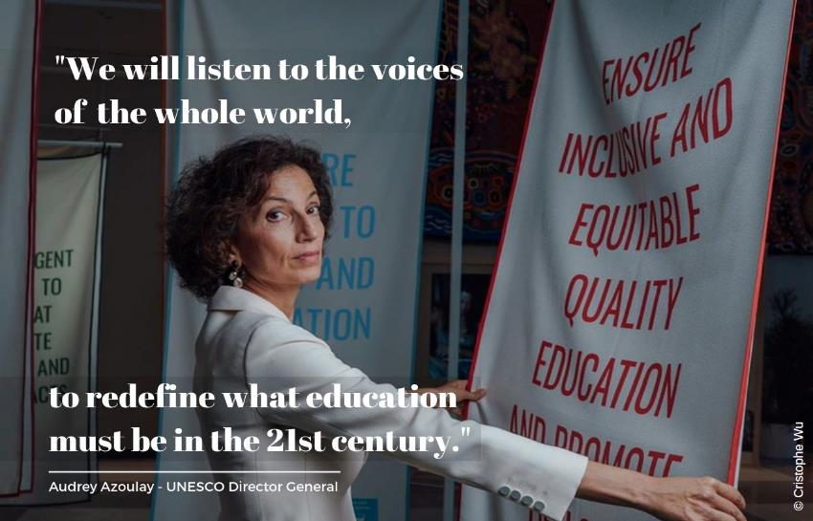
Futures of Education – Mobilizing collective reflection & action
Notes:
Basically, the forthcoming Futures of Education report will nurtured from both tracks that were just presented to you: a global, public dialogue that you’re now a part of, and the leadership of an independent International Commission.

Slide 9
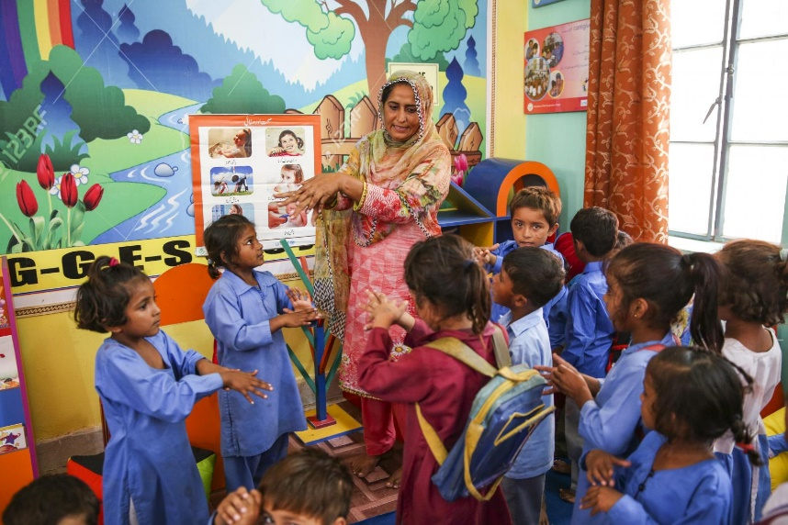
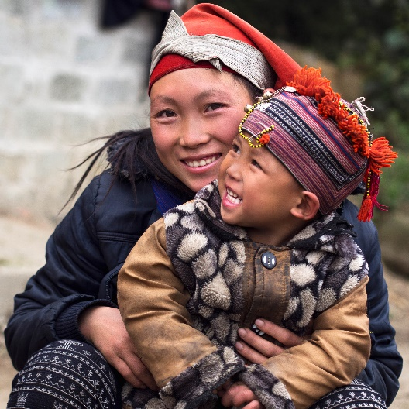
Special mobilization of the ASPnet community
Students – the main beneficiaries of education and best placed to speak about their learning and related experiences
School principals and teachers – play an instrumental role in students lives and are key stakeholders in shaping education systems
Parents – play an important role in their children’s’ education
Notes:
Any debate on the futures of education cannot take place without a strong involvement of school communities:
Students are the main beneficiaries of education and best placed to speak about their learning and related experiences. They can also bring fresh perspectives and original ideas. Inviting them to reflect about the futures of education means that they would be thinking about the education they want for their children and grandchildren.
School principals and teachers play an instrumental role in students lives and are key stakeholders in shaping education systems and, therefore, can enact meaningful changes to address concerns and priorities to future-proof education.
Parents play an important role in their children’s’ education; research has shown that parents involvement in their children’s school has many benefits for the entire school community. Parents’ involvement in their children’s learning has been given an additional emphasis during the COVID-19 crisis and lockdown of schools. Including parents in discussions on the futures of education can provide important additional insights and perspectives.

Slide 10
Special mobilization of the ASPnet community
Objective: engage ASPnet students, teachers, school principals and parents in a debate to rethink education and shape the future
Inform globale debate and UNESCO 2021 flagship report
by UNESCO’s International Commission on the Futures of
Education
Notes:
The objective of this special mobilization of the ASPnet community is to engage ASPnet students, teachers, school principals and parents in a debate to rethink education and shape the future. Key questions, such as how education, learning and knowledge need to be re-imagined in a world of increasing complexity, uncertainty and precarity as well as ASPnet’s mission and work to foster global citizens for sustainable development will be central elements for discussion.
The insights gained through these consultations will be synthesized for UNESCO’s International Commission on the Futures of Education and will help to shape the global debate and inform the UNESCO flagship report on the Futures of Education to be published next year.

Slide 11
Special mobilization of the ASPnet community
SEPTEMBER 2020
UNESCO organizes BRIEFING SESSIONS (in English, French & Spanish) for participating National Coordinators
SEPTEMBER - NOVEMBER 2020
National Coordinators organize NATIONAL FOCUS GROUP DISCUSSIONS and report back to UNESCO
DECEMBER 2020
UNESCO organizes 3 REGIONAL WEBINARS (in English, French and Spanish)
Notes:
SEPTEMBER 2020
UNESCO organizes BRIEFING SESSIONS (in English, French & Spanish) for participating National Coordinators
SEPTEMBER - NOVEMBER 2020
National Coordinators organize NATIONAL FOCUS GROUP DISCUSSIONS and report back to UNESCO
DECEMBER 2020
UNESCO organizes 3 REGIONAL WEBINARS (in English, French and Spanish) to share outcomes of national deliberations between countries and to engage with experts and commission members from the Futures of Education Initiative.

Slide 12
What will we cover in today’s session?
PRESENTATION
How to organize focus group discussions?
Topics/thematic focus: What will be discussed?
Supporting documentation: What do we have for you?
Reporting back: How does it work?
QUESTION AND ANSWER SESSION

Slide 13
Use the chat function to make comments and ask questions
Please mute the mic
Raise your hand if you want to take the floor
Notes:
This is a good moment to also recall some housekeeping-rules:
Please keep your microphone muted unless you have been given the floor to speak
Please type your questions and comments in the chat, and we will address them.
At the end of the presentation, we will have a Q&A session and also provide you with the opportunity to take the floor.

Slide 14
How to organise focus group discussions?
1
GENERAL CONTEXT | The concept of a focus group discussion
A focus group consultation can be organized by anyone within the same ASPnet school, or bring students, parents and teachers from different ASPnet schools across the country to engage in a discussion.
Group interaction is key to the focus group methodology.
2
PARTICIPANTS | Who takes part in a focus group discussion?
Students (from secondary level)
Teachers and school principals (from all levels of education)
(Optional) Parents and their children/secondary level students
10-15 individuals per group
1 Facilitator
1 Note Taker
Can be the National Coordinator, colleague at NatCom or ministry, school principal, teacher, association/NGO, etc.
&
x
Notes:
In terms of GENERAL CONTEXT let’s take a moment to look at the concept of a focus group discussion
First of all, it can be organized by anyone: it can be held within the same ASPnet school, or it can bring groups of students, parents and/or teachers from different ASPnet schools across the country together.
The group interaction itself is key to the focus group methodology.
Focus group discussions should allow people to explore and clarify their views – which oftentimes can lead discussions in new and unexpected directions, as participants reflect on their own and others’ ideas.
This is also how focus group discussions allow for participants to become an active part of the process of visioning the futures of education. They can grant agency to individuals as well as the larger stakeholder group, thereby facilitating ownership and co-construction of ideas.
PARTICIPANTS | Who takes part in a focus group discussion?
On one hand, the participants of the focus group discussion:
They will be invited to share their views and ideas on the several questions raised by the facilitator
We would like to recommend to conduct focus group discussions with:
Students from secondary level of education
Teachers and school principals, from all levels of education
(Optional) Parents and their children (ideally secondary level students)
Whenever possible, UNESCO recommends that participants belong to the same stakeholder group (e.g. a focus group comprised of students only, or teachers only, or parents with their children, etc.) in order to capitalize on shared experiences.
In terms of number of participants, UNESCO recommends conducting focus group consultations with groups of 10-15 individuals, to allow for discussion and interaction among participants
On the other hand, we have the facilitator(s), who will moderate the discussion:
The facilitator can be you, the National Coordinator, or one of your colleagues in the National Commission or Ministry. It can also be a school principal or teacher from an ASPnet member school – so they could organise it within their school, for example. It can also be an association or NGO that you work closely with. As you can hear, there is quiet some flexibility in terms of who can facilitate a focus group discussion and it depends on your context how you can set this out.
The facilitator would ideally have some experience in leading focus group discussions and, even more importantly, be familiar with the local context in order to prompt dialogue and debate.
Facilitators should also take a back-seat role as much as possible, steering and redirecting the conversation only minimally.
We also recommend that the facilitator is accompanied by a note-taker, who records significant comments, which will help putting together the short summary report. This note taker would preferable not take part in the discussions.

Slide 15
How to organise focus group discussions?
3
SPACE/LOCATION | Where can you organize a focus group discussion?
The focus group discussions can be held in a physical meeting space or online
4
LENGTH | How long does a focus group discussion last?
1h30 to 2h
5
FREQUENCY | How many?
Minimum: 4-6 focus group discussions per country
With students: 1 on GCED and 1 on ESD
With school principals and teachers: 1 on GCED and 1 on ESD
(Optional) With students and their parents: 1 on GCED and 1 on ESD
x
Notes:
SPACE/LOCATION | Where can you organize a focus group discussion?
The focus group discussions can be held in a physical meeting space or online – it depends on what is do-able in your context, especially considering current COVID-19 situation.
What is important for both is that focus group discussion sessions have a relaxed, comfortable and open-minded atmosphere, as the purpose is for participants to talk and exchange with one another.
LENGTH | How long does a focus group discussion last?
1h30 to 2h is the appropriate length of time for the focus group, but this can be contracted or expanded, depending on practical considerations.
FREQUENCY | How many?
Ideally, we would like to see four to six focus group discussions take place in each country:
2 with students: 1 on GCED and 1 on ESD
2 with school principals and teachers: 1 on GCED and 1 on ESD
(Optional) 2 with students and their parents: 1 on GCED and 1 on ESD

Slide 16
How to organise focus group discussions?
6
SCENARIOS | How to set them out at national level?
NC invites a selected number of ASPnet members in her/his country to organise focus group discussions and to report back to UNESCO
NC organises 4-6 (or more) focus group discussions and reports back to UNESCO
Mix of 1 and 2: NC invites a selected number of ASPnet members in her/his country to organise focus group discussions and then organises national webinar(s) for all participants:
(a) 1 webinar (for students, teachers, parents together), or
(b) 3 webinars (one for each group), or
(c) 4 webinars (one for each group and one altogether).
7
LANGUAGE | In what language can I hold a focus group discussion?
Language of choice; reporting to take place in English, French or Spanish
x
Notes:
SCENARIOS | How to set them out at national level?
We see different scenarios and these are just starting points for your and our collective brainstorming:
One scenario could be that you invite a selected number of ASPnet members in your country to organise focus group discussions and they would directly report back to UNESCO
Another scenario could be that you organise 4-6 (or more) focus group discussions and that you report back directly to UNESCO
The third scenario could be a mix of 1 and 2: you could invite a selected number of ASPnet members in your country to organise focus group discussions and then you could organise national webinar(s) for all participants: there again are different options: you could organise
(a) 1 webinar (in which you bring all students, teachers and parents from all focus group discussions that took place in your country together), or you could organise
(b) 3 webinars (one for each group), or
(c) 4 webinars (one for each group and one altogether).
LANGUAGE | In what language can I hold a focus group discussion?
A focus group discussions can be held in any language of choice. The PowerPoint for the facilitation of focus group discussions can be translated/adjusted according to your needs. Please note that reporting the outcomes and results of your focus group discussion to UNESCO would need to be in either English, French or Spanish.

Slide 17
How to organise focus group discussions?
8
ANNOUNCEMENT | How to invite my community to a focus group discussion?
Facilitator to send invitation to participants via email or in person
9
PREPARATION | How to prepare focus group participants?
Share the suggested hand-out we prepared for you in ANNEX V of the Guidelines “Word Stimulus Hand Out”
Notes:
ANNOUNCEMENT | How to invite my community to a focus group discussion?
Once the facilitator of the focus group discussion has been identified, we would suggest that participants receive an invitation to participate by email or in person.
PREPARATION| How to prepare focus group participants?
We have prepared a hand-out for facilitators of focus group discussions, which can be shared with participants ahead of the meeting (via Email or hand-out). You can find it in ANNEX V of the Guideline.
The handout includes a short explanation as well as two word clouds, one on GCED and one on ESD, depending on the thematic focus.
The word cloud includes key terminology associated with these two topics and intends to provide participants with food for thought and stimulation for reflection ahead of their participation. The handout will ask them to select five terms that they find most relevant and to connect them to a sentence of about 10-20 words each.

Slide 18
SUPPORTING DOCUMENTS
1. FACILITATORS’ GUIDELINES
[to be read BEFORE planning a discussion]
2. POWERPOINT DECK
[to be used during the focus group discussion]
3. REPORTING FORM
[to submit focus group deliberations]
Notes:
Everything so far presented is included in the Guidelines we shared with you. They are supposed to really flesh out how to organize a consultation. It also includes some additional information that may be of interest, such as a frequently asked questions, a set of background materials such as publications of the Commission or from ASPnet.
PowerPoint: To be used during the discussion, and adapted to the target stakeholder group and the thematic area of focus by deleting irrelevant slides.
Reporting form: to submit FG deliberations - available in a document and online

Slide 19
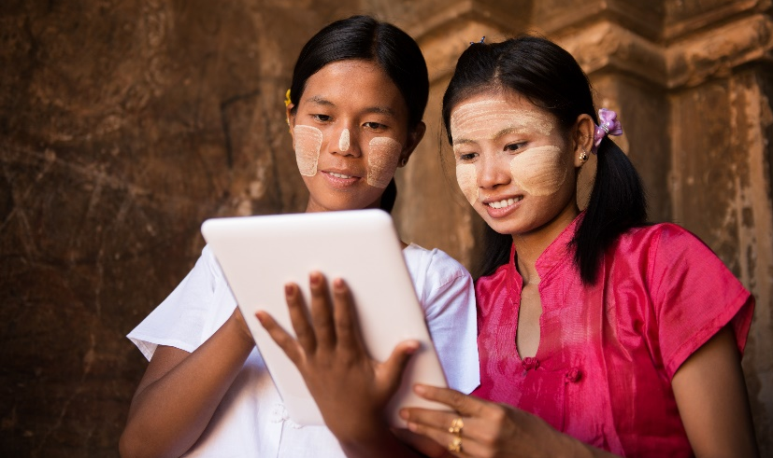
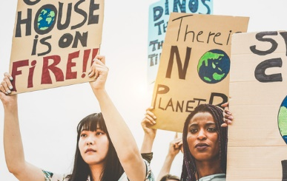
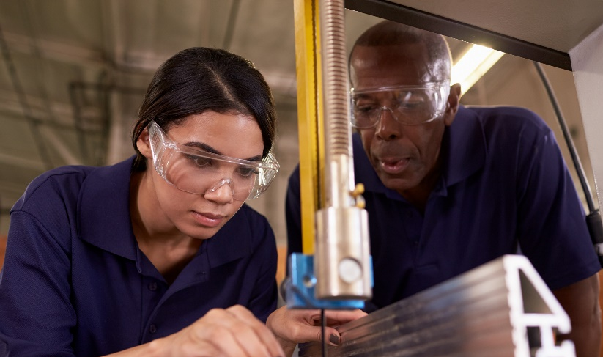
Futures of Education: Thematic focus
HUMAN & PLANETARY SUSTAINABILITY
KNOWLEDGE, ACCESS & GOVERNANCE
CITIZENSHIP & PARTICIPATION
WORK AND ECONOMIC SECURITY
Notes:
Four broad themes of the Futures of Education initiative – consultations, established in early 2020 after an initial round of consultations. Of course there are other topics covered which are cross-cutting to all these themes around teaching and learning, technology innovation and science etc…

Slide 20
ASPnet National Focus Group discussions: Thematic focus
HUMAN & PLANETARY SUSTAINABILITY
KNOWLEDGE, ACCESS & GOVERNANCE
CITIZENSHIP & PARTICIPATION
WORK AND ECONOMIC SECURITY
Notes:
Two of those themes are common to the core topics addressed by the ASPnet community, and hence why we have decided to focus on these themes in particular. You are also welcome to explore the other themes, and develop questions for discussion. However, the guidelines developed and supporting documents we prepared are focused on those themes. We invite you to get in touch with us should you want to explore other topics and we would gladly assist.
For each of the themes ‘GCED’ and ‘ESD’ we have suggested questions to be used during the discussion. In a way having ‘standard questions’ will help us craft a more synergized input from the ASPnet community of schools, teachers and hopefully parents.

Slide 21
SUPPORTING DOCUMENTS
1. FACILITATORS’ GUIDELINES
[to be read BEFORE planning a discussion]
2. POWERPOINT DECK
[to be used during the focus group discussion]
3. REPORTING FORM
[to submit focus group deliberations]
Notes:
During your session – whether conducted in person or online, the use of the PowerPoint presentation is highly advised. It helps you structure your focus group discussion in several parts.
First, you start off with a short introduction that explains the aim of the initiative and how the deliberations of the focus group discussion contribute to it – just as we did today. There are detailed notes that accompany the PowerPoint presentation, which you can rely on.
Then you move into the thematic discussion. You will notice that we prepared an exhaustive PowerPoint which includes slides for each of the stakeholder groups X theme – so effectively with three stakeholder groups and two themes, there are SIX sets of questions. To facilitate the discussion, we suggest you only keep the slides that you would need to use the day of the discussion.
We have also prepared some slides that recall the definitions of GCED and ESD as well as links to videos that you can show.

Slide 22
ASPnet National Focus Group discussions: Thematic focus
2 ROUNDS OF REFLECTION
REFLECTION ROUND
1
REFLECTION ROUND
2
Education for more just,
peaceful & sustainable societies
Our world in 2050
(Estimated duration: 30-40min)
(Estimated duration: 1h – 1h15)
Notes:
Each FGD takes about 2h – with the introduction. Each of the proposed models includes two rounds of reflection. The first round is the same, regardless of the theme or the stakeholder group. It starts with a broad reflection on our world today - on what we do and what we do not want to see in our world in 30 years time, i.e. in 2050.
In the second reflection round, we will focus on how education can contribute to countering the identified challenges and towards building more just, peaceful and sustainable societies.

Slide 23
ASPnet National Focus Group discussions: Thematic focus
REFLECTION ROUND
1
Our world in 2050
Main discussion question:
What we do and what we do not want to see in our world in 30 years time?
=> If possible, draw a mindmap of focus group discussants’ inputs
Notes:
It is possible to prepare a mindmap as participants are discussing this question. We have some tips on that in the focus group guidelines.
It is possible for the group to get ‘stuck’ in which case you can prompt them for example by saying – I am sure you would all agree that we would want a more equitable and just society; or that we have reduced carbon emissions that environmental degradation is no longer in the horizon. You would spend 30-40 minutes on this question.

Slide 24
ASPnet National Focus Group discussions: Thematic focus
REFLECTION ROUND
2
Education for more just, peaceful & sustainable societies
Questions: Theme: Global Citizenship Education
Q1. What makes a global citizen?
Q2. How can education foster global citizens?
Sub-questions for student focus group:
From your experience going to school, what has helped you in particular to becoming a global citizen?
What ideas do you have to improve today’s education to allow you/ students to become global citizens?
Sub-questions for parents focus group:
Please share an example of how your children’s school effectively fosters global citizens. What could your children’s school do better?
What role should parents play in their children’s education? What role should the wider community play in education/ schools?
Notes:
The second round of reflections is more catered by theme and stakeholder group. If you have chosen the GCED theme we propose slightly different questions for the second part of round 2. One which is more positive, around the opportunities that school offers to become a global citizen; and one more pessimistic around the challenges or how education can be improved to allow you to become a global citizen. Of course, the presentation also includes definitions of GCED.

Slide 25
ASPnet National Focus Group discussions: Thematic focus
REFLECTION ROUND
2
Education for more just, peaceful & sustainable societies
Questions: Theme: Education for Sustainable Development
Q1. How can we live more sustainably on our planet?
Q2. How can education help us to live more sustainably on our planet?
Sub-questions for a TEACHER focus group:
What works well: Please share an example of how sustainable development is (or could be) successfully taught in your class/school and that you would like to recommend for scale/i.e. to other teachers/school principals?
What does not work so well? How can education possibly exacerbate unsustainable behaviours and systems? What needs to change in our education system today to foster the knowledge, skills, attitudes and values for current and future generations to live more sustainably?
Notes:
If you choose ESD as your topic, then again we use the same logic. Here is for example the questions for the teachers focus group.

Slide 26
SUPPORTING DOCUMENTS
1. FACILITATORS’ GUIDELINES
[to be read BEFORE planning a discussion]
2. POWERPOINT DECK
[to be used during the focus group discussion]
3. REPORTING FORM
[to submit focus group deliberations]
Notes:
Once you are done with the focus group discussion, you will synthesize the discussion into the reporting form.

Slide 27
How to report the discussion outcomes?
One Focus Group Discussion = One Report
Report can be submitted online or completed on paper and sent by email
Report includes:
Basic information about the event [location, date, facilitator name and contact information, number of participants and their profiles, choice of theme]
Summary of the deliberations – one box per question discussed
List of names for acknowledgements
Pictures are optional and to be sent by email to aspnet@unesco.org and futuresofeducation@unesco.org
Notes:
As the NC you may also want to consolidate all the FGDs and prepare a different kind of input, especially if you are, say, planning to engage with other Futures of Education consultation activities with the aim of preparing a national report.

Slide 28
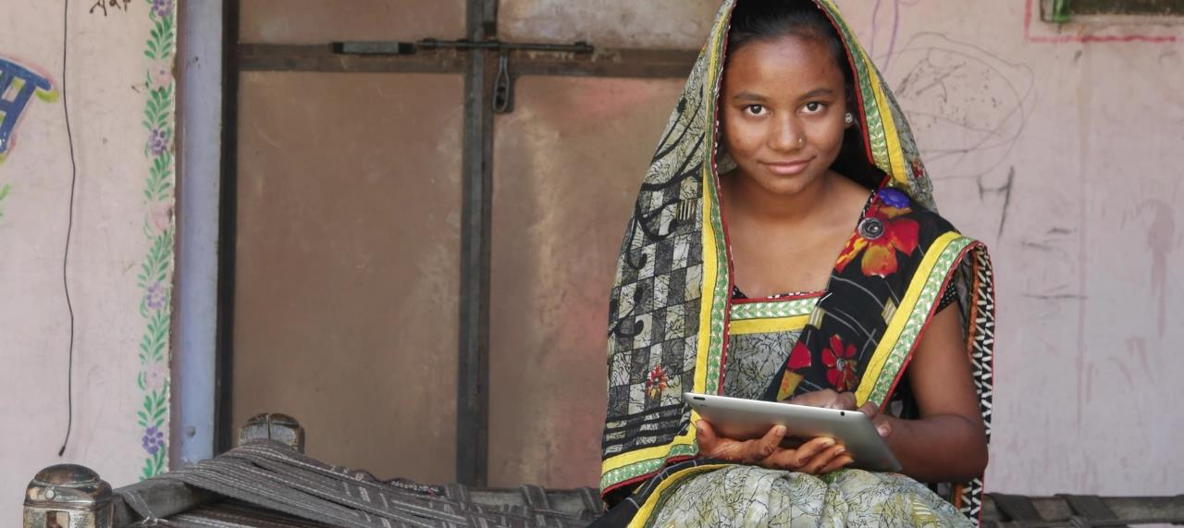
Thank you!
Q&A
Don’t hesitate to contact us if you have further questions:
aspnet@unesco.org / futuresofeducation@unesco.org
Notes:
Now we open the floor to questions and answers. We will first start with the questions that were posed in the chat.

