Slide 1
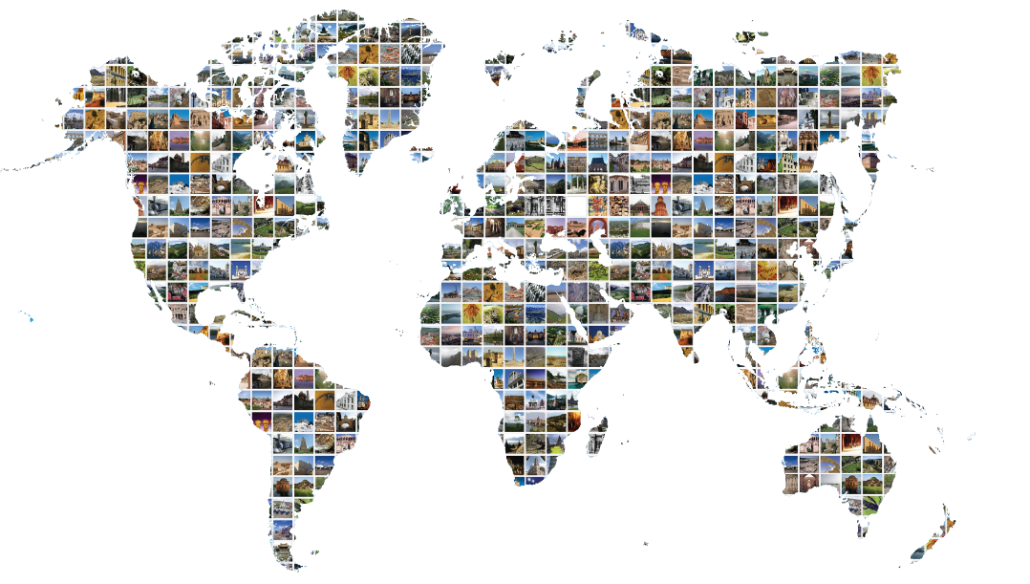
模块 1
世界遗产公约定期报告
1
定期报告
基础知识

Slide 2
Module 1
Periodic Reporting for the World Heritage Convention
1
Periodic Reporting
Fundamentals

Slide 3

学习目标
学习本模块后:
☑清楚了解谁应参与定期报告，以及各自承担的角色。
☑清楚了解第三轮定期报告增加的新内容、整个过程的时间安排以及对定期报告问卷所做的改进。
☑能够获取可用的工具、材料和离线/在线信息，以回答调查问卷中的问题。

Slide 4
Learning objectives
At the end of the session, trainees:
Will gain a clear understanding of who is involved in the Periodic Reporting exercise and what the respective roles are.
Will gain a clear view about the new elements of the Third Cycle, the timing of the process, and the improvements made to the Periodic Reporting questionnaire.
Will be able to access tools, materials and offline/online sources of information available to answer the questions in the Periodic Reporting Questionnaire.

Slide 5

模块大纲
II. 第三轮定期报告的新动态
可持续发展
与其他公约的协同效应
监测指标和分析框架
培训材料
定期报告网页和第三轮定期报告平台
其他改进
什么是定期报告？
目标
在线问卷
谁是参与方?
预期成果是什么?
报告周期：按区域上报
时间安排

Slide 6
Module outline
II. New developments for the Third Cycle
Sustainable Development
Synergies with other Conventions
Monitoring Indicators and Analytical Framework
Training materials
Periodic Reporting Webpage and Third Cycle Platform
Other improvements
I. What is Periodic Reporting?
Objectives
Online questionnaire
Who are the actors?
What are the expected outcomes?
Reporting cycle: Reporting by region
Timeline

Slide 7

什么是定期报告？
观看视频教程
全球的遗产保护监测工作
关于在国家层面和遗产地层面实施《世界遗产公约》的自我报告。
《世界遗产公约》的法定要求(第29条)
http://whc.unesco.org/include/tool_video.cfm?youtubeid=iiSFmP-InWw
解释定期报告的视频，这是一项全球保护监测活动，也是《世界遗产公约》的一项要求。
Français
English
Français
Subtitled in Arabic

Slide 8
What is Periodic Reporting?
Watch video tutorial
Global conservation monitoring activity
Self reporting on the application of the World Heritage Convention at national level and property level
Statutory requirement of the World Heritage Convention (Article 29)
http://whc.unesco.org/include/tool_video.cfm?youtubeid=iiSFmP-InWw
Video explaining the Periodic Reporting exercise, a global conservation monitoring activity and a requirement of the World Heritage Convention.
Français
English
Français
Subtitled in Arabic

Slide 9
什么是定期报告？
目标
按国家评估《世界遗产公约》的实施情况
确定突出普遍价值是否得以维持
鼓励区域合作和建立网络
协助更新遗产地信息和记录变化

Slide 10
What is Periodic Reporting?
Objectives
Assessing the application of the World Heritage Convention by country
Determining whether Outstanding Universal Value has been maintained
Encouraging regional cooperation and networking
Helping update information on properties and record changes

Slide 11
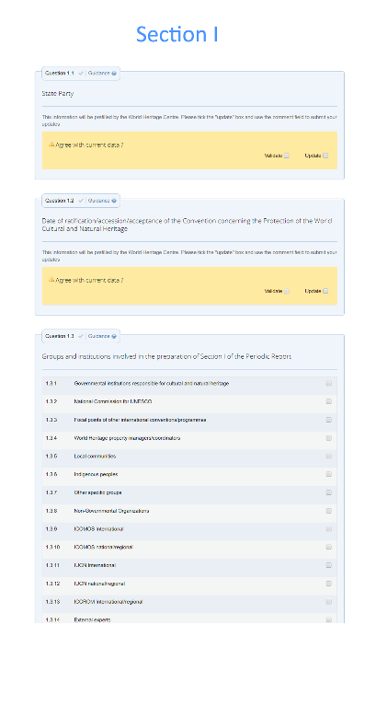
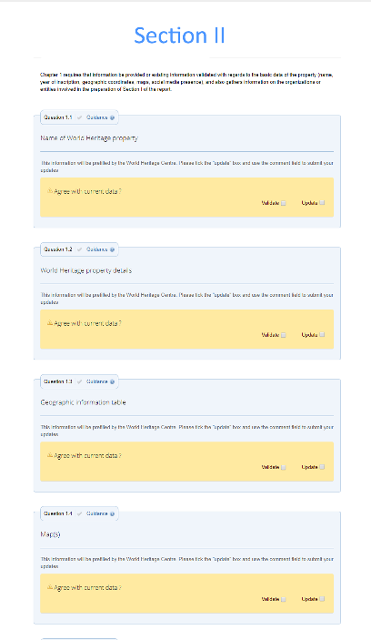
什么是定期报告？
在线问卷
访问调查问卷： http://whc.unesco.org/en/periodicreporting/
定期报告是通过在线调查问卷的方式将信息汇编成两部分：
第一部分 (国家层面)
第二部分 (遗产地层面)
http://whc.unesco.org/include/tool_video.cfm?youtubeid=iiSFmP-InWw

Slide 12
What is Periodic Reporting?
Online Questionnaire
Questionnaire can be accessed here: http://whc.unesco.org/en/periodicreporting/
Periodic Reports are compiled from information by means of an online questionnaire in two sections:
Section I (national level)
Section II (property level)
http://whc.unesco.org/include/tool_video.cfm?youtubeid=iiSFmP-InWw

Slide 13

什么是定期报告？
谁是参与方?
世界遗产中心
教科文组织总部外办事处
咨询机构
教科文组织2类机构
民间团体
当地社区
遗产地管理者
完成第二部分
国家联络机构
完成第一部分
审定第二部分
向世界遗产中心提交报告

Slide 14
What is Periodic Reporting?
Who are the actors?
Site Managers
Complete Section II of the questionnaire
National Focal Points
Complete Section I
Validates Section II
Submit the questionnaire to the World Heritage Centre
World Heritage Centre
UNESCO Field Offices
Advisory Bodies
Category 2 Centres
Civil society
Local communities

Slide 15
什么是定期报告？
预期成果
区域行动计划
为实施《世界遗产公约》确定地区优先事项的工具
解读定期报告数据并按照既定时间表将其转化为具体目标
通过国家联络结构、遗产地管理者、咨询机构和世界遗产中心的合作共同制定
一个由使用者生成的工具，包含遗产地管理者和缔约国的特殊需求
区域报告
区域内有关世界遗产保护和所面临的主要挑战的信息
与区域或全球现象相关的趋势
由世界遗产中心准备，同时咨询缔约国国家联络机构
提交世界遗产委员会

Slide 16
What is Periodic Reporting?
Expected outcomes
Regional Action Plans
tool for setting regional priorities for implementing the World Heritage Convention
a way of interpreting and translating the Periodic Reporting data into concrete goals following a set timeline.
formulated through a collaborative process that can involve national Focal Points, Site Managers, Advisory Bodies and the World Heritage Centre.
a user-generated tool that incorporates the specific needs of Site Managers and States Parties
Regional Reports
information on conservation of World Heritage in a region and the main challenges faced
trends related to regional or global phenomena
prepared by the World Heritage Centre in consultation with National Focal Points
presented to the World Heritage Committee

Slide 17
什么是定期报告？
报告周期：按区域报告
定期报告按区域进行
在区域内报告
国家联络机构完成国家层面的报告（第一部分），遗产地管理者完成各个遗产地的报告（第二部分）
提交
报告提交给世界遗产中心，并生成区域报告
区域报告
由世界遗产委员会检查并提出建议
实施
缔约国实施行动计划以及区域报告提出的建议
区域行动计划
制定策略、优先事项和目标，以实施《世界遗产公约》
  推动区域内合作
  回应各区域的具体特点

Slide 18
What is Periodic Reporting?
Reporting cycle: Reporting by region
Periodic Reporting is carried out on a region by region basis
  Promotes cooperation in the regions
  Responds to the specific characteristics of each region

Slide 19
什么是定期报告？
按区域报告：时间表
非洲
拉丁美洲与加勒比海地区
2018
2020
2022
2019
2021
阿拉伯国家
亚太地区
欧洲&北美

Slide 20
What is Periodic Reporting?
Reporting by region: Timeline
Africa
Latin America & Caribbean
2018
2020
2022
2019
2021
Arab States
Asia & Pacific
Europe & North America

Slide 21
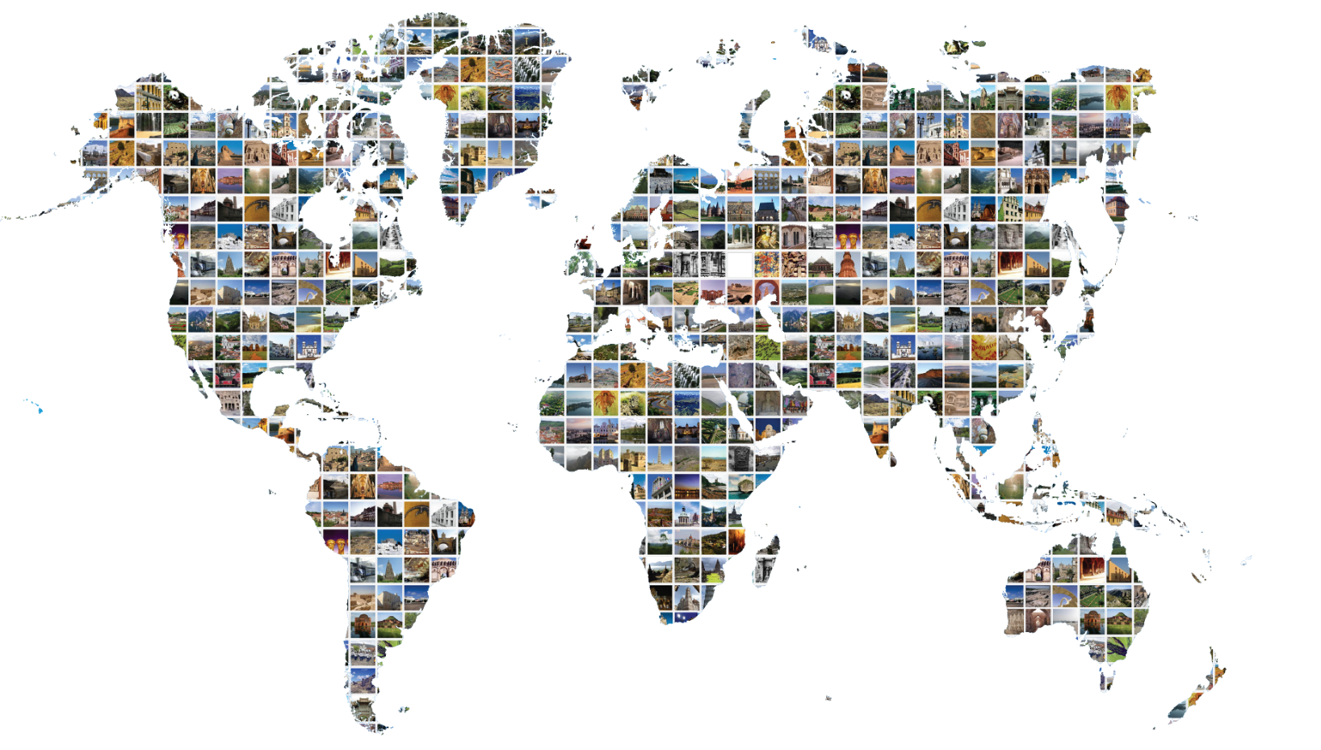
第三轮的新动态

Slide 22
New developments for the Third Cycle

Slide 23
第三轮的新动态

Slide 24
New developments for the Third Cycle

Slide 25
第三轮的新动态
（第二轮）反思期的成果(2015-2017)
进行了一系列的改进和创新：
可持续发展
与其他公约的协同
监测指标和分析框架
定期报告平台
培训材料

Slide 26
New developments for the Third Cycle
Outcomes of the Reflection Period (2015-2017)
A wide range of improvements and innovations have been introduced:
Sustainable development
Synergies with other Conventions
Monitoring Indicators and Analytical Framework
Periodic Reporting platform
Training materials

Slide 27

第三轮的新动态
可持续发展
可持续发展目标11
http://whc.unesco.org/include/tool_video.cfm?youtubeid=iiSFmP-InWw
根据可持续发展目标11，各国承诺：
“建设包容、安全、有抵御灾害能力和可持续的城市和人居环境”
具体目标11.4旨在：
“进一步努力保护和捍卫世界文化
和自然遗产”

Slide 28
New developments for the Third Cycle
Sustainable Development
Sustainable Development Goal 11
http://whc.unesco.org/include/tool_video.cfm?youtubeid=iiSFmP-InWw
With SDG 11, countries have pledged to
“make cities and human settlements inclusive, safe, resilient and sustainable”
Within this goal, Target 11.4 aims to
“strengthen efforts to protect and safeguard the world’s cultural and natural heritage”

Slide 29
第三轮的新动态
与其他公约的协同
业务指南
第一部分
问题包括文化与生物多样性相关公约之间的合作/在国家和遗产地两个层级的项目。
特别强调了1954年《海牙公约第二议定书》和1972年《关于城市历史景观的建议书》。
http://whc.unesco.org/include/tool_video.cfm?youtubeid=iiSFmP-InWw
世界遗产委员会认识到加强《世界遗产公约》与其他文化和生物多样性相关公约之间协同合作的益处。
《世界遗产公约》业务指南第41段。
第二部分
遗产地管理者与不同保护工具合作的相关问题，以及如何利用有部分重叠的体系来确保遗产的保护。
http://whc.unesco.org/en/guidelines/

Slide 30
New developments for the Third Cycle
Synergies with other Conventions
Operational Guidelines
Section I
Questions cover extent of cooperation between culture and biodiversity-related conventions/programmes at both national and property level.
Particular emphasis is given to the Second Protocol of the 1954 Hague Convention and the 1972 Recommendation and Recommendation on the Historic Urban Landscape.
http://whc.unesco.org/include/tool_video.cfm?youtubeid=iiSFmP-InWw
The World Heritage Committee recognizes the benefits of enhancing synergies amongst the World Heritage Convention and other culture and biodiversity-related conventions.
Paragraph 41 of the Operational Guidelines for the Implementation of the World Heritage Convention
Section II
Questions relating to cooperation of Site Managers with the different conservation instruments and how overlapping protection is being used to ensure the conservation of heritage.
http://whc.unesco.org/en/guidelines/

Slide 31





第三轮的新动态
与联合国教科文组织其他文化公约的协同作用
1954年《关于发生武装冲突时保护文化财产的海牙公约》
1954年《关于发生武装冲突时保护文化财产的海牙公约》第二议定书
1970年《关于禁止和防止非法进出口文化财产和非法转让其所有权的方法的公约》
2001年《保护水下文化遗产公约》
2003年《保护非物质文化遗产公约》
2005年《保护和促进文化表现形式多样性公约》

Slide 32
New developments for the Third Cycle
Synergies with other UNESCO culture Conventions
1954 Hague Convention for the Protection of Cultural Property in the Event of Armed Conflict
Second Protocol to the 1954 Hague Convention for the Protection of Cultural Property in the Event of Armed Conflict
1970 Convention on the Means of Prohibiting and Preventing the Illicit Import, Export and Transfer of Ownership of Cultural Property
2001 Convention on the Protection of the Underwater Cultural Heritage
2003 Convention for the Safeguarding of the Intangible Cultural Heritage
2005 Convention on the Protection and Promotion of the Diversity of Cultural Expressions

Slide 33







第三轮的新动态
与生物多样性相关公约和项目的协同作用
《保护世界文化和自然遗产公约》
《生物多样性公约》(CBD)
《濒危野生动植物种国际贸易公约》(CITES)
《养护野生动物移栖物种国际贸易公约》(《养护野生动物公约》)
《粮食和农业植物遗传资源国际条约》(ITPGRFA)
《关于国际重要湿地的公约》
(《拉姆萨尔公约》)
《国际植物保护公约》（IPPC）

Slide 34
New developments for the Third Cycle
Synergies with biodiversity-related Conventions and Programmes
Convention Concerning the Protection of the World Cultural and Natural Heritage
Convention on International Trade in Endangered Species in Wild Flora and Fauna (CITES)
Convention on the Conservation of Migratory Species of Wild Animals (CMS)
Convention on Biological Diversity (CBD)
International Treaty on Plant Genetic Resources for Food and Agriculture (ITPGRFA)
Convention on Wetlands of International Importance
(Ramsar Convention)
International Plant Protection Convention (IPPC)

Slide 35
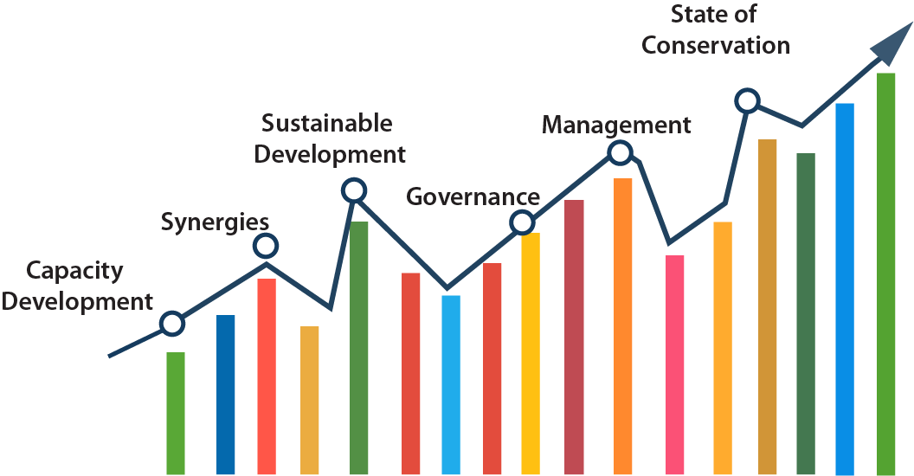
第三轮的新动态
监测指标和分析框架
衡量世界遗产保护趋势和发展的指标
基于定期报告的六个核心主题领域
在定期报告反思期（2015-2017年）框架内制定
改进数据的呈现方式，提高数据的可获取性和可用性，使缔约国能够更有效地利用数据开展各自的监测活动
在所有区域都适用的数据分析的全球模板
将首先在第一个提交报告的区域试行使用

Slide 36
New developments for the Third Cycle
Monitoring Indicators and Analytical Framework
Indicators to measure trends and developments in World Heritage conservation.
Based on the six core thematic areas of the Periodic Reports.
Developed within the framework of the Periodic Reporting Reflection Period (2015-2017)
To improve the presentation of data for enhanced accessibility and usability, allowing States Parties to use it more effectively for their own monitoring activities
A global template for the analysis of data in all regions
To be used on a trial basis in the first regions to report

Slide 37
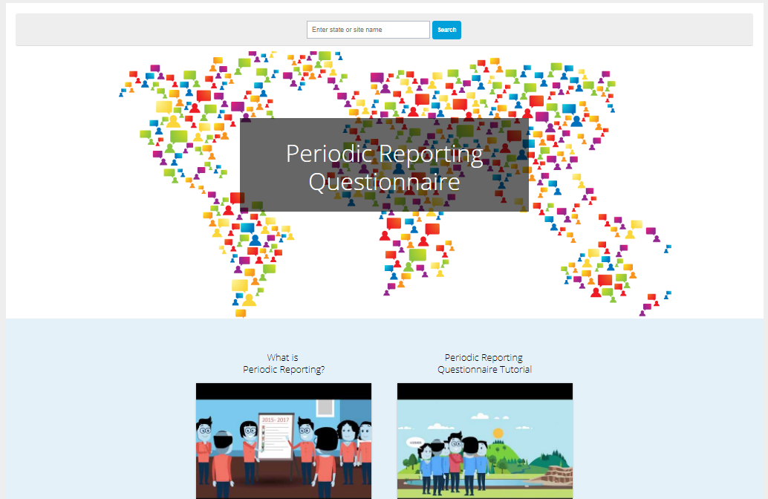
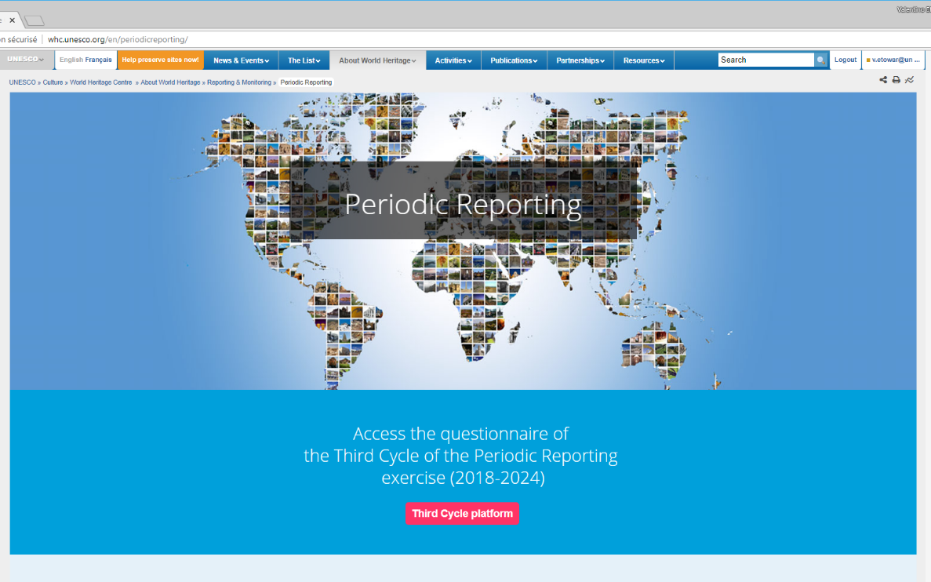
第三轮的新动态
定期报告的网页
在线定期报告
http://whc.unesco.org/include/tool_video.cfm?youtubeid=iiSFmP-InWw
第三轮报告平台：
http://whc.unesco.org/en/prcycle3/
- 调查表问卷
- 培训和指导材料
定期报告的一般信息：
whc.unesco.org/en/periodicreporting/

Slide 38
New developments for the Third Cycle
Periodic Reporting webpages
Periodic Reporting online
http://whc.unesco.org/include/tool_video.cfm?youtubeid=iiSFmP-InWw
Third Cycle Platform
http://whc.unesco.org/en/prcycle3/
- Access to the Questionnaire
- Training and guidance materials
General information on Periodic Reporting
whc.unesco.org/en/periodicreporting/

Slide 39




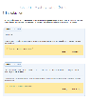
第三轮的新动态
培训材料
遗产地管理者手册
第三轮定期报告已经编制了一套专门的培训和指导材料，并将持续更新。
促进自主和成功的定期报告工作
支持能力建设工作
适用于各种情况下的使用
广大参与者易获得
设计为用户友好和直观的工具
适用于所有区域和遗产地
视频教程
1
2
学习模块
3
指南与关键术语索引
问卷样本

Slide 40
New developments for the Third Cycle
Training materials
Handbook for Site Managers
A set of training and guidance materials have been developed for the Third Cycle and continue to be updated.
Facilitate an autonomous and successful Periodic Reporting exercise
Support capacity-building activities
Adapted for use in a range of contexts
Accessible to a broad audience
Designed as user-friendly and intuitive tools
Applicable to all regions and sites
Video tutorials
1
2
Learning modules
3
Guidance & Index of key terms
Demo version of the Questionnaire

Slide 41
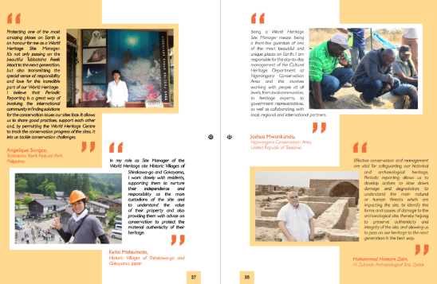
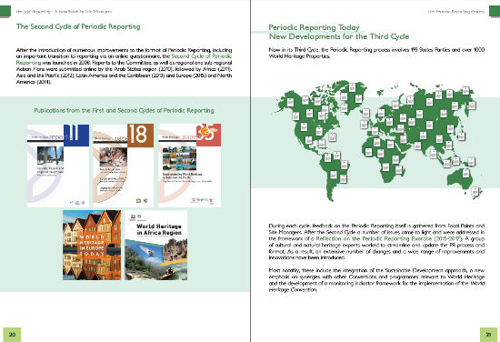
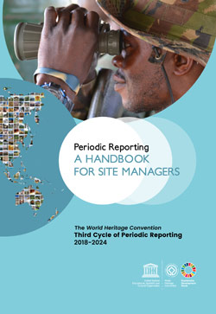
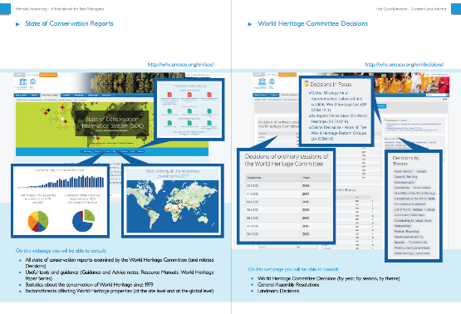
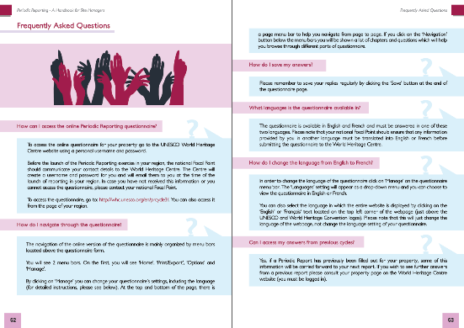
第三轮的新动态
培训材料
遗产地管理者手册
用清晰的语言解释定期报告程序和世界遗产的大背景
概述调查问卷第二部分的内容
包含技术指南和常见问题
有英、法、阿拉伯三种语言
预计将有其他语言的版本面世

Slide 42
New developments for the Third Cycle
Training materials
Handbook for Site Managers
Explains the Periodic Reporting process and the broader context of World Heritage in clear language.
Provides an overview of Section II of the questionnaire.
Contains technical guidelines and FAQs.
Available in English, français and العربية
Translation in other languages is foreseen

Slide 43
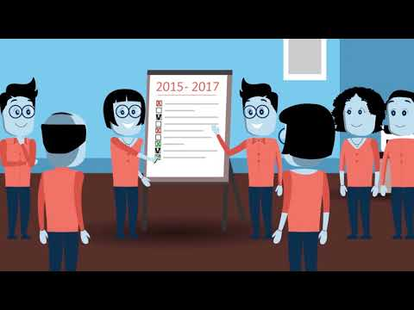

第三轮的新动态
培训材料
视频教程
动画视频1以简单明了的语言解释了定期报告的流程。
动画视频2主要介绍了定期报告第二部分的内容，讲解了主要功能、涉及的主要概念以及可提供的帮助。
  主要针对遗产地管理者，以通俗易懂的语言和引人入胜的视觉效果提供概述性介绍。
  有英文、法文版。
  有阿拉伯文字幕版本
  目前正在开发西班牙文、中文和俄文版。

Slide 44
New developments for the Third Cycle
Training materials
Video tutorials
Animation video 1 explains the Periodic Reporting process in clear and simple terms.
Animation video 2 focuses on Section 2, explaining the key functionalities, the main concepts involved and the assistance available.
Aimed primarily at Site Managers, they offer an overview in plain language with engaging visuals
Available in English, French.
Arabic subtitles versions
Adapted Spanish, Chinese and Russian versions currently under development

Slide 45
第三轮的新动态
培训材料
1
2
培训模块
1
3
定期报告课程大纲
Training
MODULE
2
定期报告的能力建设工具
为培训参与定期报告的人员而制定
利用大量的世界遗产资源
提供基础和进阶版本
综合性——适用于各种不同背景下的世界遗产
Training
MODULE
3
Training
MODULE
4
Training
MODULE
培训模块
世界遗产公约

Slide 46
New developments for the Third Cycle
Training materials
1
2
Training modules
1
3
Periodic Reporting Curriculum
Training
MODULE
2
A capacity-building tool for Periodic Reporting
Developed to facilitate trainings for those involved in Periodic Reporting
Draws on a large number of World Heritage resources
To be accessible in basic and advanced versions
Comprehensive nature will make it adaptable to many different World Heritage contexts
Training
MODULE
3
Training
MODULE
4
Training
MODULE
Training
Modules
World Heritage Convention

Slide 47
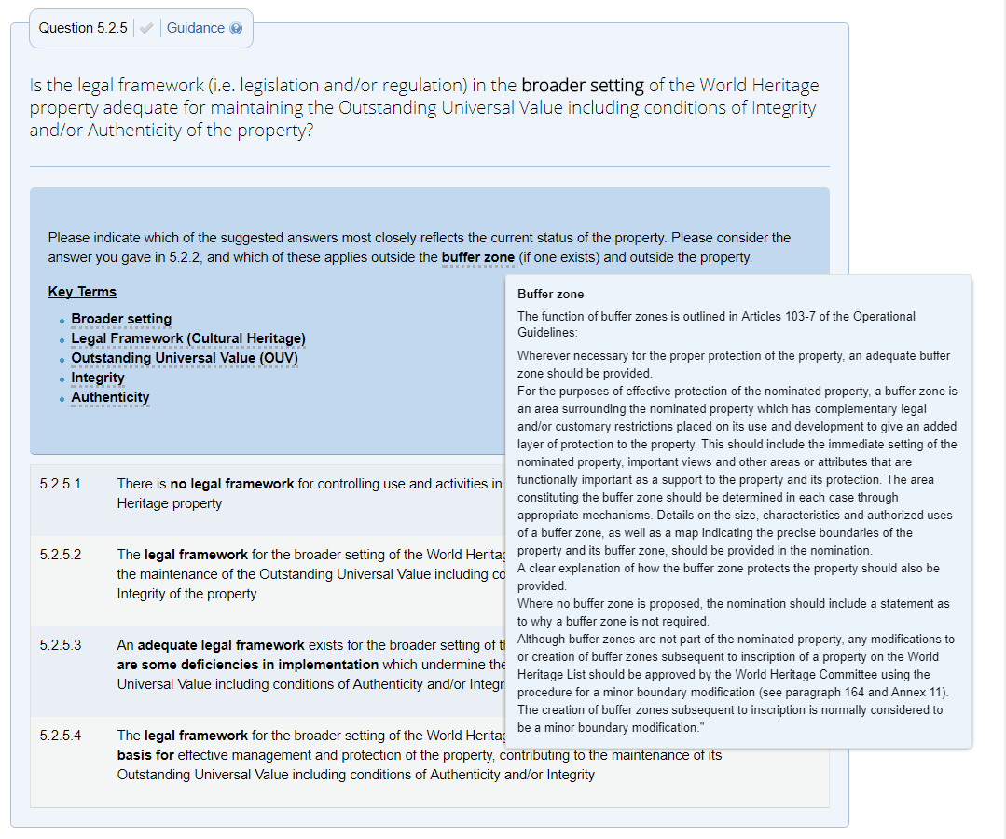
第三轮的新动态
培训材料
指南与关键术语索引
指南/关键术语索引
整合在调查问卷中，以澄清问题和解释关键概念。
说明具体问题中所要求的信息；
为所涉及的主题领域提供语境和背景信息；
问卷中的动态资源；
将以PDF格式在网上提供预览或下载。

Slide 48
New developments for the Third Cycle
Training materials
Guidance and Index of key terms
Guidance/ Index of key terms
Integrated into the questionnaire to clarify questions and explain key concepts.
provides clarifications on the information sought in specific questions
provide context and background to the thematic areas covered
a dynamic resource within the questionnaire
Will be made available online and for download in PDF format

Slide 49
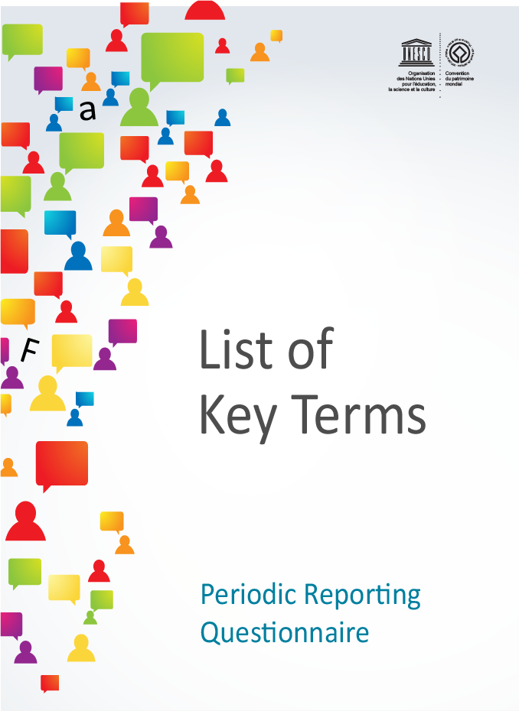
第三轮的新动态
培训资料
关键术语列表
关键术语列表
术语清单是对指南的补充，并提供了关键术语的定义。
有英文和法文版
将以PDF格式在网上提供预览或下载

Slide 50
New developments for the Third Cycle
Training materials
List of key terms
List of key terms
A list of terms supplements the guidance and provides definitions of key terms
Available in English and French
Will be made available online and for download in PDF format

Slide 51
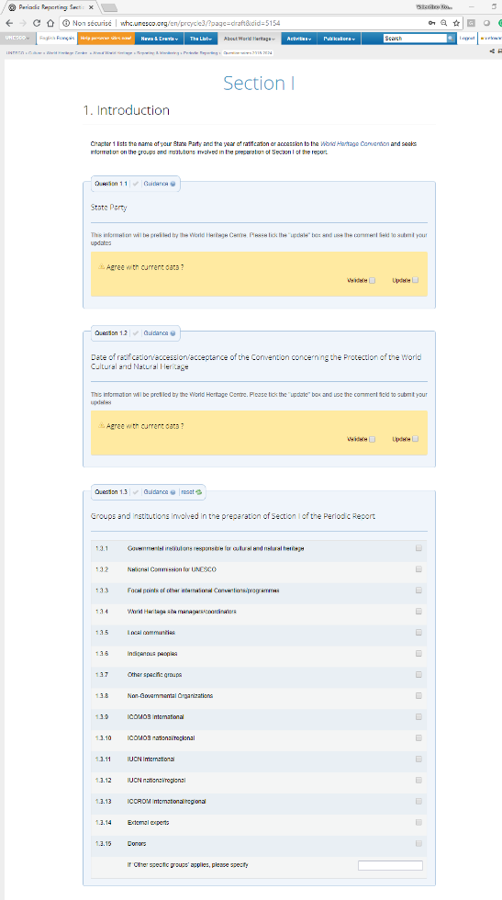
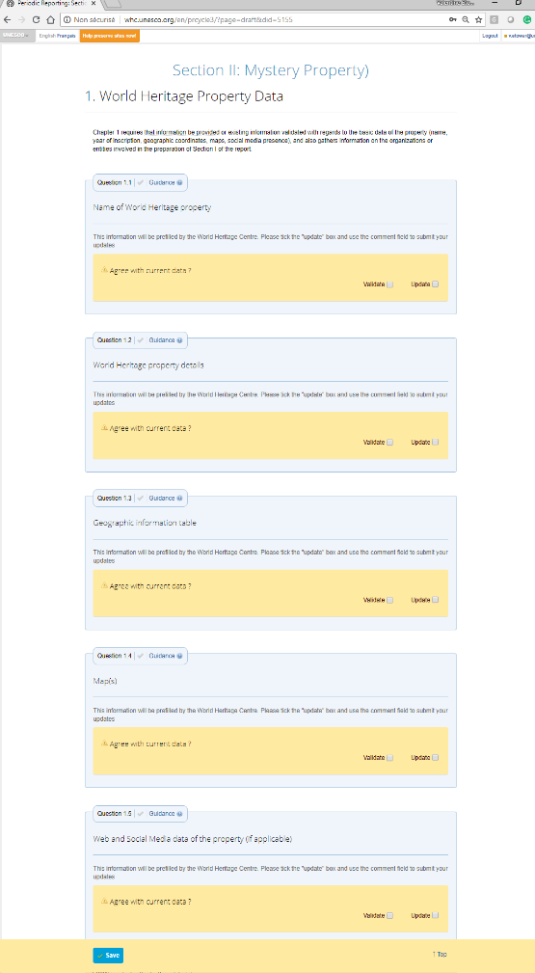
第三轮的新动态
培训资料
问卷样本
问卷样本
问卷样本可以让你练习使用问卷，熟悉其功能。
它可以导出为Word和PDF格式。

Slide 52
New developments for the Third Cycle
Training materials
Demo version of the Questionnaire
Demo version of the questionnaire
The demo version of the questionnaire (Section I Mystery Land and Section II Mystery Property) allows you to practice using the questionnaire and gain familiarity with its functions.
It can be exported to Word and PDF

Slide 53
第三轮的新动态
对调查问卷的其他改进
报告积极的成果
更加强调OUV的价值特征要素，将其作为世界遗产体系的重要内容。
在评估遗产地状况和背景时，应同时考虑到积极的和消极的、潜在的和实际的因素
收集更多关于实际的和预测的趋势的信息(价值特征要素和影响因素)
影响因素（相关信息）已关联至保护状况数据库
在线工具的技术改进

Slide 54
New developments for the Third Cycle
Other improvements to the Questionnaire
Report positive achievements
More emphasis on attributes of OUV as an important element of World Heritage system
Positive as well as negative, potential as well as actual factors to be taken into account in assessing condition and context of properties
More information on actual and predicted trends gathered (attributes and factors)
Factors now linked to State of Conservation database
Technical improvements to online tool

Slide 55

联系我们
wh-periodicreporting@unesco.org

