Slide 1
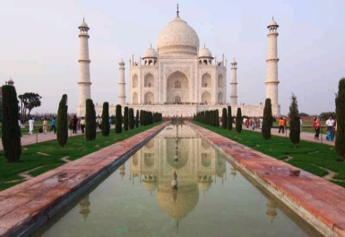
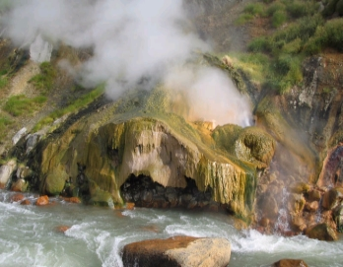
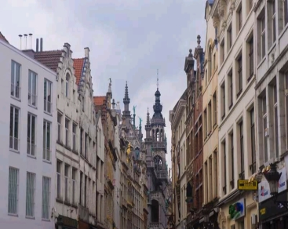
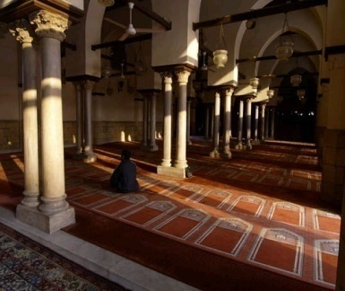
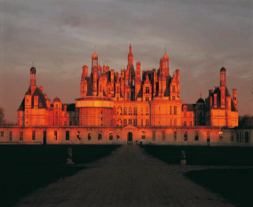
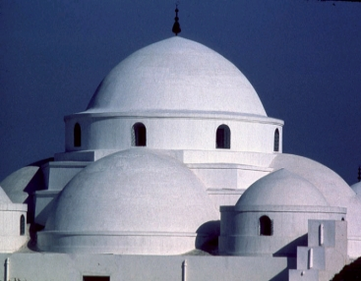
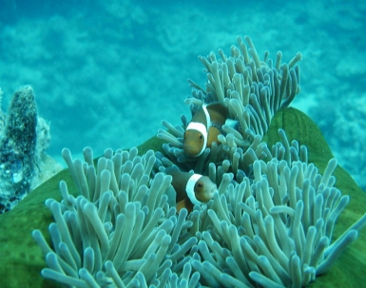
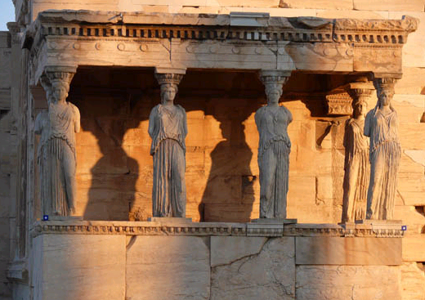
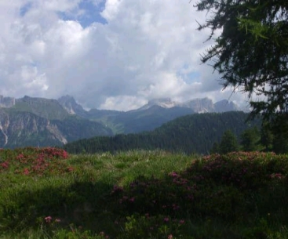
World Heritage Emblems
& Combined Logos
UNESCO
Culture Sector
Communication, Cities, Events Unit
(CLT/CCE)

Slide 2
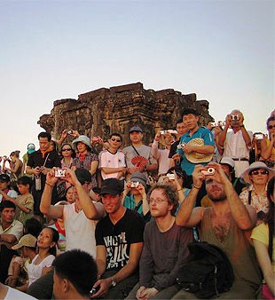
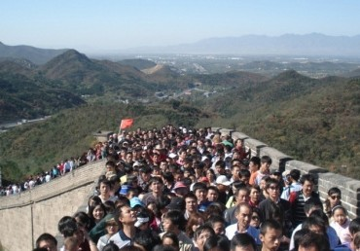
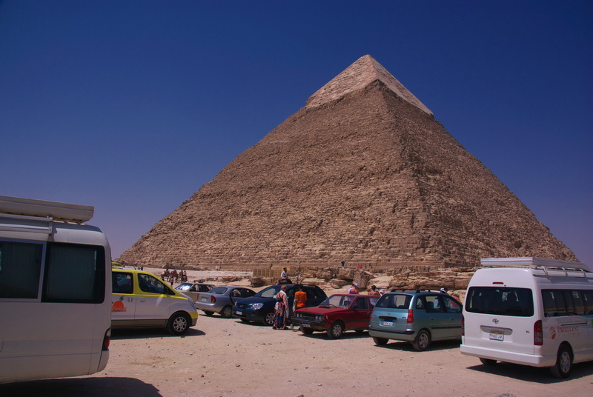
WHY USE THE LOGO?
Immediate identification
Worldwide network
Common identity
Branding reinforcement

Slide 3
The proper use of a shared and unique emblem contributes to:
Convey accurate information
Allow better orientation
Stimulate curiosity

Slide 4
Different logos and emblems
For different users
And different uses

Slide 5
I - The UNESCO logo

Slide 6
Official graphic charter
Temple
Acronym of the Organization

Slide 7
The UNESCO logo is for uses dealing with general topics
It is ruled by the: Directives concerning the use of the name, acronym, logo and Internet domain names of UNESCO
It is managed by the Sector for Priority Africa & External Relations, Division of Public Information (PAX/DPI)
All projects must be submitted to logo@unesco.org for approval before production

Slide 8
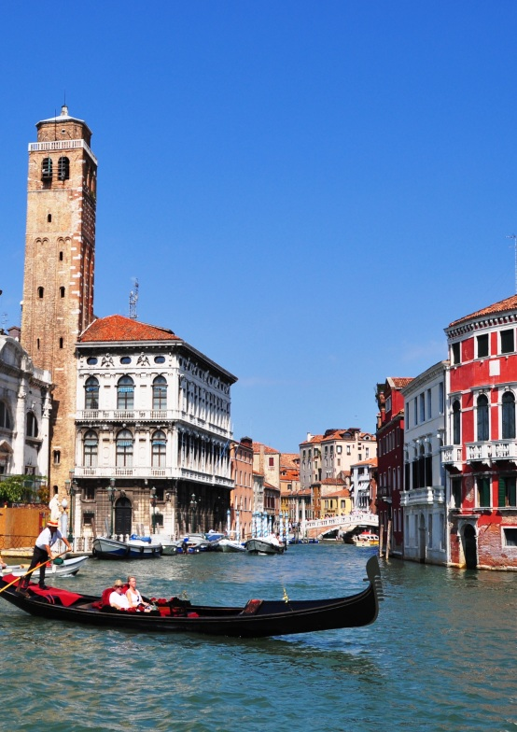
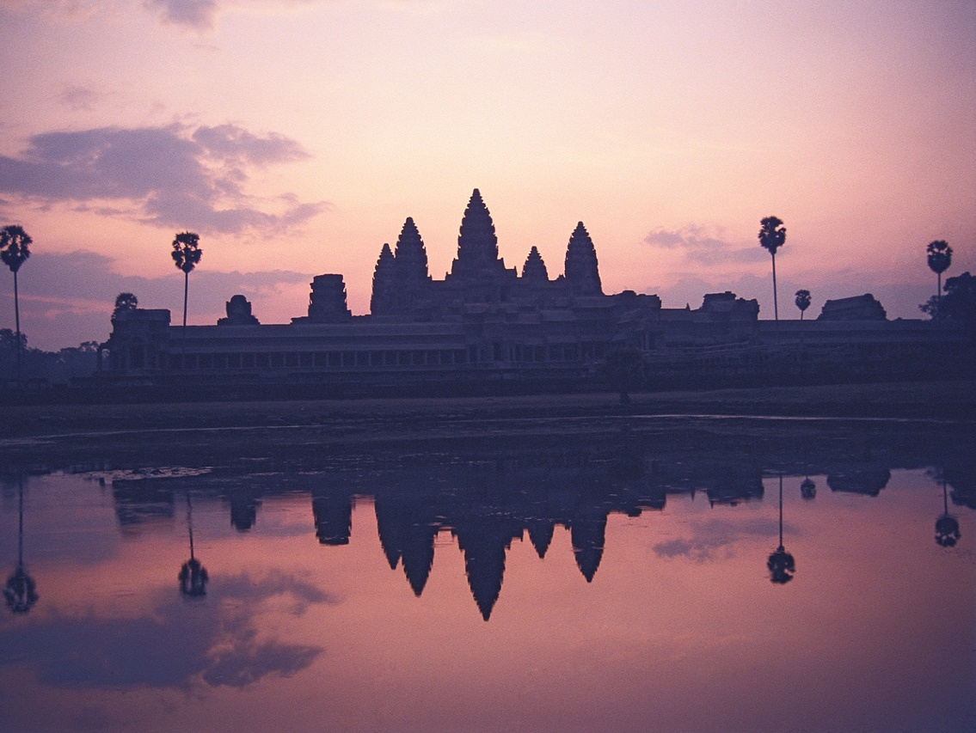
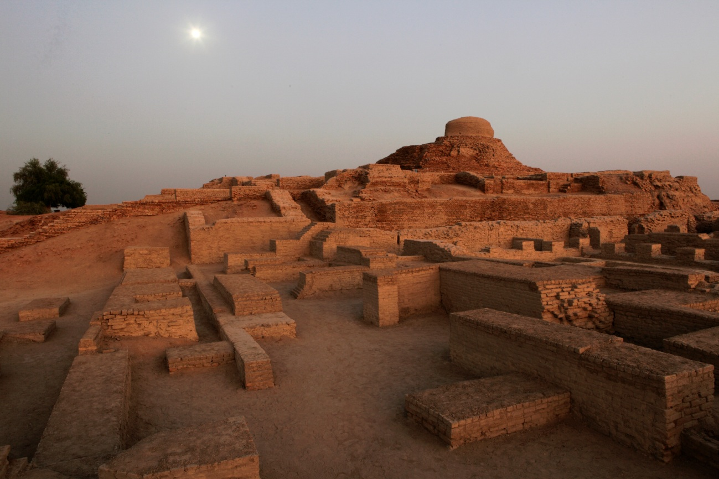
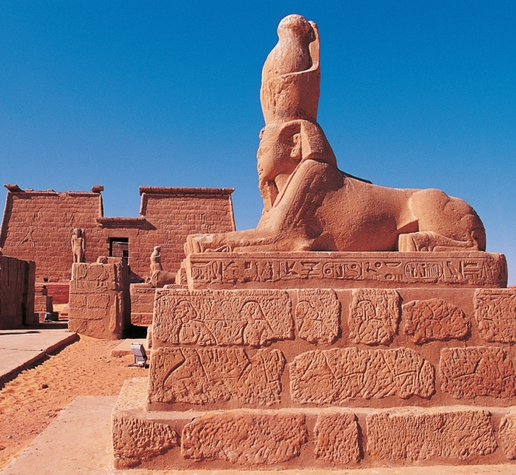
II - World Heritage Emblem and logos

Slide 9
1 - The World Heritage Emblem
Adopted in 1978
Symbol of the interaction between Human Being and Nature
Defined in Chapiter VIII of the Operational Guidelines for the Implementation of the World Heritage Convention
Mr. Michel Olyff
Designer of the World Heritage Emblem

Slide 10
The World Heritage Emblem
(alone)
Use for:
Smaller-scale communication materials
(e.g.: social media, free stickers, flyers, pins, usb key, etc.)
Road signs
(e.g.: signs indicating ways to reach the site)
Signs within the site
(e.g.: information stands, pathways, walkways, building signs, etc.)
Communication materials for commercial use*
(any products or souvenirs for sale – see slide 12)

Slide 11
Use of the emblem Excerpt from the Operational guidelines Chap. VIII
VIII.E, 275, a): « The Emblem should be utilized for all projects substantially associated with the work of the Convention, […] , in order to promote the Convention. »
VIII.E, 275, b): « […] The main criterion for approval should be the educational, scientific, cultural, or artistic value of the proposed product related to World Heritage principles and values […] »
and
« Approval should not routinely be granted to place the Emblem on products that
have no, or extremely little, educational value, such as cups, T-shirts, pins, and other tourist souvenirs… »
VIII.E, 275, d): « Except when authorized in accordance with these principles it is not legitimate for commercial entities to use the Emblem directly on their own material to show their support for World Heritage […] »

Slide 12
*Commercial use of the emblem Excerpt from the Operational guidelines Chap. VIII
VIII.E, 275, b): « A decision to approve use of the Emblem should be linked strongly to the quality and content of the product […] »
VIII.E, 275, h): « When commercial benefits are anticipated, the Secretariat should ensure that the World Heritage Fund receives a fair share of the revenues and conclude a contract or other agreement […] »
And
« National authorities are also called upon to ensure that their properties or the World Heritage Fund receive a fair share of the revenues […] »

Slide 13
2 – The Combined Logos
UNESCO developped several logos combining :
The UNESCO temple on the left
The secondary logo (Conventions, programmes, etc.) on the right
The acronym of the Organization
Various mentions
For World Heritage,
combined logos include:

Slide 14
Site-generic logo
Each World Heritage site has a generic logo:
Unique and common to all World Heritage sites
Exclusive use for national authorities and official management entities of the site
Use for free information and communication materials (brochures, flyers, posters, maps, stickers, letterheads, road signs, site entrances and exits, etc.)
Not for commercial products
No modification in any way (proportions, colour, font, contenu, partial use, etc.)
A mock-up must be submitted to CLT/CCE (b.blanchard@unesco.org) for validation before printing or production

Slide 15
This logo is created and provided:
By UNESCO services only
Upon official request to CLT/CCE (b.blanchard@unesco.org), sent by email providing detailed presentation of the project
In English, French + potentially the national language of the country upon request
In vectorized pdf format (allowing graphic work in very high resolution whatever the medium’s size)

Slide 16
Rules governing combined logos
Key dates:
2007: Ruled by the Operational Guidelines + the UNESCO Directives
2010-2014: Working Group for a revision of the OG
2015: revised OG + Annex 14 adopted by the 39th Committee
2021: New Graphic Charter of the UNESCO logo

Slide 17
Rules related to the site-generic logo
Excerpts from the Annex 14 to the Operational Guidelines
To be updated soon

Slide 19
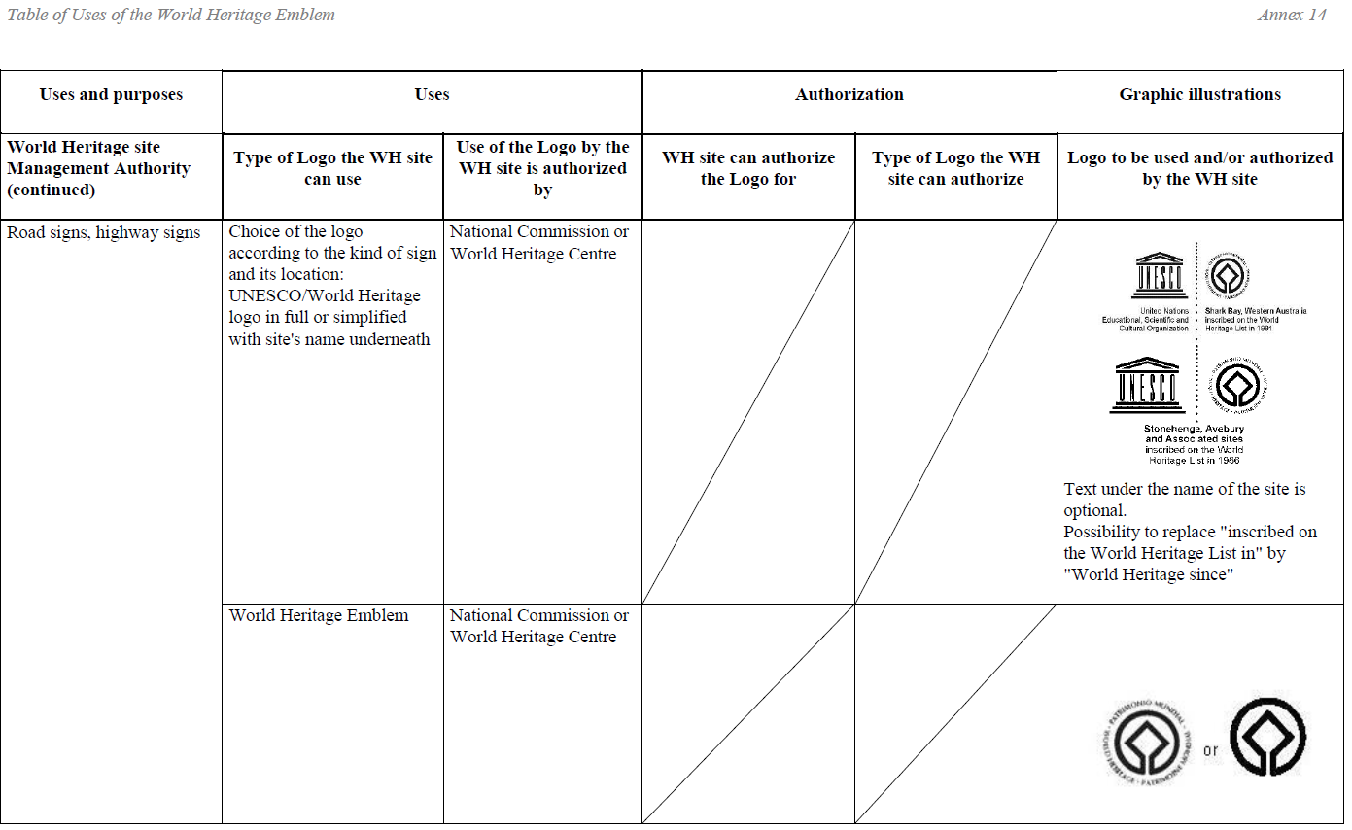
To be updated soon

Slide 20
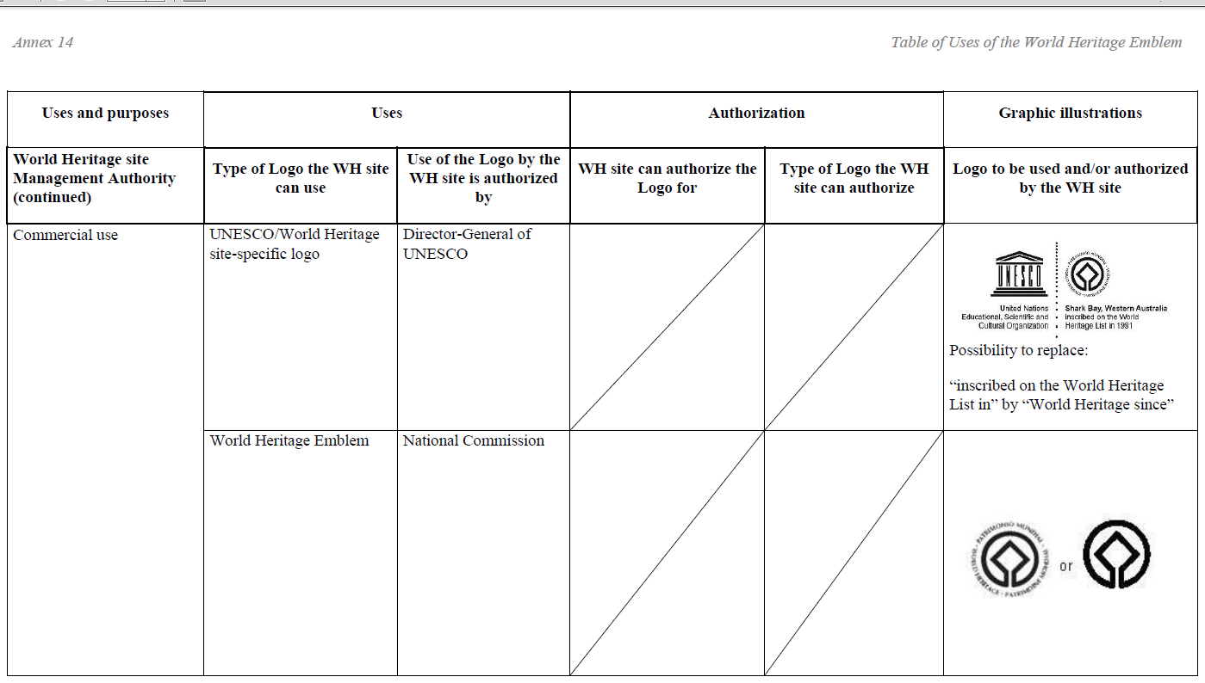
To be updated soon

Slide 21
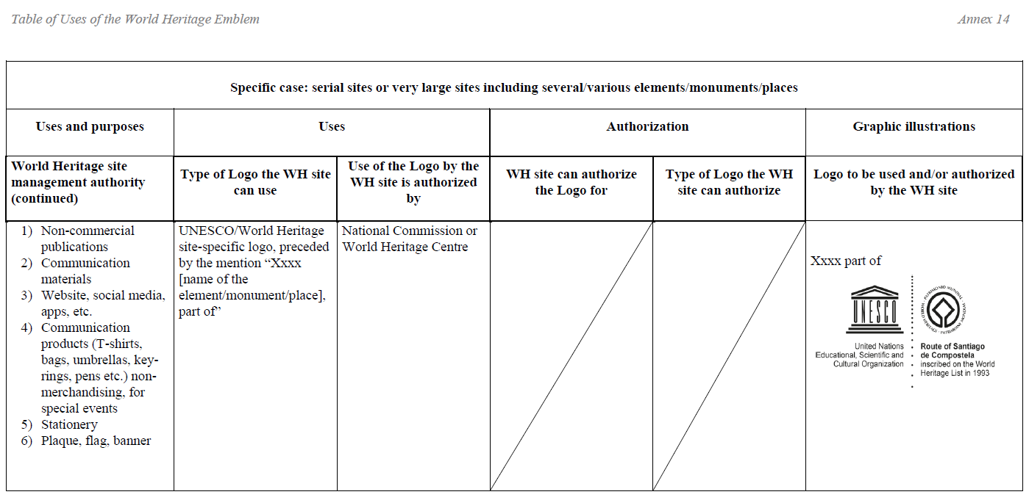
To be updated soon

Slide 22
Exemple of use for site-generic logo
Commemorative plaque of the site:
The plaque should be so placed that it can easily be seen by visitors, without disfiguring the property;
The choice of materials and format, left to the discretion of the site, should respect the spirit of the place;
The WH emblem or the site-generic logo should appear on the plaque;
The text should mention the property's OUV;
The text should make reference to the World Heritage Convention, to the World Heritage List, and to the international recognition conferred by inscription on this List.
Example of text proposed by the Committee :
"(Name of property) has been inscribed upon the World Heritage List of the Convention concerning the Protection of the World Cultural and Natural Heritage. Inscription on this List confirms the Outstanding Universal Value of a cultural or natural property which deserves protection for the benefit of all humanity."

Slide 23
Other combined logo
UNESCO + WH Emblem
+ « World Heritage Convention »:
for the exclusive use of the Secretariat of the Convention

Slide 24
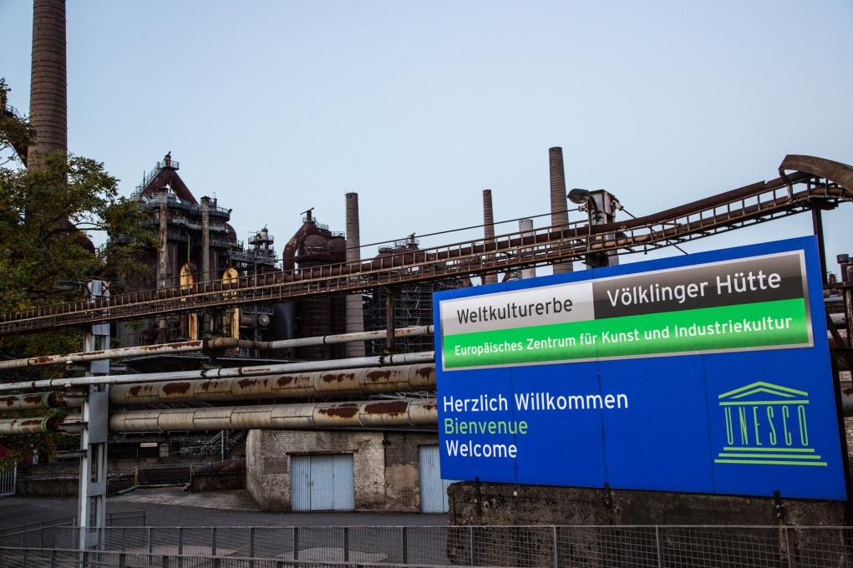
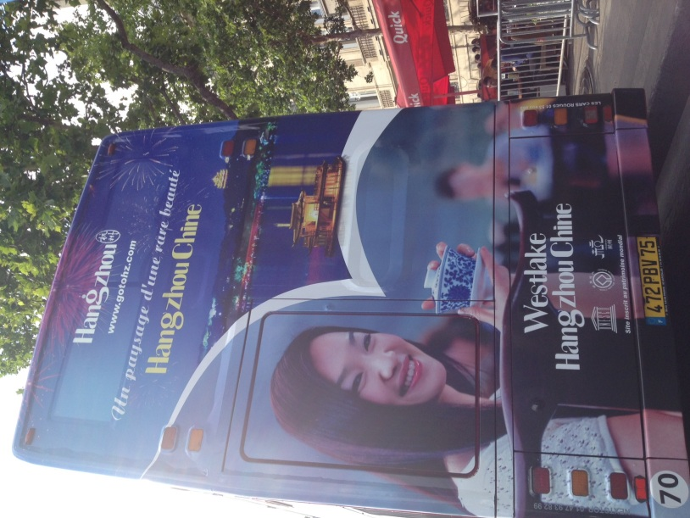
MISUSES
Examples of unofficial
or unauthorized logos

Slide 25
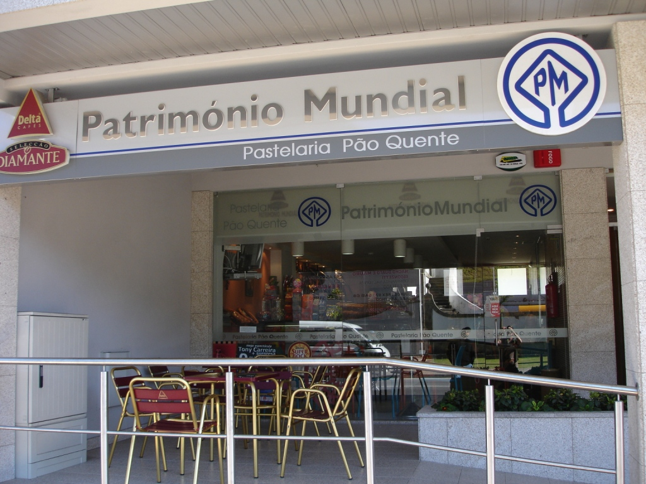
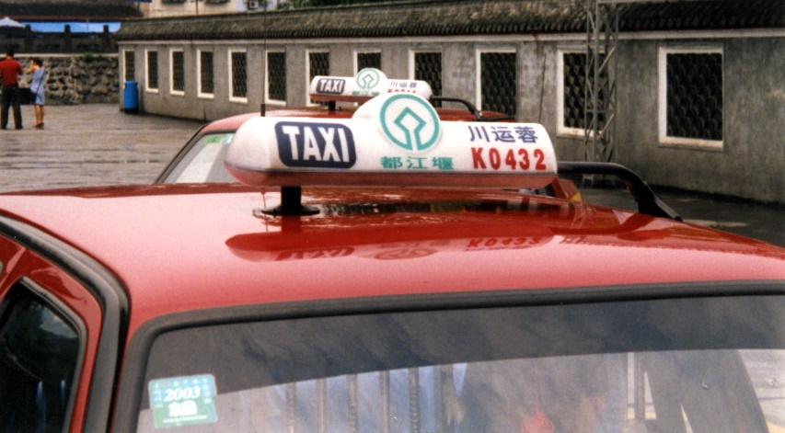
Or…
Consequences:
No funds reverted to WH site or WH Fund
No quality control

Slide 26
Conclusion
Use logos to promote sites and raise awareness of the World Heritage Convention
Help us controlling misuse
Contact us for information, assistance, or to submit a request:
Ms Barbara Blanchard
Culture Sector
Communication, Cities and Events Unit
b.blanchard@unesco.org

